Slide 1



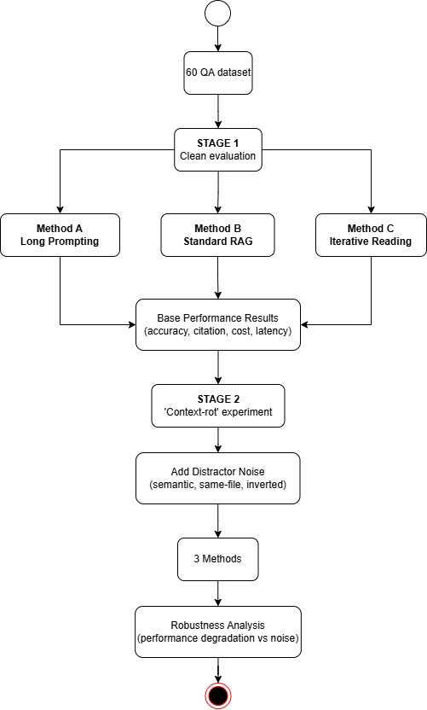
UFCFXK-30-3: Digital Systems Project
Student name: Bui Vu Nhat Minh
Project Title: Evaluating Methods for Question Answering over Large Code Repositories and Technical Documents
A QR Code link to my video submission
Abstract:
This project builds and evaluates a system for question answering over large code repositories and long technical documents with explicit evidence citations (file paths and line ranges or document sections).
The work focuses on long-context degradation (“context rot”), where model performance deteriorates when large amounts of potentially irrelevant or misleading content are provided.
We compare three approaches under a controlled evaluation setting:
single-pass long-context prompting,
standard retrieval-augmented generation (RAG), and
a structure-aware iterative reading pipeline that selectively retrieves, reads, and refines evidence across multiple steps before generating an answer.
The evaluation measures answer correctness, citation quality, cost, and latency under increasing levels of distractor noise.
Key requirements:
Functional
Must: Ingest a repository/document set and produce an index usable for QA.
Must: Answer user questions with evidence citations (file path + line range / doc section).
Must: Support three modes (A) long-context, (B) RAG, (C) structure-aware iterative reading for fair comparison.
Should: Provide retrieval-and-reading steps to improve transparency/debugging.
Should: Support multi-hop questions requiring evidence from multiple files/sections.
Non-functional
Must: Reproducible evaluation (fixed QA set + seeds + logged configs).
Must: Safe tool execution (read-only tools; no destructive repo operations).
Should: Reasonable latency per query (target: seconds–tens of seconds depending on mode).
Should: Cost tracking (tokens + calls) reported for each method.
Would: Modular design so retrieval/agent policies can be swapped.
Implementation artefacts (if any)
Repo/doc ingestion script (parsing + metadata)
Chunking + embedding index (vector store)
RAG baseline (top-k retrieve → answer + cite)
Long-context baseline (summarise/stuff → answer)
Structure-aware iterative reading pipeline (selective reading + follow-up + synthesis)
Evaluation harness (QA set + metrics + plots)
Testing
Dataset: 60 QA queries (single-hop + multi-hop).
Metrics: Accuracy, Citation correctness, Tokens/Calls, Latency.
Context-rot protocol: increase corpus size and add distractor text; plot metric vs size.
Error analysis: retrieval miss vs wrong cite vs reasoning/synthesis error.
Aims and objectives:
Ingest repo/docs → chunk + index (text + metadata).
Implement Baseline A: long-context stuffing / summarise-then-answer.
Implement Baseline B: standard RAG (top-k retrieval).
Implement Method C: structure-aware iterative reading (selective reading + follow-up retrieval + evidence synthesis)
Create 60 QA queries (single-hop + multi-hop).
Evaluate: Answer + Citation correctness, Cost, Latency
Introduce controlled distractor noise (semantic, same-file, inverted-gold)
Analyse failure cases and trade-offs
Planning and Management:
Weeks 1–2: Scope + Dataset Lock
Weeks 3–4: Ingestion & Indexing Foundation
Weeks 5–6: Baseline A & B Working
Weeks 7–8: Structure-aware iterative reading pipeline (Proposed Method)
Weeks 9–10: Evaluation & Context-Rot Study
Weeks 11–12: Packaging, Poster, Demo & Video
Design, Implementation & Testing
References: Lewis, P., Perez, E., Piktus, A., et al. (2020) ‘Retrieval-Augmented Generation for Knowledge-Intensive NLP Tasks’. In: Advances in Neural Information Processing Systems (NeurIPS 2020).
Liu, N.F., Lin, K., Hewitt, J., et al. (2024) ‘Lost in the Middle: How Language Models Use Long Contexts’. Transactions of the Association for Computational Linguistics, 12, pp. 157–173.
Yao, S., Zhao, J., Yu, D., et al. (2023) ‘ReAct: Synergizing Reasoning and Acting in Language Models’. arXiv preprint arXiv:2210.03629.
Schick, T., Dwivedi-Yu, J., Dessì, R., et al. (2023) ‘Toolformer: Language Models Can Teach Themselves to Use Tools’. arXiv preprint arXiv:2302.04761.
Zhang, A.L., Kraska, T. and Khattab, O. (2025) ‘Recursive Language Models’. arXiv preprint arXiv:2512.24601.
Research:
RAG improves grounding by retrieving external evidence, but quality depends on retrieval coverage; multi-hop questions can fail if key evidence is not retrieved (Lewis et al., 2020).
Long-context LMs can degrade on long inputs (e.g., information “lost in the middle”), motivating approaches that avoid single-shot stuffing (Liu et al., 2024).
Iterative and tool-assisted reading approaches (e.g., ReAct, IRCoT, Self-RAG) suggest that interleaving retrieval and reasoning can improve multi-step QA, but increase cost and complexity.
Recursive reading ideas propose decomposing and re-calling the model over selected parts rather than feeding a massive prompt; practical benefit must be verified with controlled evaluation (Zhang et al., 2025).

