Slide 1



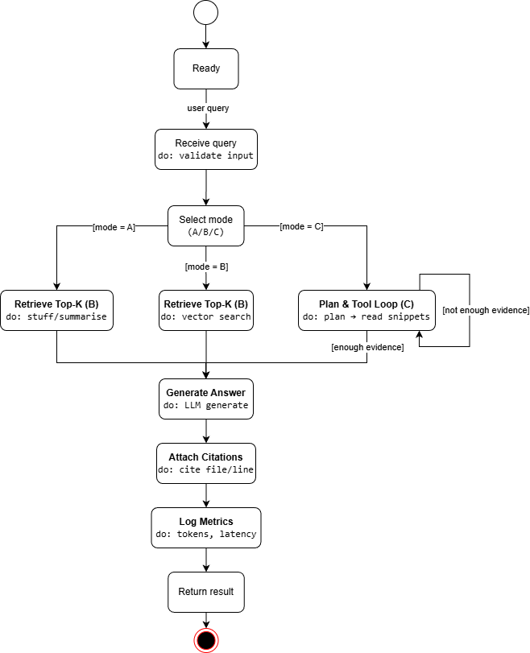
UFCFXK-30-3: Digital Systems Project
Student name: Bui Vu Nhat Minh
Project Title: An AI Agent for Understanding Large Code Repositories and Technical Documents with Context-Rot Evaluation
A QR Code link to my video submission
Abstract:
This project builds an LLM-based agent that answers questions about large code repositories and long technical documents with evidence citations (file path + line range / document section). The work evaluates long-context degradation (“context rot”) by comparing three approaches: (1) single-pass long-context (stuffing/summarise-then-answer), (2) standard RAG (retrieve top-k chunks then answer), and (3) recursive reading (decompose the query, selectively read snippets via tools, and synthesise across multiple steps). Evaluation reports answer correctness, citation correctness, cost, and latency as corpus size and distractors increase.
Key requirements:
Functional
Must: Ingest a repository/document set and produce an index usable for QA.
Must: Answer user questions with evidence citations (file path + line range / doc section).The tool should blah blah blah
Must: Support three modes (A) long-context, (B) RAG, (C) recursive reading for fair comparison.The tool would blah blah blah
Should: Provide a tool-trace (actions taken) to improve transparency/debugging.
Should: Support multi-hop questions requiring evidence from multiple files/sections.
Would: Offer a simple UI (optional) for browsing answers + citations.
Non-functional
Must: Reproducible evaluation (fixed QA set + seeds + logged configs).
Must: Safe tool execution (read-only tools; no destructive repo operations).
Should: Reasonable latency per query (target: seconds–tens of seconds depending on mode).
Should: Cost tracking (tokens + calls) reported for each method.
Would: Modular design so retrieval/agent policies can be swapped.
Implementation artefacts (if any)
Repo/doc ingestion script (parsing + metadata)
Chunking + embedding index (vector store)
RAG baseline (top-k retrieve → answer + cite)
Long-context baseline (summarise/stuff → answer)
Recursive reading controller (tools + trace)
Evaluation harness (QA set + metrics + plots)
Testing
Dataset: 60–120 QA queries (single-hop + multi-hop).
Metrics: Accuracy, Citation correctness, Tokens/Calls, Latency.
Context-rot protocol: increase corpus size and add distractor text; plot metric vs size.
Error analysis: retrieval miss vs wrong cite vs reasoning/synthesis error.
Aims and objectives:
Build a practical agent for repo/doc QA with citations, and quantify context-rot effects across methods.
The project objectives are:
Ingest repo/docs → chunk + index (text + metadata).
Implement Baseline A: long-context stuffing / summarise-then-answer.
Implement Baseline B: standard RAG (top-k retrieval).
Implement Method C: recursive reading (decomposition + selective snippet reading + synthesis).
Create 60–120 QA queries (single-hop + multi-hop).
Evaluate: accuracy, citation correctness, tokens/calls, latency; plot vs corpus size/distractors.
Planning and Management:
Weeks 1–2: Scope + Dataset Lock
Weeks 3–4: Ingestion & Indexing Foundation
Weeks 5–6: Baseline A & B Working
Weeks 7–8: Recursive Reading Agent (Proposed Method)
Weeks 9–10: Evaluation & Context-Rot Study
Weeks 11–12: Packaging, Poster, Demo & Video
Design, Implementation & Testing
References: Lewis, P., Perez, E., Piktus, A., et al. (2020) ‘Retrieval-Augmented Generation for Knowledge-Intensive NLP Tasks’. In: Advances in Neural Information Processing Systems (NeurIPS 2020).
Liu, N.F., Lin, K., Hewitt, J., et al. (2024) ‘Lost in the Middle: How Language Models Use Long Contexts’. Transactions of the Association for Computational Linguistics, 12, pp. 157–173.
Yao, S., Zhao, J., Yu, D., et al. (2023) ‘ReAct: Synergizing Reasoning and Acting in Language Models’. arXiv preprint arXiv:2210.03629.
Schick, T., Dwivedi-Yu, J., Dessì, R., et al. (2023) ‘Toolformer: Language Models Can Teach Themselves to Use Tools’. arXiv preprint arXiv:2302.04761.
Zhang, A.L., Kraska, T. and Khattab, O. (2025) ‘Recursive Language Models’. arXiv preprint arXiv:2512.24601.
Research:
RAG improves grounding by retrieving external evidence, but quality depends on retrieval coverage; multi-hop questions can fail if key evidence is not retrieved (Lewis et al., 2020).
Long-context LMs can degrade on long inputs (e.g., information “lost in the middle”), motivating approaches that avoid single-shot stuffing (Liu et al., 2024).
Tool-using agents (e.g., ReAct/Toolformer) suggest models can plan + act via tools; however, longer tool traces increase cost and compound errors (Yao et al., 2023; Schick et al., 2023).
Recursive reading ideas propose decomposing and re-calling the model over selected parts rather than feeding a massive prompt; practical benefit must be verified with controlled evaluation (Zhang et al., 2025).

