Slide 1
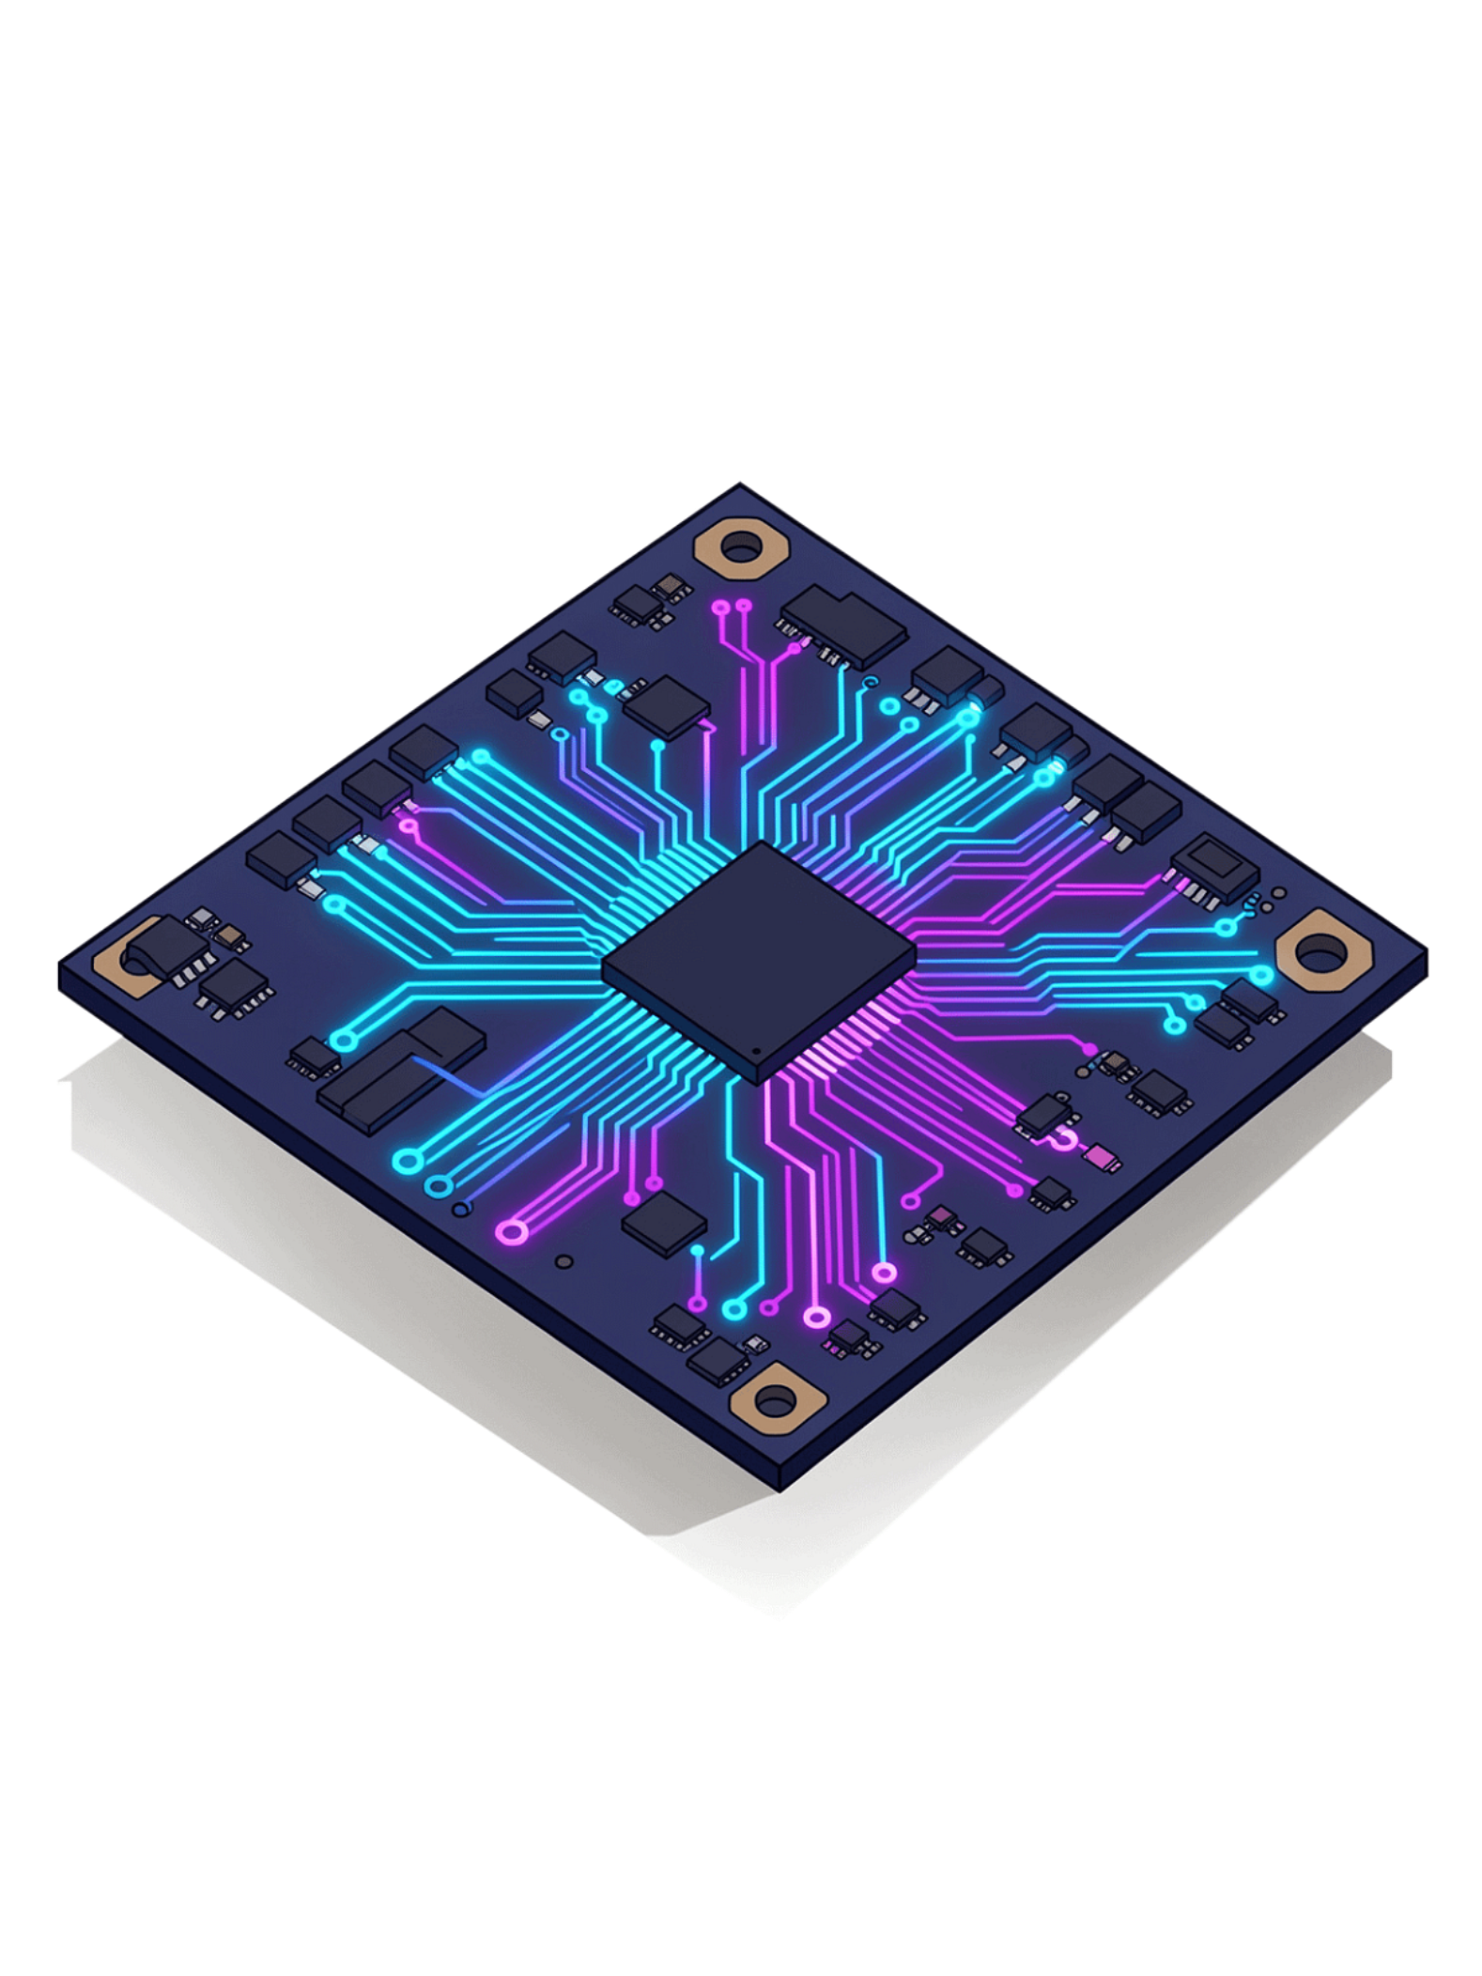
Design and Simulation of a Physical Even and Odd Parity Generator Using XOR Gates
Digital Design & Computer Architecture – PBL Project
Team Members
Academic Year
M. SUJAN
ACHSAH .P
A. SAMANVITHA
S. MOKSHITH
Y. RESHMA
2024–2025

Slide 2
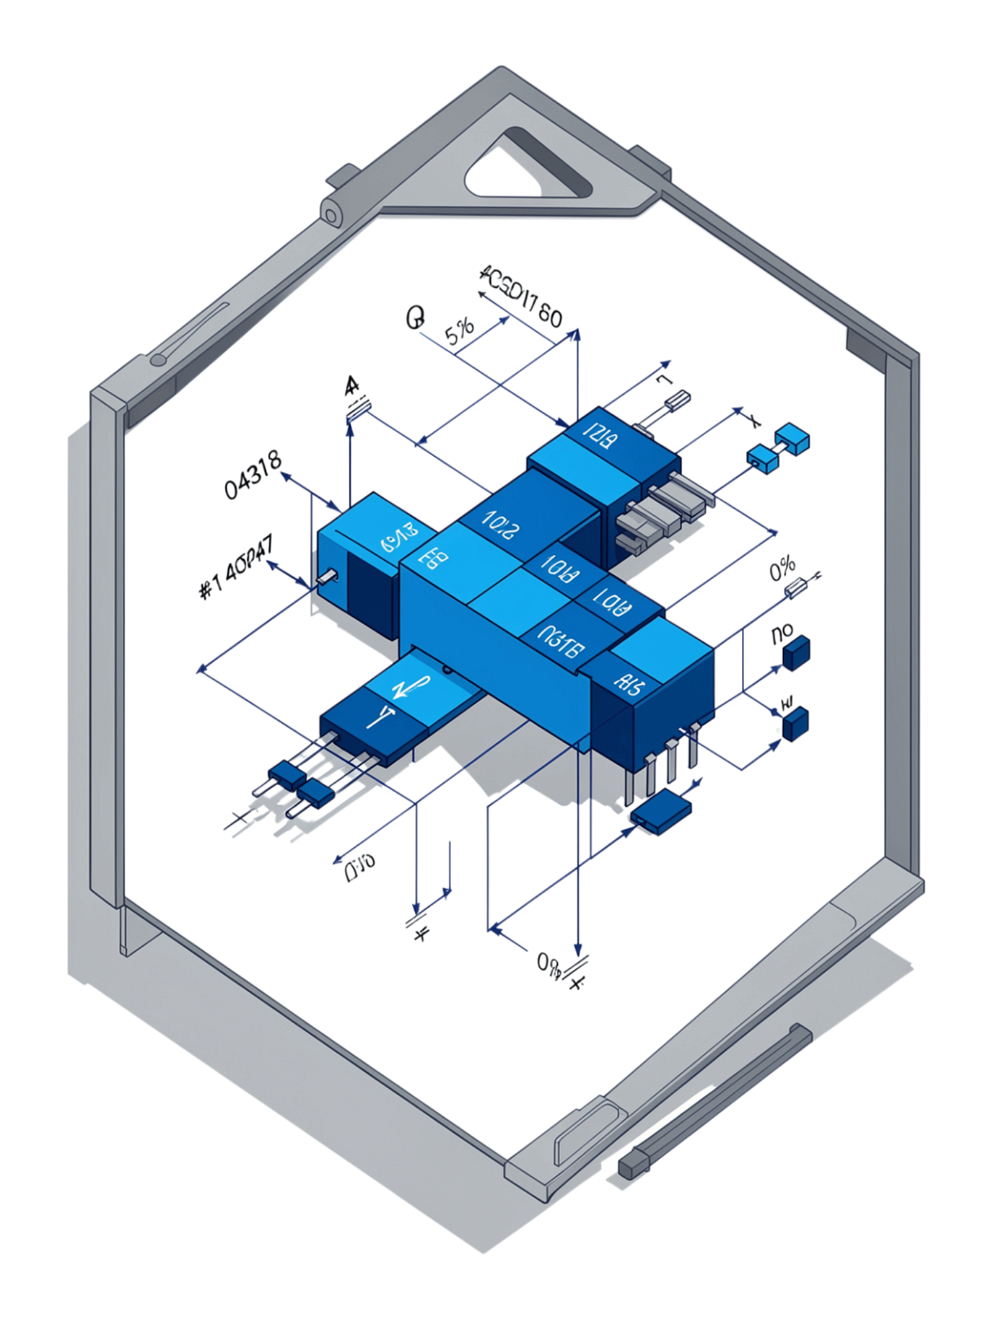

Introduction to Combinational Logic
Combinational Circuit
Output depends only on current inputs — no memory of previous states.
No Memory Element
Unlike sequential circuits, combinational logic does not store any previous input states.
Building Blocks
Constructed from fundamental logic gates: AND, OR, XOR, NOT, and their combinations.
Parity Generator
A simple, practical, and elegant example of combinational logic in action.
Core Principle: Inputs → Combinational Logic → Output

Slide 3
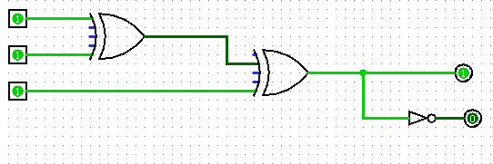
The XOR Gate
Exclusive OR (XOR) Gate
Boolean Expression: Y = A ⊕ B
Logic: Output is 1 when inputs are different; output is 0 when inputs are the same.
Key Property: Perfectly suited for parity generation — naturally counts the number of 1s.
A | B | Y = A ⊕ B
0 | 0 | 0
0 | 1 | 1
1 | 0 | 1
1 | 1 | 0

Slide 4
What is Parity?
Parity Defined
Even Parity
Odd Parity
Parity is a simple and widely-used error-detection technique in digital communication. A parity bit is an extra bit appended to binary data to ensure the total count of 1s is either even or odd.
Example: Data = 101 (two 1s)
Total number of 1s (including parity bit) must be even.
Total number of 1s (including parity bit) must be odd.
Even parity bit = 0 → total: 2 ones (even ✓)
Odd parity bit = 1 → total: 3 ones (odd ✓)

Slide 5

Even Parity Generator (3-bit)
Boolean Expression
Truth Table — Even Parity
Pₑ = A ⊕ B ⊕ C
A | B | C | Pₑ
0 | 0 | 0 | 0
0 | 0 | 1 | 1
0 | 1 | 0 | 1
0 | 1 | 1 | 0
1 | 0 | 0 | 1
1 | 0 | 1 | 0
1 | 1 | 0 | 0
1 | 1 | 1 | 1
The XOR of all input bits generates the even-parity bit. Output is 1 when an odd number of inputs are 1, ensuring the total count of 1s (data + parity) remains even.
Two cascaded 2-input XOR gates implement this expression: first XOR(A,B), then XOR(result, C).

Slide 6
Odd Parity Generator (3-bit)
Boolean Expression
Truth Table — Odd Parity
Pₒ = NOT(A ⊕ B ⊕ C)
A | B | C | Pₒ
0 | 0 | 0 | 1
0 | 0 | 1 | 0
0 | 1 | 0 | 0
0 | 1 | 1 | 1
1 | 0 | 0 | 0
1 | 0 | 1 | 1
1 | 1 | 0 | 1
1 | 1 | 1 | 0
The XOR of all input bits is inverted to generate the odd-parity bit. Output is 1 when an even number of inputs are 1, ensuring the total count of 1s (data + parity) remains odd.
Two cascaded 2-input XOR gates implement the core expression: first XOR(A, B), then XOR(result, C), followed by a NOT gate.

Slide 7

Circuit Design & Implementation Flow
Specification
Truth Table
Boolean Expression
Logic Gates
Circuit Diagram
Specification
Boolean Expressions
Verification
Design a 3-bit even/odd parity generator using XOR and NOT gates.
Pₑ = A ⊕ B ⊕ C | Pₒ = NOT(A ⊕ B ⊕ C)
Simulate all 8 input combinations and confirm outputs match the truth table.

Slide 8

Simulation & Verification
Simulation Setup
Tool: Logisim or equivalent digital circuit simulator
Components: XOR gates, NOT gate, input switches, output LEDs
Testing: Apply all 8 input combinations (000 → 111)
Verification: Confirm outputs match truth table for both parities
Why Simulate First?
Verify logic before physical construction
Test all edge cases quickly and safely
Identify and fix design errors early
Visualize real-time circuit behavior

Slide 9
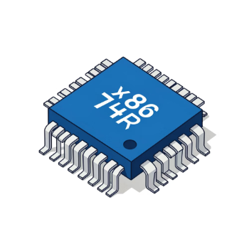
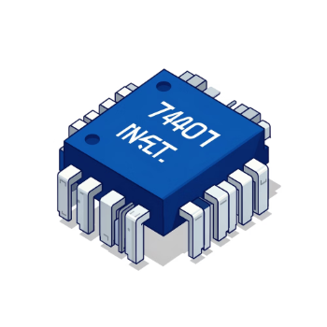
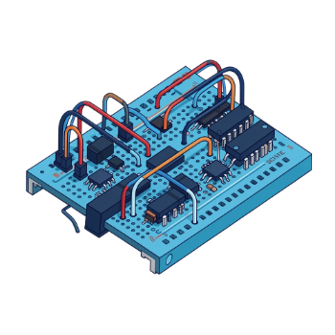
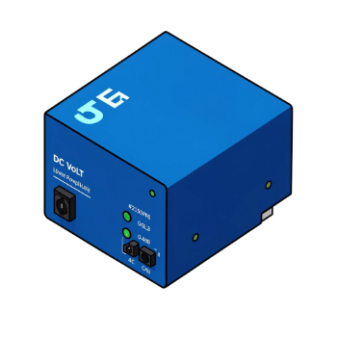

Physical Implementation
IC 7486 — XOR Gate
IC 7404 — NOT Gate
Breadboard & Wiring
Power & Testing
Quad 2-input XOR gate. Two gates cascade to implement Pₑ = A ⊕ B ⊕ C.
Hex inverter. Complements the XOR output to produce Pₒ (odd parity).
Circuit assembled on breadboard with toggle switches for inputs A, B, C and LEDs for output indication.
+5V DC supply. Apply all 8 combinations and verify LED outputs against the truth table.
Process: Simulation → Breadboard Layout → Physical Wiring → Testing & Verification

Slide 10

Results, Applications & Conclusion
✓ Project Results
Real-World Applications
Designed 3-bit even and odd parity generators
Used XOR (7486) and NOT (7404) gates as core logic elements
Verified design using comprehensive 8-row truth tables
Successfully simulated the circuit in Logisim
Demonstrated combinational logic bridging theory and practice
Digital communication & data transmission
Error detection in memory systems (RAM, ROM)
Computer networks & communication protocols
Data storage & integrity verification
Thank you to our audience for your time and attention, to our instructors for their guidance and support, and to our team members for their dedication and collaboration throughout this project. We truly appreciate everyone who helped make this work possible.
Thank You

