Slide 1



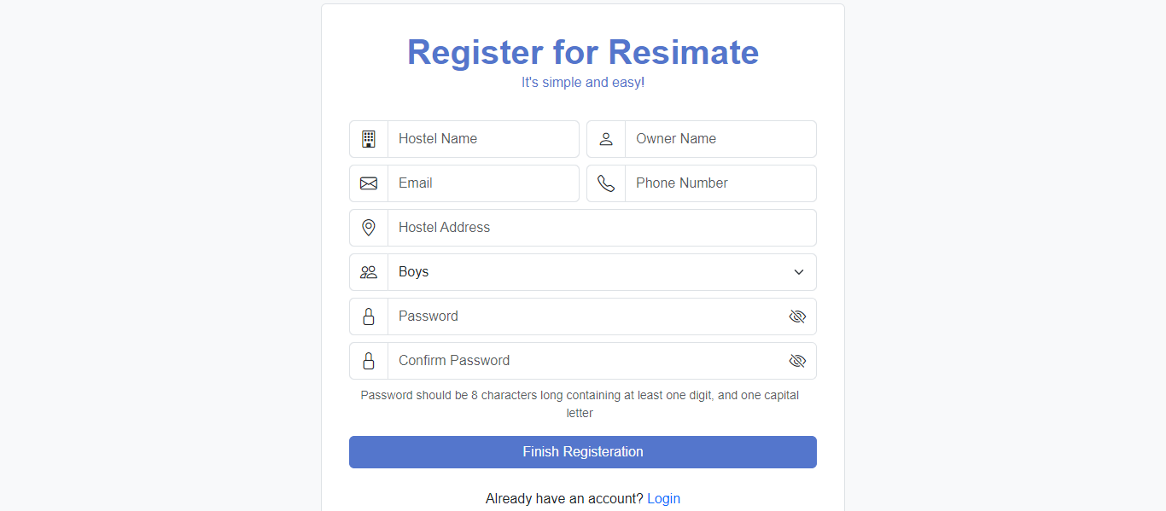
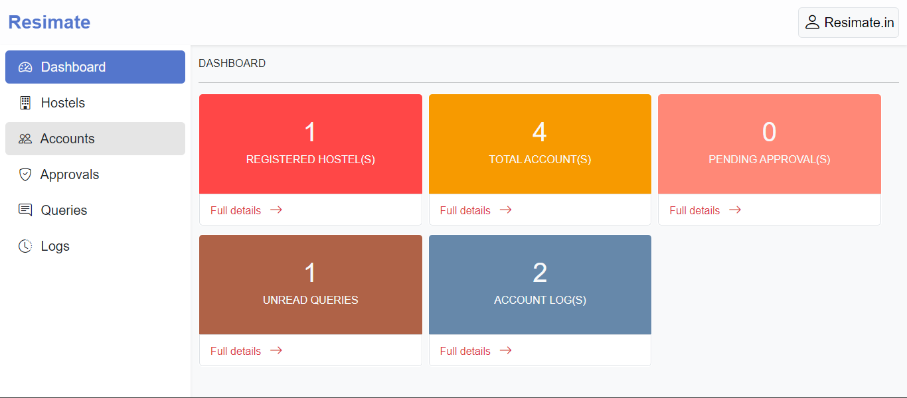
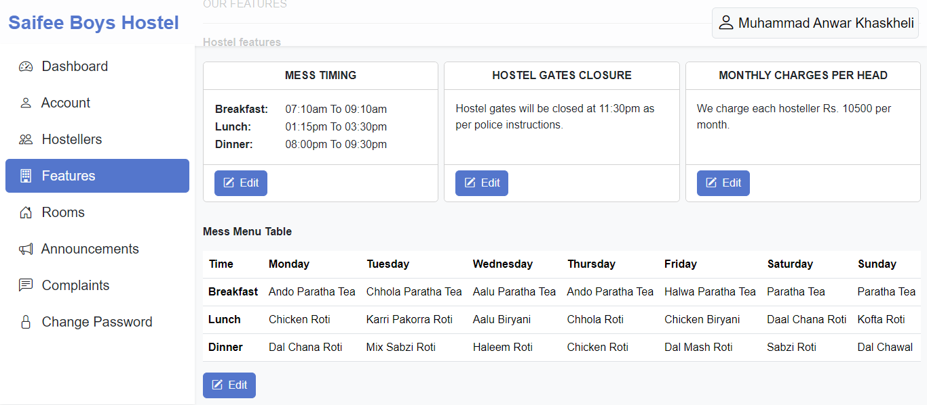
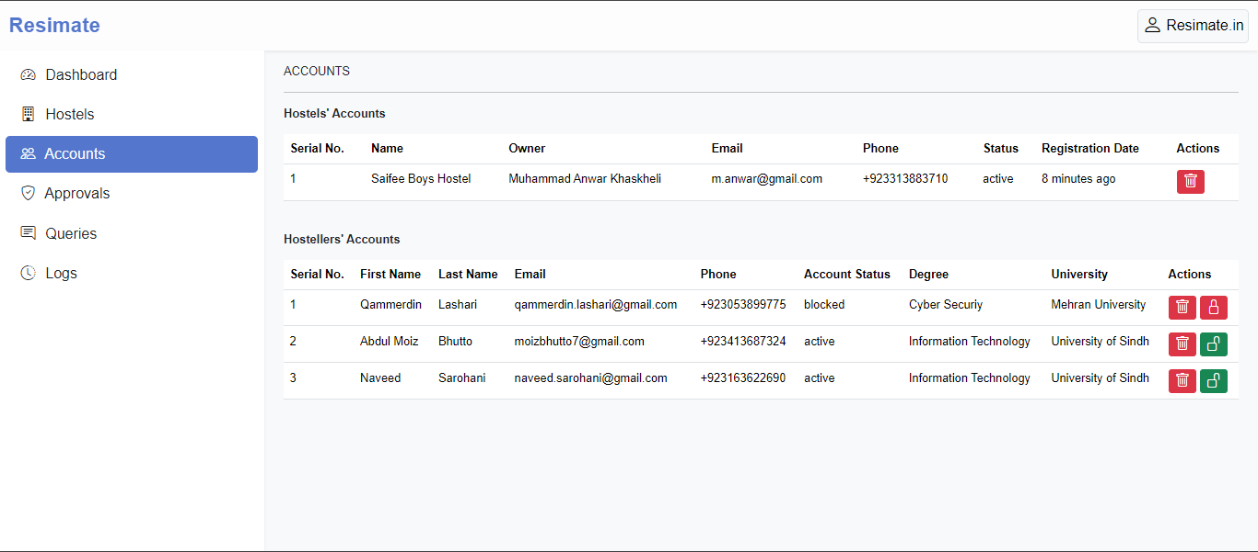
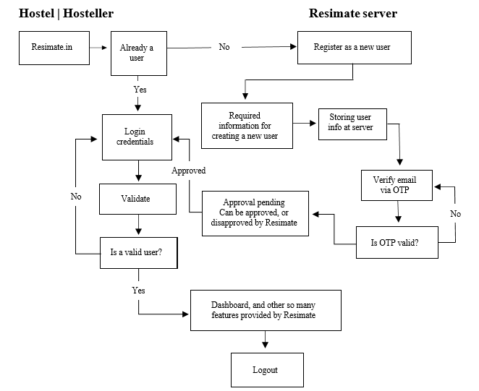
ResiMate
Naveed Ahmed, Abdul Moiz, and Qammer din
Supervisor: Prof. Dr. Dil Nawaz Hakro
BS (Information Technology) Batch 2020 “Evening”
Session: 2023
Project ID: ITE-09
Dept. of Information Technology
University of Sindh, Jamshoro
Resimate is not a single application but a service which provides lot of functionalities to make hostel management too easy for hostel owners It is multi-functional service at the single places hostel owners, and hostellers can also login to their dedicated portals to perform their daily operation regarding hostel management, making announcement for their hostellers, make change for their any kinds of terms, and rules for their hostellers, let them know immediately,
A hosteller can make complaint regarding their issues/problems, their hostel’s everything will be displayed at their portal to stay up to dated of each and every change from their current hostel.
It is well structured application fully following all the security aspects to ensure hostel, and their content integrity.
RESULTS
ABSTRACT
Time efficient Hostel Management Resimate aims to maintain time efficiency for hostel owner, leveraging manual record keeping to a modern solution to manage hostel
Track of Hostellers Once the hosteller checks-out his record will be safely kept in the hostel database for next time ease in re-allocating them at their hostel
User-friendly and intuitive dashboard Resimate provides dynamic dashboard to each and every hostel to boost up their daily operation without any hassle, make hostellers up-to-date.
OBJECTIVES
TOOLS & TECHNOLOGY
VISUAL STUDIO
APACHE SERVER
HTML
CSS & BOOTSTRAP
TYPESCRIPT
REACTJS
PHP + OOPS
MYSQL
AJAX + RESTFUL API
NPM
NODEJS
MORE 3RD PARTY LIBRARIES
METHODOLOGY
CONCLUSION
It is web based single page application built using cutting edge technologies ReactJS with Typescript, which makes the application standout among the modern edge application with modern solution, Resimate follows all the security and user experience aspects to fully accelerate it’s efficiency for Hostel Management as a modern solution. Its backend system is very robust, and dynamic, Restful APIs are created using core-PHP implementing OOPs and MySQL as the database service, communication is secured and reliable between ReactJS and PHP to make it function well.
2023

