Slide 1
Conditional Random Fields
Probabilistic Models for Segmenting
And Labeling sequence data
John Lafferty, Andrew McCallum, Fernando Pereira

Slide 2
Contents
Introduction
Conditional Random Fields
Parameter estimation for CRFs
Experiments
Conclusions

Slide 3
1.
Introduction
Generative Models
Conditional Models
The Label Bias Problem

Slide 4
1
Sequence Segmenting and Labelling
Need to segment and label sequences arises in many different problems in several
scientific fields
Computational Biology
eg: homologous sequences to known evolutionary family,
analyze RNA secondary structure
Computational Linguistics
eg: topic segmentation, POS tagging, Information Extraction,
and Syntactic disambiguation

Slide 5
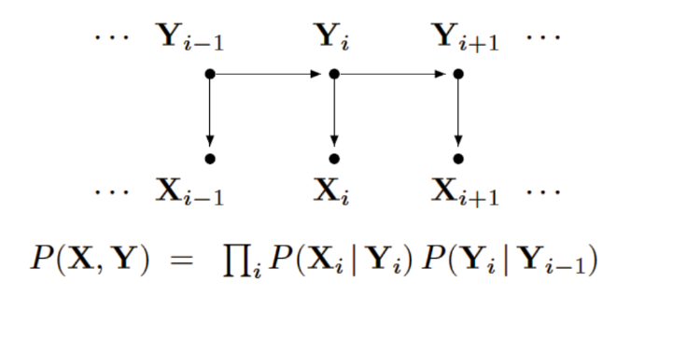
1
Generative Models
Given an observable variable X and a target/label variable Y, a generative model is a
statistical model of the joint probability distribution on X and Y, P(X,Y)
Eg: HMMs and stochastic grammars
The parameters typically trained to maximize the joint likelihood of training examples

Slide 6
1
Generative Models Difficulties and disadvantages
Need to enumerate all possible observation sequences
Not practical to represent multiple interacting features or long-range dependencies
of the observations
Very strict independence assumptions on the observations

Slide 7
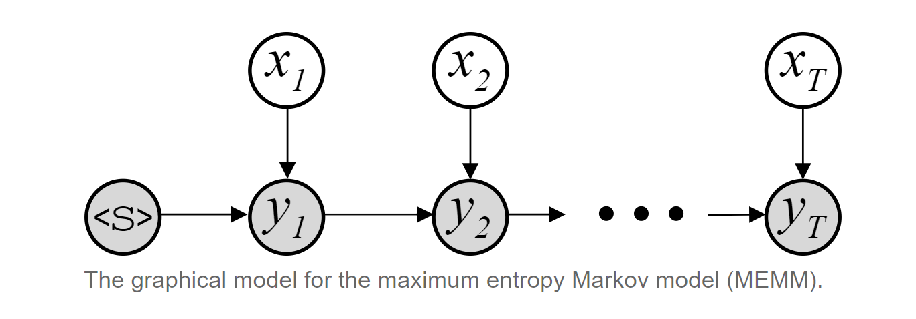
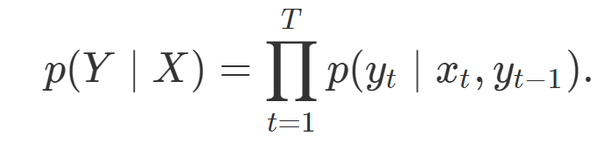
1
Conditional Models
Given an observable variable X and a target/label variable Y, a conditional model is a
statistical model of the conditional probability distribution of Y given X, P(Y|X)
Eg: Maximum entropy Markov Models ( MEMMs)
Allow arbitrary, non-independent features on the observation sequence X
The probability of a transition between labels may depend on past and future
observations relax strong independence assumptions in generative models

Slide 8
1
Label Bias
Many sequence classification models suffer from the label bias problem.
At its worst, label bias can cause a model to completely ignore the current observation
when predicting the next label.
Let us talk about an example of POS tagging for a simple sentence.
Take the sentence “the cat sat” which consists of the tokens [the, cat, sat]
We’d like our model to output the sequence [ARTICLE, NOUN, VERB] .
We will use MEMM to solve this,

Slide 9
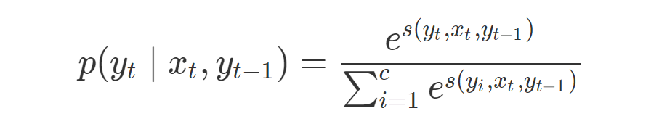
1
Label Bias
X=[x1​,…,xT​] is the input or observation sequence Y=[y1​,…,yT​] is the output or label sequence.
The Probabilities are computed with a SoftMax.
where c is the number of output classes and s(yt​, xt​,yt−1​) is a scoring function which should give a higher score for yt​ which are likely to be the correct label.
Since we normalize over the set of possible output labels at each time step, we say the model is locally normalized and p(yt​∣xt​,yt−1​) are the local probabilities.

Slide 10
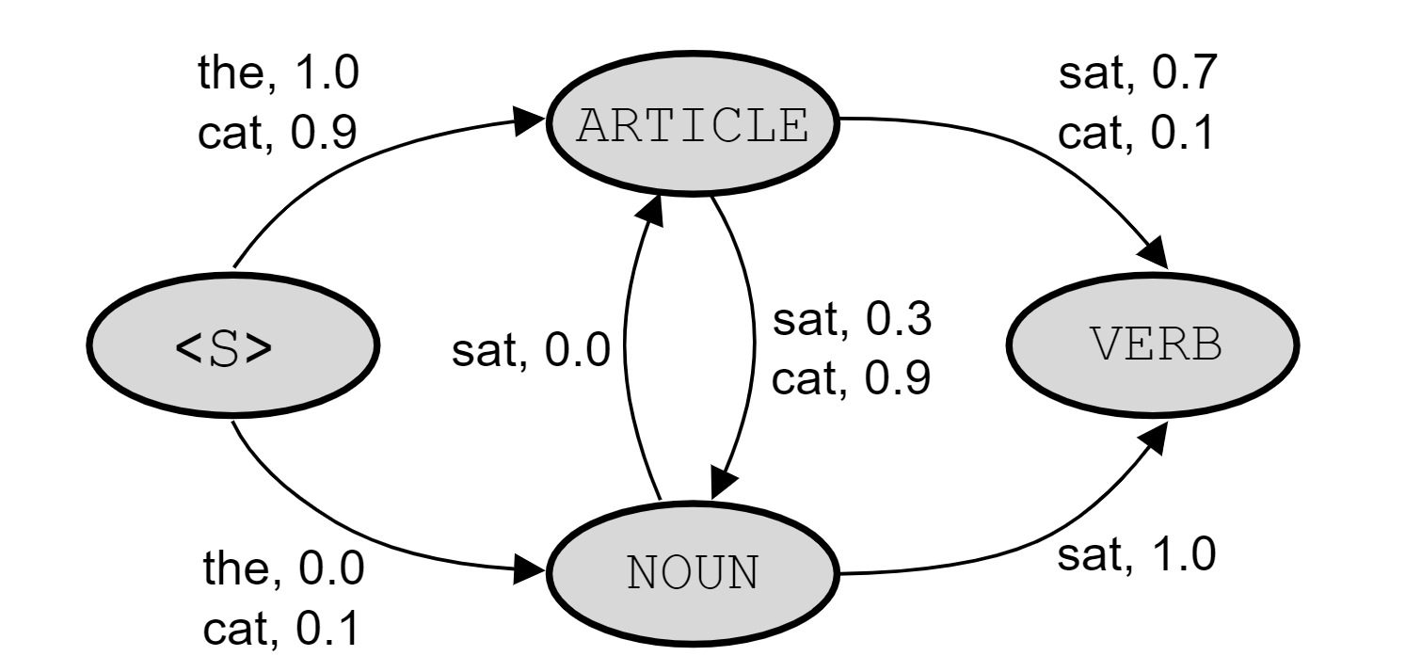
1
Label Bias
To compute the probability of [ARTICLE, NOUN,VERB], we just follow the observations along each arc leading to the corresponding label.
In this case he probability would be 1.0×0.9×1.0
An inference graph for the MEMM with the label set {ARTICLE, NOUN, VERB}.
Each arc is labelled with the probability of transitioning to the corresponding state given the observation. The sum of the probabilities on arcs leaving a node for a given observation should sum to one.
For simplicity not all observation, score pairs are pictured.

Slide 11
1
Label Bias
As another example, say we drop the article and just have the sequence [cat sat]. While it’s not a great sentence, the correct label should be [NOUN, VERB].
However, if we follow the probabilities we see that the score for
[ARTICLE, NOUN] is 0.9×0.3=0.27
whereas for
[NOUN, VERB] is 0.1×1.0=0.1.

Slide 12
1
Label Bias
The model is not used to seeing ’CAT’ at the start of a sentence, so the scores leading from the start state are poorly calibrated.
What we need is information about how uncertain the model is for a given observation and previous label pair.
If the model has rarely seen the observation ‘CAT’ from the starting node <S> then we want to know that, and it should be included in the scores.
It’s actually possible that the model did at some point implicitly store this uncertainty information.
However, by normalizing the outgoing scores for a given observation, we are forcing this information to be discarded.

Slide 13
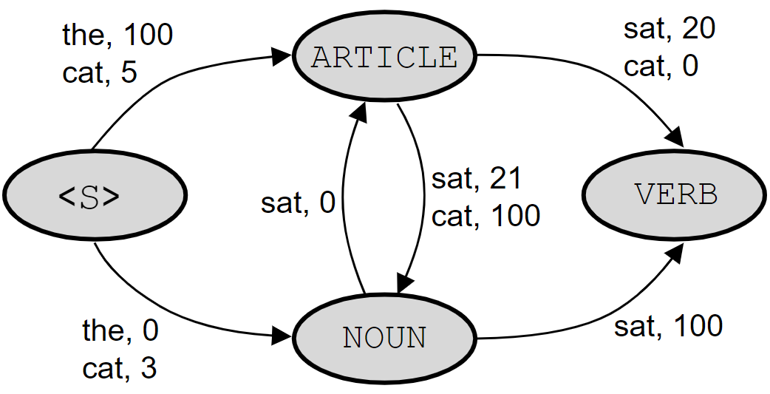

1
Label Bias
Notice in the unnormalized graph, the score for [ARTICLE, NOUN] is 5 + 21 = 26 while the score for [NOUN, VERB] is 3+100=103.
The right answer gets a better score in the unnormalized graph!
Note, we are adding scores here instead of multiplying them because the unnormalized scores are in log-space.

Slide 14
1
Label Bias
The label bias problem results from a “conservation of score mass” .
Conservation of score mass just says that the outgoing scores from a state for a given observation are normalized.
All of the incoming probability to a state must leave that state.
An observation can only dictate how much of the incoming probability to send where.
It cannot change the total amount of probability leaving the state.
The net result is any inference procedure will bias towards states with fewer outgoing transitions.

Slide 15
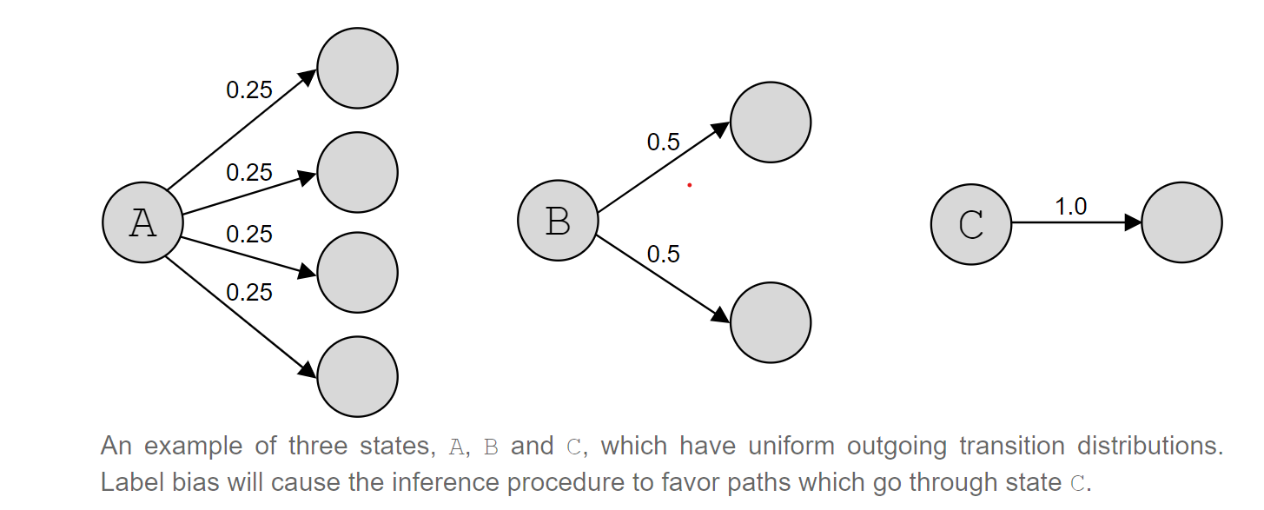
1
Label Bias

Slide 16
1
Label Bias
Suppose that the same amount of probability arrives at the three states.
State A will decrease the probability mass for any path by a factor of four, whereas state B will only decrease a given path’s score by a factor of two and state C won’t penalize any path at all.
In every case the observation is ignored, but the state with the fewest outgoing transitions is preferred.
Even if outgoing transitions from states A and B did not ignore their observations,
they would still reduce a paths score since the probabilities aren’t likely to be one. This would cause state C to be preferred even though it always ignores it’s observation.

Slide 17
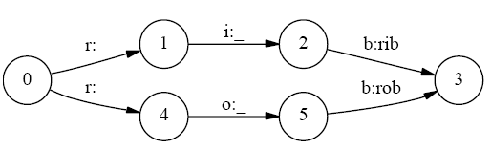
1
Label Bias simple example
Consider the above state transitions model.
Here, we expect P(1 and 2 | ri) > P( 1 and 2 | ro)
But P( 1 and 2 | ri) = P(2 | 1 and ri) p( 1 | ri) = P( 2 | 1 ) P(1 | r)
P(1 and 2 | ro) = P(2 | 1 and ro)P(1 | ro) = P( 2 | 1 )P(1 | r)

Slide 18
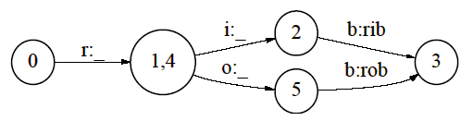
1
Solve Label Bias
We can change the state-transition structure of the model
Not practical
We connect every node to every other node and let the training
procedure figure out the true structure
We lose out the important prior information of data
.

Slide 19
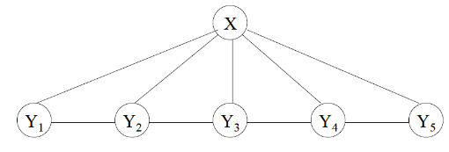
2
Conditional Random Fields
Let X be the observation sequence ( X1, X2, X3..) and
Y be the label sequence (Y1, Y2, Y3 ...)
When conditioned on X, the random variables Y1, Y2.. follow markov
property.
Here, P(Y3 | X and all other Y) = P( Y3 | X, Y2, Y4)
.

Slide 20
2
Comparision of Models
It has all the advantages of MEMMs without label-bias problem
CRF follows global normalization of exponential whereas MEMMs
have per-state local normalizations
Undirected Acyclic Graph
Allows us to put local potentials for a given transition.
.

Slide 21
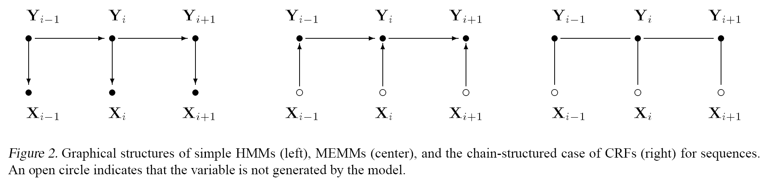
2
Graphical Comparision among
HMMs, MEMMs and CRFs

Slide 22
2
Formulation of CRFs
The Graph G =(V, E) is assumed to be a simple chain sequence
By fundamental theorem of random fields, (Hammersley & Clifford, 1971),
the joint distribution over the label sequence Y given X is
Here, fk’s and gk’s are boolean feature functions defined on edges and
individual nodes respectively and are fixed when defining a model.
Eg: the word Xi ends with “-ing” and the tag Yi is “verb”
Training the model helps us find unknown parameters of our distribution.

Slide 23
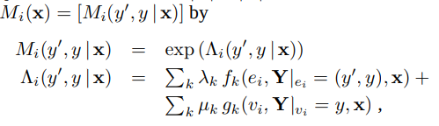
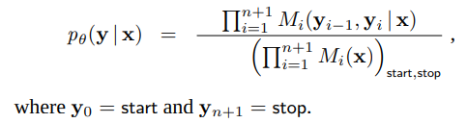
2
Formulation of CRFs
Here we consider each sequence to be size n. Two new nodes “start” and
“stop” are added to label sequence.
The conditional probability is expressed in a matrix which is useful for
parameter estimation and inference algorithms.

Slide 24
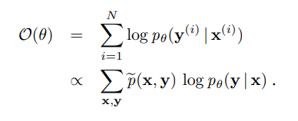
2
Parameter estimation
The iterative scaling algorithms is followed to maximize the log-likelihood
of training data.
The above function is concave w.r.t λ , μ and is guaranteed to have
global maximum.

Slide 25



2
Parameter estimation Algorithm S
The update equations for parameters is given by according to Algo S
Where S = large constant,
The above equation is the model average.

Slide 26
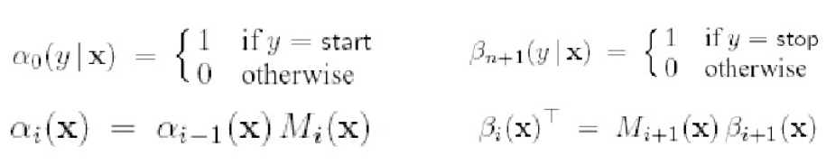

2
Parameter estimation Algorithm S

Slide 27
Instructions for use
EDIT IN GOOGLE SLIDES
Click on the button under the presentation preview that says "Use as Google Slides Theme".
You will get a copy of this document on your Google Drive and will be able to edit, add or delete slides.
You have to be signed into your Google account.
EDIT IN POWERPOINT®
Click on the button under the presentation preview that says "Download as PowerPoint template". You will get a .pptx file that you can edit in PowerPoint.
Remember to download and install the fonts used in this presentation (you’ll find the links to the font files needed in the Presentation design slide)
More info on how to use this template at www.slidescarnival.com/help-use-presentation-template
This template is free to use under Creative Commons Attribution license. You can keep the Credits slide or mention SlidesCarnival and other resources used in a slide footer.

Slide 28
Quotations are commonly printed as a means of inspiration and to invoke philosophical thoughts from the reader.

Slide 29

Hello!
I am Jayden Smith
I am here because I love to give presentations.
You can find me at @username

Slide 30
BIG CONCEPT
Bring the attention of your audience over a key concept using icons or illustrations

Slide 31
You can also split your content
White
Is the color of milk and fresh snow, the color produced by the combination of all the colors of the visible spectrum.
Black
Is the color of coal, ebony, and of outer space. It is the darkest color, the result of the absence of or complete absorption of light.

Slide 32
In two or three columns
Yellow
Is the color of gold, butter and ripe lemons. In the spectrum of visible light, yellow is found between green and orange.
Blue
Is the colour of the clear sky and the deep sea. It is located between violet and green on the optical spectrum.
Red
Is the color of blood, and because of this it has historically been associated with sacrifice, danger and courage.

Slide 33

A picture is worth a thousand words
A complex idea can be conveyed with just a single still image, namely making it possible to absorb large amounts of data quickly.

Slide 34

Want big impact? Use big image.

Slide 35
Gray
White
Black
Use charts to explain your ideas

Slide 36
And tables to compare data
 | A | B | C
Yellow | 10 | 20 | 7
Blue | 30 | 15 | 10
Orange | 5 | 24 | 16

Slide 37
Maps
our office

Slide 38
89,526,124
Whoa! That’s a big number, aren’t you proud?

Slide 39
89,526,124$
That’s a lot of money
185,244 users
And a lot of users
100%
Total success!

Slide 40
Our process is easy
first
second
last

Slide 41
Let’s review some concepts
Yellow
Is the color of gold, butter and ripe lemons. In the spectrum of visible light, yellow is found between green and orange.
Blue
Is the colour of the clear sky and the deep sea. It is located between violet and green on the optical spectrum.
Red
Is the color of blood, and because of this it has historically been associated with sacrifice, danger and courage.
Yellow
Is the color of gold, butter and ripe lemons. In the spectrum of visible light, yellow is found between green and orange.
Blue
Is the colour of the clear sky and the deep sea. It is located between violet and green on the optical spectrum.
Red
Is the color of blood, and because of this it has historically been associated with sacrifice, danger and courage.

Slide 42
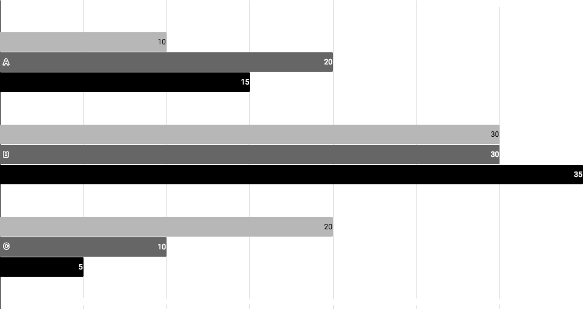
You can insert graphs from Google Sheets

Slide 43
Android project
Show and explain your web, app or software projects using these gadget templates.
Place your screenshot here

Slide 44
iPhone project
Show and explain your web, app or software projects using these gadget templates.
Place your screenshot here

Slide 45
Tablet project
Show and explain your web, app or software projects using these gadget templates.
Place your screenshot here

Slide 46
Desktop project
Show and explain your web, app or software projects using these gadget templates.
Place your screenshot here

Slide 47
Thanks!
Any questions?
You can find me at
@username
user@mail.me

Slide 48
Credits
Special thanks to all the people who made and released these awesome resources for free:
Presentation template by SlidesCarnival
Photographs by Unsplash

Slide 49
Presentation design
This presentation uses the following typographies:
Titles: Work sans bold
Body copy: Work sans light
You can download the fonts on this page:
https://github.com/weiweihuanghuang/Work-Sans/tree/master/fonts/desktop
You don’t need to keep this slide in your presentation. It’s only here to serve you as a design guide if you need to create new slides or download the fonts to edit the presentation in PowerPoint®

Slide 50
SlidesCarnival icons are editable shapes.
This means that you can:
Resize them without losing quality.
Change fill color and opacity.
Change line color, width and style.
Isn’t that nice? :)
Examples:

Slide 51
😉
Now you can use any emoji as an icon!
And of course it resizes without losing quality and you can change the color.
How? Follow Google instructions https://twitter.com/googledocs/status/730087240156643328
✋👆👉👍👤👦👧👨👩👪💃🏃💑❤😂😉😋😒😭👶😸🐟🍒🍔💣📌📖🔨🎃🎈🎨🏈🏰🌏🔌🔑 and many more...

Slide 52

Free templates for all your presentation needs
For PowerPoint and Google Slides
100% free for personal or commercial use
Ready to use, professional and customizable
Blow your audience away with attractive visuals

