Slide 1
Web Development using React js
Arrangements
Sharmake Ali Kahiye
Ahmed Mohamed Abdulkadir
Lecturer
Faculty of Computer & IT
Jamahiriya University of Science & Technology
Shafie Abdi Mohamed

Slide 2
Chapter #2
Web Development
Environment Setup & Installation Guide
Node and Package Manager (NPM)
Dependency
Setting up a React Project
React project folder structure
Intro To JSX
Dynamic Values & Lists in JSX
Conditionals in JSX
React props
Adding styles to a components
React Basics & JSX

Slide 3
Web Development
Web development refers to the building, creating, and maintaining of websites. It includes aspects such as web design, web publishing, web programming, and database management. It is the creation of an application that works over the internet i.e. websites.
A website (also written as web site) is a collection of web pages and related content that is identified by a common domain name and published on at least one web server.

Slide 4
Web Development
A web server accepts and fulfills requests from clients for static content (i.e., HTML pages, files, images, and videos) from a website. Web servers handle HTTP requests and responses only.
The word Web Development is made up of two words, that is:
Web: It refers to websites, web pages or anything that works over the internet.
Development: Building the application from scratch.

Slide 5
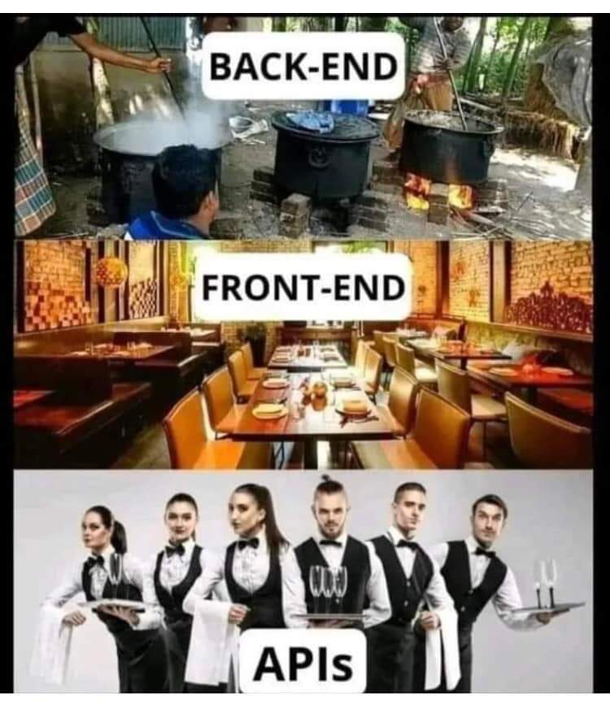
Web Development
Web Development can be classified into two ways:
Frontend Development
Backend Development
Frontend Development: The part of a website that the user interacts directly is termed as front end. It is also referred to as the ‘client side’ of the application.

Slide 6
Web Development
Frontend Frameworks and Libraries:
AngularJS
React.js
VueJS
jQuery
Bootstrap
Material UI
Tailwind CSS
jQuery UI

Slide 7
Web Development
Backend Development: Backend is the server side of a website.
It is the part of the website that users cannot see and interact.
It is the portion of software that does not come in direct contact
with the users. It is used to store and arrange data.

Slide 8
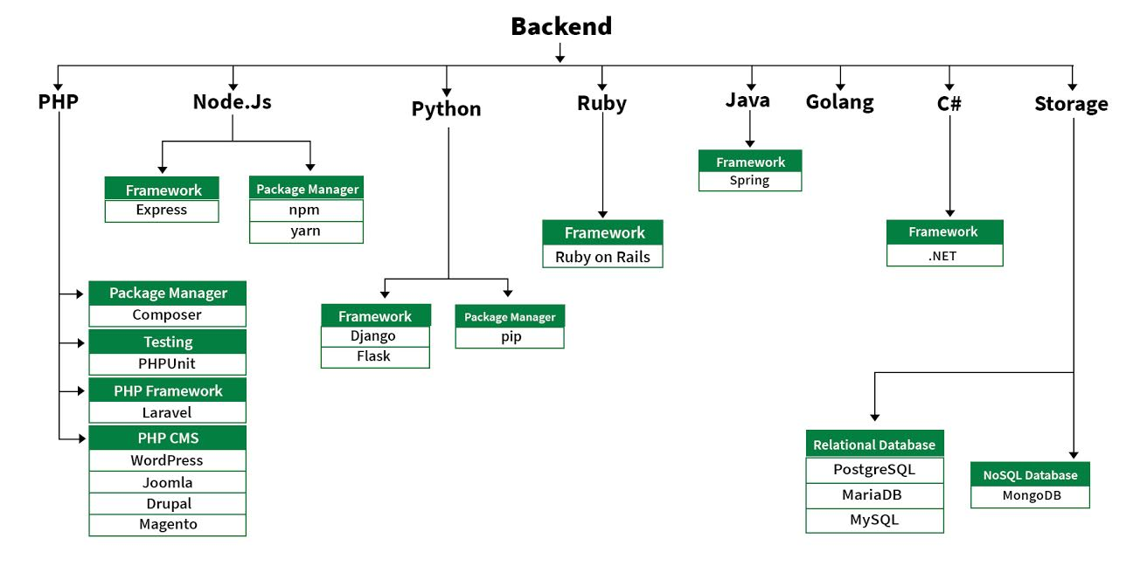
Web Development
https://www.geeksforgeeks.org/web-development/
Notes:
PHP: PHP is a server-side scripting language designed specifically for web development.
Java: Java is one of the most popular and widely used programming language. It is highly scalable.
Python: Python is a programming language that lets you work quickly and integrate systems more efficiently.
Node.js: Node.js is an open source and cross-platform runtime environment for executing JavaScript code outside a browser.
Back End Frameworks: The list of back end frameworks are: Express, Django, Rails, Laravel, Spring, etc.

Slide 9
Web Development
React js: is a declarative, efficient, and flexible JavaScript library for building user interfaces.
It is an open-source, component-based front-end library responsible
only for the view layer of the application. It is maintained by Facebook.
It uses a declarative paradigm that makes it easier to reason about your application and aims to be both efficient and flexible.
It designs simple views for each state in your application, and React will efficiently update and render just the right component when your data changes.
https://www.geeksforgeeks.org/web-development/

Slide 10
Web Development
There are some prerequisites and some basic concepts that you should know before you jump to the React. These basic concepts will also help you to pick up some other frameworks and libraries of java script in the future.
HTML and CSS.
Fundamentals of JavaScript and ES6.

Slide 11
Web Development
Features of React.js: some unique features available on React because that it is widely popular.
Use JSX: It is faster than normal JavaScript as it performs optimizations while translating to regular JavaScript. It makes it easier for us to create templates.
Virtual DOM: Virtual DOM exists which is like a lightweight copy of the actual DOM.
One-way: Data Binding: This feature gives you better control over your application.

Slide 12
Web Development
Features of React.js continue…
Component: is one of the core building blocks of React. In other words, we can say that every application you will develop in React will be made up of pieces called components. And Components make the task of building UIs much easier.
Performance: React.js use JSX, which is faster compared to normal JavaScript and HTML. Virtual DOM is a less time taking procedure to update webpages content.

Slide 13
Selecting IDEs
What is an IDE ?
An integrated development environment (IDE) is software for building applications that combines common developer tools into a single graphical user interface (GUI).
An IDE typically consists of:
Source code editor: A text editor that can assist in writing software code with
features such as syntax highlighting with visual cues, providing language
specific auto-completion, and checking for bugs as code is being written.

Slide 14
Selecting IDEs
Local build automation: Utilities that automate simple, repeatable tasks as part of creating a local build of the software for use by the developer, like compiling computer source code into binary code, packaging binary code, and running automated tests.
Debugger: A program for testing other programs that can graphically display the location of a bug in the original code.

Slide 15
Why do developers use IDEs?
An IDE allows developers to start programming new applications quickly because multiple utilities don’t need to be manually configured and integrated as part of the setup process.
Best Web Development IDES
Visual Studio Code simply vscode
Atom
Sublime Text 3 and many others.

Slide 16
Why do developers use IDEs?
Links you can download
https://code.visualstudio.com/ is recommended
https://atom.io/
https://www.sublimetext.com/download

Slide 17
Node and Package Manager (NPM)
Node (or more formally Node.js) is an open-source, cross-platform runtime environment that allows developers to create all kinds of server-side tools and applications in JavaScript.
The runtime is intended for use outside of a browser context (i.e. running directly on a computer or server OS) and can be downloaded the official website of node js https://nodejs.org/en/.

Slide 18
Node and NPM
npm is the package manager for the Node JavaScript platform. It puts modules in place so that node can find them, and manages dependency conflicts intelligently.
NPM is included with Node. js installation

Slide 19


Node and NPM
To Check installed versions of node js and npm
node –v for node js
npm –v for npm

Slide 20
Dependency or Packages
dependency is a third-party bit of software that was probably written by someone else and ideally solves a single problem for you.
A web project can have any number of dependencies, ranging from none to many.
A project dependency can be an entire JavaScript library or framework — such as React or Vue.

Slide 21
Dependency
Package manager: is a system that will manage your project dependencies.
The package manager will provide a method to install new dependencies (also referred to as "packages"), manage where packages are stored on your file system, and offer capabilities for you to publish your own packages.
Popular package managers include NPM & Yarn
Notes:
NPM stands for Node package manager
Yarn stands for Yet Another Resource Negotiator

Slide 22
Creating React App
Create React App: is a comfortable environment for learning React, and is the best way to start building a new single-page application in React.
It sets up your development environment so that you can use the latest JavaScript features.
provides a nice developer experience, and optimizes your app for production.
You’ll need to have Node >= 14.0.0 and npm >= 5.6 on your machine. To create a project.
Notes:
NPM stands for Node package manager
Yarn stands for Yet Another Resource Negotiator

Slide 23
Creating React App
To create a project, use the following commands:
npx create-react-app [your-app-name] // Creates your Application
cd [your-app-name] // Gets your application directory
code . // opens your project into VSCODE
npm start // starts your react project
Notes:
NPM stands for Node package manager
Yarn stands for Yet Another Resource Negotiator

Slide 24
Creating React App
To run project navigate in side created project folder, using the following commands:
cd first-project
npm start
The command will open the browser on localhost:3000 with your project (demo-project)
The npx stands for Node Package Execute and it comes with the npm.
To check installed npx run npx –v.
If npx is not installed you can install that separately by running
npm install –g npx
Notes:
NPM stands for Node package manager
Yarn stands for Yet Another Resource Negotiator

Slide 25
Creating React App
You can also create react app using the following commands:
npm install create-react-app –g // first install create-react-app
create-react-app [ project-name ] // use create-react-app to create project
npm start
It is recommended to use first approach
Notes:
NPM stands for Node package manager
Yarn stands for Yet Another Resource Negotiator

Slide 26
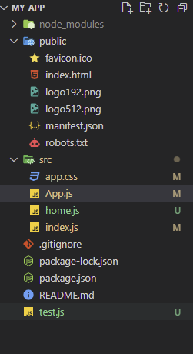
React Project folder structure
Notes:
NPM stands for Node package manager
Yarn stands for Yet Another Resource Negotiator

Slide 27
React Project folder structure
node_modules/: This folder contains all node packages that have been installed. Since we used create-react-app, a couple of node modules are already installed. We’ll not touch this folder, since node packages are usually installed and uninstalled with npm via the command line.
package.json: This file shows you a list of node package dependencies and other project configurations.
package-lock.json: This file indicates npm how to break down all node package versions. We’ll not touch this file.
Notes:
NPM stands for Node package manager
Yarn stands for Yet Another Resource Negotiator

Slide 28
React Project folder structure
.gitignore: This file displays all files and folders that shouldn’t be added to your git repository when using git, as such files and folders should be located only in your local project.
public/: This folder holds development files, such as public/index.html. The index file is displayed on localhost:3000 when the app is in development or on a domain that is hosted elsewhere. The default setup handles relating this index.html with all the JavaScript from src/.
Notes:
NPM stands for Node package manager
Yarn stands for Yet Another Resource Negotiator

Slide 29
React Project folder structure
In the beginning, everything you need is located in the src/ folder. The main focus lies on the src/App.js file which is used to implement React components.
It will be used to implement your application, but later you might want to split up your components into multiple files, where each file maintains one or more components on its own.
All your project-specific commands can be found in your
package.json under the scripts property.
Notes:
NPM stands for Node package manager
Yarn stands for Yet Another Resource Negotiator

Slide 30
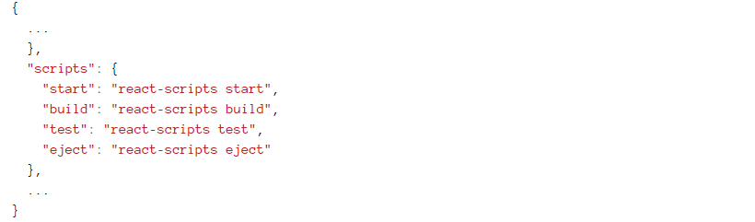
React Project folder structure
Package.json may look similar to these
Notes:
NPM stands for Node package manager
Yarn stands for Yet Another Resource Negotiator

Slide 31
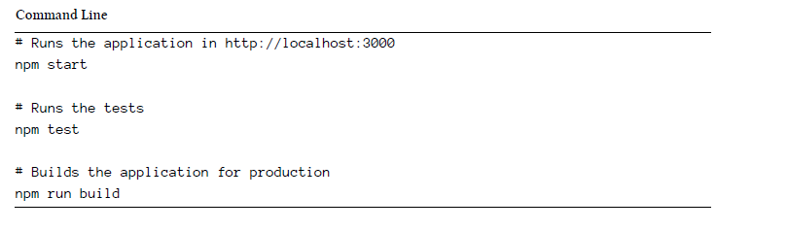
React Project folder structure
Package.json scripts
Notes:
NPM stands for Node package manager
Yarn stands for Yet Another Resource Negotiator

Slide 32
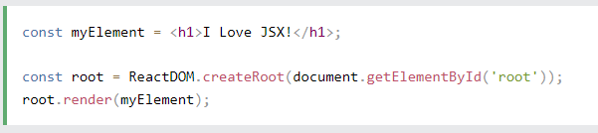
Introduction to JSX
JSX allows us to write HTML elements in JavaScript and place them in the DOM without any createElement() and/or appendChild() methods.
JSX stands for JavaScript XML.
JSX converts HTML tags into react elements.
JSX makes it easier to write and add HTML in React.
Here is example. JSX:

Slide 33
Introduction to JSX
As you can see in the first example, JSX allows us to write HTML directly within the JavaScript code.
JSX is an extension of the JavaScript language based on ES6, and is translated into regular JavaScript at runtime.

Slide 34
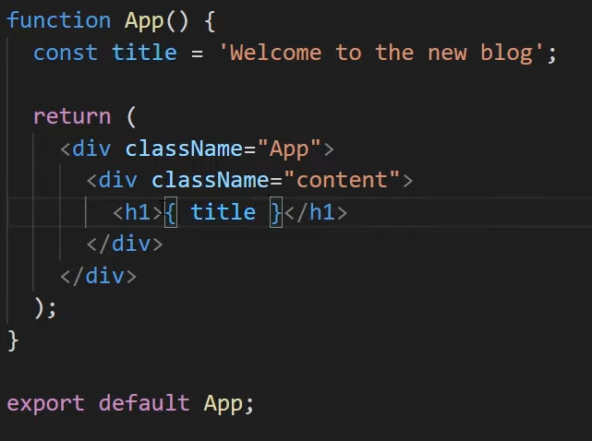

Dynamic Values & lists in JSX
With JSX you can write expressions, variables inside curly braces { }.
The expression can be a React variable, or property, or any other valid JavaScript expression. JSX will execute the expression and return the result

Slide 35
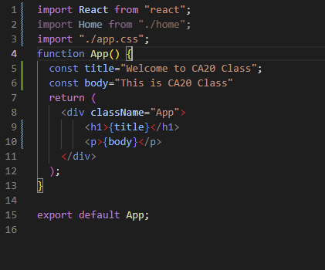
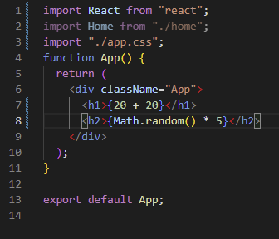
Dynamic Values & lists in JSX
With JSX you can write expressions, variables inside curly braces { }.
The expression can be a React variable, or property, or any other valid JavaScript expression. JSX will execute the expression and return the result

Slide 36

Dynamic Values & lists in JSX
First, let’s review how you transform lists in JavaScript.
Given the code below, we use the map() function to take an array of numbers and double their values. We assign the new array returned by map() to the variable doubled and log it:
Output: This code logs [2, 4, 6, 8, 10] to the console.
In React, transforming arrays into lists of elements is nearly identical.
You can build collections of elements and include them in JSX using curly braces {}.

Slide 37
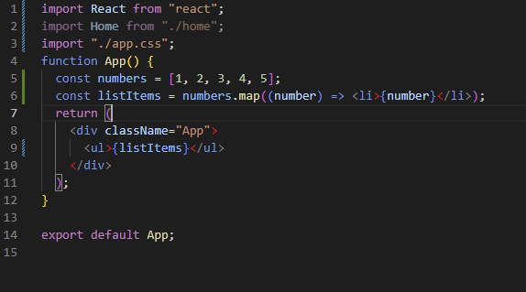
Dynamic Values & lists in JSX
Below, we loop through the numbers array using the JavaScript map() function. We return a <li> element for each item. Finally, we assign the resulting array of elements to listItems:

Slide 38
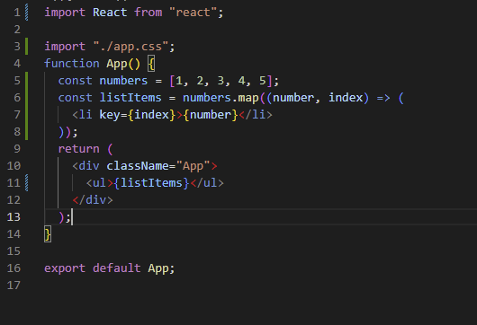
Dynamic Values & lists in JSX
When you run this code, you’ll be given a warning that a key should be provided for list items. A “key” is a special string attribute you need to include when creating lists of elements. We’ll discuss why it’s important in the next section.
Let’s assign a key to our list items inside numbers.map() and fix the missing key issue.

Slide 39
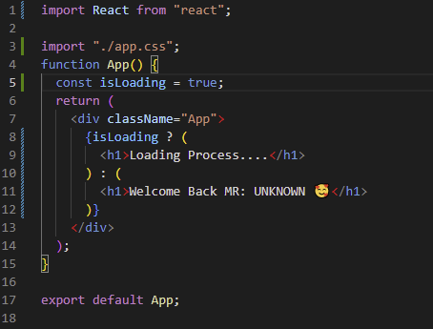
Conditionals in JSX
In React, you can create distinct components that encapsulate behavior you need. Then, you can render only some of them, depending on the state of your application.
Conditional rendering in React works the same way conditions work in JavaScript. Use JavaScript operators like if or the conditional operator to create elements representing the current state, and let React update the UI to match them.
Practice:

Slide 40
Conditional Rendering
While declaring a variable and using an if statement is a fine way to conditionally render a component, sometimes you might want to use a shorter syntax.
There are a few ways to inline conditions in JSX, explained below.
Inline If with Logical && Operator
You may embed expressions in JSX by wrapping them in curly braces. This includes the JavaScript logical && operator. It can be handy for conditionally including an element.

Slide 41
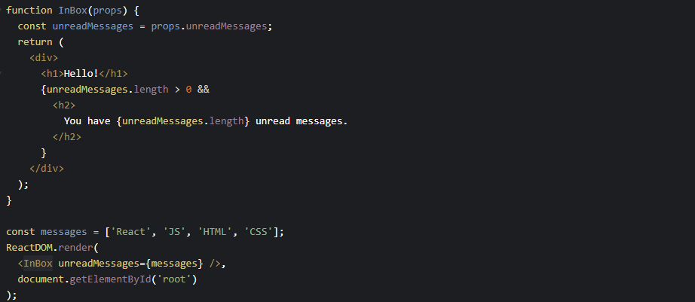
Conditional Rendering

Slide 42
React Props
Props stand for "Properties." They are read-only components. It is an object which stores the value of attributes of a tag and work similar to the HTML attributes. It gives a way to pass data from one component to other components. It is similar to function arguments. Props are passed to the component in the same way as arguments passed in a function

Slide 43
React Props
Props are immutable so we cannot modify the props from inside the component. Inside the components, we can add attributes called props. These attributes are available in the component as props and can be used to render dynamic data in our render method

Slide 44
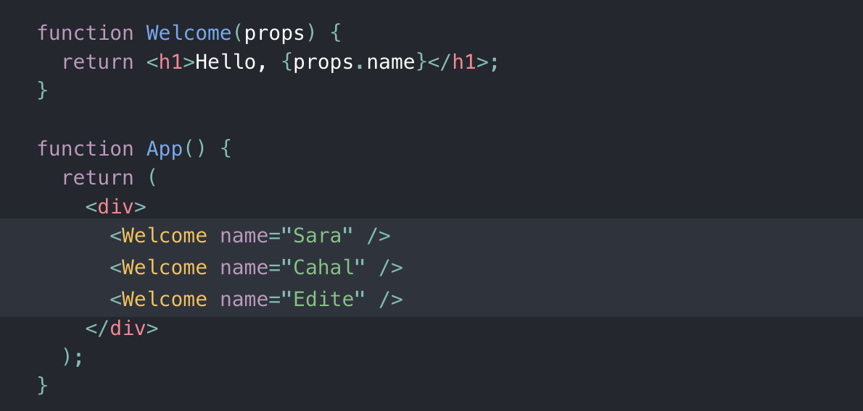
React Props

Slide 45
Adding styles to a components
React component gets its own CSS file, which is scoped to that file and component. For a React component you'd like to style, simply create a CSS file containing the styles for that component.

Slide 46
Adding styles to a components
React component gets its own CSS file, which is scoped to that file and component. For a React component you'd like to style, simply create a CSS file containing the styles for that component.

Slide 47
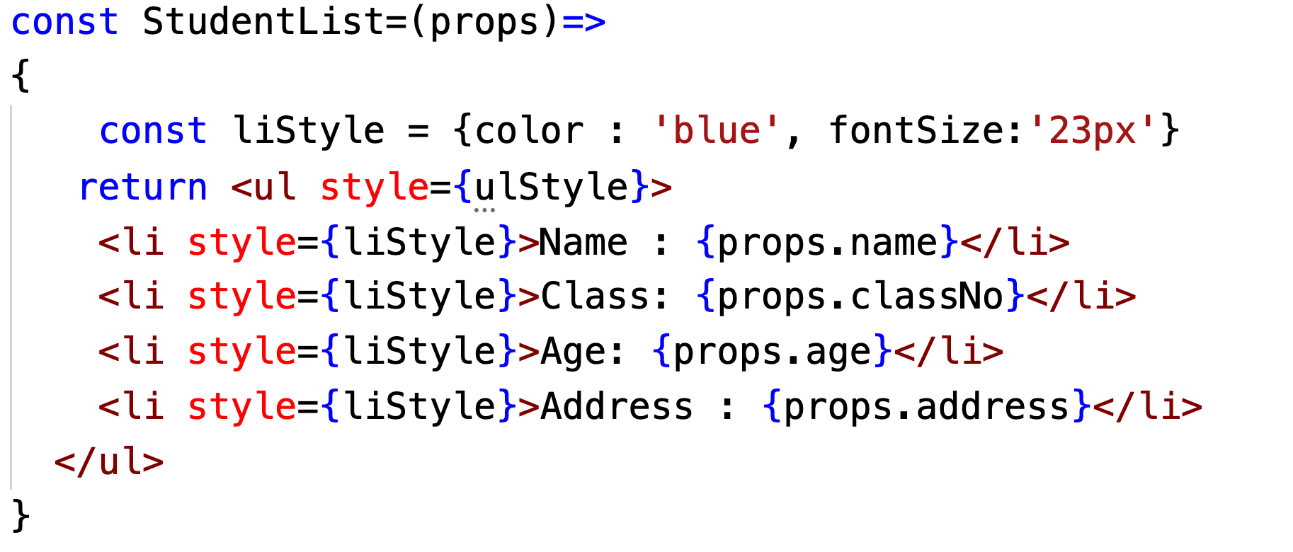
Adding styles to a components

Slide 48
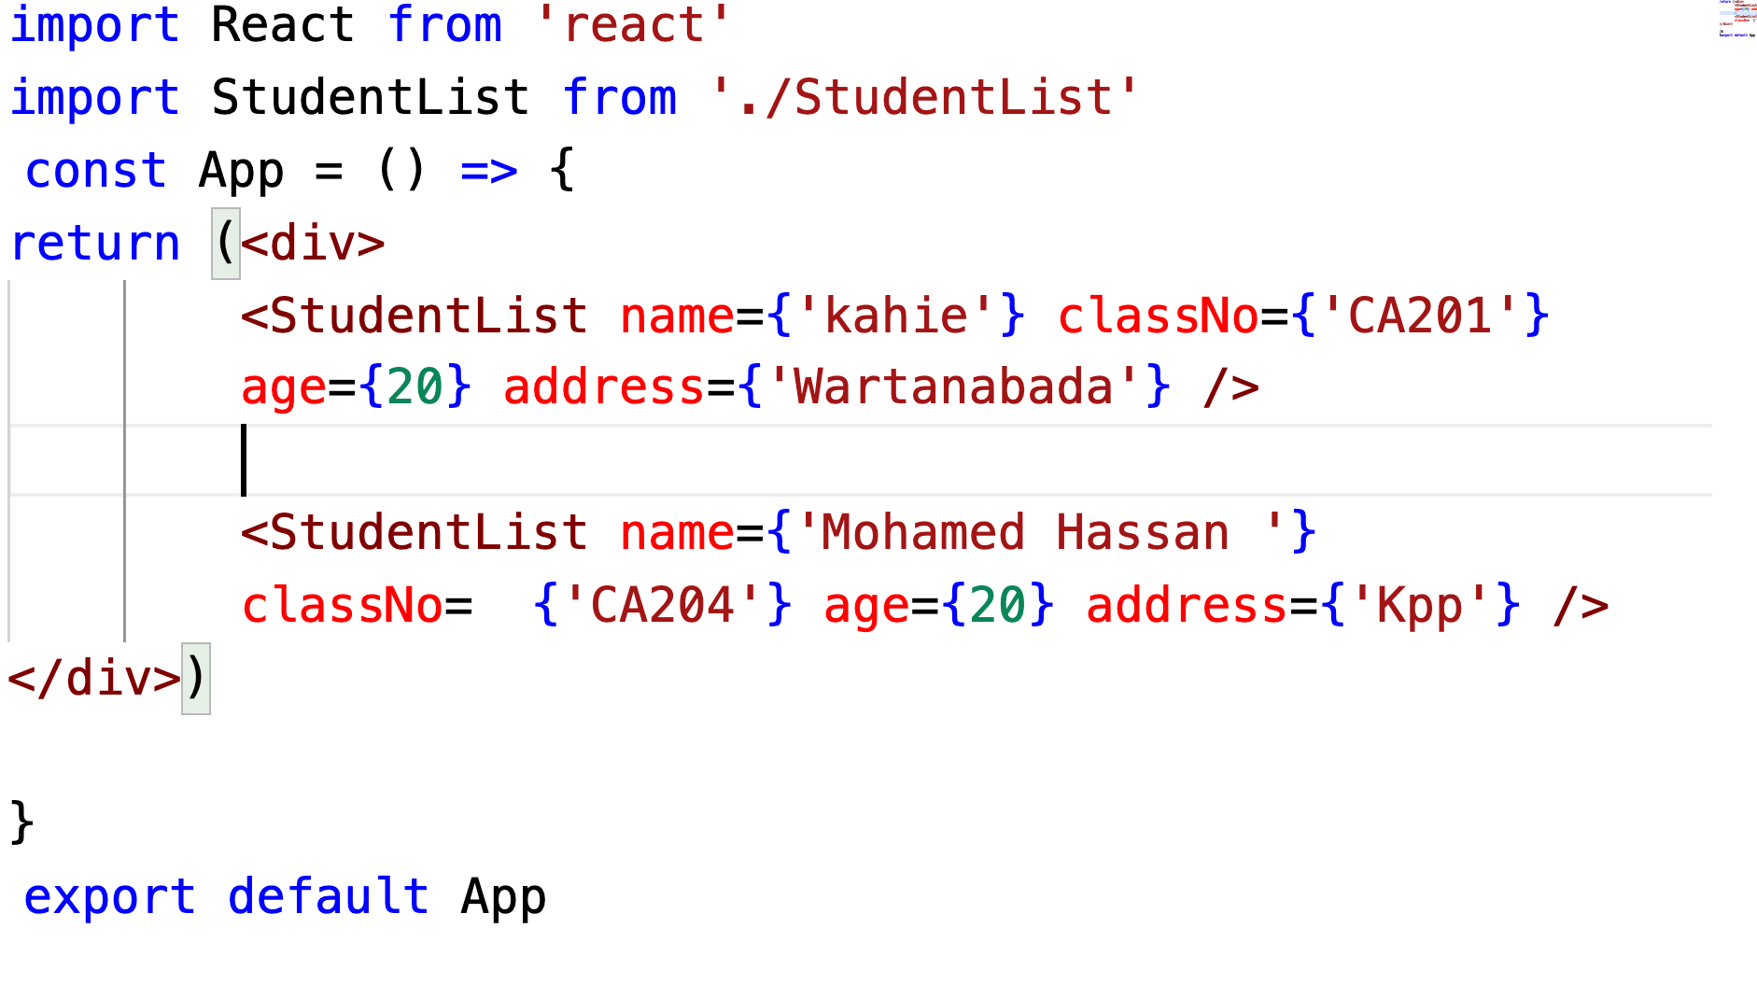
Adding styles to a components

Slide 49
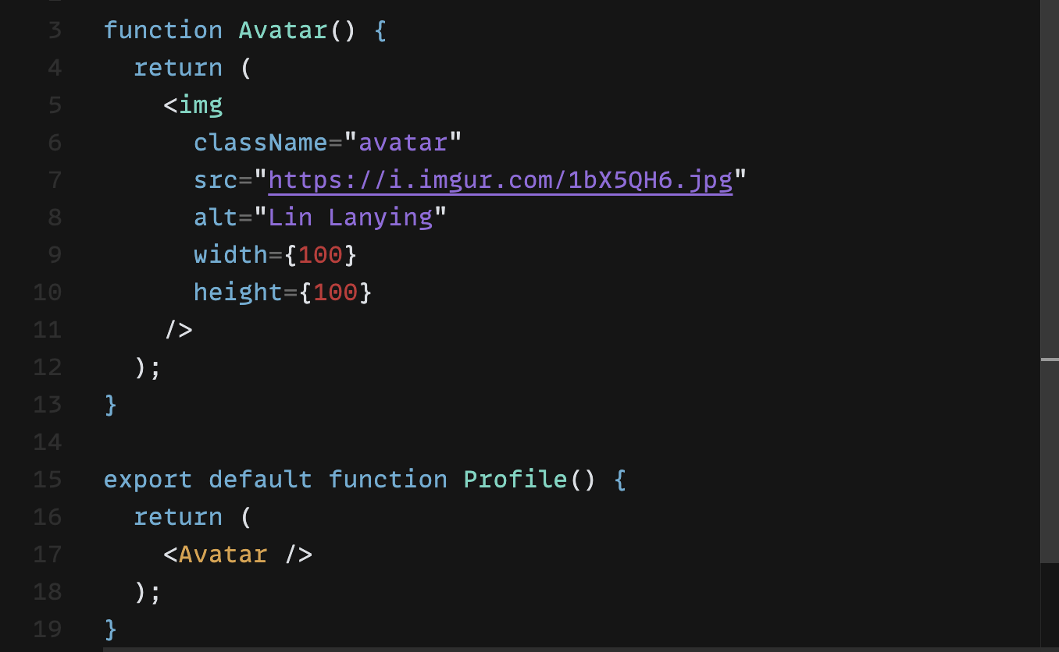
Props are the information that you pass to a JSX tag. For example, className, src, alt, width, and height are some of the props you can pass to an <img>
Props
Notes:
.avatar { margin: 10px; border-radius: 50%; }

Slide 50
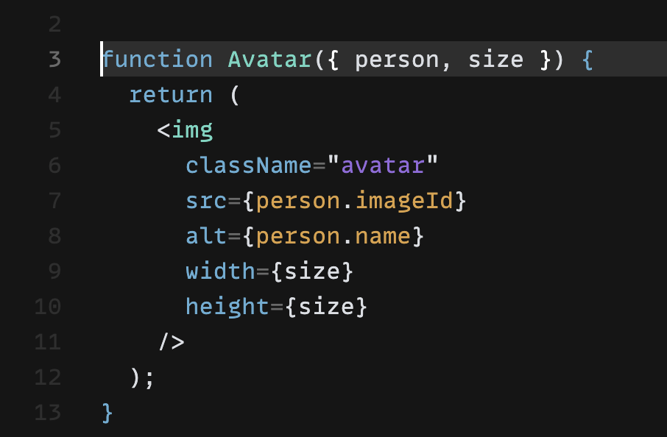
Avatar components

Slide 51
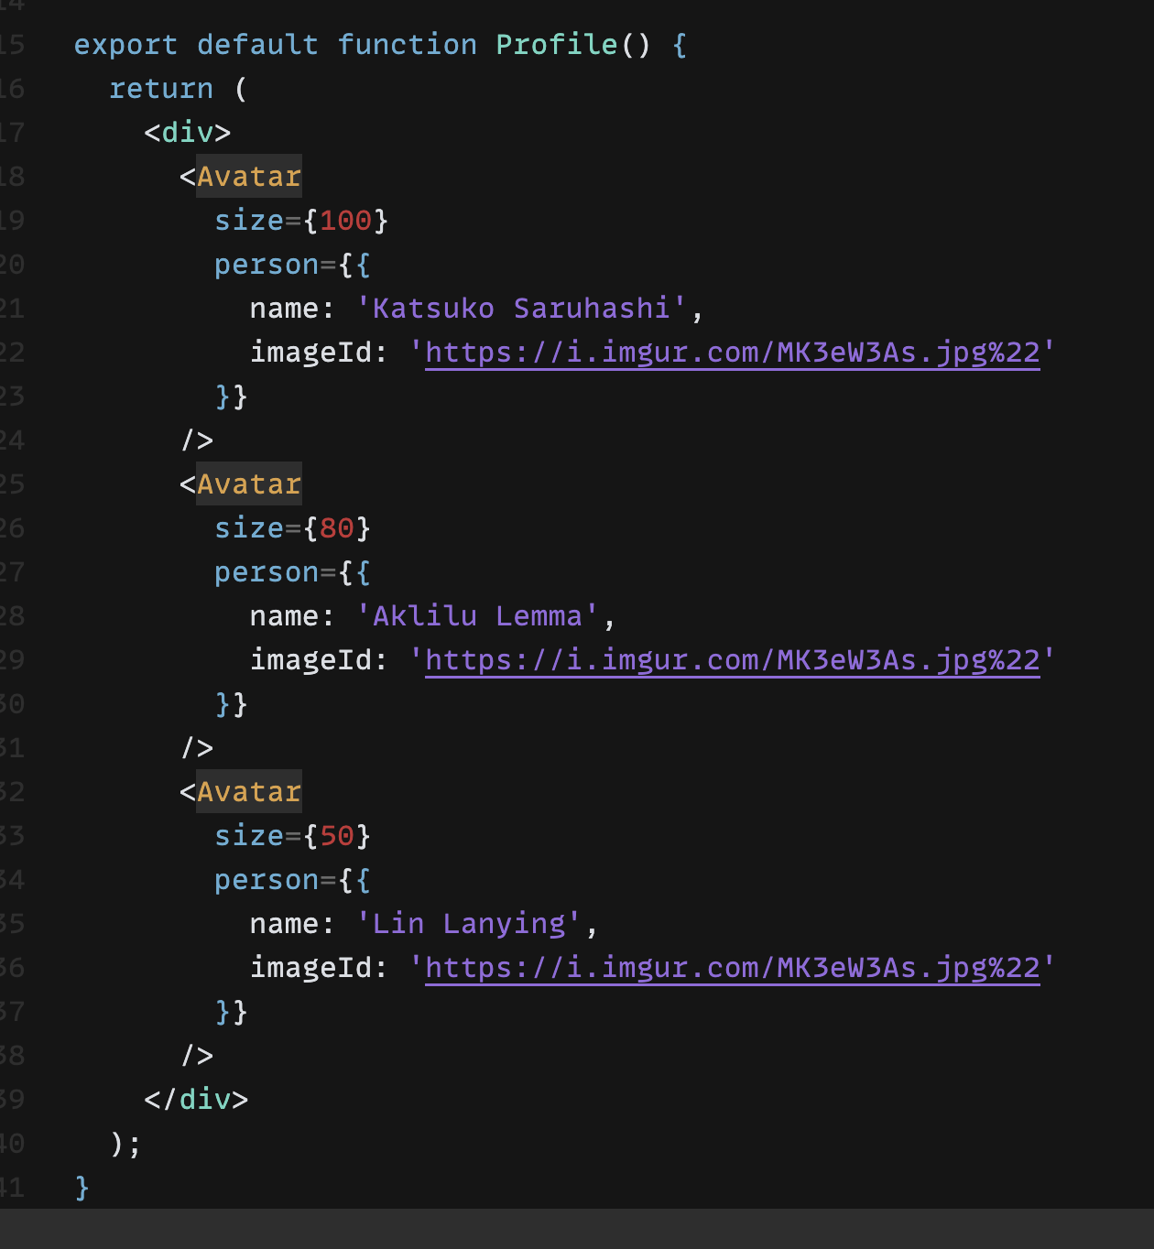
Profile components

Slide 52
END.

