Slide 1
MSc Thesis Presentation
BEHAVIORAL AND ACADEMIC INDICATOR-BASED DEPRESSION SCREENING AMONG HIGHER EDUCATION STUDENTS
A COMPARATIVE MACHINE LEARNING STUDY
Submitted by:
Md. Murad Hossain
Supervised by:
Dr. Mrinal Kanti Baowaly
Department of Computer Science & Engineering Gopalganj Science and Technology University, Bangladesh
March 2026

Slide 2
Presentation Outline
01
Problem Statement & Motivation
06
Classification Algorithms
02
Research Objectives
07
Experimental Setup
03
Literature Review
08
Results & Performance Analysis
04
Dataset & Feature Description
09
Conclusion & Future Work
05
Methodology & Preprocessing
Md. Murad Hossain | MSc Thesis Defense | Dept. of CSE, Gopalganj Science & Technology University
2 / 14

Slide 3
Problem Statement & Motivation
Why does this research matter?
The Challenge
Bangladesh Context
▸ 280 million people affected by depression globally (WHO)
▸ Depression prevalence: 23–41% among higher education students in South Asia
▸ Clinical screening (PHQ-9, BDI) is resource-intensive and difficult to scale
▸ Social stigma prevents students from seeking help
▸ No systematic automated tool for early detection at institutional level
▸ 1.5+ million students enrolled in degree programs
▸ Rapid lifestyle changes increasing psychological burden
▸ Academic pressure, financial strain, social expectations
▸ Limited mental health infrastructure at institutions
▸ Urgent need: low-cost, automated, scalable screening
Md. Murad Hossain | MSc Thesis Defense | Dept. of CSE, Gopalganj Science & Technology University
3 / 14

Slide 4
Research Objectives
01
Construct a clinically-informed behavioral & academic survey dataset from 539 higher education students across 23 feature dimensions
02
Design and implement a systematic data preprocessing pipeline (encoding, imputation, and Z-score normalization)
03
Train and evaluate 4 supervised ML classifiers: SVM, Logistic Regression, XGBoost, and MLP
04
Compare models using Accuracy, Precision, Recall, F1-Score, and ROC AUC under 10-fold cross-validation
05
Identify the optimal model for real-world student depression screening deployment
Md. Murad Hossain | MSc Thesis Defense | Dept. of CSE, Gopalganj Science & Technology University
4 / 14

Slide 5
Literature Review
Key prior work in ML-based depression detection
Mohd & Yahya (2018)
LR + ANN on student questionnaire data → 72–78% accuracy
Bae & Lee (2015)
Data mining of Korean adolescent clinical data → Depression = strongest predictor of suicide
Deshpande & Rao (2017)
SVM + Naive Bayes on emotion-tagged social content → F1-score based evaluation
Dipnall et al. (2016)
Fused ML + statistics for biomarker discovery → Ensemble learning effective in psychiatry
Cacheda et al. (2019)
Dual Random Forest on social network streams → Early detection, dual model outperforms single
Shrestha (2018)
Twitter text features for depression prediction → Limited generalizability due to small dataset
Research Gap: No multi-classifier benchmarking framework on behavioral survey data for Bangladeshi higher education students
Md. Murad Hossain | MSc Thesis Defense | Dept. of CSE, Gopalganj Science & Technology University
5 / 14

Slide 6
Dataset & Feature Description
539 students · 23 features · binary class label
539
23
40.62%
59.38%
Student Records
Feature Dimensions
Depressed
Not Depressed
Behavioral / Psychological
Academic / Performance
Digital / Lifestyle
Family / Social
Clinical / Risk
Social norms acceptance
SSC Result
Smartphone ownership
Family contentment
Suicide attempt history
Personality type
HSC Result
Daily sleep duration
Feel like a burden
Thoughts on suicide
Solitude comfort
University CGPA
Contentment in current role
Comfortable environment
Age (17–33)
Talking about problems
Challenging Education System
Work anxiety
Family size
Gender
Hanging out with friends
Extracurricular activities
→ Class Label: Depression (Yes/No)
Md. Murad Hossain | MSc Thesis Defense | Dept. of CSE, Gopalganj Science & Technology University
6 / 14

Slide 7
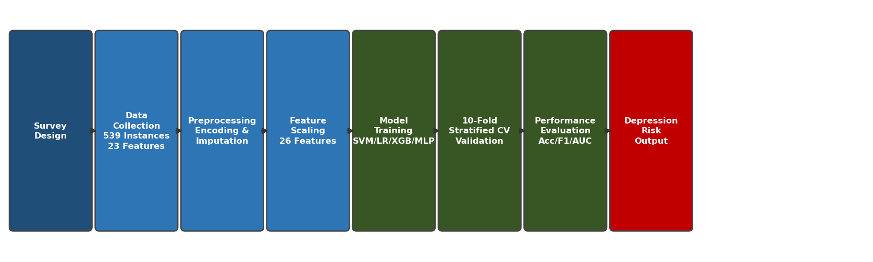
Methodology & System Workflow
Fig. 1: End-to-End System Pipeline — from Survey Design to Depression Risk Output
Preprocessing Pipeline
1. Binary Encoding
2. One-Hot Encoding
3. Median Imputation
4. Z-Score Scaling
5. Feature Space
Yes/No → 1/0 (13 features)
Gender, Personality Environment → binary
Missing values replaced by median
μ=0, σ=1 StandardScaler
23 attrs → 26 dimensions
Md. Murad Hossain | MSc Thesis Defense | Dept. of CSE, Gopalganj Science & Technology University
7 / 14

Slide 8
Classification Algorithms
Four complementary ML paradigms for comparative analysis
SVM
Logistic Regression
XGBoost
MLP (Neural Net)
▸ Kernel-based margin maximization
▸ Linear probabilistic classifier
▸ Gradient-boosted decision trees
▸ 3 hidden layers: 128 → 64 → 32
▸ RBF kernel for non-linear boundaries
▸ Sigmoid function → probability
▸ L1/L2 regularization built-in
▸ ReLU activation, Adam optimizer
▸ C=10, gamma='scale'
▸ L-BFGS solver, C=1.0, max_iter=1000
▸ 200 estimators, max_depth=6, lr=0.1
▸ Softmax output, max_iter=500
▸ Strong on small-to-medium datasets
▸ Interpretable decision boundary
▸ Handles missing values natively
▸ Non-linear feature representation
Evaluation: 10-Fold Stratified Cross-Validation | Metrics: Accuracy · Precision · Recall · F1-Score · ROC AUC
Md. Murad Hossain | MSc Thesis Defense | Dept. of CSE, Gopalganj Science & Technology University
8 / 14

Slide 9
Experimental Setup & Evaluation Protocol
Simulation Environment
Evaluation Protocol
✓ Programming Language: Python 3.9
10-Fold Stratified CV
Class ratio preserved in every fold
Train / Test Split
80% (431) training / 20% (108) testing
✓ scikit-learn 1.2.2
Accuracy
(TP+TN) / (TP+TN+FP+FN)
✓ XGBoost 1.7.5
Precision
TP / (TP + FP)
✓ pandas 1.5.3 | NumPy 1.24.3
Recall (TPR)
TP / (TP + FN)
✓ Matplotlib 3.7.1
F1-Score
2 × (Precision × Recall) / (P+R)
ROC AUC
Area under ROC curve (0–1)
Md. Murad Hossain | MSc Thesis Defense | Dept. of CSE, Gopalganj Science & Technology University
9 / 14

Slide 10
Experimental Results
TABLE: Performance Comparison — 10-Fold Stratified Cross-Validation
Metric
MLP
Logistic Regression
XGBoost
SVM ★
Accuracy (%)
96.84
97.77
97.59
97.96
Avg. Precision (%)
95.47
97.23
96.30
97.23
Avg. Recall (%)
95.37
97.22
96.30
97.22
Avg. F1-Score (%)
95.34
97.22
96.30
97.22
Avg. ROC AUC (%)
99.01
99.50
99.57
99.11
★ SVM achieved highest overall accuracy; XGBoost achieved highest ROC AUC | All models exceeded 96% accuracy
Md. Murad Hossain | MSc Thesis Defense | Dept. of CSE, Gopalganj Science & Technology University
10 / 14

Slide 11
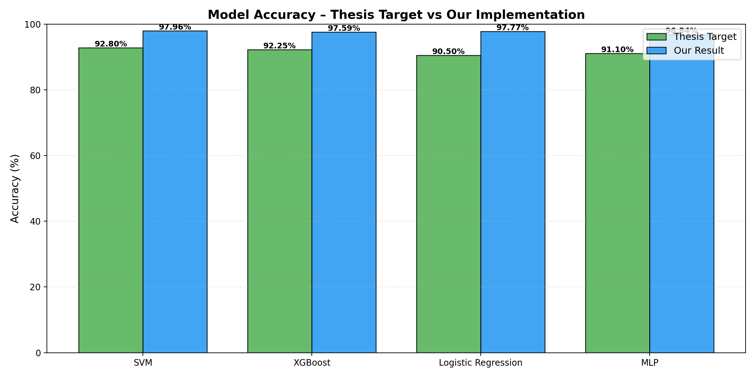
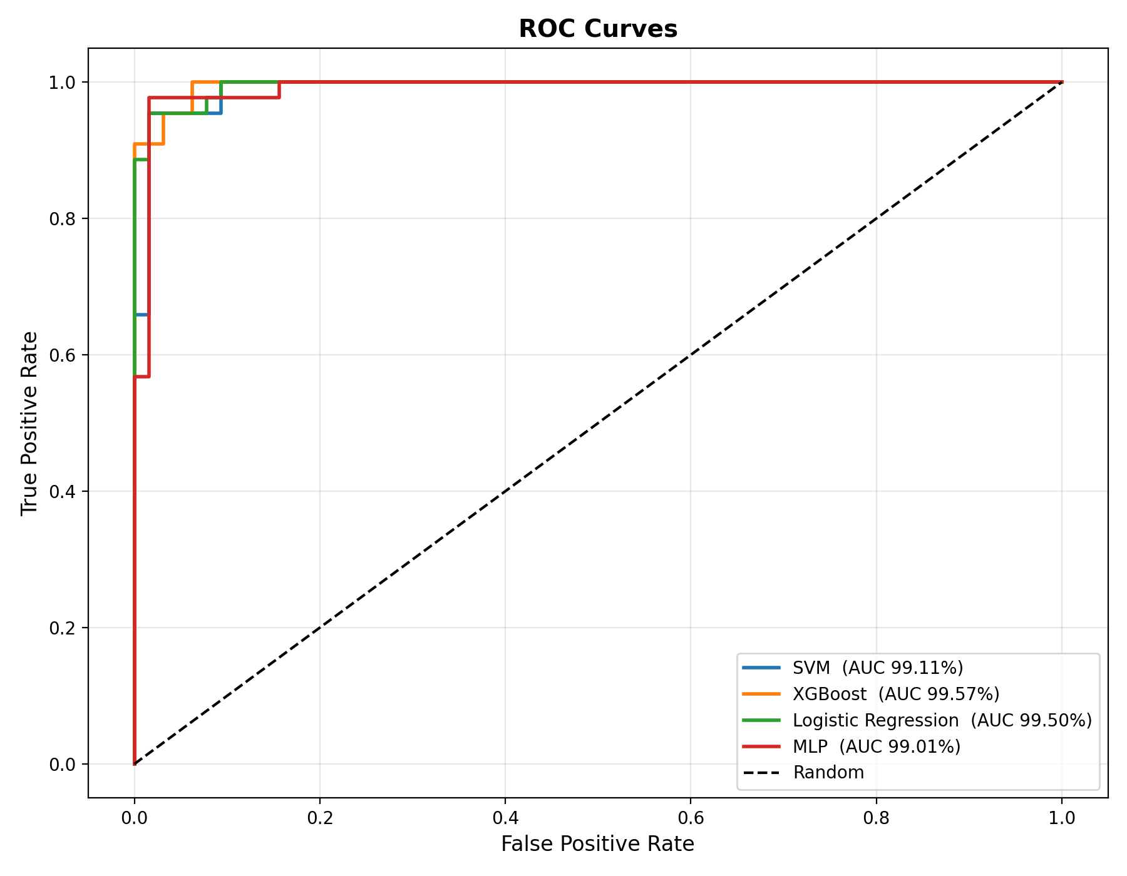
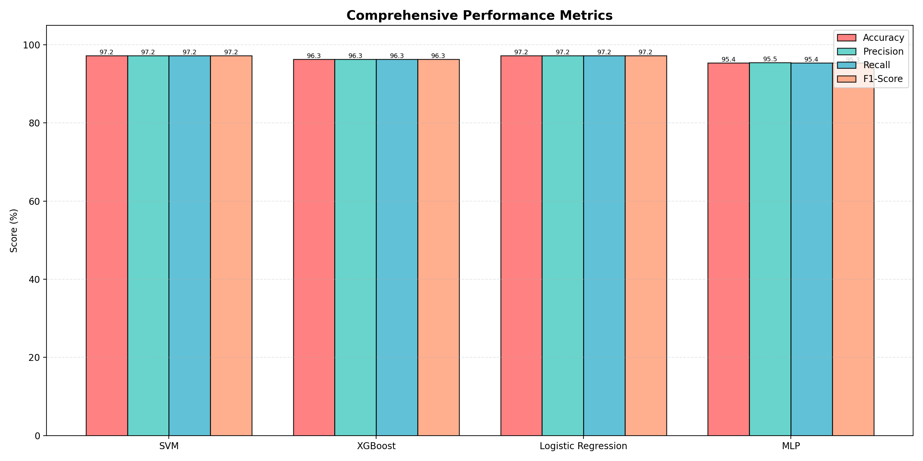
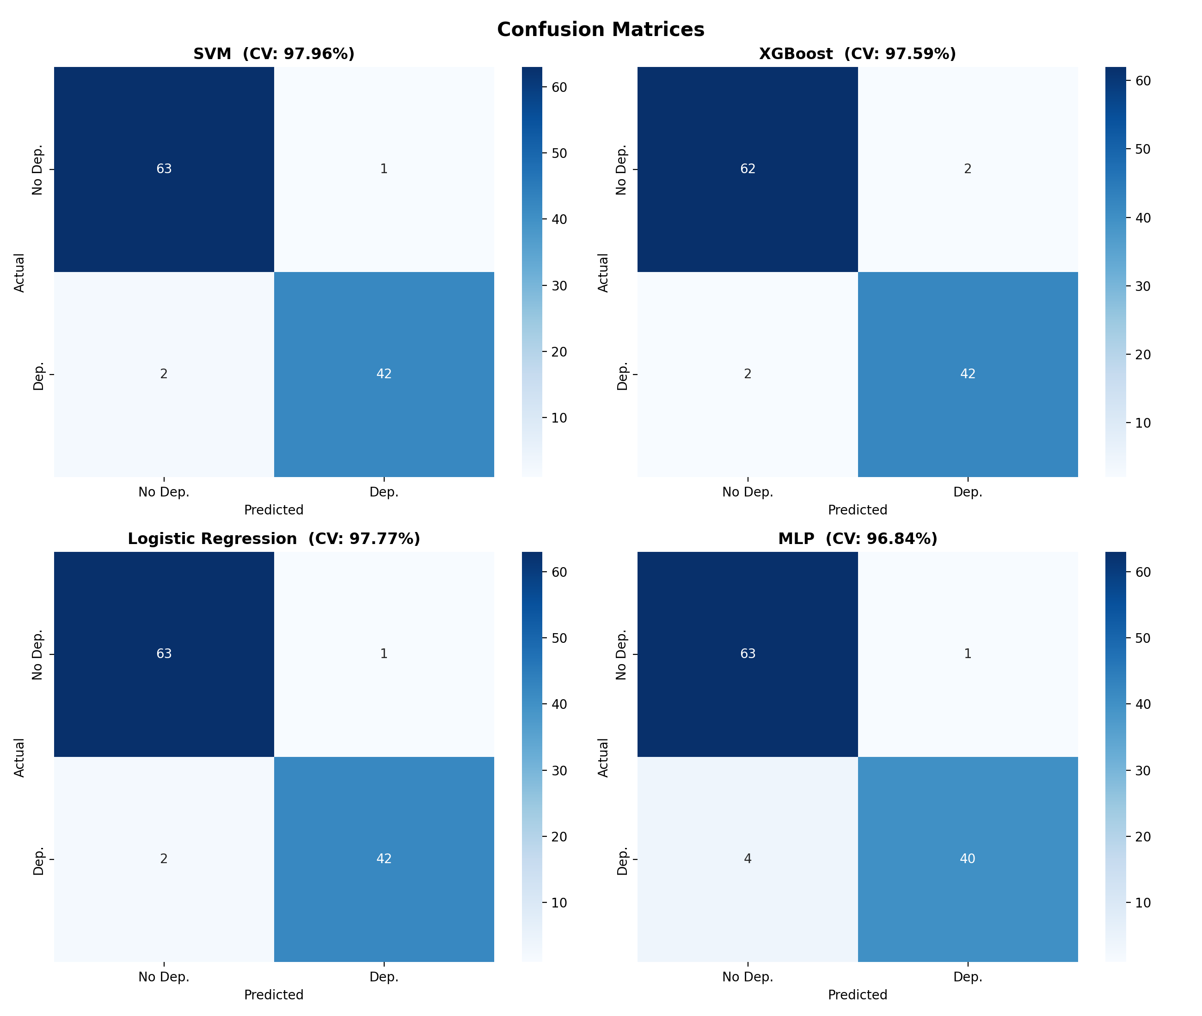
Results — Visual Analysis
Fig. 3: Accuracy Comparison
Fig. 5: ROC Curves (all AUC > 99%)
Fig. 6: All Metrics Comparison
Fig. 4: Confusion Matrices
Md. Murad Hossain | MSc Thesis Defense | Dept. of CSE, Gopalganj Science & Technology University
11 / 14

Slide 12
Key Findings & Discussion
SVM — Best Accuracy
97.96% accuracy confirms that RBF kernel maximum-margin classification captures non-linear patterns in behavioral survey features most effectively.
Logistic Regression — Strong Linear Performance
97.77% accuracy despite linear decision boundary — indicates the preprocessed feature space is substantially linearly separable.
XGBoost — Highest ROC AUC
99.57% ROC AUC demonstrates superior ranking capability; gradient boosting effectively captures feature interaction effects.
MLP — Solid Neural Network Baseline
96.84% accuracy; hierarchical neural feature representations valid for complex non-linear depression indicator patterns.
Overall Conclusion
All 4 models exceed 96% accuracy and 99% AUC — validating that behavioral survey data + principled preprocessing = reliable depression screening.
Md. Murad Hossain | MSc Thesis Defense | Dept. of CSE, Gopalganj Science & Technology University
12 / 14

Slide 13
Conclusion & Future Work
Conclusion
Future Work
✔ Proposed ML-based depression screening framework for higher education students using 23-feature survey data
➤ Expand dataset — multi-institution, longitudinal, diverse socioeconomic backgrounds
✔ SVM achieved highest accuracy: 97.96%
➤ Multi-class severity: mild / moderate / severe aligned with PHQ-9 clinical scale
✔ All 4 models exceeded 97% accuracy and 99% ROC AUC
➤ Deep learning: transformers, graph neural networks for relational/temporal feature modeling
✔ Survey-driven, non-invasive, low-cost approach — deployable at institutional scale
➤ Passive sensing: smartphone usage, wearable sleep data as complementary features
✔ SVM recommended as optimal classifier for this domain
➤ Real-time web application for university counseling service integration
Md. Murad Hossain | MSc Thesis Defense | Dept. of CSE, Gopalganj Science & Technology University
13 / 14

Slide 14
Thank You
Questions & Discussion
Md. Murad Hossain
muradmd312@gmail.com
Supervised by: Dr. Mrinal Kanti Baowaly
Dept. of CSE | Gopalganj Science and Technology University, Bangladesh
SVM: 97.96% LR: 97.77% XGBoost: 97.59% MLP: 96.84%
All ROC AUC > 99% | 10-Fold Stratified Cross-Validation | 539 Students | 23 Features

