Slide 1
WELCOME TO OUR PRESENTATION
BUS RESERVATION SYSTEM(SWING)
Submitted By
Farid Khan
Misha Islam Punam
Joya Islam

Slide 2
INTRODUCTION
Bus Reservation System is designed to automate the online ticket purchasing through an easy-to-use online bus booking system. In our System we can provides different types of buses categories like Express, Volvo, AC or Non AC etc .In our system we can manage all types of Passenger data & bus data. All details that is related to Traveling like fare details Seat availability, details of Booking, bus details, seating arrangements, inquiry etc.

Slide 3
FACILITIES
Check the whether of user is valid or invalid.
Admin should manage the details of bus.
Admin should manage the details of customer.
Admin should manage the bus fare and passenger details.
Booking process complete by only system user.
User should print the booked ticket.

Slide 4
REQUIREMENTS
Hardware Requirements
Processors(1GB)
RAM(2GB)
Disk Space(10GB)
Software Requirements
Operating System
Front End( java swing )
Back End(mySql)

Slide 5
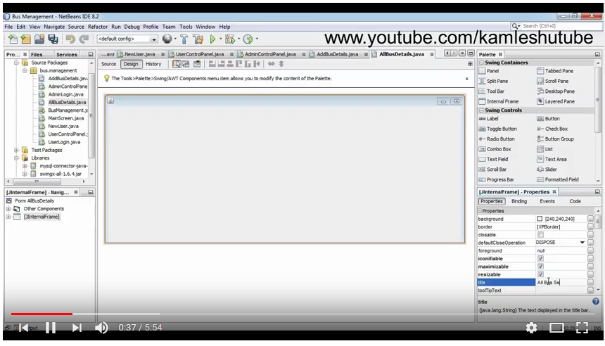
DESIGN OVERVIEW

Slide 6
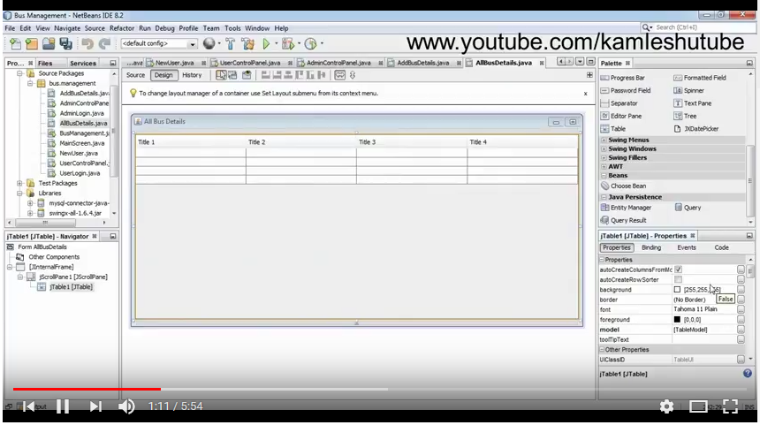
TABLE OVERVIEW

Slide 7
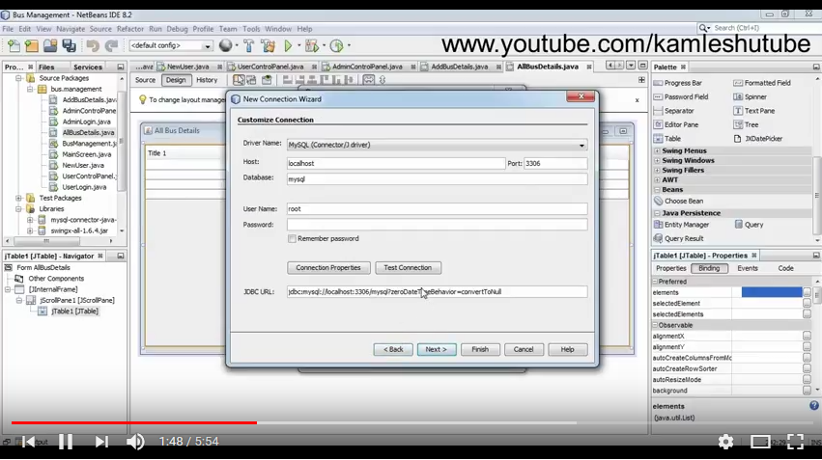
CREATING CONNECTION PAGE

Slide 8
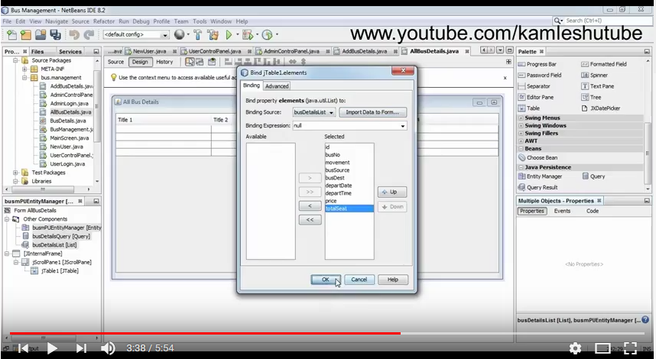
CREATING TABLE

Slide 9
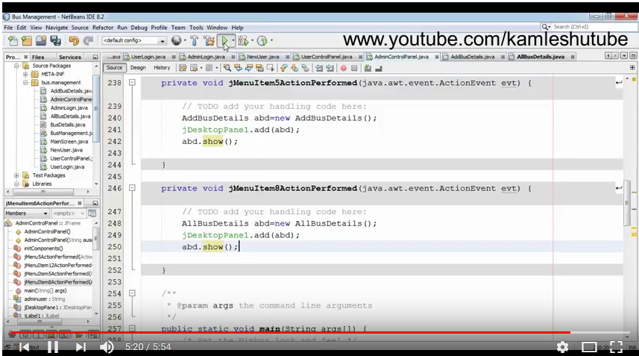
CODING

Slide 10
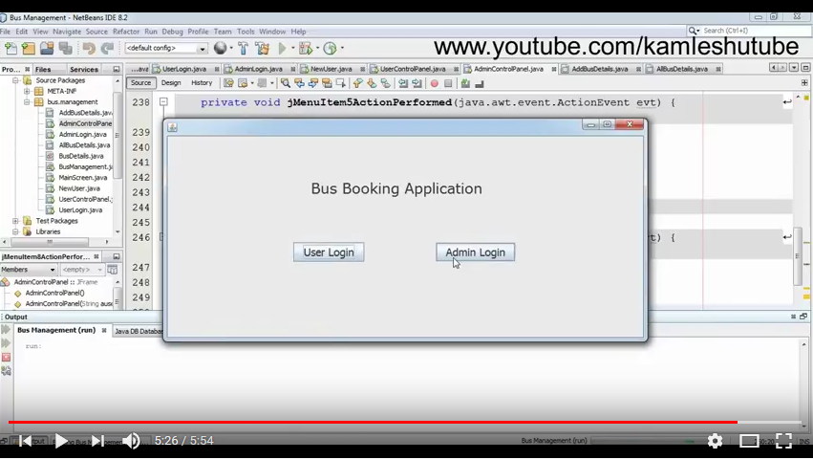
BOOKING FORM

Slide 11
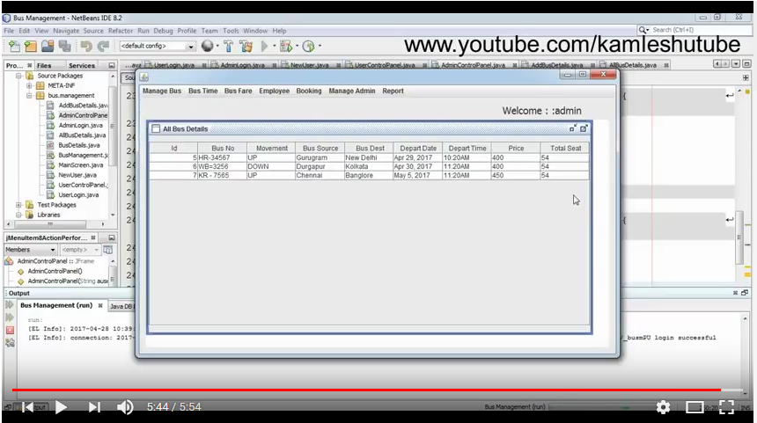
ADMIN PANNEL

Slide 12
THANK YOU FOR WATCHING
ANY QUESTION?

