Slide 1
Course Registration System (CRS)
Murad Hajiyev (610691)
Uuganbayar Oyun (610751)
Mohamed Ibrahim (610695)
Odbayar Nanjidjamts (610526)
MIU CS425
1
Notes:
1

Slide 2
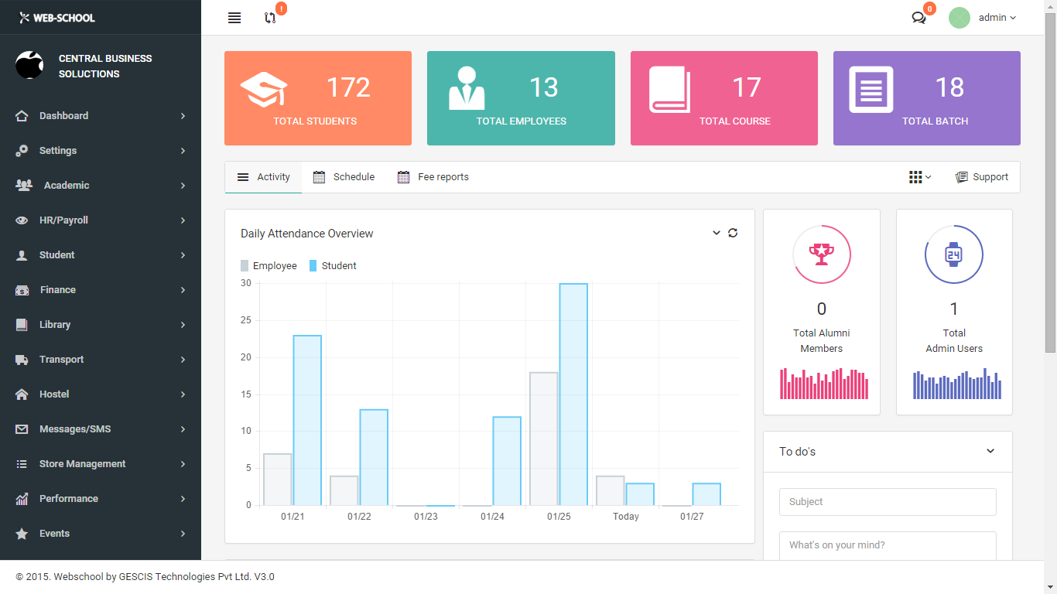
1. Project Description
Course Registration System for students
Features
Administrator can create faculties, courses, classes, blocks and additional users for the system
Students can choose a class from each block and enroll.
If there is no available seats in class, it will be deactivate to be enrolled.
Blocks have a set of classes

Slide 3
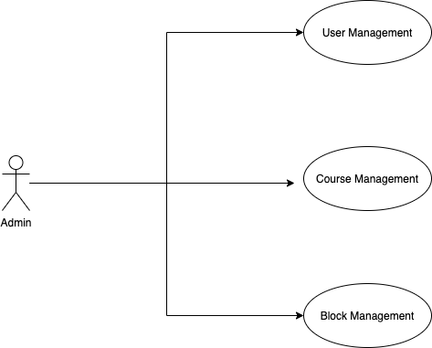
2.Use case diagram
3

Slide 4
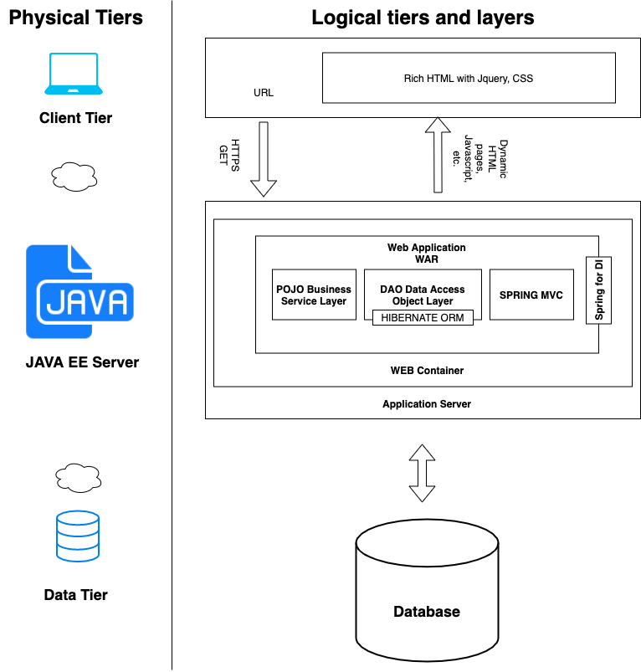



3. High level architecture & Technologies used
4

Slide 5
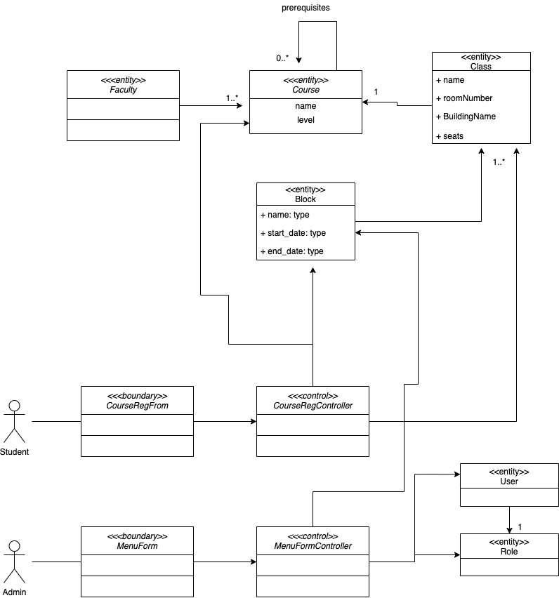
4. Class Diagram
5

Slide 6
Thank you
MIU CS425
6
Notes:
In Slide Show mode, click the arrow to enter the PowerPoint Getting Started Center.
6

