Slide 1
Course Registration System (CRS)
Murad Hajiyev (610691)
Uuganbayar Oyun (610751)
Mohamed Ibrahim (610695)
Odbayar Nanjidjamts (610526)
MIU CS425
1
Notes:
1

Slide 2
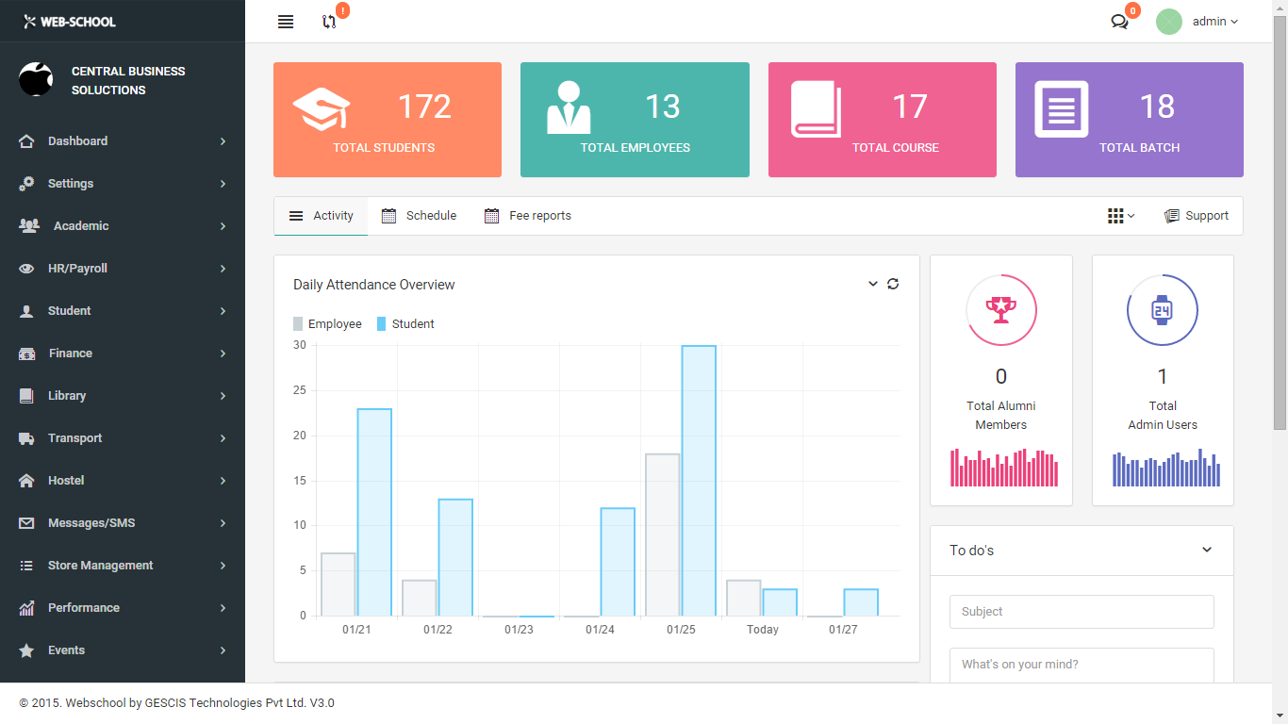
1. Project Description
Course Registration System for students
Features
Administrator can create faculties, courses, classes, blocks and additional users for the system
Students can choose a class from each block and enroll.
If there is no available seats in class, it will be deactivated to be enrolled.
Blocks have a set of classes

Slide 3
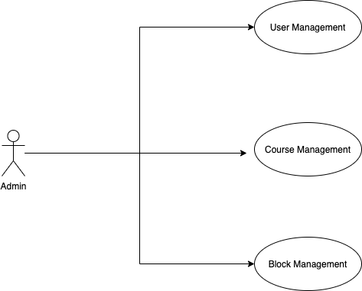
2.Use case diagram
3

Slide 4
3.Key abstractions
Student
Administrator
Faculty
Course
Block
Class
Available Seats
Prerequisite
Transcript
Grade
4

Slide 5
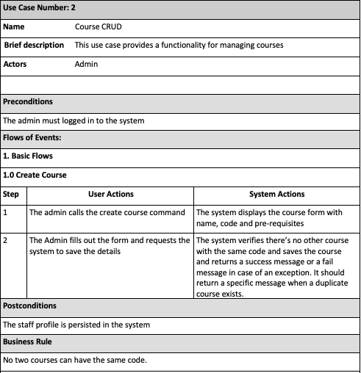
4.Use case description ( a sample )
5

Slide 6
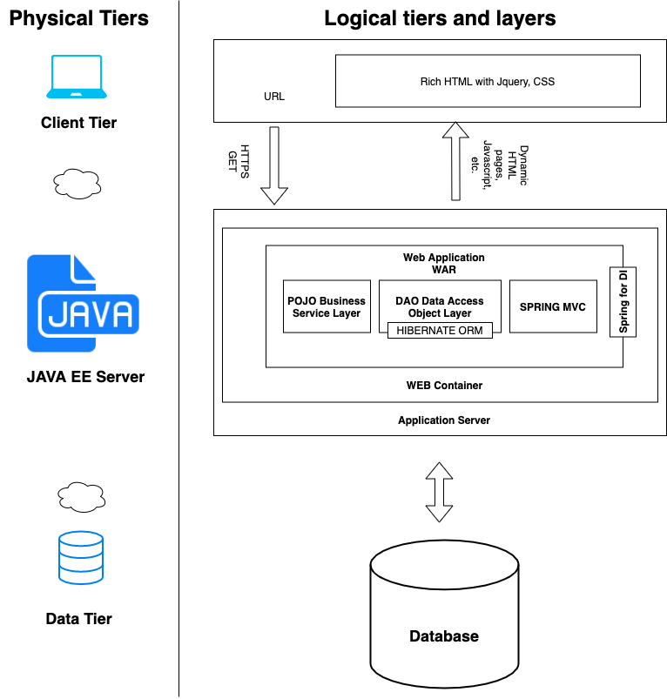



5. High level architecture & Technologies used
6

Slide 7
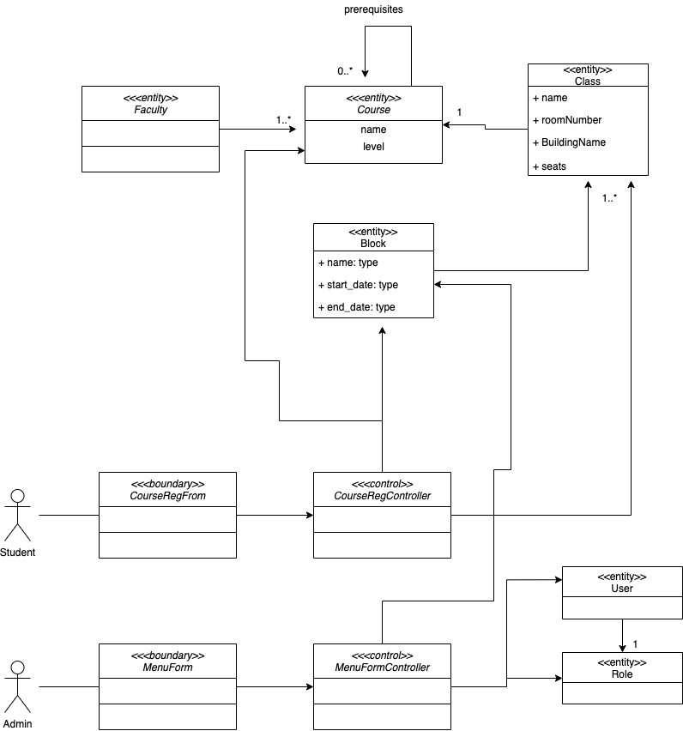
6. Class Diagram
7

Slide 8
Thank you
MIU CS425
8
Notes:
In Slide Show mode, click the arrow to enter the PowerPoint Getting Started Center.
8

