Slide 1







TechCatalog
End-to-End E-Commerce
Data Pipeline
TECHCATALOG PLATFORM
PRESENTED BY
Muradi Alshammari · Aseel Aldukhael · Haneen Alotaibi · Joudi Alharbi
Supervisors:
Nasr Alani · Maher Selim
Saudi Digital Academy — Data Engineering Bootcamp | September 2026

Slide 2


TechCatalog
WHY THIS PROJECT EXISTS
The Problem and the Solution
The Problem
The Solution
Scattered Data: Difficulty in tracking electronic product prices across multiple fragmented stores and sources.
Inconsistent Structure: Non-standardized data formats and product specifications between platforms.
Complex Comparison: Time-consuming and inefficient effort required to analyze data and make purchasing decisions.
Automated Ingestion: An automated Data Pipeline that gathers prices and specifications seamlessly.
Data Standardization: Cleaning and unifying product data into a single consolidated model.
Data-Driven Decision: Interactive Power BI dashboard enabling users to instantly spot the best deals.
02

Slide 3


TechCatalog
PRICE COMPARISON
One Laptop. Three Prices.
8,799 SAR
Amazon KSA
MacBook Pro 16"
TechCatalog
9,100 SAR
Amazon US
MacBook Pro 16"
Best Price via TechCatalog
8,399 SAR
Google Shopping
MacBook Pro 16"
MacBook Pro 16"
Same product · 3 sources
03

Slide 4





















TechCatalog
SYSTEM ARCHITECTURE
Azure-Native Data Platform Pipeline
RapidAPI · Azure Databricks · Azure Data Lake Gen2 (ADLS) · Power BI
ORCHESTRATION & MONITORING · AZURE DATABRICKS WORKFLOWS
Daily Job Trigger
Azure Key Vault & Secrets
Retry & Error Handling
Job Run History & Logs
Daily Databricks Job run (10:00 AM Riyadh)
Encrypted API keys, never hard-coded
Auto-recovers from rate limits/errors
Tracks run status, failure alerts & logs
DATA SOURCES
INGESTION
STORAGE & PROCESSING (Azure Data Lake Storage Gen2)
BUSINESS INTELLIGENCE
POWERED BY
POWERED BY
POWERED BY
POWERED BY
RapidAPI
Python
ADLS Gen2
Delta Lake
Azure Databricks
PySpark
Power BI
Amazon
Google
1
2
3
4
5
6
7
Google Shopping
& Amazon APIs
Fetch & Ingest
Pipeline
Raw
(Bronze Ingestion)
Bronze
(History Storage)
Silver
(Cleaned & Unified)
Gold
(Star Schema)
Power BI
Dashboard
Via RapidAPI / Token-auth product & price data
5 categories, daily batch, JSON raw payload
Timestamped JSON files in bronze_path, append mode
Delta format, append raw with ingestion_timestamp
Drop duplicates, fillna (rating, availability), Merge / Incremental load
Star Schema: gold_dim_product, gold_fact_products tables
Price comparison & market KPIs for stakeholders
DATA GOVERNANCE & DEVOPS
Data Quality
Data Layers
Access & Secrets
Versioning & Ops
Delta ACID transactions; every batch validated before commits.
Raw → Bronze → Silver → Gold, unidirectional, no direct edits.
Unity Catalog permissions; key Vault and Databricks secrets.
Single orchestrated workflow; CI/CD pipeline on GitHub.
04

Slide 5
TechCatalog
STEP 3 · AUTOMATION
Pipeline Orchestration and Automation
Automated End-to-End Orchestration
Sequential Task Dependency (DAG Flow)
Enterprise Reliability & Monitoring
Managed via Databricks Workflows (scheduled jobs) with seamless execution and no manual intervention.
API ingestion secured with Azure Key Vault tokens, then processed in order across Bronze → Silver → Gold.
Built-in retries and failure logging auto-refresh the Gold star schema that feeds Power BI.
06

Slide 6
TechCatalog
CHALLENGES & SOLUTIONS · 1 OF 3
Multi-Market Data & Currency Normalization
The Challenge
The Solution
We integrated data from both the US and SA markets, but the conflicting currencies (Dollars vs. Riyals) made it impossible to compare prices accurately.
We built an automated step during the data cleaning phase that detects the currency type and instantly converts all prices to Saudi Riyals (SAR) for a fair and accurate comparison.
07

Slide 7
TechCatalog
CHALLENGES & SOLUTIONS · 2 OF 3
Smart Data Categorization
The Challenge
The Solution
The original data did not specify the product type, causing the dashboard to group all devices (Laptops, Phones, Tablets) into one messy "Other" category.
We developed a smart rule that reads the product titles, identifies keywords, and automatically organizes every product into its correct category before sending it to the dashboard.
08

Slide 8
TechCatalog
CHALLENGES & SOLUTIONS · 3 OF 3
Ensuring Dashboard Reliability
The Challenge
The Solution
The dashboard frequently failed to refresh due to hidden duplicate records and historical data conflicts coming from the source.
We set up strict data validation rules to automatically remove any duplicates and clear out conflicting old records, ensuring the final dashboard runs smoothly and updates without any errors.
09

Slide 9

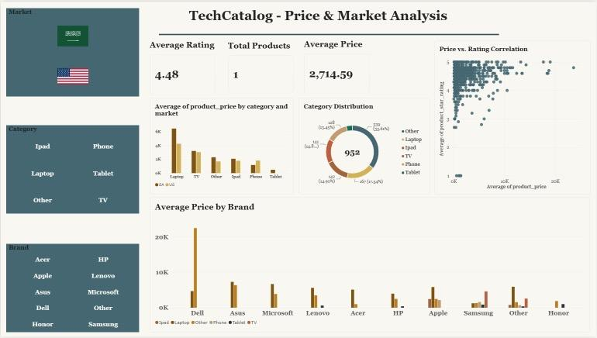


TechCatalog
STEP 4 · CONSUMPTION
Business Intelligence and Power BI Analytics
Executive KPIs
LIVE DASHBOARD PREVIEW
Total products, average price and rating — refreshed daily from Gold tables.
Price & Market Analytics
Price benchmarking by brand and category across every source.
Dynamic Filtering
Market, category and brand slicers for self-serve exploration.
10

Slide 10
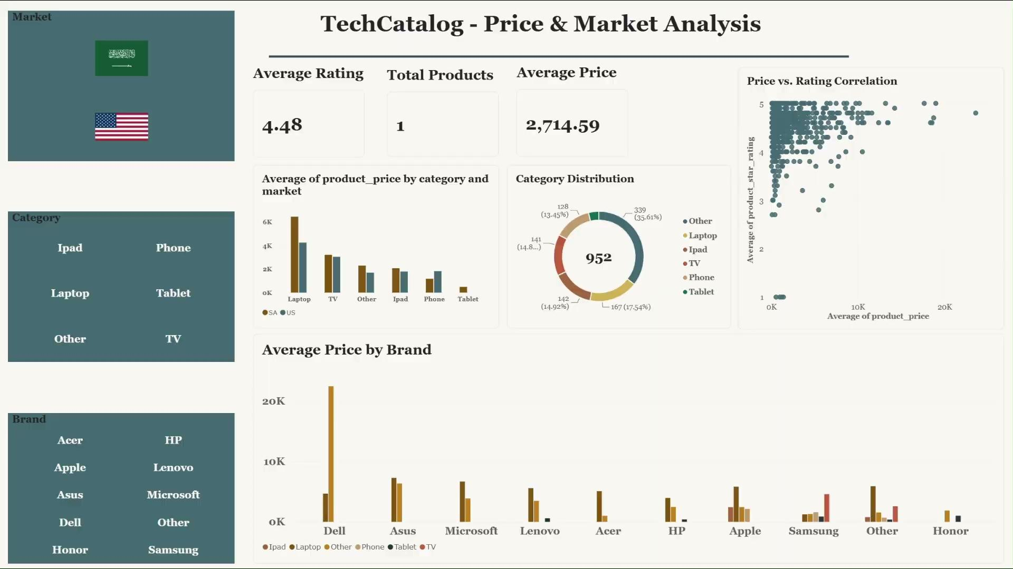

Slide 11

TechCatalog
Thank you for your time and attention
TechCatalog · Saudi Digital Academy Data Engineering Bootcamp

