Slide 1


Autism Spectrum Disorder Prediction and Classification Using Machine Learning
Presented By
Name: Murad Kabir Md. Rakib
ID: 241155
Supervisor: Professor Shamim Al Mamun, PhD

Slide 2
Introduction
ASD is a neurodevelopmental disorder characterized by challenges in social communication and behavior, affecting 1 in 54 people globally.
Early diagnosis allows for timely interventions, which can significantly improve developmental outcomes for children with ASD. Traditional diagnostic methods are slow, subjective, and inconsistent, often leading to delayed diagnoses.
The absence of standardized diagnostic criteria causes variability in ASD diagnosis, complicating early identification and treatment.

Slide 3
Objectives
To predict ASD using machine learning (ML) models.
To identify key features related to ASD using a merged dataset.
To compare different ML models for their effectiveness in diagnosing ASD.
To enhance the accuracy and speed of early ASD detection.

Slide 4
Literature Review
Model / Study | Accuracy (%) | Additional Metrics | Notes / Data Source
Ma et al. (2020) | Not specified | Precision, Recall, F1-score | Applied deep learning to healthcare data for chronic kidney disease, adaptable to ASD diagnosis; dataset: Healthcare-related data
Golan et al. (2018) | ~85% | Sensitivity, Specificity, ROC Curve | Used decision trees and SVM on behavioral data from children; dataset: Behavioral assessments of children with ASD
Zhang et al. (2021) | ~90% | AUC, Precision, Recall | Combined AQ data with demographic features for prediction; dataset: AQ screening tool and demographic info
Chen et al. (2019) | ~80-85% | Accuracy, Feature Selection Impact | Employed Recursive Feature Elimination (RFE) for feature selection; dataset: ASD-related behavioral features
Singh et al. (2020) | Not specified | Interpretability (XAI), Accuracy | Discussed the importance of explainable AI in healthcare; dataset: General healthcare datasets applicable to ASD

Slide 5
Tools and Technology
Python was used for developing machine learning models and data processing.
Scikit-learn: Implemented machine learning algorithms like Random Forest, Decision Trees, and Stochastic Gradient Descent.
TensorFlow/Keras: Used for building and training the Convolutional Neural Network (CNN) model.
Pandas: Handled data manipulation and preprocessing tasks.
NumPy: Used for numerical operations and handling arrays/matrices.
Matplotlib/Seaborn: Utilized for visualizing results, confusion matrices, and accuracy/loss metrics.
Google Colab: Used for GPU support when training deep learning models like CNN.

Slide 6
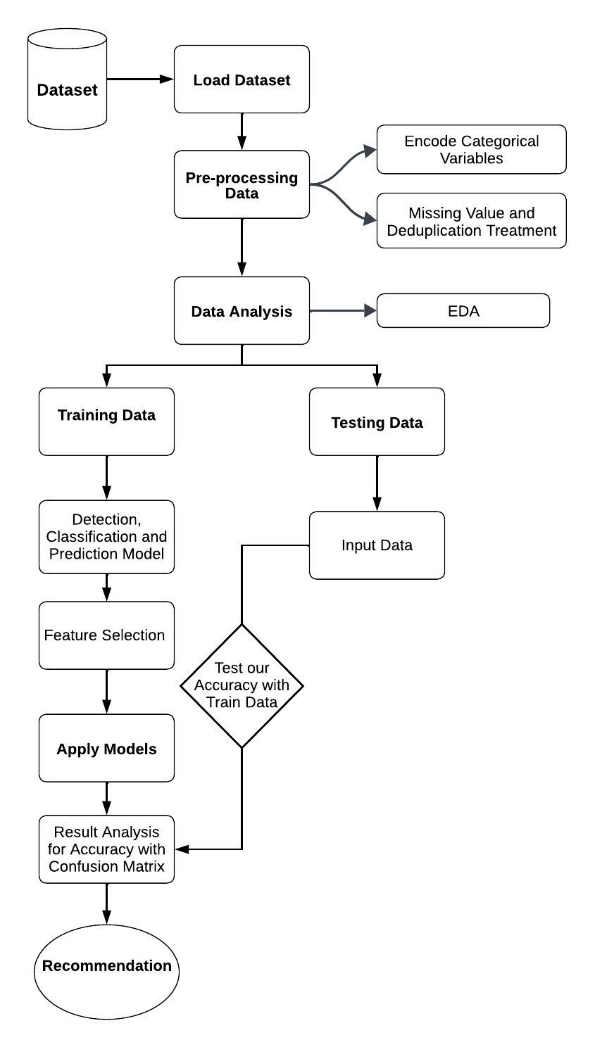
Overview of the Proposed System Methodology

Slide 7
Research Methodology
Data Collection:
1,985 Data from the UCI Machine Learning Repository and clinical data.
Features include behavioral, demographic, and clinical characteristics.
ML Models Tested:
Random Forest, Decision Tree, Stochastic Gradient Descent, CNN.
Data Preprocessing:
Imputation for missing values, feature selection, and normalization.

Slide 8
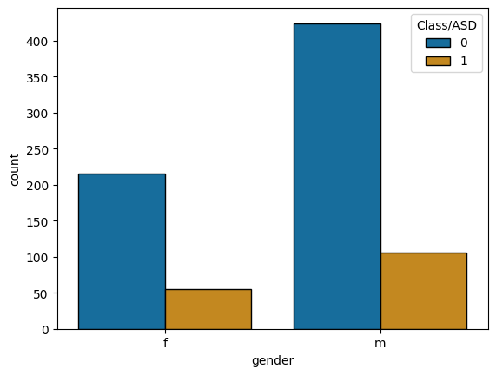
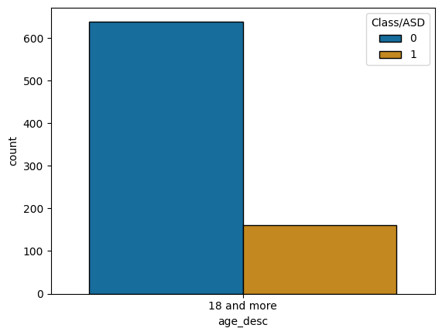
Distribution of ASD and Non-ASD Cases

Slide 9
Experimental Results
Random Forest classifier achieved 88% accuracy.
CNN showed high training accuracy (98.92%) but overfitting during validation (80%).
Comparative analysis with other models (SGD, Decision Tree).
Confusion Matrices: Random Forest performed best for non-ASD prediction, but struggled with ASD cases.

Slide 10
Model | Accuracy (%)
Random Forest Classifier | 88.00
SGD Classifier | 81.00
Decision Tree | 79.50
CNN Model (Training Accuracy) | 98.92
CNN Model (Validation Accuracy) | 80.00

Slide 11
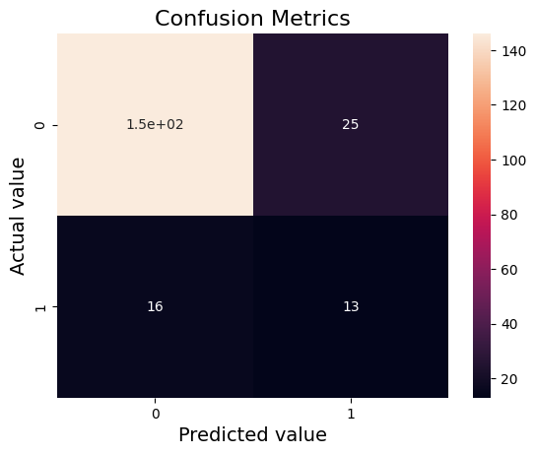
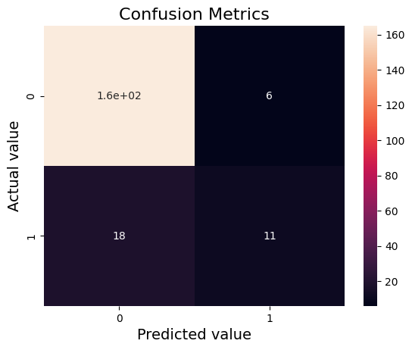
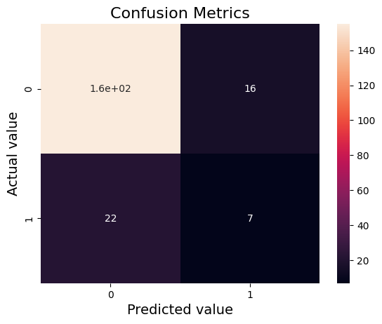
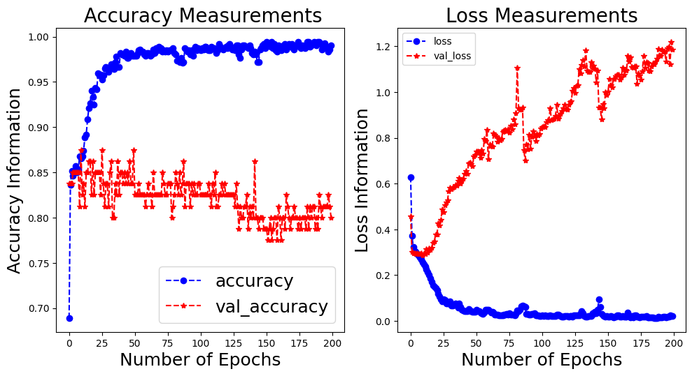

Slide 12
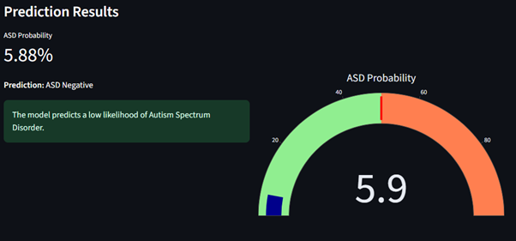
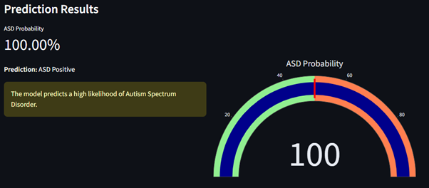
Web Application

Slide 13
Impact on Society
Improved accuracy and efficiency of early ASD detection.
Aids healthcare systems by reducing diagnostic delays and costs.
Facilitates early intervention, which leads to better long-term outcomes for children with ASD.
Scalable diagnostic tools using AI that can evolve with new data and medical advancements.
Potential for expansion to other health conditions.

Slide 14
Conclusion
Machine learning offers significant improvements over traditional diagnostic methods for ASD.
The developed system provides an accurate, efficient, and scalable tool for healthcare providers.
Future improvements can lead to personalized, real-time diagnostic and treatment tools for ASD.

Slide 15
References
Ma, et al. (2020). Applied deep learning to healthcare data for chronic kidney disease, adaptable to ASD diagnosis. Healthcare-related data.
Golan, et al. (2018). Used decision trees and SVM on behavioral data from children. Behavioral assessments of children with ASD.
Zhang, et al. (2021). Combined AQ data with demographic features for prediction. AQ screening tool and demographic info.
Chen, et al. (2019). Employed Recursive Feature Elimination (RFE) for feature selection. ASD-related behavioral features.
Singh, et al. (2020). Discussed the importance of explainable AI in healthcare. General healthcare datasets applicable to ASD.

Slide 16
THANK YOU

