Slide 1
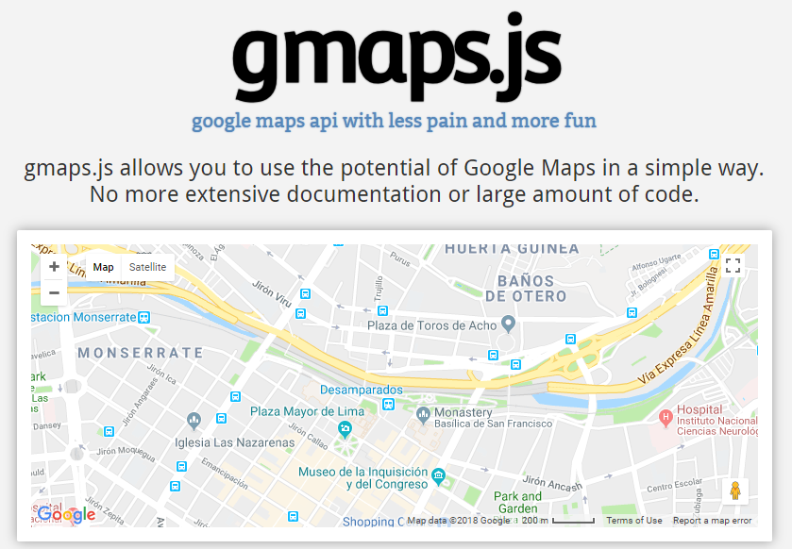
https://hpneo.github.io/gmaps/

Slide 2
https://hpneo.github.io/gmaps/

