Slide 1

XAMPP
(Apache + MariaDB + PHP + Perl)
https://www.apachefriends.org
most popular PHP development environment.
completely free, open source package
containing MariaDB, PHP, and Perl
easy to install
easy to use

Slide 2
XAMPP is not meant for production use but only for development environments.
The way XAMPP is configured is to be open as possible to allow the developer anything he/she wants.
For development environments this is great but in a production environment it could be fatal.

Slide 3
Here a list of missing security in XAMPP:
The MySQL administrator (root) has no password.
The MySQL daemon is accessible via network.
ProFTPD uses the password "lampp" for user "daemon".
PhpMyAdmin is accessible via network.
The XAMPP demopage is accessible via network.
The default users of Mercury and FileZilla are known.
All points can be a huge security risk. Especially if XAMPP is accessible via network and people outside your LAN. It can also help to use a firewall or a (NAT) router. In case of a router or firewall, your PC is normally not accessible via network. It is up to you to fix these problems. As a small help there is the "XAMPP Security console".
Please secure XAMPP before publishing anything online.

Slide 4
XAMPP INSTALLATIOM FOLDER
d:/xampp (ATAU)
c:/xampp

Slide 5
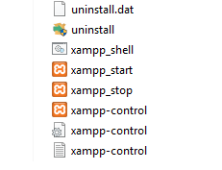
XAMPP Control Panel
(Apache & MySQL - Start, Restart, Stop)
d:/xampp/xampp-control.exe

Slide 6
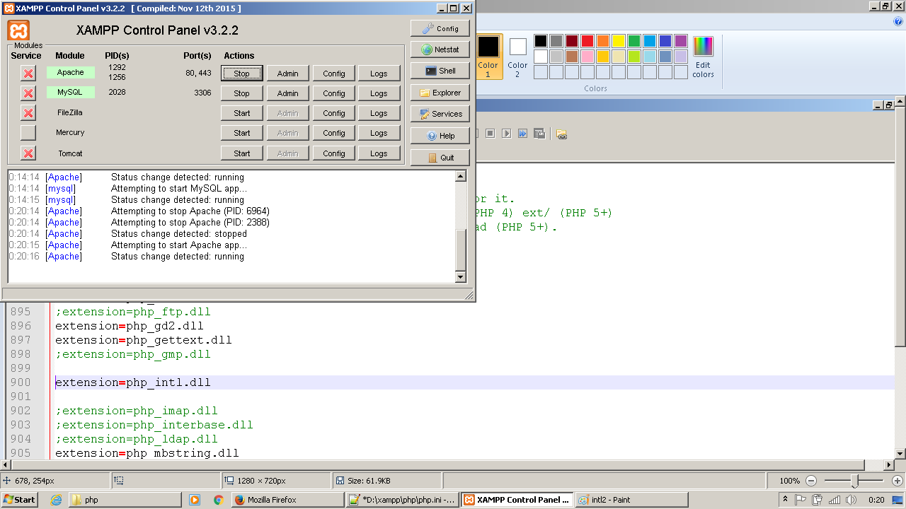
XAMPP Control Panel
(Apache & MySQL - Start, Restart, Stop)

Slide 7
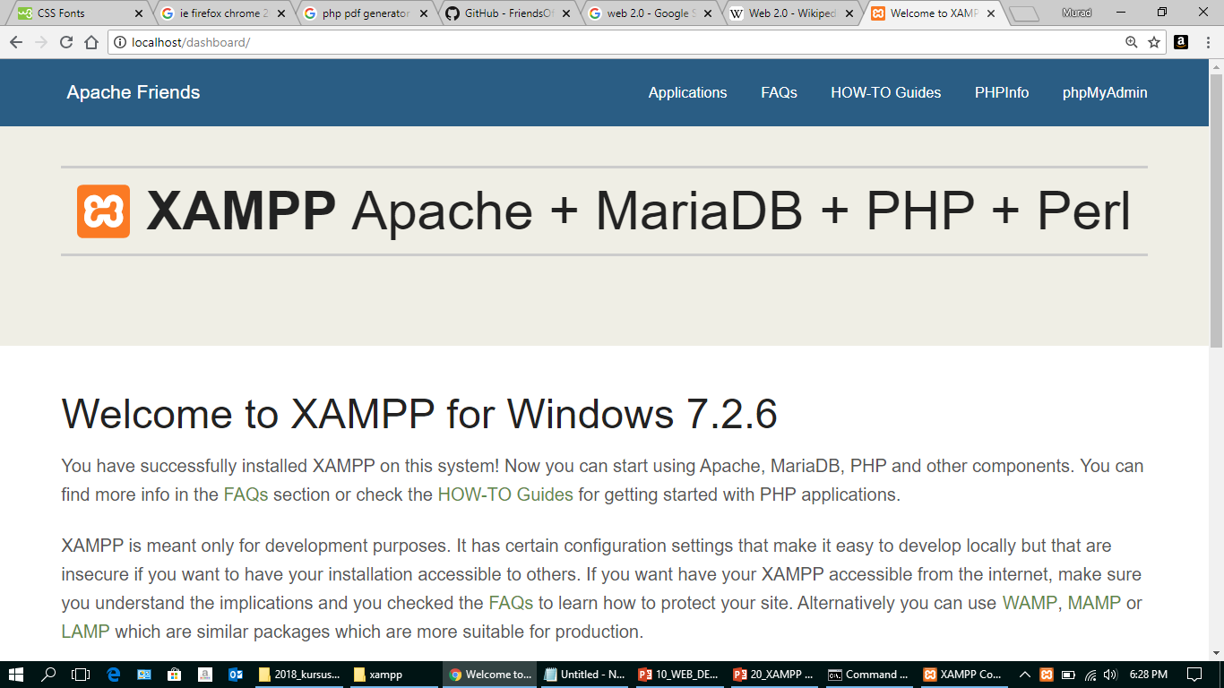
XAMPP default page
http://localhost/

Slide 8
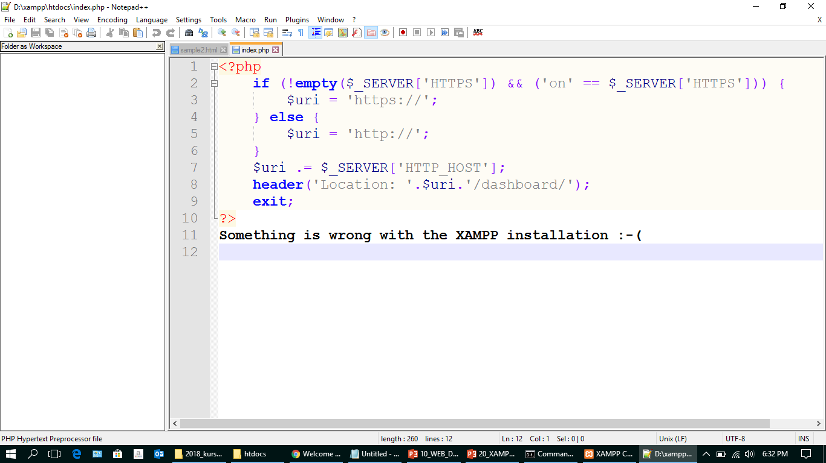
http://localhost
(page redirect)
Redirect to folder

Slide 9
APACHE CONFIGURATION
d:/xampp/apache/conf/*
d:/xampp/apache/conf/httpd.conf
d:/xampp/apache/conf/extra/httpd-default.conf

Slide 10
APACHE CONFIGURATION
d:/xampp/apache/conf/extra/httpd-default.conf
Line 55 :
ServerTokens Prod
Line 65 :
ServerSignature Off

Slide 11
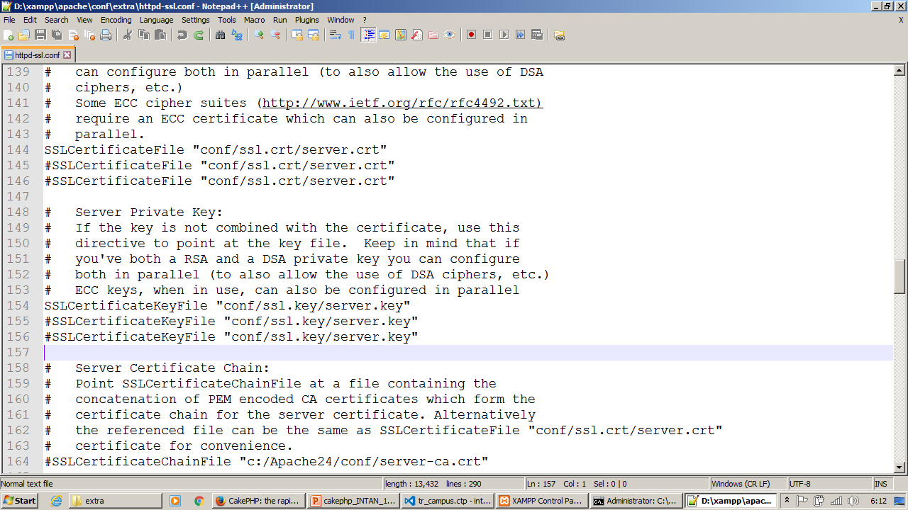
Apache HTTPS
https://localhost
server.crt
server.key

Slide 12
PHP CONFIGURATION
d:/xampp/php/php.ini
Line 369 :
expose_php=Off
Line 472 (Prod:off, dev:on):
display_errors=Off
Line 891 :
extension=intl

Slide 13
PHP CONFIGURATION
d:/xampp/php/php.ini
Line 665 :
post_max_size=8M
Line 818 :
upload_max_filesize=2M

Slide 14
APACHE CONFIGURATION
d:/xampp/apache/conf/extra/httpd-xampp.conf
Line 90, 91 :
Alias /phpmyadmin "D:/xampp/phpMyAdmin/"
<Directory "D:/xampp/phpMyAdmin">

Slide 15
MYSQL CONFIGURATION
d:/xampp/mysql/bin/my.ini

Slide 16
LINUX SERVER
UBUNTU SERVER

Slide 17
Ubuntu Server 18.04 LTS
*install virtual box
*install ubuntu server
apt install apache2 -y
apt install php libapache2-mod-php
apt mysql-server mysql-client -y
apt install curl -y
apt install nmap -y
apt install nikto -y

