Slide 1


Database Server
MariaDB, MySQL
https://mariadb.org/
https://www.mysql.com/

Slide 2
RDBMS - MariaDB
popular DB server
made by the original developers of MySQL
open source software (OSS)
Wikipedia, WordPress.com and Google.
Banking, websites
replacement for MySQL.
fast, scalable and robust,
rich ecosystem of storage engines, plugins
RDBMS - SQL interface for accessing data.
support GIS and JSON features.

Slide 3
Database Server - MariaDB
community-developed fork of the MySQL RDBMS
intended to remain free under the GNU GPL.
Development is led by some of the original developers of MySQL
forked it due to concerns over its acquisition by Oracle Corporation (2008).
MariaDB intends to maintain high compatibility with MySQL

Slide 4

Database, table, column, row
create, alter, index, select, insert, update, delete, where, group by, order by, limit, sum, ..
https://www.w3schools.com/sql/

Slide 5


MySQl GUI Tools
Workbench
Sequel Pro
HeidiSQL
phpMyAdmin

Slide 6
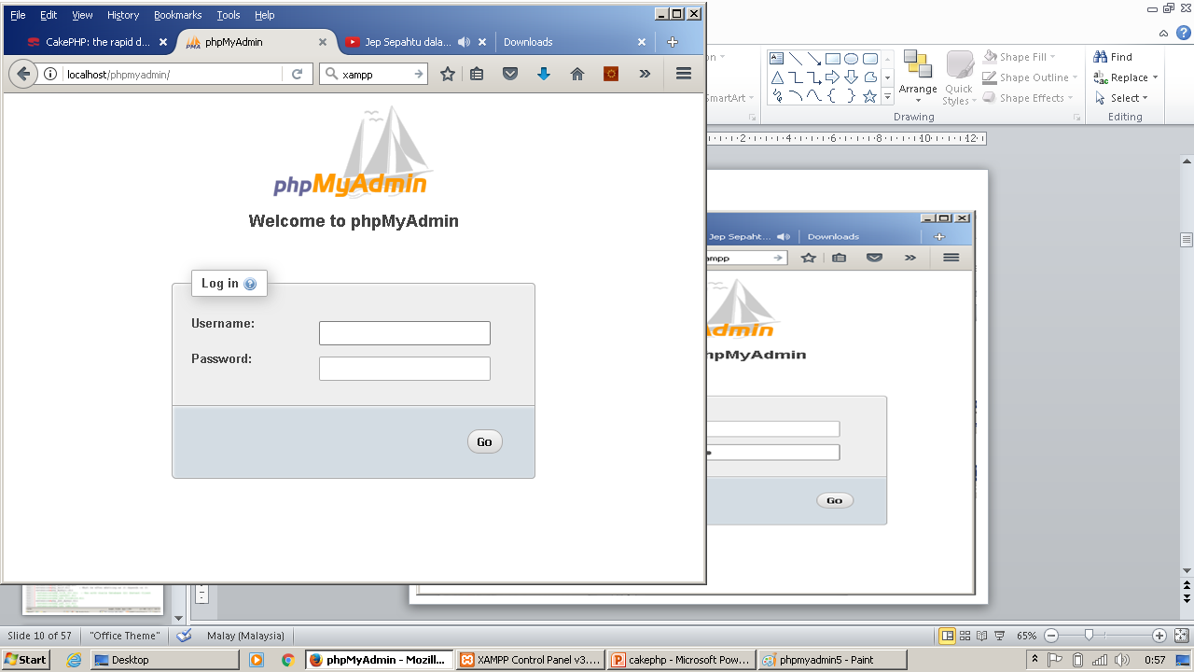
PHPMyAdmin
http://localhost/phpmyadmin/

Slide 7
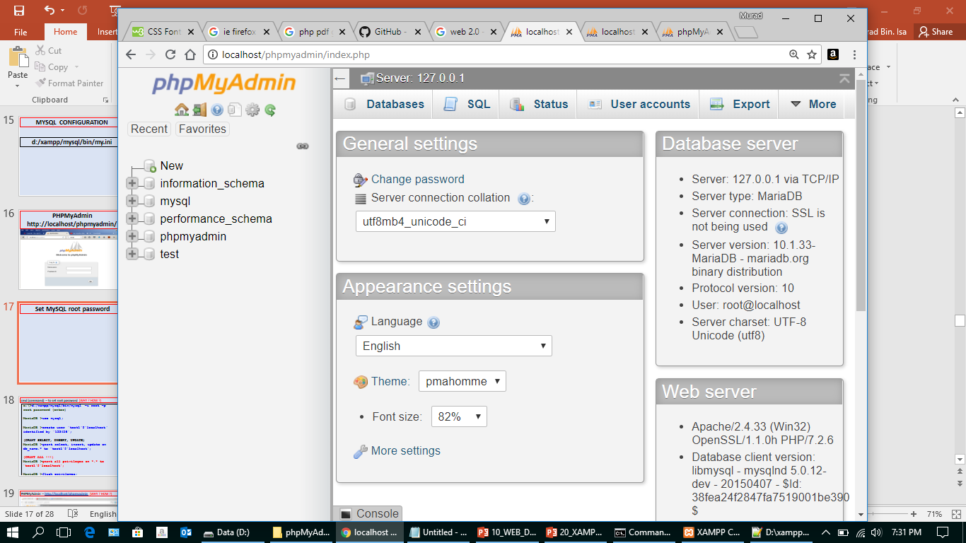
Set MySQL root password

Slide 8
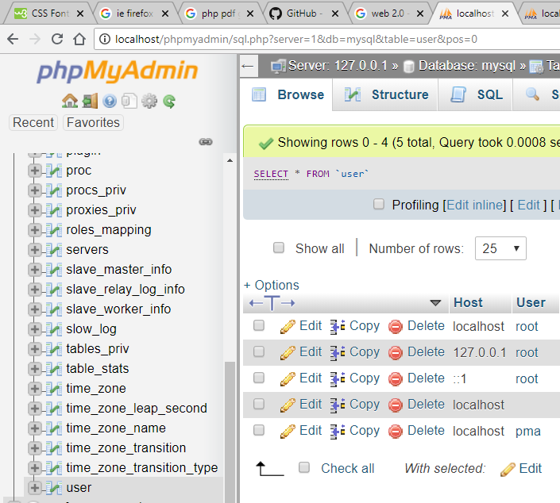
Set MySQL root password

Slide 9
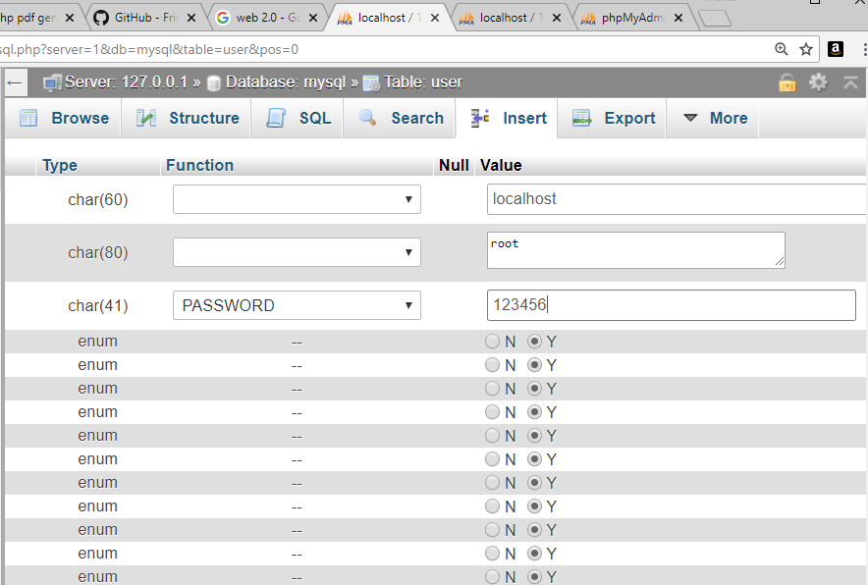
Set MySQL root password

Slide 10
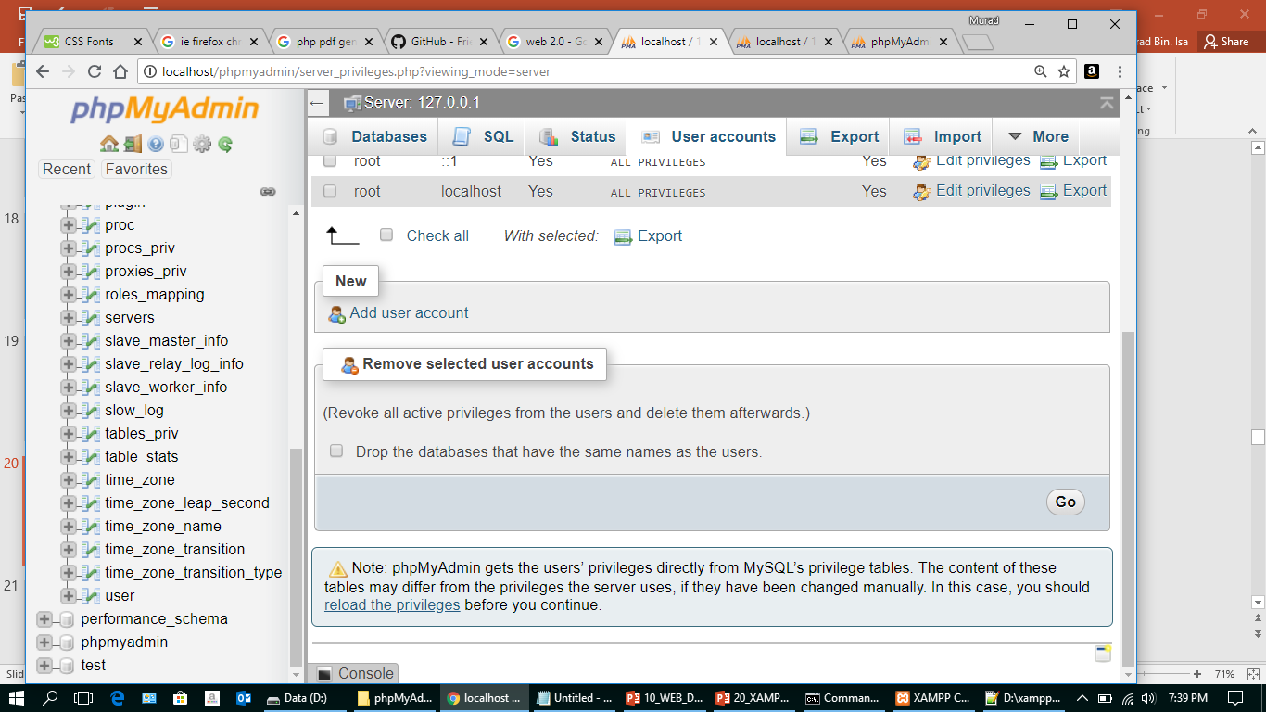
Set MySQL root password

Slide 11
PHPMyAdmin – http://localhost/phpmyadmin/
d:/xampp/phpMyAdmin/config.inc.php
Line 19 :
$cfg['Servers'][$i]['auth_type'] = 'http';
Line 23 :
$cfg['Servers'][$i]['AllowNoPassword'] = false;

Slide 12
PHPMyAdmin – http://localhost/phpmyadmin/
Logout,
Login (with root password)

Slide 13
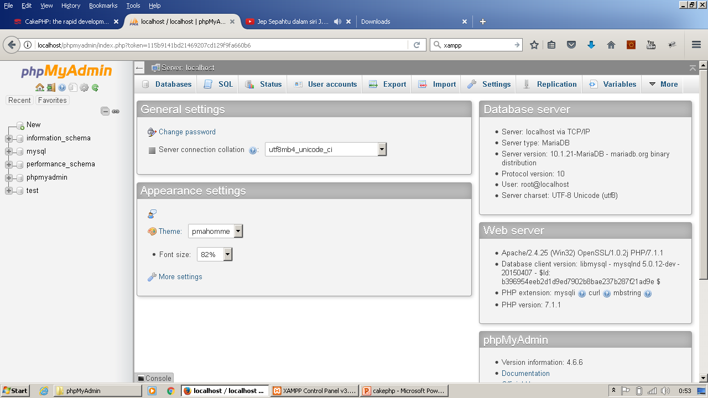
PHPMyAdmin – https://localhost/phpmyadmin/
database
Status
Export
Setting
SQL
User Account
Import
database
Version

Slide 14
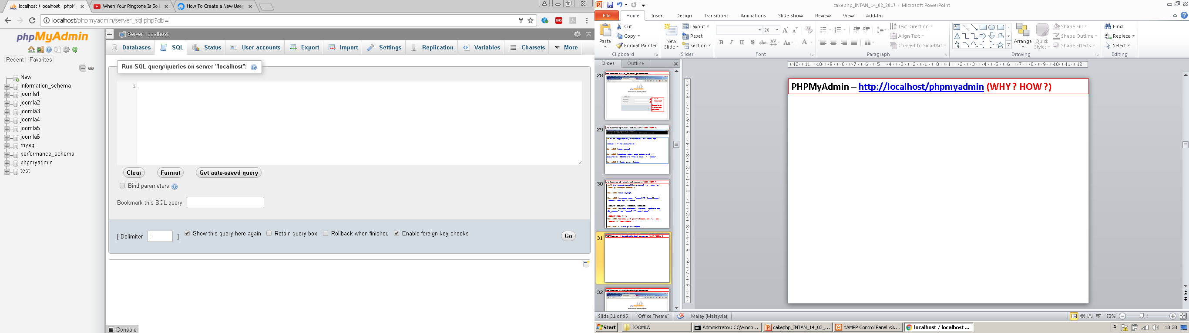
PHPMyAdmin – http://localhost/phpmyadmin
RUN SQL COMMAND IN PHPMYADMIN

Slide 15
PHPMyAdmin
http://localhost/phpmyadmin/
DEMO
Setting : root, password
Create : Database, Table
Create :user, password, privileges
Select MySQL Engine (MyIsam)
Column type -Integer, char, varchar, text, date, datetime,

Slide 16
PHPMyAdmin – https://localhost/phpmyadmin/
6. Primary Key
7. Foreign Key
8. Column : Indexing, unique
9. Auto Increment
10. Column : move column
11. Relationship (left join, inner join, full join, right join)
12. Login, logout, Menu,
13. Database list, Create Database,
14. Create table, Structure, db engine

Slide 17
PHPMyAdmin – https://localhost/phpmyadmin/
14. Data : Insert, Browse, edit, delete,
copy, SQL, Export, Import
15. Table : Alter, Move, Rename, Copy,
Delete, empty, delete
16. Convert data dari MS Excel to
MySQL

Slide 18
Auto increment keys vs. UUID
https://medium.com/@Mareks_082/auto-increment-keys-vs-uuid-a74d81f7476a

Slide 19
NEVER DELETE DATA IN A DATABASE ?
Rather, when its no longer needed, it's better to simply mark it or flag it as 'not in use / is_deleted'.
depends on the actual content of your database

Slide 20
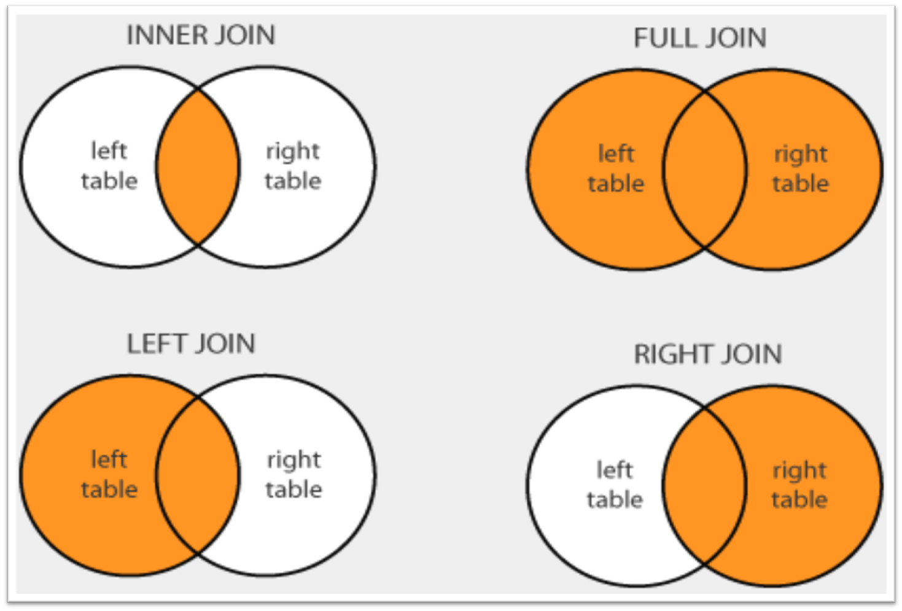
TABLE - JOIN TYPE
https://www.w3schools.com/sql/sql_join.asp
https://www.w3schools.com/sql/sql_join_inner.asp
https://www.w3schools.com/sql/sql_join_left.asp
https://www.w3schools.com/sql/sql_join_right.asp
https://www.w3schools.com/sql/sql_join_full.asp

Slide 21
TABLE - JOIN TYPE
MySQL LEFT JOIN
http://www.mysqltutorial.org/mysql-left-join.aspx

Slide 22
Load Data To MySQL
Web → Excel → MySQL
dbf → MySQL
PDF → MySQL

Slide 23
Task : 1. Create database 2. Create table
3. Type : varchar, datetime, int,.. 4. primary key
5. Foreign key
6. relationship
5. Auto increment

