Slide 1

https://www.tutorialrepublic.com/php-tutorial/
https://www.w3schools.com/php/php_mysql_connect.asp
https://www.tutorialrepublic.com/php-examples.php

Slide 2
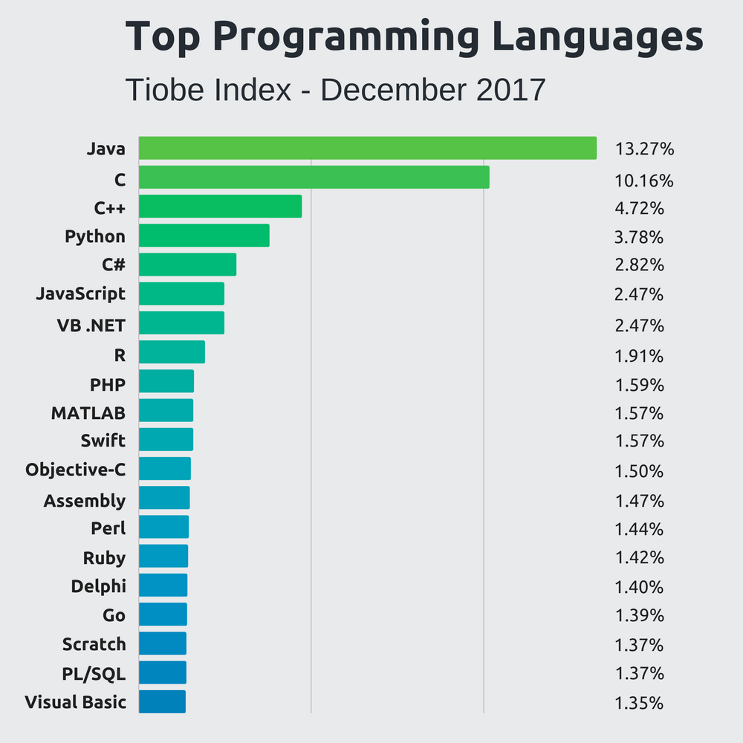

Slide 3
Programming languages used in most popular websites
https://en.wikipedia.org/wiki/Programming_languages_used_in_most_popular_websites
Websites | Front-end (Client-side) | Back-end (Server-side) | Database
Google.com^{[2]} | JavaScript | C, C++, Go,^{[3]} , Python, PHP (HHVM) | Bigtable,^{[4]} MariaDB^{[5]}
Facebook.com | JavaScript | Hack, PHP (HHVM), Python, C++, Erlang, D,^{[6]} XHP,^{[7]} Haskell^{[8]} | MariaDB, MySQL,^{[9]} HBase, Cassandra^{[10]}
YouTube.com | JavaScript | C, C++, Python, ^{[11]} Go^{[12]} | Vitess, BigTable, MariaDB^{[5][13]}
Yahoo | NodeJS, JavaScript | C, C++, PHP, GO, Ruby | MySQL, PostgreSQL, HBase, Cassandra, MongoDB,^{[14]}
Amazon.com | JavaScript | C++, Perl^{[16]} | Oracle Database^{[17]}
Wikipedia.org | JavaScript | PHP, Hack | MariaDB^{[18]}
Twitter.com | JavaScript | C++, Scala, Ruby^{[19]} | MySQL^{[20]}
Bing | JavaScript | C# | Microsoft SQL Server
eBay.com | JavaScript | ^{[21]} JavaScript,^{[22]} Scala^{[23]} | Oracle Database
MSN.com | JavaScript | C# | Microsoft SQL Server
Microsoft | JavaScript | C# | Microsoft SQL Server
Linkedin.com | JavaScript | JavaScript,^{[24]} Scala | Voldemort^{[25]}
Pinterest | JavaScript | Django,^{[26]} Erlang | MySQL, Redis ^{[27]}
WordPress.com | JavaScript | PHP, JavaScript ^{[28]} | MariaDB, MySQL

Slide 4
PHP: Hypertext Preprocessor
open source server-side scripting language
embedded with HTML web pages.
dynamically generated web pages.
PHP scripts are executed on the server. result sent to the browser as HTML.
integrated with databases (MySQL, PostgreSQL, Oracle, Sybase, Informix, MSSQL Server)

Slide 5
PHP: Hypertext Preprocessor
Easy to learn
Open source. free.
Portability. runs on various platforms (MS Windows, Linux, Mac)
compatible with all web servers (Apache, NGINX, IIS)
Fast Performance.
Documentation. Tutorial. Community.

Slide 6
Native PHP / Raw PHP
vs PHP Framework
https://www.carmatec.com/blog/raw-php-vs-php-frameworks/
https://code.tutsplus.com/tutorials/should-you-use-a-php-framework-five-pros-and-cons--cms-28905

Slide 7
PHP Standards Recommendations
(PSR)
https://www.php-fig.org/psr/

Slide 8
7 problems that might prevent your PHP code from being awesome
https://phpenthusiast.com/blog/7-problems-that-may-prevent-your-PHP-code-from-being-awesome

Slide 9
PHP Function
http://php.net/manual/en/indexes.functions.php
https://www.guru99.com/functions-in-php.html

Slide 10
PHP Built-in Functions
huge collection of internal or built-in functions
to perform a specific task
gettype(), print_r(), var_dump, substring, strlen,…
*check out PHP Doc

Slide 11
PHP User-Defined Functions
reduces the repetition of code
easier to maintain code — any changes made inside a function
fixing errors becomes much easier
Functions can be reused in other application

Slide 12
PHP User-Defined Functions
<?php
// Defining function
function getSum($num1, $num2)
{
$sum = $num1 + $num2;
echo "Sum of $num1 and $num2 is : ". $sum;
}
// Calling function
getSum(10, 20);
?>

Slide 13
PHP User-Defined Functions
<?php
// Defining function
function getSum($num1, $num2)
{
$total = $num1 + $num2;
return $total;
}
// Printing returned value
echo getSum(5, 10); // Outputs: 15
?>

Slide 14
PHP – Built In Functions
https://matthewhorne.me/learning-php-101-built-in-functions/
the length of a String
<?php
$name = "Matthew ";
echo strlen($name); // 8
?>
<?php
$name = "Matthew ";
echo substr($name, 0, 5); // Matth
echo substr($name, 2,2); // tt
?>
<?php
$name = "Matthew ";
echo strtoupper($name); // MATTHEW
echo strtolower($name); // matthew
?>

Slide 15
PHP – Built In Functions
<?php
$name = "Matthew ";
echo strpos($name, "M"); // 0
echo strpos($name, "hew"); // 4
echo strpos($name, "m"); // false
?>
<?php
$number = 3.55776232;
echo
round($number) . "<br/>". // 4
round($number, 1) . "<br/>". // 3.6
round($number, 3) . "<br/>"; // 3.558
?>

Slide 16
Function : var_dump() vs print_r()
$obj = ['qualitypoint', 'technologies', 'India'];
var_dump();
object(stdClass)#1 (3) {
[0]=> string(12) "qualitypoint"
[1]=> string(12) "technologies"
[2]=> string(5) "India“
}
print_r($bbb);
stdClass Object (
[0] => qualitypoint
[1] => technologies
[2] => India
)

Slide 17
PHP JSON Parsing
encode and decode JSON data in PHP.
JSON (JavaScript Object Notation)
standard lightweight data-interchange format which is quick and easy to parse and generate.
https://www.tutorialrepublic.com/php-tutorial/php-json-parsing.php
http://localhost/cakephp367/qt-quotes/index.json
http://localhost/cakephp367/qt-quotes/index.xml
http://localhost/php_json/1_courses_list_with_json.php

Slide 18
PHP - Indexed Arrays
<?php
// Define an indexed array
$colors = ["Red", "Green", "Blue“];
echo $colors[0]; // Red
echo $colors[1]; // Green
echo $colors[2]; // Blue
?>

Slide 19
PHP - Associative Arrays
<?php
// Define an associative array
$ages = ["Peter"=>22, "Clark"=>32, "John"=>28];
echo $ages["Peter"]; // 22
echo $ages["Clark"]; // 32
echo $ages["John"]; // 28
?>

Slide 20
PHP - Multidimensional Arrays
<?php
// Define a multidimensional array
$contacts = [
[
"name" => "Peter Parker",
"email" => "peterparker@mail.com",
],
[
"name" => "Clark Kent",
"email" => "clarkkent@mail.com",
],
[
"name" => "Harry Potter",
"email" => "harrypotter@mail.com",
]
];
// Access nested value
echo "Name:".$contacts[0]['name']." Email:".$contacts[0]["email"]."<br>";
echo "Name:".$contacts[1]['name']." Email:".$contacts[1]["email"]."<br>";
?>

Slide 21
Sending Information to Server. HTTP GET, HTTP POST
GET method : . $_GET
the data is sent as URL parameters. name and value pairs. HTML form. method="get".
http://www.example.com/action.php?name=john&age=24
$_GET["name"]; // john
$_GET["age"]; // 24

Slide 22
Sending Information to Server. HTTP GET, HTTP POST
Advantages and Disadvantages of Using the GET Method
data sent by the GET method are displayed in the URL, it is possible to bookmark the page with specific query string values.
not suitable for passing sensitive information. fully visible in the URL
length of the URL is limited. limitation for data to be sent.

Slide 23
The POST Method
Advantages and Disadvantages of Using the POST Method
POST method. $_POST. the data is sent as a package in a separate communication with the processing script.
Data sent not visible in the URL.
more secure. Sent data never visible in the URL query string, server logs.
much larger limit on the amount of data that can be passed and one can send text data / binary data (uploading a file)
not possible to bookmark the page with specific query.

Slide 24
Require VS Include
require
include
require_once (use server resources)
include_once (use server resources)

Slide 25
PHP File Upload
Contoh : https://www.tutorialrepublic.com/php-tutorial/php-file-upload.php

Slide 26
PHP Sessions
<?php
// Starting session
session_start();
// Storing session data
$_SESSION["firstname"] = "Peter";
$_SESSION["lastname"] = "Parker";
?>
https://www.tutorialrepublic.com/php-tutorial/php-sessions.php

Slide 27
Display PHP Error
ini_set('display_errors', 0);
ini_set('display_startup_errors', 0);
error_reporting(E_ALL);
*However, this doesn't make PHP to show parse errors - the only way to show those errors is to modify your php.ini :
display_errors = on

Slide 28
MySQL, MariaDB
most popular RDBMS
free
easy to install, use
extremely powerful
fast
Secure
scalable.
runs on UNIX, Linux, MS Windows, OS X, ..
supports for small, large applications.
data security layers that protect sensitive data from intruders.

Slide 29
Talking to MySQL, MariaDB Databases with SQL
SQL (Structured Query Language)
standardized language for RDBMS
creating databases and tables
save (insert) data
query (select) database for specific records,
deleting (delete) data
updating (update) data

Slide 30
PHP - MySQL
Object Oriented
Procedural
PDO (PHP Data Objects)
https://www.tutorialrepublic.com/php-tutorial/php-mysql-select-query.php

Slide 31
PHP Connect to MySQL Server
MySQLi (Improved MySQL)
supports MySQL only
to switch project to use another database, need to rewrite the entire code
easier way to connect, execute queries
provides speed and feature (compare to PDO)
better choice for MySQL-specific projects.
offers a procedural API (easier for beginner)
offer an object-oriented API
support Prepared Statements (protect from SQL injection)

Slide 32
PHP Connect to MySQL Server
PDO (PHP Data Objects)
more portable and supports more than 12 different DB
to switch project to use another database, PDO makes the process easy.
offer an object-oriented API
support Prepared Statements (protect from SQL injection)

Slide 33
Connecting to MySQL Database Server
MySQLi, Procedural way
$link = mysqli_connect("hostname", "username", "password", "database");
MySQLi, Object Oriented way
$mysqli = new mysqli("hostname", "username", "password", "database");
PHP Data Objects (PDO) way
$pdo = new PDO("mysql:host=hostname;dbname=database", "username", "password");
https://www.tutorialrepublic.com/php-tutorial/php-mysql-select-query.php

Slide 34
PHP - MySQL
Insert Data
Update Data
Delete Data
Select Data
http://blog.chapagain.com.np/php-crud-add-edit-delete-view-application-using-oop-object-oriented-programming/
https://www.codeofaninja.com/2014/06/php-object-oriented-crud-example-oop.html
https://www.codexworld.com/php-crud-operations-with-mysqli-extension/
https://www.sourcecodester.com/tutorials/php/11119/oop-php-crud-operation-using-mysqli-part-1.html

Slide 35
<?php
// Create connection
$conn = new mysqli("localhost","username","password","dbname");
// Check connection
if ($conn->connect_error) {
die("Connection failed: " . $conn->connect_error);
}
$sql = "INSERT INTO MyGuests (firstname, lastname, email) VALUES ('John', 'Doe', 'john@example.com')";
if ($conn->query($sql) === TRUE) {
echo "New record created successfully";
} else {
echo "Error: " . $sql . "<br>" . $conn->error;
}
$conn->close();
?>
Example : MySQLi (Object-oriented)

Slide 36
SECURITY
Authentication :
process of identifying yourself.
When you log in to a service, you authenticate yourself by using some credentials. This credentials usually are a pair of username and password. If the provided credentials are correct then we can say that you have successfully authenticated yourself.
Authorization :
process of checking if you have the right to do something.
To do this, first you have to authenticate yourself, because without knowing who you are it is not possible for someone to check if you have the right to do something or not.

Slide 37
SECURITY
Why are common hashing functions such as md5() and sha1() unsuitable for passwords?
Hashing algorithms such as MD5, SHA1 and SHA256 are designed to be very fast and efficient. With modern techniques and computer equipment, it has become trivial to "brute force" the output of these algorithms, in order to determine the original input.
Because of how quickly a modern computer can "reverse" these hashing algorithms, many security professionals strongly suggest against their use for password hashing.

Slide 38
SECURITY
Use Bcrypt or Scrypt Instead of SHA* for Your Passwords, Please!
TL;DR; SHA1, SHA256, and SHA512 are all fast hashes and are bad for passwords.
SCRYPT and BCRYPT are both a slow hash and are good for passwords.
https://rietta.com/blog/2016/02/05/bcrypt-not-sha-for-passwords/

Slide 39
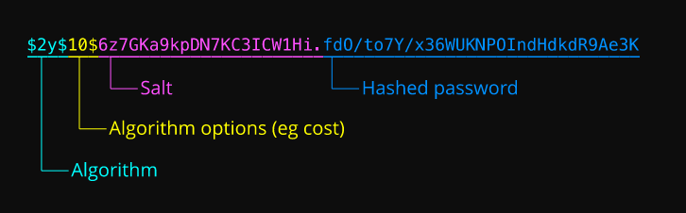
SECURITY
Secure Login Menggunakan Bcrypt Di Php
https://aguzrybudy.blogspot.com/2017/04/secure-login-menggunakan-bcrypt-di-php.html

Slide 40
SECURITY
captcha
https://www.phpcaptcha.org/
https://github.com/yasirmturk/simple-php-captcha
https://www.w3schools.in/php-script/captcha/
https://labs.abeautifulsite.net/simple-php-captcha/

Slide 41
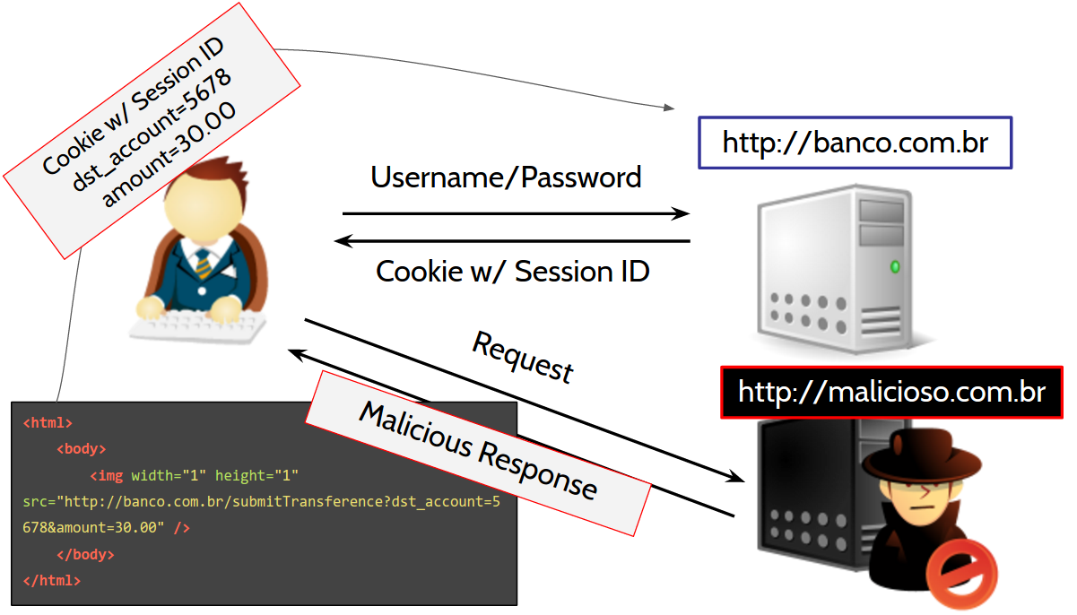
SECURITY
CSRF (Cross-site Request Forgery)
attack that forces an end user to execute unwanted actions on a web application in which they're currently authenticated.

Slide 42
SECURITY
CSRF (Cross-site Request Forgery)
Including a random token with each request
Using a random name for each form field.
https://www.webhostinghero.com/protect-php-forms-from-csrf-attacks/
https://www.wikihow.com/Prevent-Cross-Site-Request-Forgery-(CSRF)-Attacks-in-PHP

Slide 43
Security : SQL injection
What is wrong with this query : "SELECT * FROM table WHERE id = $_POST[ 'id' ]"
It is vulnarable to SQL injection. Never use user input directly in queries. Sanitize it first. Preferebly use prepared statements (PDO).
Don't select all columns (*), but specify every single column. This is predominantly ment to prevent queries hogging up memory when for instance a BLOB column is added at some point in the future.

Slide 44
SECURITY
Prevent SQL injection vulnerabilities in PHP applications and fix them
https://www.acunetix.com/blog/articles/prevent-sql-injection-vulnerabilities-in-php-applications/
http://packetcode.com/article/preventing-sql-injection-php-security
*Then try to learn PDO to take advantage of prepared statements and portability across database vendors.

Slide 45
How to prevent SQL injection in PHP?
$unsafe_variable = $_POST['user_input'];
mysql_query("INSERT INTO `table` (`column`) VALUES ('$unsafe_variable')");
*user can input something like value'); DROP TABLE table;--, and the query becomes:
INSERT INTO `table` (`column`) VALUES('value'); DROP TABLE table;--')
What can be done to prevent this from happening?

Slide 46
How to prevent SQL injection in PHP?
Use prepared statements and parameterized queries.
These are SQL statements that are sent to and parsed by the database server separately from any parameters. This way it is impossible for an attacker to inject malicious SQL.

Slide 47
Using MySQLi
$stmt = $dbConnection->prepare('SELECT * FROM employees WHERE name = ?');
$stmt->bind_param('s', $name);
// 's' specifies the variable type => 'string'
$stmt->execute();
$result = $stmt->get_result();
while ($row = $result->fetch_assoc())
{
// do something with $row
}

Slide 48
Using PDO (for any supported database driver):
$stmt = $pdo->prepare('SELECT * FROM employees WHERE name = :name');
$stmt->execute(array('name' => $name));
foreach ($stmt as $row) {
// do something with $row
}

Slide 49
MySQL Improved Extension
http://php.net/manual/en/book.mysqli.php
Why You Should Be Using PHP's PDO for Database Access
https://code.tutsplus.com/tutorials/why-you-should-be-using-phps-pdo-for-database-access--net-12059

Slide 50
SECURITY
XSS (Cross-Site Scripting)
Escaping user input - htmlentities()
validating input
sanitizing
https://www.owasp.org/index.php/XSS_%28Cross_Site_Scripting%29_Prevention_Cheat_Sheet
https://www.netsparker.com/blog/web-security/cross-site-scripting-xss/

Slide 51
How to Validate (and Sanitize) User Input In PHP Using Filter_Input() and Filter_Var()
https://www.johnmorrisonline.com/validate-sanitize-user-input-php-using-filter_input-filter_var/
Preventing XSS
http://packetcode.com/article/preventing-xss-attack-php-security

Slide 52
XSS - htmlentities();
<?php
function safe( $value ) {
htmlentities( $value, ENT_QUOTES, 'utf-8' );
// other processing
return $value;
}
// retrieve $title and $message from user input
$title = $_POST['title'];
$message = $_POST['message'];
// and display them safely
print '<h1>' . safe( $title ) . '</h1>
<p>' . safe( $message ) . '</p>';
?>

