Slide 1
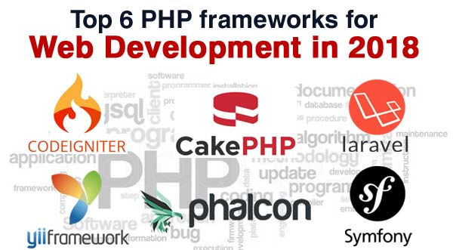
PHP Frameworks

Slide 2
Spaghetti code
source code that has a complex and tangled control structure (twisted and tangled)
caused by several factors, such as continuous modifications by several people with different programming styles over a long life cycle.
PHP file : PHP + SQL + HTML

Slide 3
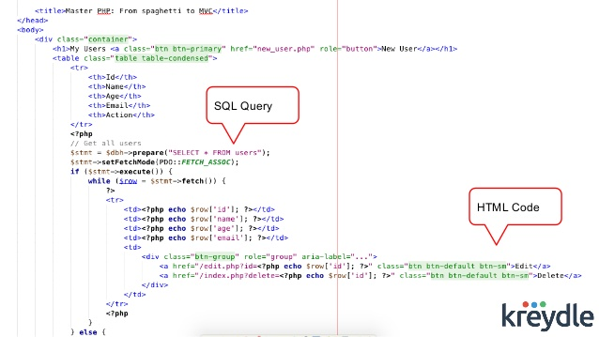
Spaghetti code

Slide 4
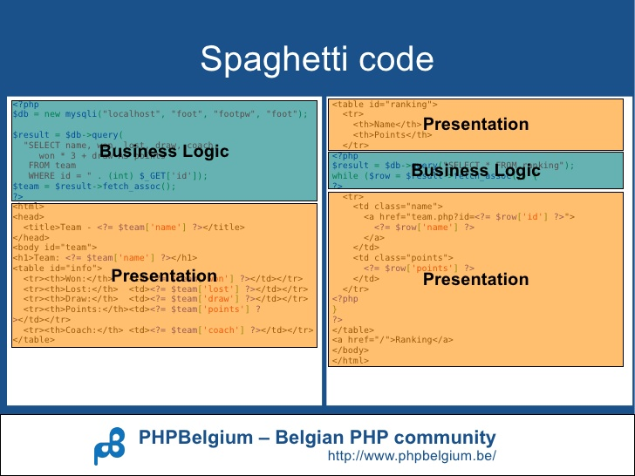
Spaghetti code ?

Slide 5
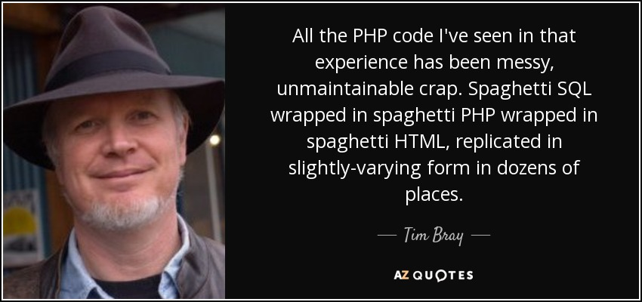
Spaghetti PHP Code

Slide 6
100 Signs that I May Be Writing Spaghetti PHP Code
https://viralsolani.wordpress.com/2010/09/18/100-signs-that-i-may-be-writing-spaghetti-php-code/

Slide 7
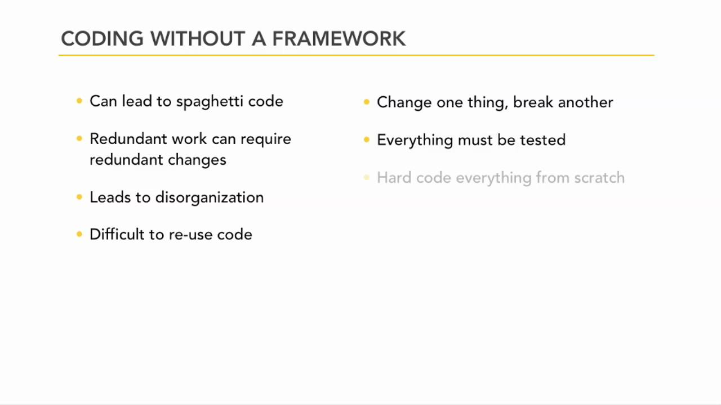

Slide 8
PHP Frameworks

Slide 9
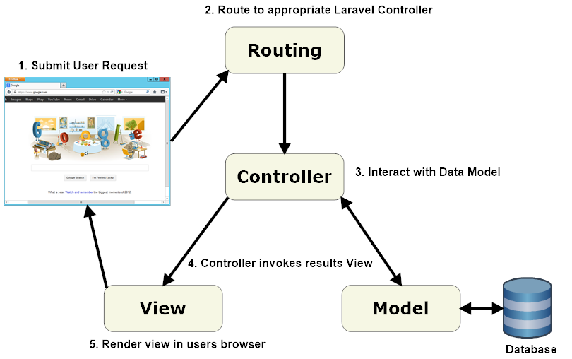
MVC (MODEL – VIEW – CONTROLLER)

Slide 10
MVC (Model, View, Controller)
separate business logics and presentation layer (user interface)
code cleaner and extensible.
Models : data structures, database.
Views : page templates and output.
Controllers : page requests, bind everything

Slide 11
Why PHP Framework ?
code better and faster
Write Less Code
rapid developement
provides with code base
Enforcing of Good Coding Standards
folder structure for code management
easier maintenance
structure consistent and maintainable
follow the same standards
everything organized in a certain way

Slide 12
Why Framework ?
separate business logics and presentation layer of your website, making its structure consistent and maintainable.
easy to chase down bugs, maintain code, and make changes to the existing code.
Performance Tools / debug tool
Efficiently Access Database
Community Support
Simplified and Pretty URLs (good for SEO)
easier and robust way to develop applications.

Slide 13
Why PHP Framework ?
Utilities and Libraries
Form Validation
SOAP/REST API
Caching Mechanism
Input/Output Filtering
Data Handle With JSON
Database Abstraction
Session and Cookie Handling
Email, Calendar, Pagination, etc…

Slide 14
Why PHP Framework ?
Security
Central Authentication
SQL injection Protection
Central input validation and filtering
Cross Site Request Forgery (CSRF) Protection
Session Management Security
Cross Site Scripting (XSS) Protection

Slide 15

Why Laravel Is The Best PHP Framework In 2018?
https://www.valuecoders.com/blog/technology-and-apps/laravel-best-php-framework-2017/

Slide 16
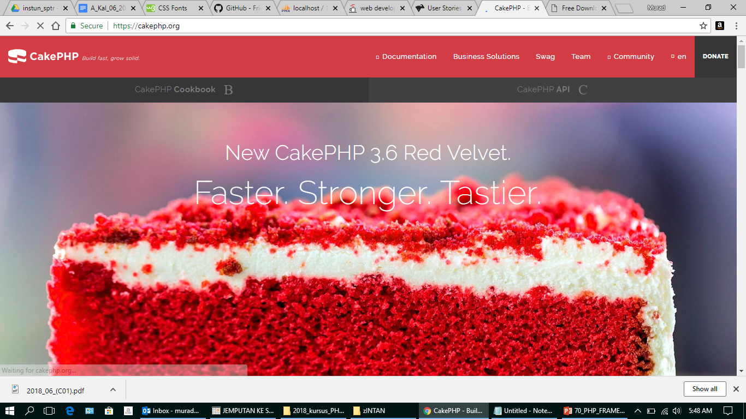
CakePHP – https://cakephp.org

Slide 17
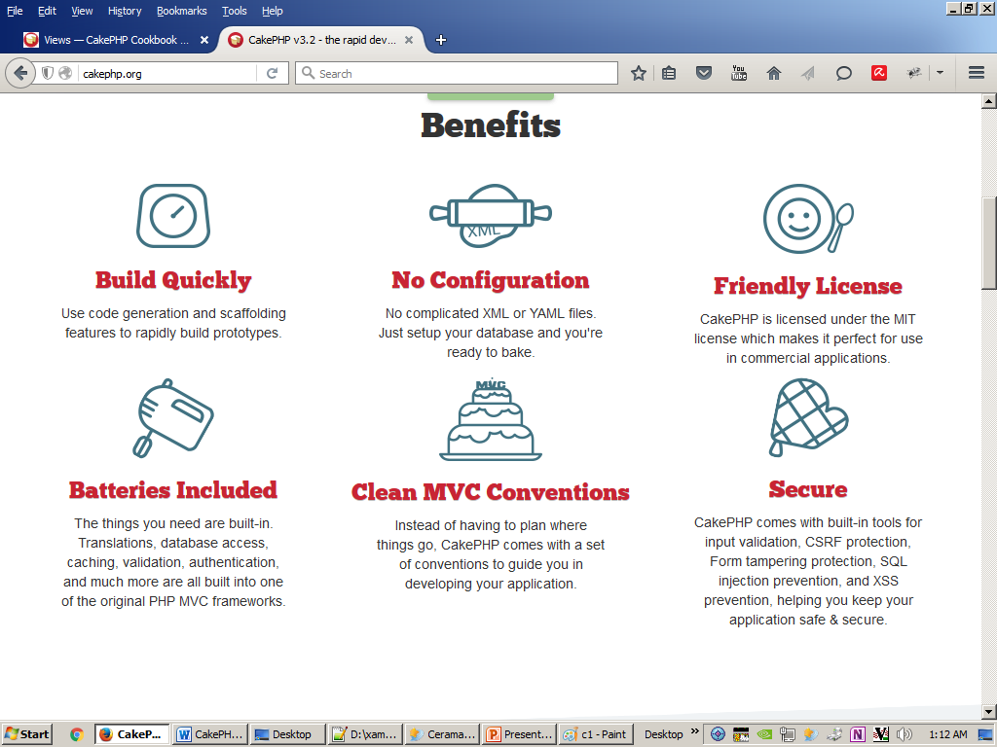
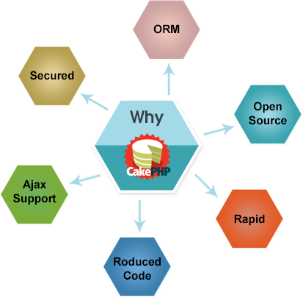
CakePHP

Slide 18
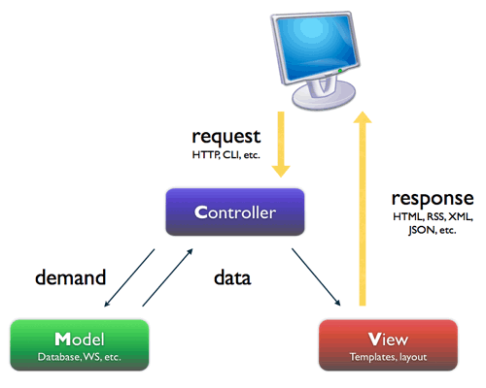
Model–view–controller

Slide 19
CAKEPHP
DEMO

Slide 20
CAKE BAKE COMMAND
D:\xampp\htdocs\dev\cakephp367>
d:/xampp/php/php d:/xampp/htdocs/dev/cakephp367/bin/cake.php bake all
D:\xampp\htdocs\dev\cakephp367>
d:/xampp/php/php d:/xampp/htdocs/dev/cakephp367/bin/cake.php bake all qt_quotes

Slide 21
CAKE BAKE COMMAND
D:\xampp\htdocs\dev\cakephp367>
d:/xampp/php/php d:/xampp/htdocs/dev/cakephp367/bin/cake.php bake all -c profile
D:\xampp\htdocs\dev\cakephp367>d:/xampp/php/php d:/xampp/htdocs/dev/cakephp367/bin/cake.php bake all -c profile

