Slide 1

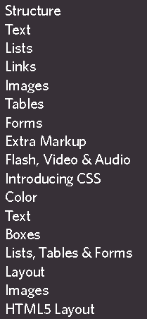
https://www.w3schools.com/Html/

Slide 2

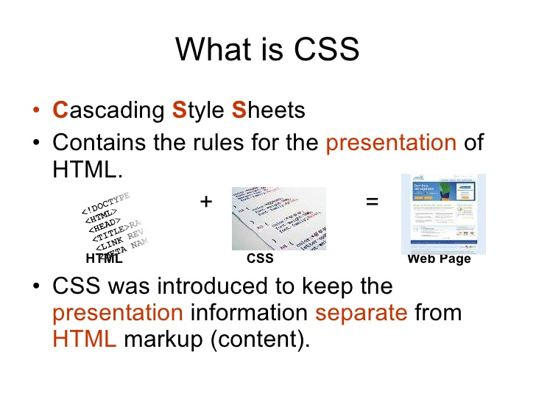
https://www.w3schools.com/css/default.asp

Slide 3

Top 5 Responsive CSS Framework
https://www.themexpert.com/blog/top-5-responsive-css-framework
The most popular HTML, CSS, and JS library.
https://getbootstrap.com/docs/4.1/getting-started/introduction/

