Slide 1


Slide 2
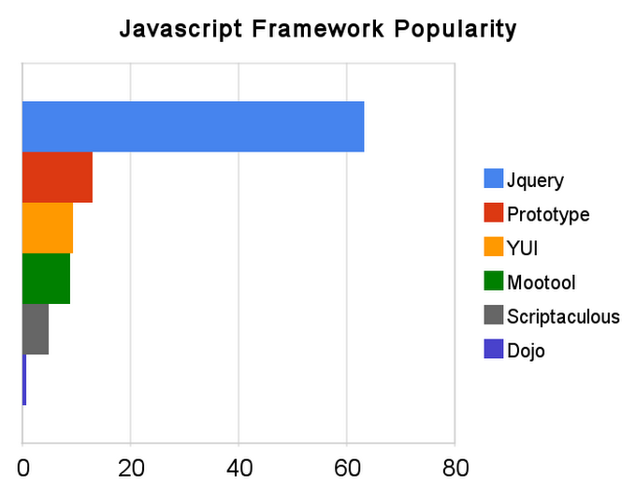

Slide 3

Hide/show,
fade,
Slide,
Animate,
stop(),
callback,..

Slide 4


