Slide 1
Virus Attacking
Yoann

Slide 2

Story
The Zika-Mosquitos are attacking KAIST.
Gladly Prof. Harry has invented controllable giant Hornets to defend and and attack them.
Controll your swarm in order to anhilate the Mosquito nest!

Slide 3


User Interface
Units: 30/100

Slide 4
Concept
Multiplayer
Network
Realtime-Synchronization
Singleplayer
AI
Develop individual strategies
Complex maps, with obstacles and special buildings

Slide 5
Cube Room
Hyunho Ha

Slide 6


Story
You’re stuck in the cube
This room will be destroyed!
You have to move another room!
If you click a wrong door…

Slide 7
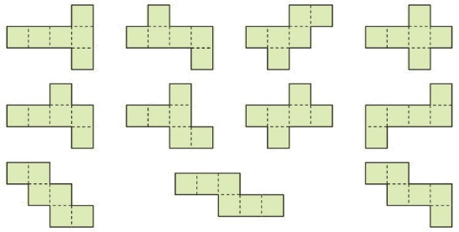
How to play
You’re in the cube, you can see other cube’s face by rotate a phone.
So, You can click total 6 doors.
Solution will be given by the planar figure.
Match with cube using arrow, find the right door.
Arrow doesn’t mean that answer is there.
Escape fixed number of cube with in time.
Various planar figure

Slide 8
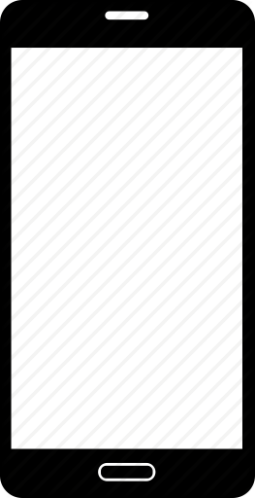
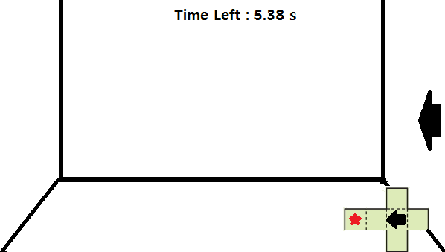
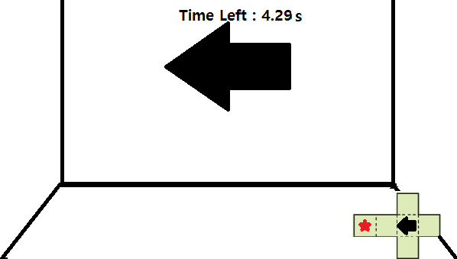
User Interface

Slide 9

Conceptual Diagram
Single Player
Smart Phone
Sensor
Touch
Rotate
Data
Visualization
Cube Room

Slide 10
System Design
Room
Camera
OpenGL
Room
Room Information
Direction Data
Android
Compass
Room Class
Gyroscope
Acceleration Sensor
Planar figure
Exit
Touch Sensor

Slide 11
Alien Tower Defense
Namjo Ahn

Slide 12
Story
You are a space security guard of the grade A+
Someday, the aliens starts invading us.
They are called “The Profs”.
The Profs are now sending many many assignments.
You have to protect your grade from the invasion by the Profs…

Slide 13
Game Logic
Tilt, rotate device -> Actual view rotation
Click button -> Fire
Direct hit(Laser)
Objectile(Missile)
Modes
Standard - waves
Endless
Boss rush

Slide 14




User Interface
A
B

Slide 15


Conceptual Model
model
data
View
Control
Model
Game
Logic
Rendered
screen
Motion

Slide 16
System Design
User
Rotation, touch event
Screen
Physical device
Measurements
View
Main routine
Rendered
View
Pass essential datas
Process Input
Game logic control
Request OpenGL Render
Manage
Objects

Slide 17
Trash
Alevtina

Slide 18
Game Logic & Story
Tilt -> Aim Change
Slide -> Throw!
Simple scoring
Trash anything you want!
You can apply any kind of images to the ball

Slide 19
User Interface

Slide 20
Conceptual Model
model
data
View
Control
Model
Game
Logic
Rendered
screen
Motion

Slide 21
System Design
User
Rotation, touch event
Screen
Physical device
Measurements
View
Main routine
Rendered
View
Pass essential datas
Process Input
Game logic control
Request OpenGL Render
Manage
Objects

Slide 22
(Someone’s face..?)

