Slide 1
Ethical hacking internship
Murageshgouda G F

Slide 2
Task : 03
Title : cross site scripting
Domain :vulnweb.com
Subdomain: testasp.vulnweb.com
Steps:
Step 1: first I Visited the http://testasp.vulnweb.com/ website
Step 2: On that home page in top menu I found search option
Step 3: I clicked on it and I prompted with a search box.
Step 4: Later I used a XSS payload and typed inside a search bar
Step 5: I got payload from github.com
I used <script>alert(document.cookies)</script>
Step 6: I used Burpsuite and send the requests to intruder and pasted all the
payloads whichever copied from the github.com
Step 7: I found successful payload for XSS

Slide 3
Impact :
XSS can have huge implications for a web application and its users.
User accounts can be hijacked,
credentials could be stolen,
sensitive data could be exfiltrated,
access to your client computers can be obtained.
It is harmful for the Website/Organization because with XSS user data can be stolen.

Slide 4
Mitigation
Mitigations for XSS typically involve sanitizing data input (to make sure input does not contain any code), escaping all output (to make sure data is not presented as code),
re-structuring applications so code is loaded from well-defined endpoints
If you want safety of your website vulnerable of XSS (cross site scripting )then just block the user for scripting on browser.

Slide 5
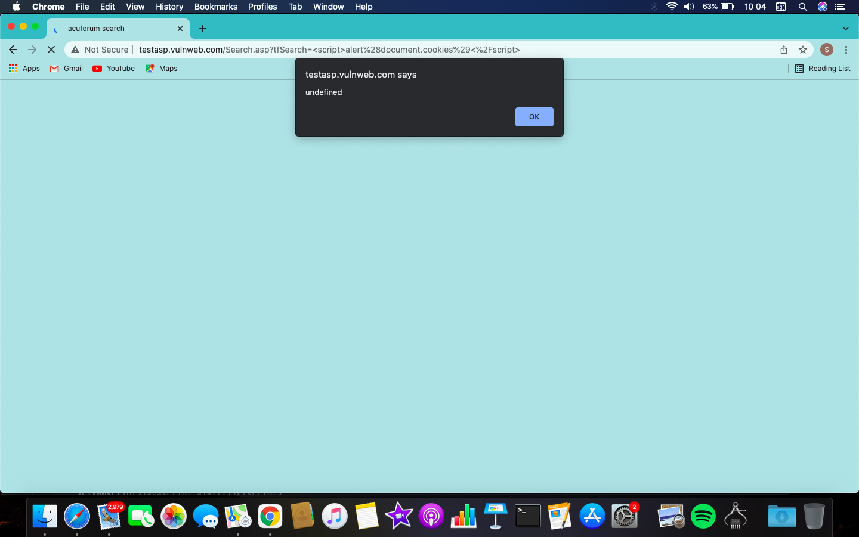
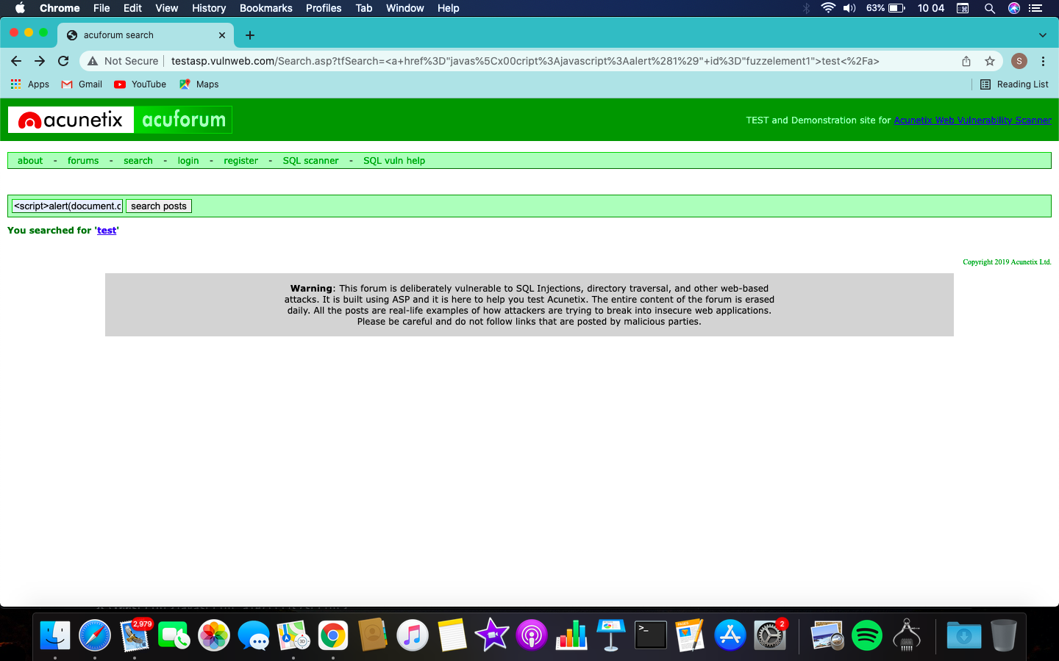
Screenshots :
XSS payload used :<script>alert(document.cookies)</script>

Slide 6
Gratitude
Its an amazing platform to learn Ethical Hacking i AM very much thankful to entire team of Internship studio .
We learned many things which we have to aware in day todays life .we looking forward to learn much more things from you.
Thank you

