Slide 1

TRACKING CHARITY DONATION USING BLOCKCHAIN
Malla Reddy College of Engineering & Technology (MRCET)
Department of Information Technology
Batch No: 07
CH.MURAHARI 21N31A1225
B.TARUN 21N31A1218
B.SANDEEP 21N31A1219
INTERNAL GUIDE:
Ms.K. Swetha
Associate professor

Slide 2

AGENDA
The project "Tracking Charity Donations Using Blockchain" focuses on using blockchain technology to make charitable donations more transparent, secure, and efficient.
With this project, donors will be able to see exactly where their money goes and ensure it’s used as intended.
This means more trust from donors, less paperwork for charities, and better overall management of funds.

Slide 3
INTRODUCTION
Charitable organizations play a vital role in addressing global challenges, but with so many charities in existence, it's important to ensure they are truly effective and trustworthy. Tracking charity detection helps monitor these organizations, ensuring they use donations responsibly and have a real impact. This process involves analyzing data to evaluate a charity’s performance, transparency, and legitimacy. By doing so, donors can make informed decisions, ensuring their contributions make a meaningful difference. This project explores methods to enhance how we track and evaluate charities.

Slide 4

REQUIREMENTS
HARDWARE REQUIREMENTS:- Processor : Intel or AMD. 64-bit CPU (Intel) RAM : 4 GB or above. SSD : 256 GB SOFTWARE REQUIREMENTS:- Language : Python/Blockchain/Html. Operating System. : Windows 10
IDE : VS CODE

Slide 5
EXISTING SYSTEM
The existing system for tracking charities often relies on manual methods, leading to time-consuming processes, errors, and limited transparency. It primarily focuses on basic financial metrics, missing out on evaluating other crucial factors like operational efficiency and long-term impact. Additionally, it struggles to scale effectively, resulting in outdated or incomplete information.

Slide 6

PROPOSED SYSTEM
The proposed solution uses blockchain technology to make charitable donations more transparent. Donors' money is kept in a secure virtual fund until certain conditions are met, ensuring it is used correctly. This prevents misuse and lets donors see how their money is spent. All transactions go through a single, authorized system for easy tracking. Blockchain helps keep the donation process secure and clear

Slide 7
Functionalities
The project uses blockchain to make charitable donations clear and secure. Donors' money is kept safe until specific goals are met, then released to the charity. Donors can see how their money is used, and all transactions go through a trusted system for easy tracking. This setup ensures donations are handled properly and transparently. The system also prevents misuse of funds by only releasing money when conditions are met. It provides a detailed record of transactions that anyone can view. Overall, this approach makes charitable giving more trustworthy and accountable

Slide 8
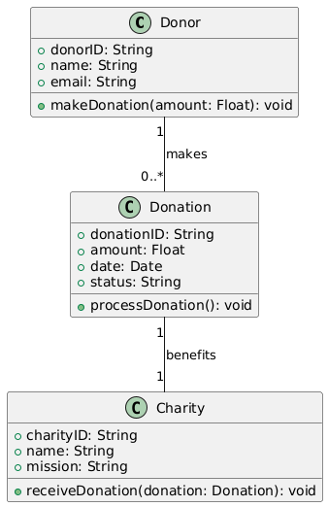
Class Diagram

Slide 9

USE CASE DIAGRAM
Create Campaign
Signup
Login
Receive Funds
Donate
CHARITY
DONOR
Browse Campaigns
Display Transaction History
Log-out

Slide 10
Activity Diagram
User Register for Donation
Orphanage Receiving Donation request
Is valid
yes
Allocate Deliverer
no
Terminate Donation
Receive Donation
Send Feedback

Slide 11
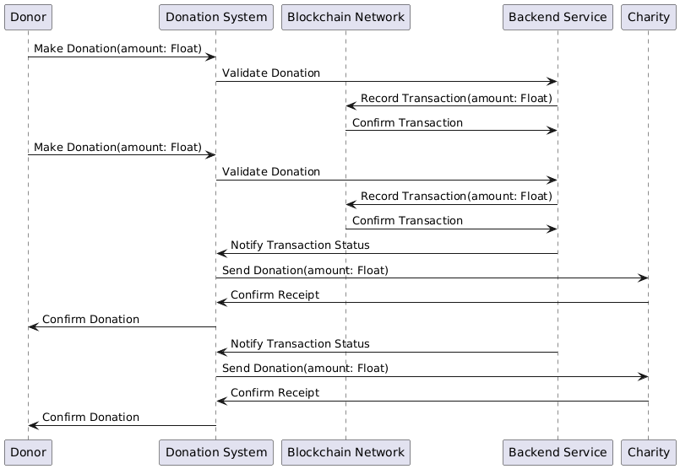
Sequence Diagram

