Slide 1
SECURE DATA HIDING IN IMAGES USING STEGANOGRAPHY
CAPSTONE PROJECT
PRESENTED
By
MURALI DUDDU
PACE INSTITUTE OF TECHNOLOGY & SCIENCES
&
ELECTRONICS AND COMMUNICATION ENGINEERING

Slide 2
OUTLINE
Problem Statement
Technology used
Wow factor
End users
Result
Conclusion
Git-hub Link
Future scope

Slide 3
PROBLEM STATEMENT
Challenge:
Secure data transmission is vulnerable to cyberattacks, risking unauthorized access and data breaches during transmission.
Solution:
Steganography embeds encrypted messages within images, making the data undetectable and accessible only to authorized users, ensuring secure communication

Slide 4
TECHNOLOGY USED
Core Language :
Python
Libraries Used :
OpenCV : For image processing and manipulation.
OS : For system-level operations and file handling.
Method :
Encryption & Embedding : Secure messages are encrypted and embedded within the pixel color values of an image.
Passcode Protection : A passcode is used to ensure secure encryption and decryption, allowing only authorized users to access the hidden message.

Slide 5
WOW FACTORS
Advanced Security:
Pixel-based encryption ensures that sensitive data is securely embedded within image pixels, making it virtually undetectable.
User Authentication:
Passcode-protected access guarantees that only authorized users can decrypt and retrieve the hidden messages.
Instant Execution:
Enables real-time embedding and retrieval of data, ensuring seamless and efficient communication without delay.

Slide 6
END USERS
Professionals:
Utilize secure communication methods to protect sensitive information in their day-to-day work.
Organizations:
Enable confidential data exchange, safeguarding business secrets and proprietary information.
Developers:
Integrate secure data-hiding features into applications to enhance user privacy and data protection.
General Users:
Enjoy personal secure messaging, ensuring their private conversations remain confidential and safe.

Slide 7
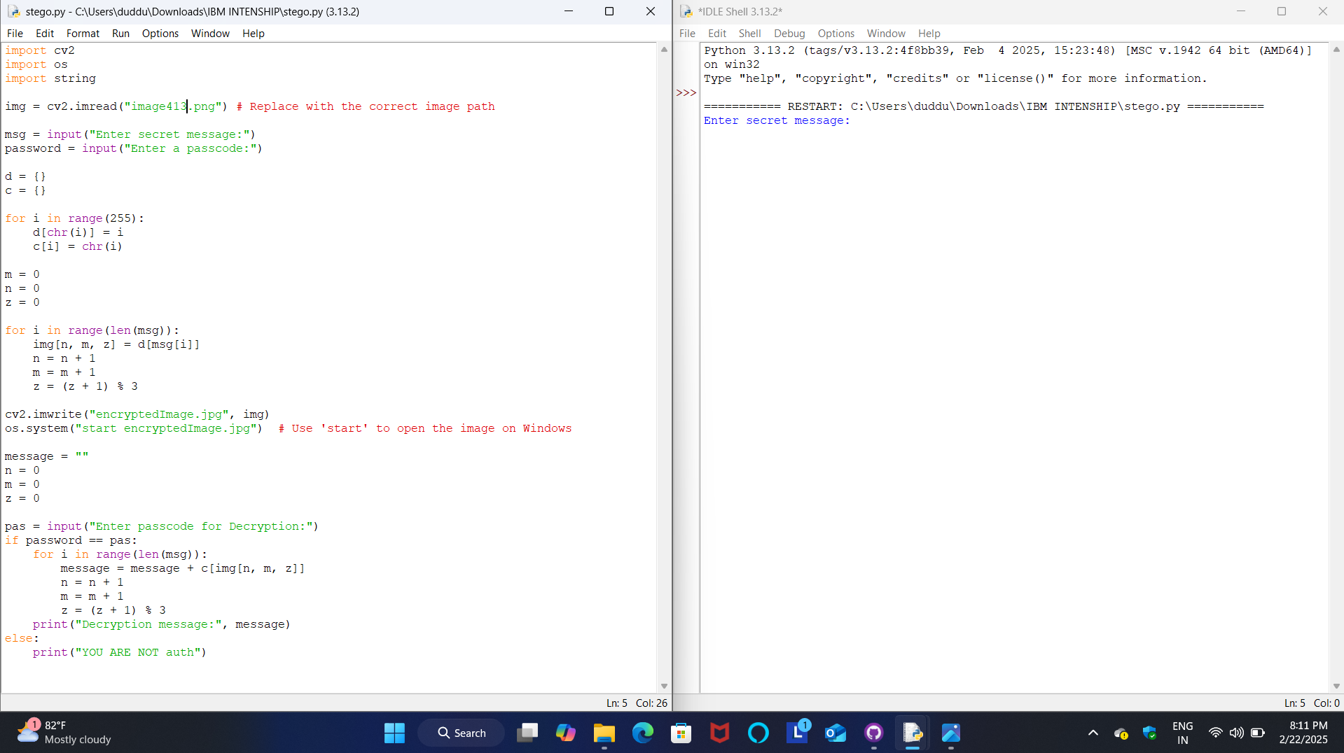
RESULTS
In this process, a Python OpenCV2 code is used to encrypt and embed a secret message within an image. The code accepts a passcode, encrypts the message, and embeds it into the image, making it unreadable without the correct key. The encrypted image can then be decrypted by entering the correct passcode. This method provides a secure way to transmit hidden information within a seemingly ordinary image

Slide 8

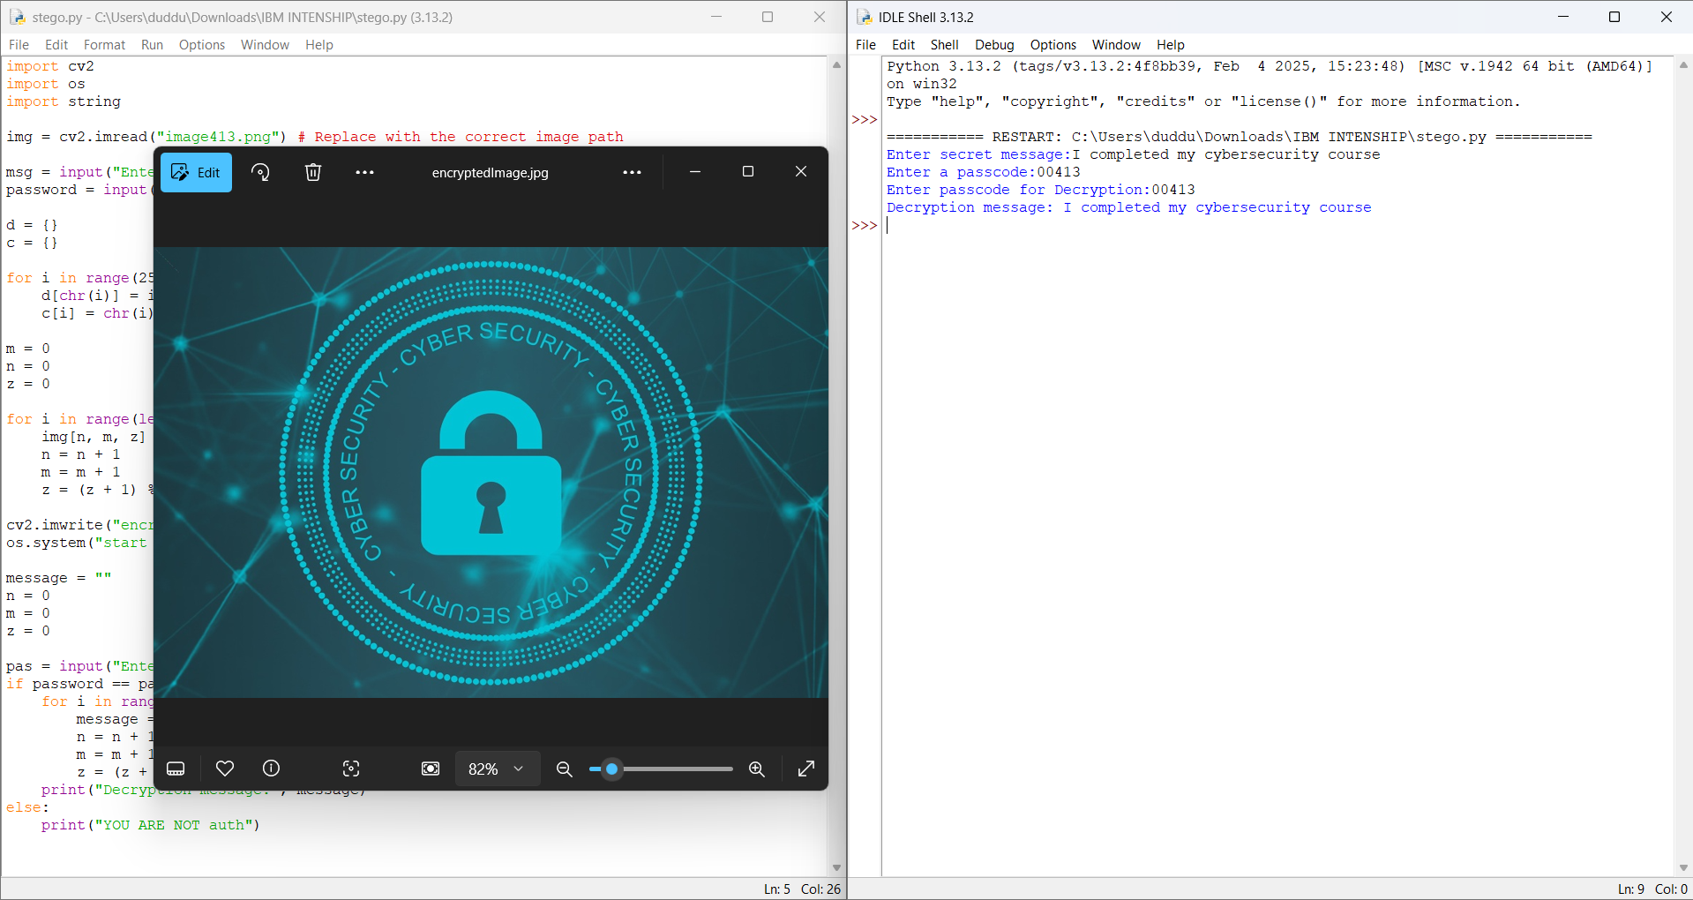

1.Normal image
2.Normal image into encrypted with using python code
&
Decryption : I completed my cybersecurity course
3.Encrypted image

Slide 9
CONCLUSION
Steganography provides a powerful method for secure, undetectable data hiding,
ensuring privacy during transmission.
Encryption combined with a passcode adds an extra layer of confidentiality,
safeguarding sensitive information.
This technology is ready for seamless integration into real-world applications,
enhancing security across various industries.

Slide 10
GITHUB LINK
Repository: [https://github.com/murali-36/my-stego413.git]
an overview of the README file on GitHub. It includes setup instructions, prerequisites, and code examples for implementing encryption and decryption. Follow the steps outlined to configure your environment. Ensure all dependencies are properly installed before running the provided code

Slide 11
FUTURE SCOPE(OPTIONAL)
Stronger Encryption Methods:
Implementing advanced encryption algorithms to further enhance data security.
Multimedia Support:
Expanding to include secure embedding of data in audio, video, and text files for broader use
cases.
Real-Time Secure Messaging:
Enabling instant, encrypted communication for seamless and secure interactions.
Detection Tools:
Developing advanced tools to detect and prevent hidden data in images, ensuring greater security
against steganography attacks.

Slide 12
THANK YOU

