Slide 1

Team Name: SMART SYSTEM
Theme: For Good Cleaning Porpose
Project Title:
S.No | Name of the student | Year/Dept. | Email Id | Contact Number
1* | Murali Krishnan T | IInd/ECE | muralikrishnan23@gmail.com | 9942223212
2 | Pragadeeshwaran RR | IInd/ECE | pragadeeshwaran45@gmail.com | 7825873831
3 | Sai Shackthi S | IIndECE | saishackthi67@gmail.com | 6374125535
College Name: K Ramakrishnan College Of Technology
Team Leader Name : Murali Krishnan.T

Slide 2
Problem Statement
The kitchenware industry is increasingly demanding innovative solutions to address common challenges faced by both home cooks and professional chefs. One significant problem is the need for versatile and space-saving kitchen tools. Traditional ladles come in fixed sizes, often requiring multiple utensils for different portion sizes, leading to clutter and inefficiency. Additionally, these ladles are not designed to handle varying food types and portioning needs, which can be inconvenient and wasteful. As more consumers focus on healthy eating, portion control, and efficient meal preparation, there is a growing need for a flexible, adjustable ladle that can accommodate diverse cooking tasks. A stretchable ladle could solve these problems by offering adjustable sizes for different portions, reducing the need for multiple tools, and providing an easy-to-store, multi-functional solution for various food types. This would not only optimize kitchen space but also support healthier cooking practices by allowing precise portion control.

Slide 3
TARGET MARKETING
Home Cooks
Health-Conscious Consumers
Professional Chefs & Restaurants
Meal Prep Enthusiasts & Catering Services
Eco-Conscious Consumers
Cooking Enthusiasts & DIYers
Tech-Savvy & Smart Kitchen Enthusiasts

Slide 4
Solution Concept
Telescoping Design
The ladle has an adjustable scoop and handle that expand or contract to suit different portion sizes.It features a compact design for easy storage, making it ideal for kitchens with limited space.The ergonomic, heat-resistant handle ensures comfort and control during use.
Modular Ladle with Interchangeable Heads
The ladle features interchangeable scoop heads for different food types, such as soups, sauces, and stews.Quick-snap connectors allow for easy attachment and detachment of heads for convenience.The modular design saves space and eliminates the need for multiple ladles.
Foldable or Collapsible Scoop
The ladle's scoop folds or collapses to reduce its size, making it easy to store.The handle is telescoping, allowing users to adjust the length as needed.It is heat-resistant and durable, making it suitable for high-temperature cooking

Slide 5

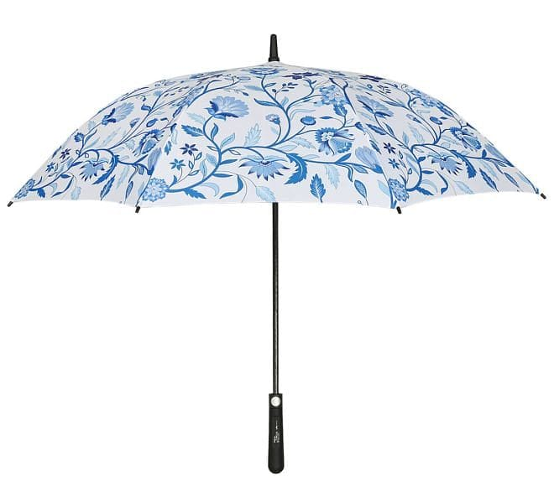
Prototype

Slide 6
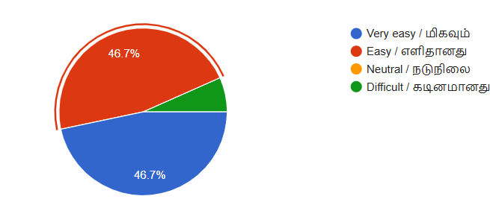
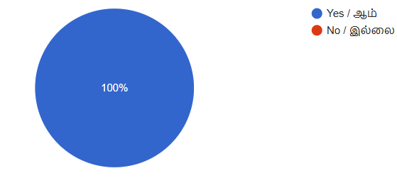
HIGHLIGHTED SURVEY REPORT
How easy was it to use the product?
Do you think the adjustable feature is useful?

Slide 7
Competitor Analysis
Traditional Ladles:
Examples: OXO Good Grips Ladle, Cuisipro Ladle, Joseph Joseph Ladle.
Strengths: Affordable, durable, easy to use, widely available.
Adjustable Portion Control Ladles
Examples: Progressive International Adjustable Ladle, Kuhn Rikon Adjustable Ladle.
Strengths: Adjustable portion sizes, good for portion control, versatile for soups and sauces.
Multi-Function Kitchen Tools
Examples: OXO Good Grips 3-in-1 Avocado Slicer, All-Clad Multi-Purpose Ladle.
Strengths: Space-saving, versatile, compact.

Slide 8
Value Proportion
Versatility and Adaptability
Space-Saving Design
Precise Portion Control
Durability and Quality
Convenience and Ease of Use
Cost Efficiency

Slide 9
Channels For Marketing
E-commerce Platforms
Company Website
Social Media
Influencer Marketing
Email Marketing
Content Marketing
Online Advertising
Retail Partnerships
Customer Referral Program

Slide 10
Revenue Model
Direct Sales (E-commerce)
Wholesale Distribution to Retailers
Subscription Model (Product Bundles)
Licensing & Brand Collaborations
Premium Product Variations (Upsell)
Corporate or Event Sales
Affiliate Marketing and Partnerships

Slide 11
MARKETING STATERGY
The marketing strategy for the stretchable ladle will focus on building brand awareness, generating excitement, and establishing long-term customer loyalty through a multi-channel approach. Initially, the strategy will leverage social media marketing and influencer partnerships to showcase the product’s unique features, such as its adjustability and space-saving design. Platforms like Instagram, YouTube, and TikTok will be used to engage with food enthusiasts, home cooks, and influencers in the cooking and lifestyle space to demonstrate real-life use cases and create buzz. Additionally, content marketing through cooking blogs, recipe websites, and video tutorials will emphasize the ladle’s benefits for portion control and healthier cooking, targeting health-conscious consumers and meal prep enthusiasts. The strategy will also focus on SEO and PPC advertising on platforms like Google and Facebook to drive traffic to the brand’s website, where customers can purchase directly. To increase visibility, partnerships with retailers like Walmart and Target, and collaborations with meal kit delivery services like HelloFresh or Blue Apron, will ensure broader distribution.

Slide 12

NORMAL LADLE
FLEXI LADLE

Slide 13


