Slide 1
MIMIC-III Visualization Assignment
Exploring Real-World ICU Data Through Python Visualization
AI 395T — AI for Healthcare | Summer 2026 | Dr. Ying Ding

Slide 2
What Is MIMIC-III, and Why Use It?
The Problem It Solves
What Makes It Different
Why This Course Uses It
Hospital data was difficult for researchers to access and share.
Contains de-identified data from 40,000+ ICU patients.
Lets us work with real hospital data instead of sample datasets.
Source: Johnson et al. (2016), MIMIC-III Clinical Database; PhysioNet.org

Slide 3
How the MIMIC-III Schema Is Structured
Key IDs
Tables
Dictionary Tables
SUBJECT_ID = Patient
HADM_ID = Hospital admission
ICUSTAY_ID = ICU stay
Prescriptions
Patients
Lab Events
Microbiology Events
ICU Stays & Admissions
D_ tables describe medical codes and measurements.
Source: Johnson et al. (2016), MIMIC-III Clinical Database; PhysioNet.org

Slide 4
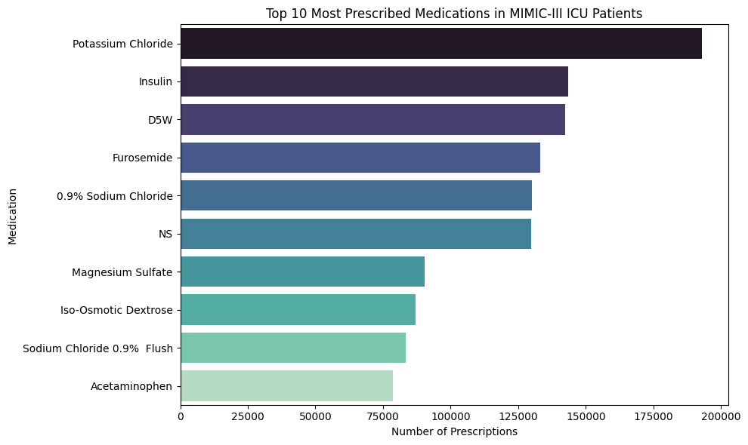
Visualization 1
Top 10 Most Prescribed Medications
What the query does:
Finds the 10 most frequently prescribed medications.
Why it matters clinically:
Shows the treatments most commonly used in the ICU.
Real-world use:
Helps hospitals monitor medication usage.
How to create:
Query the prescriptions table
Count prescriptions by drug name
Sort by count
Plot top 10 medications as a bar chart
Tables: prescriptions - Bar chart

Slide 5
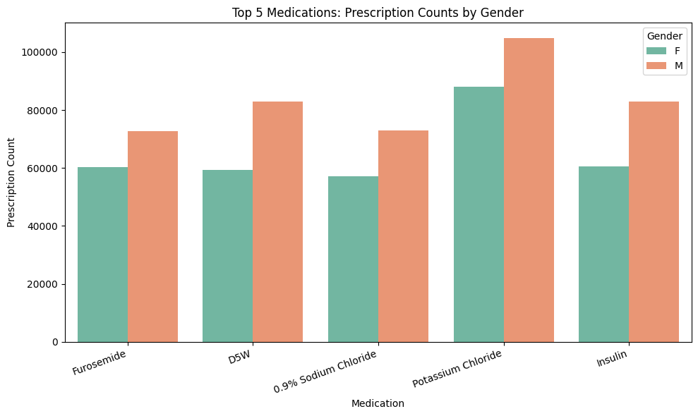
Visualization 2
Top Medications: Prescriptions by Gender
What the query does:
Compares prescriptions for the top medications by gender.
Why it matters clinically:
Shows whether treatment patterns differ between groups.
Real-world use:
Used to check for possible healthcare disparities.
How to create:
Join prescriptions and patients
Select top 5 medications
Group by medication and gender
Create grouped bar chart
Tables: prescriptions, patients - grouped bar chart

Slide 6
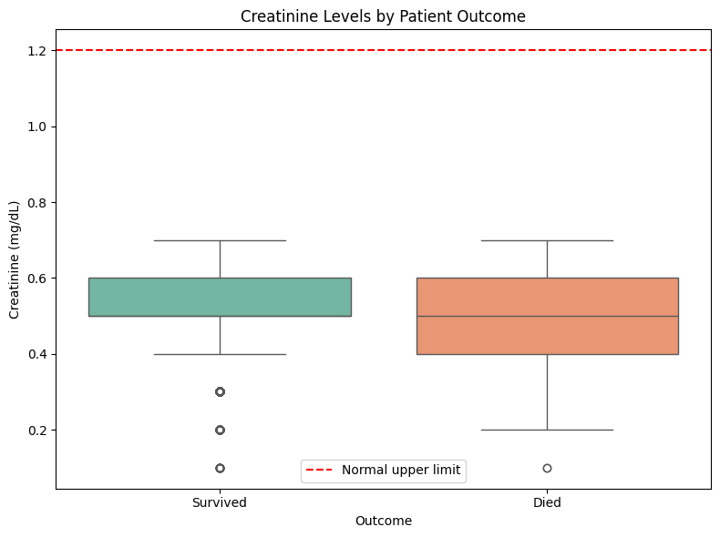
Visualization 3
Creatinine Levels by Patient Outcome
What the query does:
Compares creatinine levels for survivors and non-survivors.
Why it matters clinically:
Creatinine is an important measure of kidney function.
Finding:
Creatinine levels were similar in both groups in this sample.
How to create:
Join labevents, admissions, and d_labitems
Filter for creatinine values
Group by patient outcome
Create box plot
Tables: labevents, admissions, d_labitems – Box plot

Slide 7
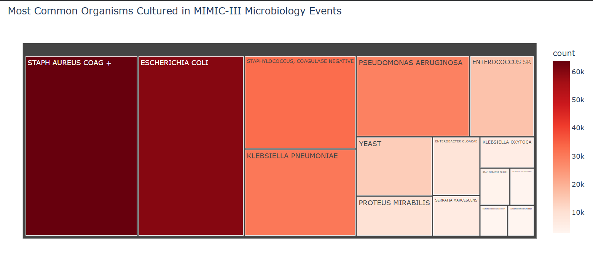
Visualization 4 — BONUS
Most Common Organisms Cultured
What the query does:
Finds the 15 most common organisms in culture results.
Why it matters clinically:
Shows the infections most often seen in ICU patients.
Real-world use:
Helps guide early antibiotic treatment.
How to create:
Query microbiologyevents
Count organism occurrences
Select top 15 organisms
Create treemap
Tables: microbiologyevents - treemap (Plotly, bonus library)

Slide 8
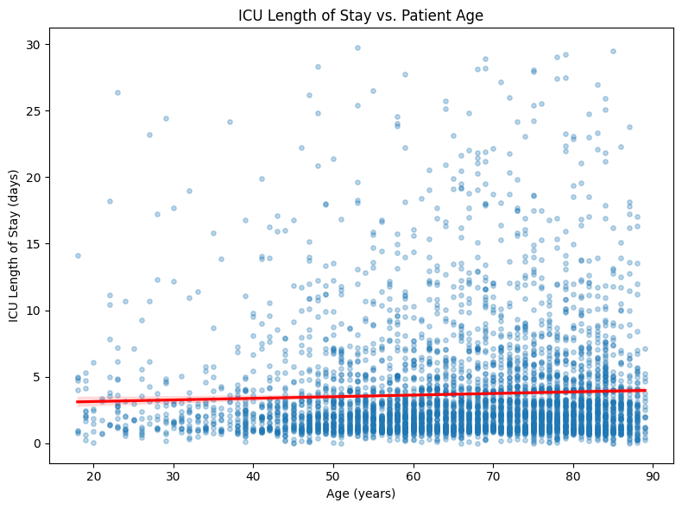
Visualization 5
ICU Length of Stay vs. Patient Age
What the query does:
Compares patient age with ICU length of stay.
Important MIMIC quirk:
Ages were filtered to remove MIMIC de-identification artifacts.
Finding:
Age showed only a weak relationship with ICU stay length.
How to create:
Join icustays, admissions, and patients
Calculate patient age
Filter out extreme values
Create scatter plot with trendline
Tables: icustays, admissions, patients - scatter + trendline

Slide 9
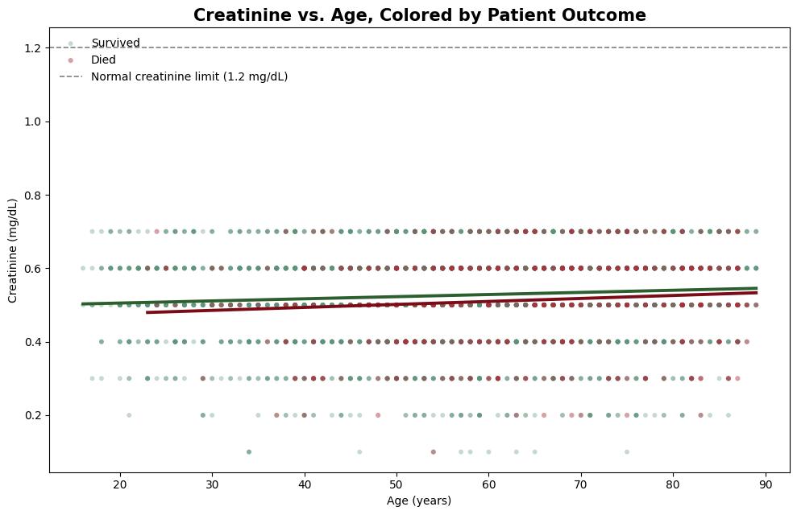
Visualization 6
Creatinine vs. Age, Colored by Outcome
What the query does:
Combines age, creatinine level, and patient outcome.
Why it matters clinically:
Explores whether age and kidney function relate to mortality.
How to read it:
Two separate trendlines, one per outcome. Overlapping lines mean creatinine isn't separating outcomes in this sample.
Finding:
The trendlines are very similar for both groups.
How to create:
Join age, creatinine, and outcome data
Separate survivors and non-survivors
Plot scatter points
Add trendlines for each group
Tables: labevents, admissions, patients, d_labitems

Slide 10
From Charts to Clinical Decisions
Medication charts help monitor drug usage.
Gender comparisons help evaluate fairness in care.
Creatinine analysis helps study risk factors.
Organism frequency helps guide antibiotic choices.
Length-of-stay analysis supports resource planning.
Key takeaway
These are the same types of analyses used to support real clinical decision-making.
How to Reproduce This Analysis
Obtain access to MIMIC-III on PhysioNet.
Load MIMIC-III into Google BigQuery.
Run the SQL queries provided in the notebook.
Export results to Pandas DataFrames.
Create visualizations using Matplotlib, Seaborn, and Plotly.

