Slide 1
Readmission Patterns in ICU Patients
A SQL Analysis of MIMIC-III Clinical Data
MIMIC-III Clinical Database • HW2 SQL Tutorial

Slide 2
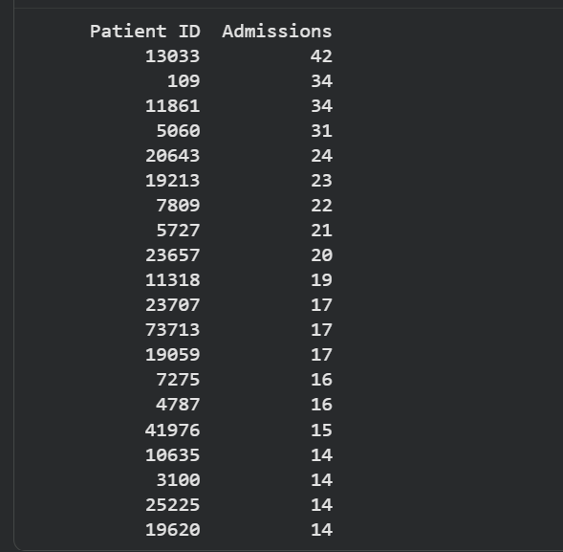
Q1
Top 20 Most Readmitted Patients
Description
[ Screenshot of query results ]
Finds the 20 patients with the most hospital admissions. Groups admissions by patient and filters to those with more than one visit.
SQL Query
SELECT
subject_id,
COUNT(hadm_id) AS num_admissions
FROM admissions
GROUP BY subject_id
HAVING COUNT(hadm_id) > 1
ORDER BY num_admissions DESC
LIMIT 20
Interpretation
The most-admitted patient returned 42 times; the bottom of the top 20 had 14. A small group of patients accounts for a disproportionate share of hospital visits.
MIMIC-III Clinical Database • HW2 SQL Tutorial

Slide 3
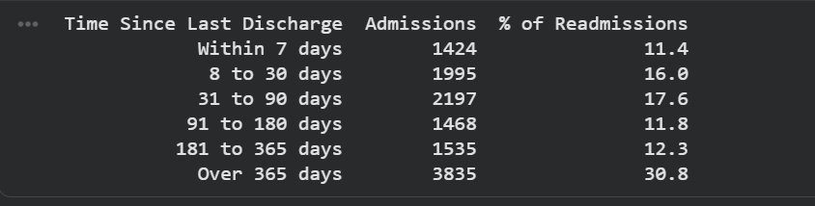
Q2
Distribution of Time Between Admissions
Description
[ Screenshot of query results ]
Measures how many days passed between each patient's discharge and their next admission. Buckets the gaps to show whether returns happen quickly or over time.
SQL Query
WITH gaps AS (
SELECT subject_id,
DATE_DIFF(DATE(admittime),
DATE(LAG(dischtime) OVER
(PARTITION BY subject_id
ORDER BY admittime)), DAY)
AS days_since_last_discharge
FROM admissions
)
SELECT gap_bucket,
COUNT(*) AS num_admissions,
ROUND(COUNT(*)/SUM(COUNT(*))
OVER()*100,1) AS pct
FROM gaps g JOIN repeat_patients r
ON g.subject_id = r.subject_id
WHERE days_since_last_discharge >= 0
GROUP BY gap_bucket
ORDER BY gap_bucket
Interpretation
27% of returns happen within 30 days — rapid bounce-backs. But the biggest group (31%) waited over a year, suggesting many readmissions reflect long-term chronic disease rather than discharge failures.
MIMIC-III Clinical Database • HW2 SQL Tutorial

Slide 4
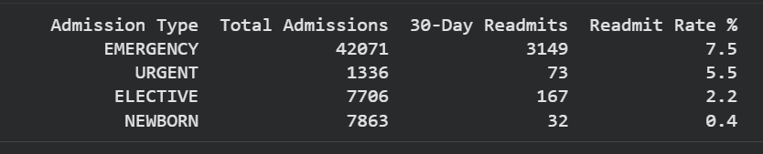
Q3
30-Day Readmission Rate by Admission Type
Description
[ Screenshot of query results ]
Calculates what percentage of patients in each admission category returned within 30 days of discharge.
SQL Query
WITH gaps AS (
SELECT subject_id, hadm_id,
admission_type,
DATE_DIFF(DATE(admittime),
DATE(LAG(dischtime) OVER
(PARTITION BY subject_id
ORDER BY admittime)), DAY)
AS days_gap
FROM admissions
)
SELECT admission_type,
COUNT(*) AS total_admissions,
SUM(CASE WHEN days_gap<=30
THEN 1 ELSE 0 END) AS readmits,
ROUND(SUM(CASE WHEN days_gap<=30
THEN 1 ELSE 0 END)/COUNT(*)*100,1)
AS readmit_rate_pct
FROM gaps
GROUP BY admission_type
ORDER BY readmit_rate_pct DESC
Interpretation
Emergency patients return at the highest rate (7.5%) — over 3x the elective rate (2.2%). Nearly 3,150 emergency patients came back within a month.
MIMIC-III Clinical Database • HW2 SQL Tutorial

Slide 5
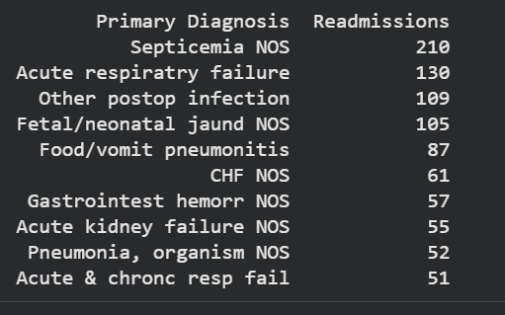
Q4
Top Diagnoses Driving 30-Day Readmissions
Description
[ Screenshot of query results ]
Identifies the top 10 diagnoses among patients who returned within 30 days. Joins diagnosis codes to their readable labels.
SQL Query
WITH gaps AS (
SELECT subject_id, hadm_id,
DATE_DIFF(DATE(admittime),
DATE(LAG(dischtime) OVER
(PARTITION BY subject_id
ORDER BY admittime)), DAY)
AS days_gap
FROM admissions
)
SELECT d.short_title,
COUNT(*) AS readmit_count
FROM gaps g
JOIN diagnoses_icd dx
ON g.hadm_id = dx.hadm_id
AND dx.seq_num = 1
JOIN d_icd_diagnoses d
ON dx.icd9_code = d.icd9_code
WHERE g.days_gap <= 30
GROUP BY d.short_title
ORDER BY readmit_count DESC
LIMIT 10
Interpretation
Sepsis, respiratory failure, and postoperative infection top the list — all conditions with chronic disease roots. These aren't one-off events; they reflect underlying conditions that weren't fully resolved at discharge.
MIMIC-III Clinical Database • HW2 SQL Tutorial

Slide 6
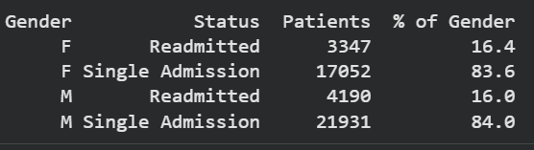
Q5
Gender Breakdown: Readmitted vs Single-Admission
Description
[ Screenshot of query results ]
Compares how many male vs female patients were readmitted versus admitted only once. Uses an outer join so all patients are counted.
SQL Query
SELECT p.gender,
CASE
WHEN a.num_adm > 1
THEN 'Readmitted'
WHEN a.num_adm = 1
THEN 'Single Admission'
ELSE 'No Admission Record'
END AS readmit_status,
COUNT(*) AS patient_count
FROM patients p
LEFT JOIN (
SELECT subject_id,
COUNT(hadm_id) AS num_adm
FROM admissions
GROUP BY subject_id
) a ON p.subject_id = a.subject_id
GROUP BY p.gender, readmit_status
ORDER BY p.gender, readmit_status
Interpretation
Male and female patients are readmitted at nearly the same rate (16.0% vs 16.4%). Gender is not a useful predictor — admission type matters far more.
MIMIC-III Clinical Database • HW2 SQL Tutorial

Slide 7
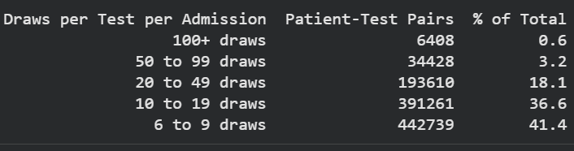
Q6
Lab Test Repetition Frequency Within One Admission
Description
[ Screenshot of query results ]
Counts how many times the same lab test was ordered in a single admission. Groups by frequency range to show how common heavy repetition is.
SQL Query
WITH test_counts AS (
SELECT l.subject_id, l.hadm_id,
TRIM(UPPER(d.label)) AS test_name,
COUNT(*) AS times_tested
FROM labevents l
JOIN d_labitems d
ON l.itemid = d.itemid
WHERE l.hadm_id IS NOT NULL
GROUP BY
l.subject_id, l.hadm_id, test_name
)
SELECT
CASE
WHEN times_tested>=100 THEN '100+'
WHEN times_tested>=50 THEN '50-99'
WHEN times_tested>=20 THEN '20-49'
WHEN times_tested>=10 THEN '10-19'
ELSE '6-9'
END AS repetition_bucket,
COUNT(*) AS num_pairs,
ROUND(COUNT(*)/SUM(COUNT(*))
OVER()*100,1) AS pct
FROM test_counts WHERE times_tested>5
GROUP BY repetition_bucket
Interpretation
Most repeated tests fall in the routine range (6–19 draws). However, 6,408 admission-test combinations had the same test drawn 100+ times in one stay — driven by critically ill patients needing hourly blood gas monitoring.
MIMIC-III Clinical Database • HW2 SQL Tutorial

Slide 8
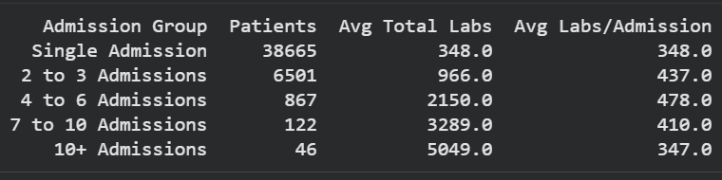
Q7
Avg Lab Draws by Readmission Frequency Group
Description
[ Screenshot of query results ]
Compares lifetime lab draw totals across patients grouped by how many times they were admitted. Shows whether heavier testing comes from more visits or more intensive care per visit.
SQL Query
WITH admission_counts AS (
SELECT subject_id,
COUNT(hadm_id) AS num_admissions
FROM admissions GROUP BY subject_id
),
lab_counts AS (
SELECT subject_id,
COUNT(*) AS total_lab_draws
FROM labevents
WHERE hadm_id IS NOT NULL
GROUP BY subject_id
)
SELECT
CASE
WHEN a.num_admissions=1
THEN 'Single Admission'
WHEN a.num_admissions<=3
THEN '2-3 Admissions'
WHEN a.num_admissions<=6
THEN '4-6 Admissions'
WHEN a.num_admissions<=10
THEN '7-10 Admissions'
ELSE '10+ Admissions'
END AS readmission_group,
COUNT(*) AS num_patients,
ROUND(AVG(l.total_lab_draws),0)
AS avg_total_labs
FROM admission_counts a
JOIN lab_counts l
ON a.subject_id = l.subject_id
GROUP BY readmission_group
Interpretation
Patients with 10+ admissions accumulate 14.5x more lifetime lab draws than single-admission patients. Notably, the number of labs per individual stay stays roughly the same across all groups — the extra burden comes entirely from returning more often.
MIMIC-III Clinical Database • HW2 SQL Tutorial

Slide 9
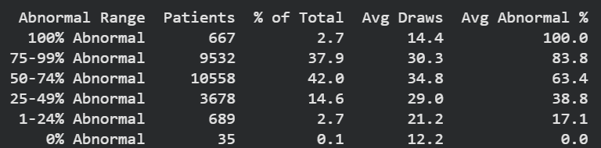
Q8
Recurring Abnormal Glucose: Population Distribution
Description
[ Screenshot of query results ]
Looks at patients with 10 or more glucose tests on record and calculates what percentage of those tests came back abnormal. Groups patients into ranges from 0% to 100% abnormal.
SQL Query
WITH glucose_summary AS (
SELECT l.subject_id,
COUNT(*) AS total_draws,
SUM(CASE WHEN l.flag='abnormal'
THEN 1 ELSE 0 END) AS abnml,
ROUND(SUM(CASE WHEN l.flag=
'abnormal' THEN 1 ELSE 0 END)
/COUNT(*)*100,1) AS abnml_pct
FROM labevents l
JOIN d_labitems d
ON l.itemid=d.itemid
WHERE d.label LIKE '%Glucose%'
AND l.hadm_id IS NOT NULL
GROUP BY l.subject_id
HAVING COUNT(*) >= 10
)
SELECT
CASE WHEN abnml_pct=100
THEN '100% Abnormal' ... END
AS abnormal_bucket,
COUNT(*) AS patient_count,
ROUND(COUNT(*)/SUM(COUNT(*))
OVER()*100,1) AS pct_of_patients
FROM glucose_summary
GROUP BY abnormal_bucket
Interpretation
80% of frequently-tested patients had abnormal glucose results more than half the time. Only 35 patients out of 25,000+ were never abnormal. Most patients leave the hospital with glucose that still isn't under control.
MIMIC-III Clinical Database • HW2 SQL Tutorial

Slide 10

Q9
Same Primary Diagnosis on Consecutive Admissions
Description
[ Screenshot of query results ]
Compares each patient's primary diagnosis to their previous admission's diagnosis. Flags cases where the exact same condition brought them back.
SQL Query
WITH primary_dx AS (
SELECT a.subject_id, a.hadm_id,
a.admittime, dx.icd9_code,
d.short_title
FROM admissions a
JOIN diagnoses_icd dx
ON a.hadm_id=dx.hadm_id
AND dx.seq_num=1
JOIN d_icd_diagnoses d
ON dx.icd9_code=d.icd9_code
),
with_lag AS (
SELECT subject_id, hadm_id,
icd9_code, short_title,
LAG(icd9_code) OVER
(PARTITION BY subject_id
ORDER BY admittime)
AS prev_icd9_code
FROM primary_dx
)
SELECT recurrence_flag,
COUNT(*) AS num_admissions,
ROUND(COUNT(*)/SUM(COUNT(*))
OVER()*100,1) AS pct
FROM with_lag
WHERE prev_icd9_code IS NOT NULL
GROUP BY recurrence_flag
Interpretation
13% of readmissions — 1,566 cases — returned with the identical primary diagnosis. These are patients whose core condition wasn't resolved between visits, representing the most directly preventable category of readmissions.
MIMIC-III Clinical Database • HW2 SQL Tutorial

Slide 11
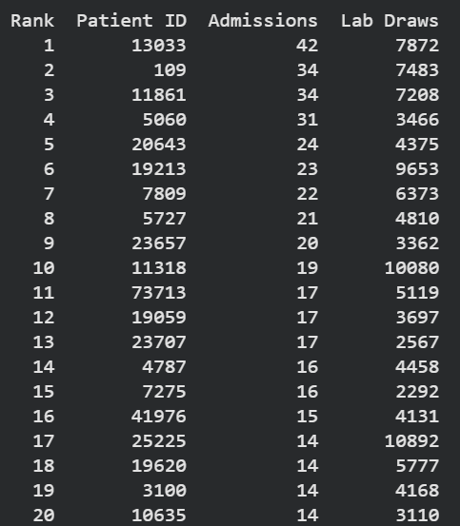
Q10
High-Utilizer Overlap: Frequent Readmissions + Heavy Lab Testing
Description
[ Screenshot of query results ]
Finds patients who appear in both the frequent-readmission group and the heavy lab-testing group. Ranks them by a combined score of admissions and lab draws.
SQL Query
WITH frequent_readmitters AS (
SELECT subject_id,
COUNT(hadm_id) AS num_admissions
FROM admissions
GROUP BY subject_id
HAVING COUNT(hadm_id) > 2
),
frequent_testers AS (
SELECT subject_id,
COUNT(*) AS num_lab_draws
FROM labevents
WHERE hadm_id IS NOT NULL
GROUP BY subject_id
HAVING COUNT(*) > 200
)
SELECT r.subject_id,
r.num_admissions,
t.num_lab_draws,
RANK() OVER (
ORDER BY r.num_admissions DESC,
t.num_lab_draws DESC)
AS utilizer_rank
FROM frequent_readmitters r
JOIN frequent_testers t
ON r.subject_id = t.subject_id
ORDER BY utilizer_rank
LIMIT 20
Interpretation
The highest-burden patients show up in both lists. Patient 13033 had 42 admissions and 7,872 lab draws — the clearest example of a high-utilizer whose repeated returns drove compounding resource consumption across their entire hospital history.
MIMIC-III Clinical Database • HW2 SQL Tutorial

Slide 12
Readmission Patterns in ICU Patients: A Cohesive Story
Q1
Q2
Q3
Q4
Q5
Who comes back?
How fast?
Which pathway?
Why?
Who?
Top 20 patients: up to 42 admissions each
27% return within 30 days; 31% after 1+ year
Emergency: 7.5% 30-day rate vs Elective: 2.2%
Sepsis, resp failure & postop infection lead
Gender neutral: M 16.0% vs F 16.4%
Q6
Q7
Q8
Q9
Q10
Testing burden
Lifetime labs
Unresolved?
Same problem?
Who is highest risk?
0.6% of test pairs: 100+ draws in one stay
10+ admissions → 14.5x more lifetime labs
80% of patients: glucose abnormal >50% of draws
13% return with identical primary diagnosis
Overlap: most admissions + most lab draws
A small subset of patients with chronic, poorly-controlled conditions cycles repeatedly through emergency admissions — and the data to identify them proactively exists in the EHR.

