Slide 1
Predicting 30-Day
Hospital Readmission
Using MIMIC-III data to estimate, ahead of time, which patients are likely to come back within 30 days.
A SELF-LEARNING TUTORIAL | MIMIC-III + BIGQUERY + PYTHON
Notes:
Welcome - this tutorial builds a model that predicts whether a patient will be readmitted to the hospital within 30 days of discharge, using MIMIC-III data. We compare a simple baseline model against a small neural network and look honestly at which one actually wins. FULL CODE : Attached the colab notebook

Slide 2
MOTIVATION
Why Try to Predict This?
Hard to see by eye
Costly to get wrong
Something we can test
A doctor can't track every risk factor for every patient by hand. The pattern is real, but it's hidden in the data.
A patient coming back usually means something wasn't fully treated the first time - harder on the patient, and expensive to repeat.
MIMIC-III lets us check whether this pattern is strong enough to predict in advance, not just describe after the fact.
2
Notes:
Keep this framing short - one slide, then move into the mechanics. The goal is to go from 'we can describe who comes back' to 'we can flag who's at risk before they leave.'

Slide 3
SETUP
Setting Up the Problem
The Label
The Cohort
For every hospital stay, we look at the patient's next admission, if there is one. If it starts within 30 days of this discharge, we mark this row as a readmission (1). Otherwise, 0.
One row in our table = one hospital admission, not one patient - the same patient can appear more than once.
Data comes from MIMIC-III, pulled live through Google BigQuery.
We leave newborn admissions out of the cohort, since they behave very differently from adult stays and would skew the pattern.
3
Notes:
Slow down on the label definition - this is the part people get confused by. We check each admission's NEXT admission and see if it starts within 30 days of discharge. Newborns are excluded from the cohort for the reason stated.

Slide 4
FEATURES
What We Feed the Model
admission_type
FINDING
Emergency, urgent, or planned. Emergency patients tend to be less medically stable going in.
MIMIC-III shifts the recorded age of anyone over 89, to protect their privacy. That can make raw data show ages of 200+ years.
We cap age at 90 in our query, so the model isn't confused by this quirk.
prior_admission_count
How many times this patient has been admitted before. More visits often means a chronic condition.
primary_diagnosis
The main reason for this stay. Some conditions come back more easily than others.
lab_abnormal_pct
How much of this stay's lab work came back outside the normal range.
age, gender
Basic facts, included as a check - not assumed to matter until the model says so.
Text categories like admission_type and primary_diagnosis get turned into separate yes/no columns later — more on that shortly.
4
Notes:
Go feature by feature, one plain reason each. Save the one-hot encoding explanation for the next relevant slide - just flag here that it's coming.

Slide 5
BEFORE MODELING
Readmission Is Rare
Share of Admissions
6.3%
of admissions were followed by a readmission within 30 days.
• Most rows are “no” - this is called class imbalance.
• Always guessing “no” would score ~94% while being useless.
• So we won't judge the model by plain accuracy.
5
Notes:
Show the real split before building anything. Say it plainly: a model that always predicts 'no' would already be about 94% accurate while catching zero real readmissions. This sets up why AUROC and AUPRC matter later.

Slide 6
PIPELINE
Getting the Data Model-Ready
1. One-hot encode
2. Split the data
3. Scale the numbers
Turn each text category into its own yes/no column. A model can only work with numbers, not words.
80% for training, 20% for testing — keeping the same 6.3% readmission rate in both, so the test is a fair check.
Put every number on a similar scale, so a big number like total labs doesn't drown out a small one like age.
6
Notes:
Quick, mechanical slide - don't dwell here. The one thing worth a sentence: keeping the same readmission rate in both the train and test sets matters because the positive class is so rare to begin with.

Slide 7
BASELINE MODEL
Start Simple: Logistic Regression
Logistic regression guesses a probability of readmission, from 0 to 1, by adding up weighted features. Each feature gets a weight, and the model combines them.
FINDING
0.657
AUROC
It's simple and easy to check afterward - a fair baseline. If a neural network can't beat it, the extra complexity isn't worth it.
Meaningfully better than a coin flip (0.5). This is the score the neural network has to beat.
class_weight='balanced' tells the model to pay more attention to the rare readmit cases, instead of mostly learning from the common “no” cases.
7
Notes:
Always start with a simple, interpretable baseline before reaching for deep learning - say this out loud, it's a good habit for a peer to pick up. 0.657 AUROC means the model ranks meaningfully better than random guessing. Keep this number in mind for the comparison slide later.

Slide 8
GOING DEEPER
A Small Neural Network, By Design
Input
22 features
→
Dense 32
+ Dropout 0.3
→
Dense 16
+ Dropout 0.2
→
Output
1 probability
Why 32 → 16 nodes: with only ~22 columns after encoding, a much bigger network would just memorize the training rows instead of learning a pattern that generalizes. Why dropout 0.3, then 0.2: dropout randomly turns off nodes during training so the model can't lean on just one - set higher near the input, since that's where overfitting risk is greatest with so few readmit cases to learn from.
8
Notes:
This slide carries the architecture-justification argument - spend real time here, since a peer reviewer specifically checks whether you can explain design choices instead of just picking numbers. Two hidden layers is enough for this few columns; more depth mostly adds overfitting risk, not signal.

Slide 9
EVALUATION
Why We Don't Trust Accuracy Here
Accuracy
AUROC
AUPRC
Misleading here. Always guessing “no” scores about 94% while catching zero real readmissions.
How well the model ranks readmitted patients above everyone else. 0.5 = random guessing, 1.0 = perfect.
A stricter score, focused only on the rare readmit group. Closer to the question a care team actually asks.
9
Notes:
Define each metric in plain language before showing results - this slide is why the next two slides make sense. Precision = of the patients flagged high-risk, how many actually came back. Recall = of the patients who did come back, how many did we catch.

Slide 10
RESULTS
Logistic Regression vs. Neural Network
Both models land in almost the same place.
Model | AUROC | AUPRC
Logistic Regression | 0.657 | 0.135
Neural Network | 0.659 | 0.140
For a small, mostly-tabular dataset like this one, a simple model can do nearly as well as a neural network. That's a fair result to report honestly, not something to explain away.
10
Notes:
State the result plainly: AUROC 0.657 vs 0.659, AUPRC 0.135 vs 0.140 - essentially tied. Resist spinning this as the neural network 'winning' - the honest takeaway is that a simple, interpretable model gets you almost all the way there on this dataset.

Slide 11
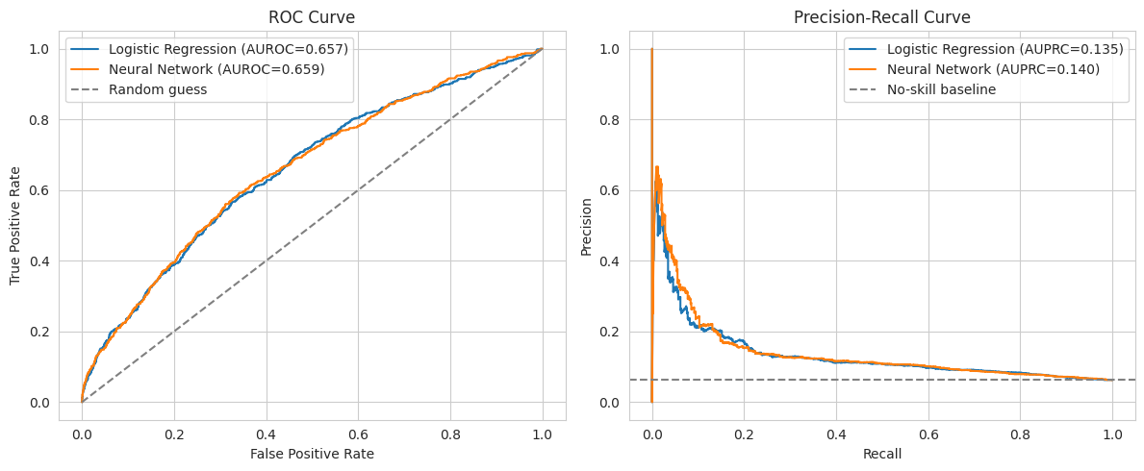
THE TRADE-OFF
Recall vs. Accuracy at the Cutoff
At a 0.5 cutoff: Logistic Regression catches 55% of true readmissions and stays 67% accurate overall. The neural network catches more - 66% - but its accuracy drops to 57%, since it flags more false alarms. Which model is “better” depends on what costs more: missing a real readmission, or an unnecessary follow-up call.
11
Notes:
Slow down here - this is the most clinically relevant slide. The two models make different kinds of mistakes. Which one a hospital would prefer is a clinical decision, not something the model decides on its own.

Slide 12
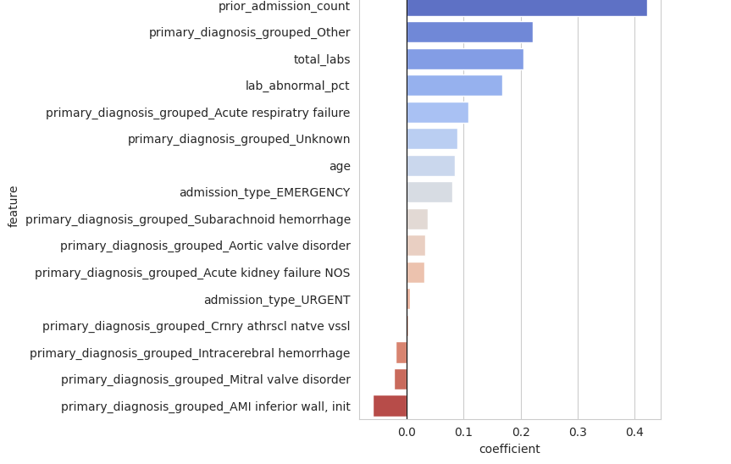
INTERPRETATION
What Actually Predicts Readmission?
FINDING
A few diagnoses — kidney failure, intracerebral hemorrhage — seem to LOWER predicted risk.
But these also carry higher in-hospital mortality. A patient who doesn't survive can't be readmitted — so this is probably about survival, not a safer outcome.
prior_admission_count is the strongest predictor, by a clear margin.
12
Notes:
Walk the chart top to bottom - these are the real logistic regression coefficients from the run. Then spend real time on the finding box: this is the kind of critical reading a model's output needs, not just reporting numbers at face value.

Slide 13
What We Learned
Takeaways
Limitations
• Readmission is somewhat predictable, but not strongly — both models land around 0.66 AUROC.
• We didn't use any of the discharge note text yet.
• A simple model did almost as well as a neural network here.
• Some features come from the same admission we're predicting on — a real deployment would need to check timing more carefully.
• A patient's admission history is the clearest signal we found.
• The mortality mix-up noted earlier isn't separately handled.
• Where to set the risk cutoff is a choice for the hospital, not the model.
• No tuning or cross-validation — kept simple on purpose for this tutorial.
13
Notes:
Close the technical content with an honest, balanced summary. Don't skip the limitations column - naming them clearly is part of what makes the work credible to a reviewer.

Slide 14
Try It Yourself
1
Get PhysioNet-credentialed access to MIMIC-III, and load it into Google BigQuery.
2
Run the feature-engineering SQL query to build the admission-level dataset.
3
Install scikit-learn and TensorFlow.
4
Run the notebook top to bottom - no manual steps needed in between.
Full commented code, with the complete notebook, is linked in this deck's title-slide notes.
14
Notes:
Close by pointing back to the code link on the title slide. Invite questions on any step - especially the architecture reasoning and the metric choices, since those are the parts most worth discussing live.

