Slide 1
NeuroAgent
A Team of AI Specialists for Reviewing Epilepsy EEG Data
AI in Healthcare — High-Risk Project
Murali Balarama Chakaravarthy | The University of Texas at Austin
Notes:
Hi, I'm Murali Balarama Chakaravarthy, and this is NeuroAgent, my high-risk project for AI in Healthcare. In the next few minutes I'll walk through the problem I set out to solve, how I built the system, what I found when I tested it, and where I'd take it next.

Slide 2
The Problem
Reading an EEG to figure out a patient's seizure type is hard, even for trained specialists. Two doctors can look at the same recording and disagree.
50M+
Seizure type matters because it changes what treatment works. Getting it wrong, or staying uncertain too long, has a real cost for patients.
people affected by epilepsy worldwide
In hospitals, doctors sometimes handle uncertain cases by asking a colleague, or a full team, to review it together. This project asks: can a small team of AI models do something similar?
2
Notes:
Epilepsy affects more than 50 million people worldwide. The type of seizure someone has really matters, because different types respond to different treatments. But reading an EEG to work out the type is genuinely hard, even for trained specialists. Two experienced doctors can look at the same recording and reach different conclusions. In real hospitals, doctors sometimes handle that uncertainty by asking a colleague to review a hard case with them. That's the idea I wanted to test with AI.

Slide 3
The Idea: A Board of AI Specialists
Instead of one AI model giving one confident answer, NeuroAgent asks three AI models, each playing a different clinical role, to review the same EEG data independently.
Neurologist
Epileptologist
Neurophysiologist
General seizure differential
Deeper reasoning on hard, ambiguous cases
Focuses on the raw signal pattern
A fourth AI agent, the moderator, compares the three opinions and explains where they agree or disagree - instead of just picking a winner.
3
Notes:
The core idea is simple: instead of one AI model giving one confident answer, ask three AI models, each playing a different clinical role, to review the same EEG data independently. One acts like a general neurologist, one like an epileptologist who specializes in hard cases, and one like a neurophysiologist focused purely on the signal itself. A fourth agent, the moderator, then compares all three opinions and explains where they agree or disagree, instead of just picking one winning answer.

Slide 4
The Data
This project uses the CHB-MIT Scalp EEG Database, a public dataset of EEG recordings from pediatric epilepsy patients, hosted on PhysioNet.
2
4
patients
EEG files
From this dataset, two patient cases and four EEG files were used, giving eight 20-second EEG windows — four during a labeled seizure, four during normal activity.
8
256Hz
windows
sample rate
4
Notes:
For data, I used the CHB-MIT Scalp EEG Database, a public dataset of pediatric epilepsy EEG recordings hosted on PhysioNet. I worked with two patient cases and four EEG files, which gave me eight 20-second windows to test with — four during a labeled seizure, and four during normal activity for contrast.

Slide 5
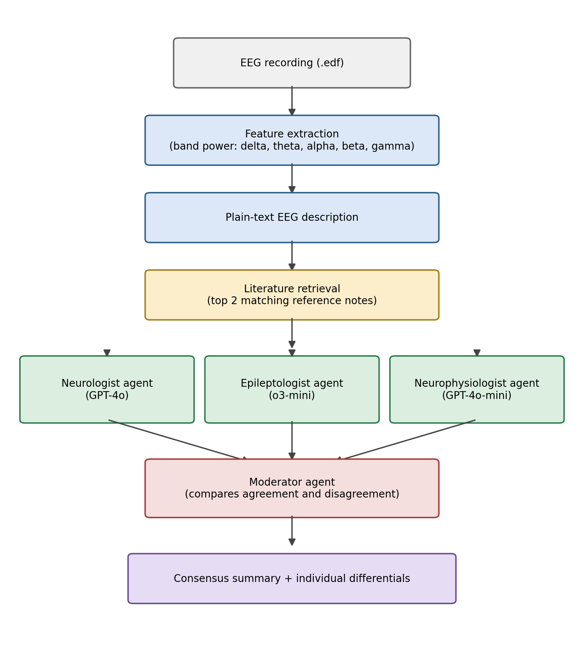
How It Works
Raw EEG signal is converted into a plain-text summary of frequency patterns, matched against a small reference library, then reviewed independently by the three specialist agents before the moderator summarizes the discussion.
5
Notes:
Here's the full pipeline. Raw EEG data is first turned into a short, plain-text description of its frequency patterns — because language models read text, not raw signal. That description is matched against a small reference library of what different EEG patterns typically look like. Then the three specialist agents each independently review it, and the moderator summarizes their discussion.

Slide 6
A Simple Comparison Point
Before trusting a complex multi-agent system, it's worth asking: how far can a simple classical model get using the same inputs?
75%
Accuracy
A logistic regression model was trained on the same five frequency-band numbers the AI agents see.
6
Notes:
Before trusting a complex system, it's worth asking how far a much simpler method gets with the same inputs. I trained a basic logistic regression model on the same five frequency-band numbers the AI agents see, using leave-one-out cross-validation since I only had 8 windows. It got 6 out of 8 correct, 75 percent. With this few samples, that's a rough signal, not a precise number — but it gives me something real to compare the AI board against.

Slide 7
Key Finding: A Shared Blind Spot
One EEG window was mislabeled by two very different methods — for the same likely reason.
The Baseline Model
The Epileptologist Agent
On a non-seizure window, the logistic regression baseline incorrectly predicted “seizure.”
On the same window, the epileptologist agent independently leaned toward “possible ictal activity” at medium confidence — the same wrong direction.
This points to a real limitation in the input features, not a random error: the window likely reflects natural sleep activity, which looks similar to seizure activity.
7
Notes:
Here's the most interesting result. Look at one specific EEG window, one that's labeled non-seizure in the dataset. The baseline classifier got it wrong, predicting seizure. And completely independently, the epileptologist agent also leaned toward possible seizure activity at medium confidence, while the neurologist agent correctly leaned away from it. That's not a coincidence. Two very different methods, a simple statistical model and a language model reasoning in plain text, were fooled by the same thing: this window likely reflects natural sleep activity, which looks a lot like seizure activity if you only look at average frequency power. That's a real, specific finding about where the input features fall short, not just random noise.

Slide 8
What This Tells Us
Across all eight windows, the three AI specialists didn't always agree - and the moderator consistently pointed to a specific, identifiable reason: whether strong slow-wave activity should be read as sleep or as seizure.
Limitations
All three agents use models from the same company
No seizure-type labels yet - detection only
Only 2 patients, 8 windows - illustrative, not validated
No clinician has reviewed the outputs
8
Notes:
Across all eight windows, the three specialists didn't always agree, and the moderator was able to consistently point to a specific reason: whether strong slow-wave activity should be read as sleep or as seizure activity. That's the core behavior I set out to test — surfacing real uncertainty instead of a single falsely confident answer. I want to be upfront about the limitations too: all three agents currently use models from the same company, so their independence is limited; I only have detection labels, not seizure-type labels yet; the sample size is very small; and no real clinician has reviewed any of this. [DEMO CUE: switch screen to the Colab notebook here. Fast-forward through the run, then land on the results table and the chb05_06.edf output for a few seconds before cutting back to slides.]

Slide 9
Future Directions
Real seizure-type labels
True model diversity
Use a dataset like Siena or TUSZ, which have real clinician-diagnosed seizure types, not just detection labels.
Add agents built on models from more than one company for genuinely independent opinions.
A medication agent
Rebuild with Agent framework
A fourth agent grounded in published treatment guidelines, once seizure type is known.
Use a framework built specifically for multi-agent conversation instead of orchestration in the code.
9
Notes:
If I kept going with this, here's where I'd take it. First, use a dataset with real seizure-type labels, like Siena or TUSZ, so the system can actually tell types apart, not just detect seizures. Second, add genuine model diversity by mixing in models from more than one company. Third, add a fourth agent focused on medication choice once a type is known, grounded in real treatment guidelines. And finally, I'd rebuild the multi-agent coordination using AutoGen, a framework built specifically for this, instead of the hand-written code I used here.

Slide 10
Conclusion
NeuroAgent shows that a small team of AI specialists can surface genuine, explainable disagreement in EEG review - and that a shared blind spot between an AI agent and a classical model can point to a real gap in the data, not just noise.
It's a research prototype, and not a replacement for a real doctor's judgment.
Code submitted as a Colab notebook alongside this presentation
Thank you
Notes:
To wrap up: NeuroAgent shows that a small team of AI specialists can surface real, explainable disagreement when reviewing EEG data, instead of hiding uncertainty behind one confident answer. And the case study I showed you, where an AI agent and a simple classical model shared the same blind spot, points to a real gap in the underlying data, not just random noise. This is a research prototype for a course project, not a medical device, and it's not a replacement for a real doctor. Thank you for watching — the notebook is included with this submission.

