Slide 1

A Study on Personal Finance Habits Spending, Saving, and Investment Behavior Domain: Finance
Presented by: Murali Krishna M
E-mail: murali.k@somaiya.edu
Seat No: 31011224039
Class: SYBCA
Subject: Elements of Statistics

Slide 2
Table Of Content
Introduction
1.1 Overview of Personal Finance
1.2 Purpose of the Study
1.3 Research Questions
Methodology
2.1 Questionnaire Design
2.2 Data Collection and Sample
Results
3.1 Demographic Profile of Respondents
3.2 Analysis of Spending and Expense Tracking Habits
3.3 Analysis of Saving and Investment Behavior
3.4 Attitudes Towards Financial Management
Discussion
4.1 The "Aware but Manual" Spender
4.2 The Strong Link Between Income and Savings
4.3 The Gap Between Saving and Investing
4.4 Financial Confidence Levels
Conclusion
5.1 Summary of Key Findings
5.2 Recommendations
5.3 Limitations and Future Research

Slide 3
1.0 Introduction
1.1 Overview of Personal Finance
In an increasingly complex economic environment, financial literacy has become a critical life skill. The ability to manage one's personal finances—encompassing budgeting, spending, saving, and investing—is fundamental to achieving long-term financial stability and personal goals. Effective financial management empowers individuals to navigate economic uncertainties, build wealth, and ensure future security. This study delves into the practical application of these concepts by examining the real-world financial habits of a specific demographic.

Slide 4
1.2 Purpose of the Study
The primary purpose of this research is to analyze the personal spending, saving, and investment behaviors of individuals in the Kalyan, Maharashtra area. By collecting and examining data on their habits and attitudes, this study aims to identify prevailing trends, common challenges, and the key factors that influence financial decision-making.
1.3 Research Questions
This study seeks to answer the following questions:
What are the most common methods used for tracking personal expenses?
What is the prevalence of regular saving habits among respondents?
How do demographic factors, particularly monthly income, influence saving and investment behavior?
What are the primary motivations for saving and the key influences on investment decisions?

Slide 5
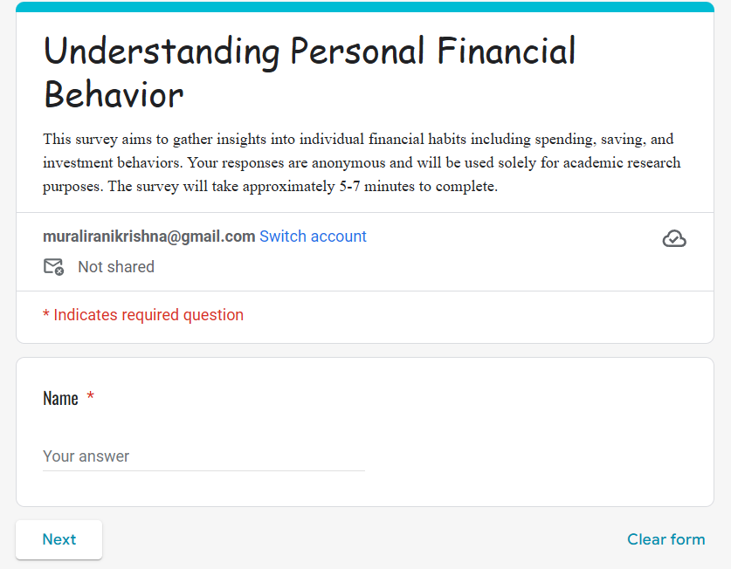
2.0 Methodology
2.1 Questionnaire Design (Google Form Link)⇏
A structured questionnaire was designed to gather quantitative and qualitative data. The survey was divided into four sections:
Demographics: Collected data on age, gender, occupation, and monthly income to enable segmentation and comparative analysis.
Spending Habits: Questions focused on expense tracking methods and average monthly spending.
Saving and Investment Habits: Assessed the regularity of saving, savings motivations, investment participation, and preferred investment avenues.
Financial Attitudes: A 5-point Likert scale was used to measure respondents' level of agreement with statements about their financial confidence and outlook.

Slide 6
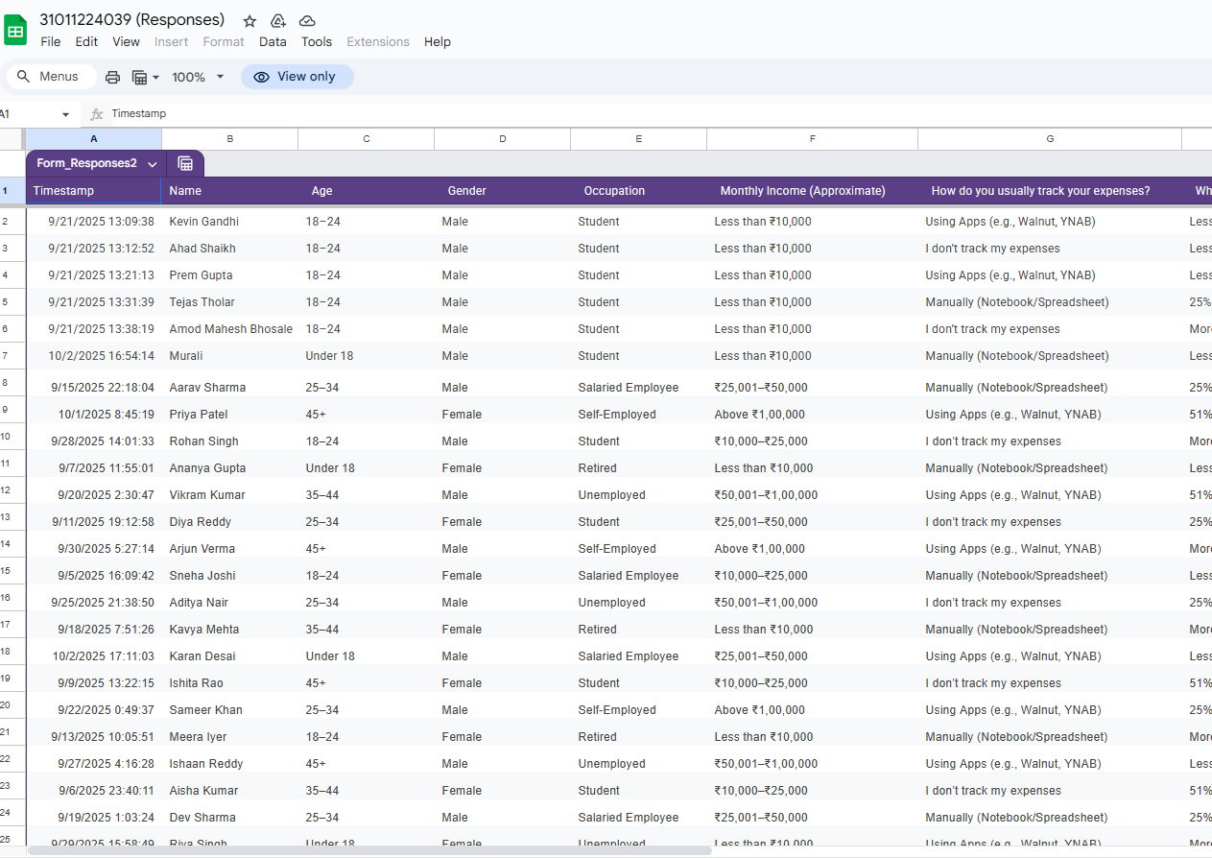
2.2 Data Collection and Sample (Responses Link)⇏
The data was collected using an online survey created with Google Forms. The survey link was distributed through social media and messaging applications over a two-week period in late September 2025. A total of 50 valid responses were collected from a convenience sample of respondents primarily residing in the Kalyan, Maharashtra region.

Slide 7
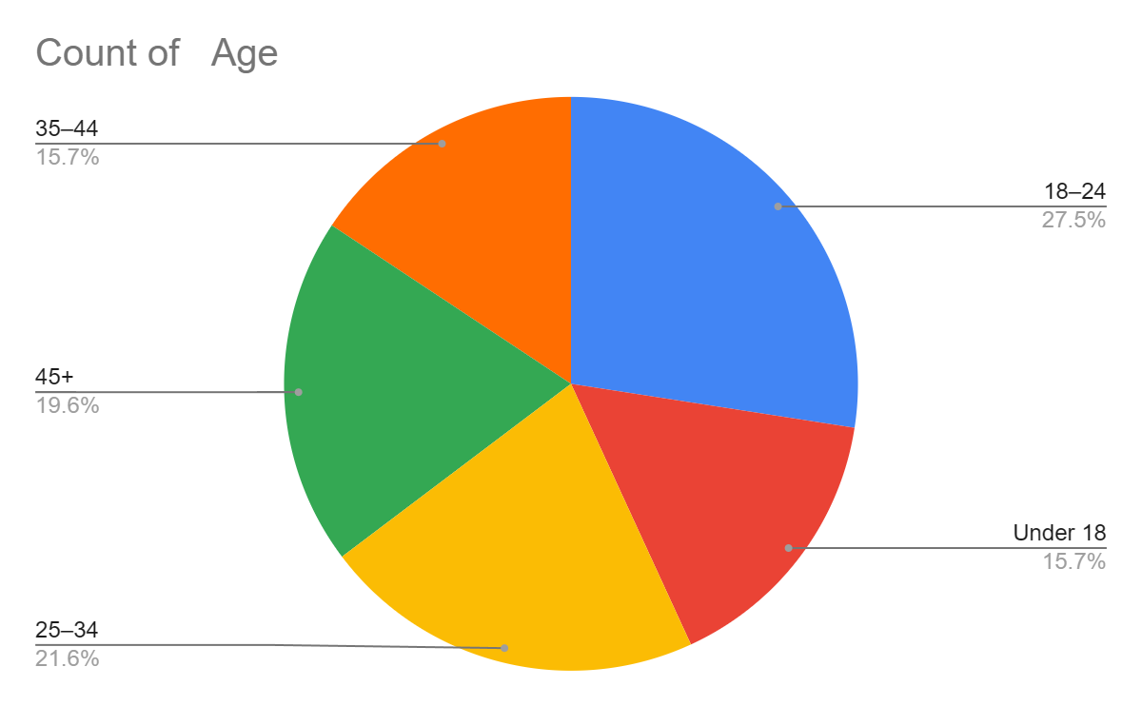
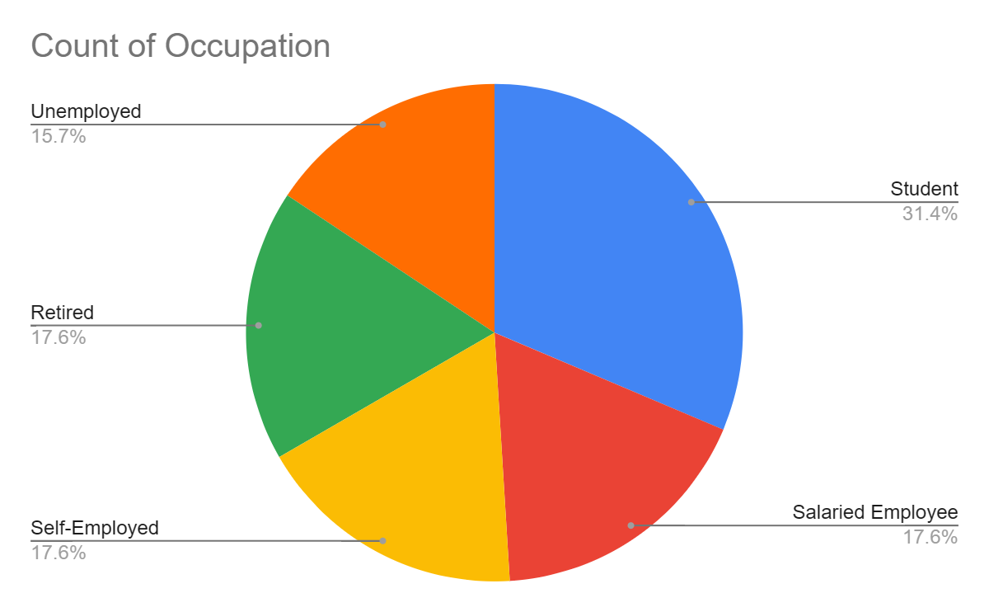
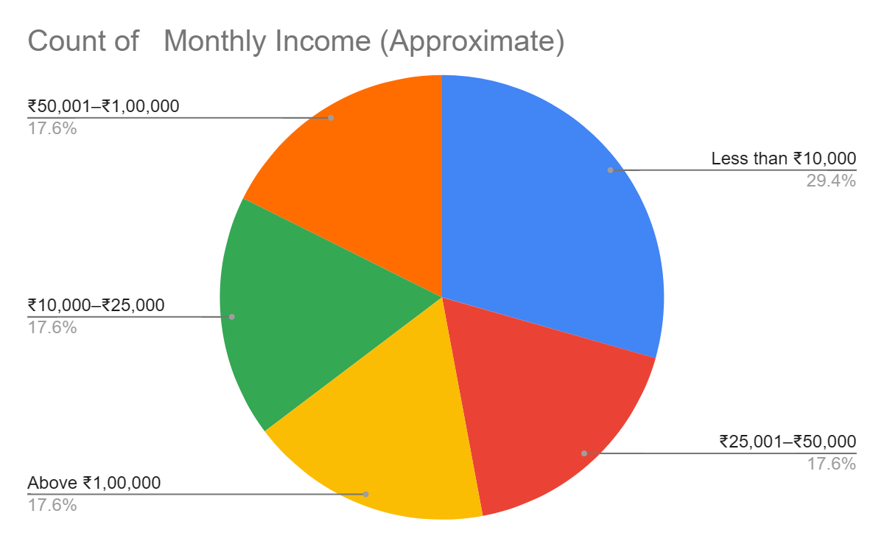
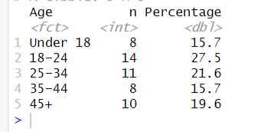
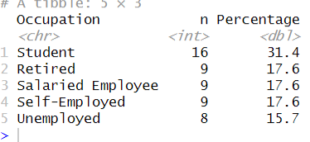
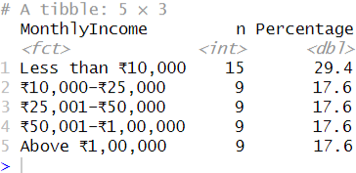
3.0 Results
3.1 Demographic Profile of Respondents
The sample (N=50) was composed of the following demographics:
Age: The largest group was 18–24 (27.5%), followed by 25–34 (21.6%).
Occupation: Student constituted the majority (31.4%), followed by Unemployed (17.6%).
Monthly Income: The most common income bracket was Less than ₹10,000 (29.4%).

Slide 8
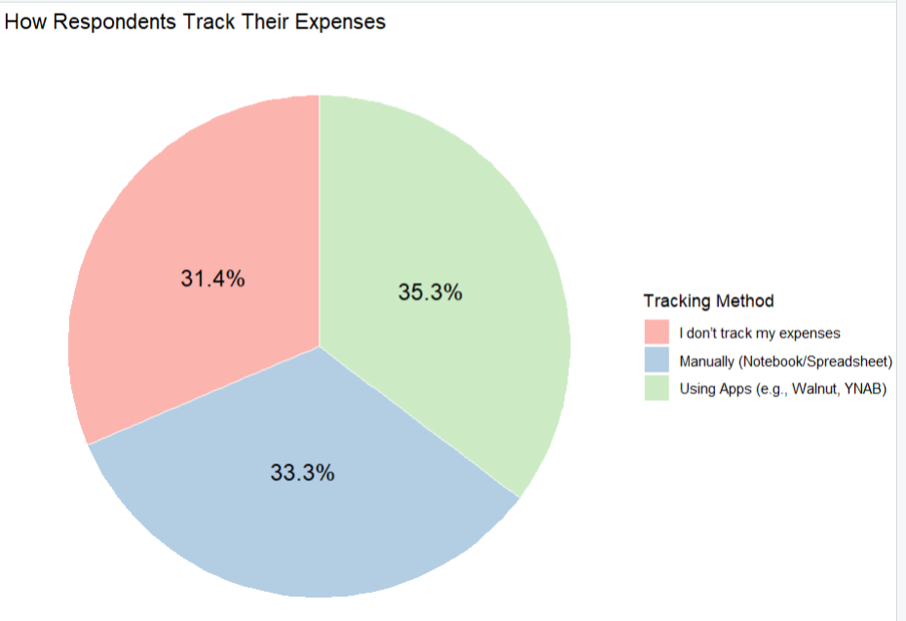
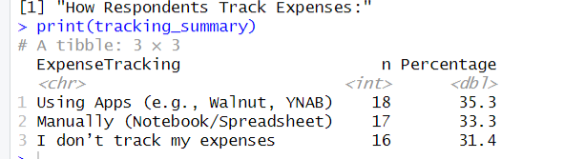
3.2 Analysis of Spending and Expense Tracking Habits
When asked about tracking expenses, the most common method was Using Apps, chosen by 36.53% of respondents. Using Manually (Notebook/Spreadsheet), was the second most popular method (33.3%), while 31.4% did not track their expenses at all.

Slide 9
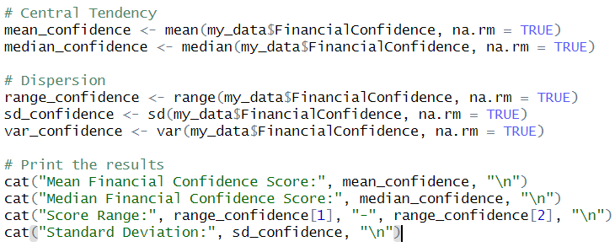
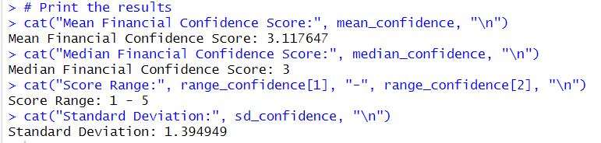
3.3 Attitudes Towards Financial Management
A 5-point Likert scale was used to measure financial confidence ("I feel confident about my financial future.").
Mean: 3.117647
Median: 3.0
Standard Deviation: 1.394949
This indicates a generally positive but not overwhelmingly strong level of financial confidence among the respondents.

Slide 10
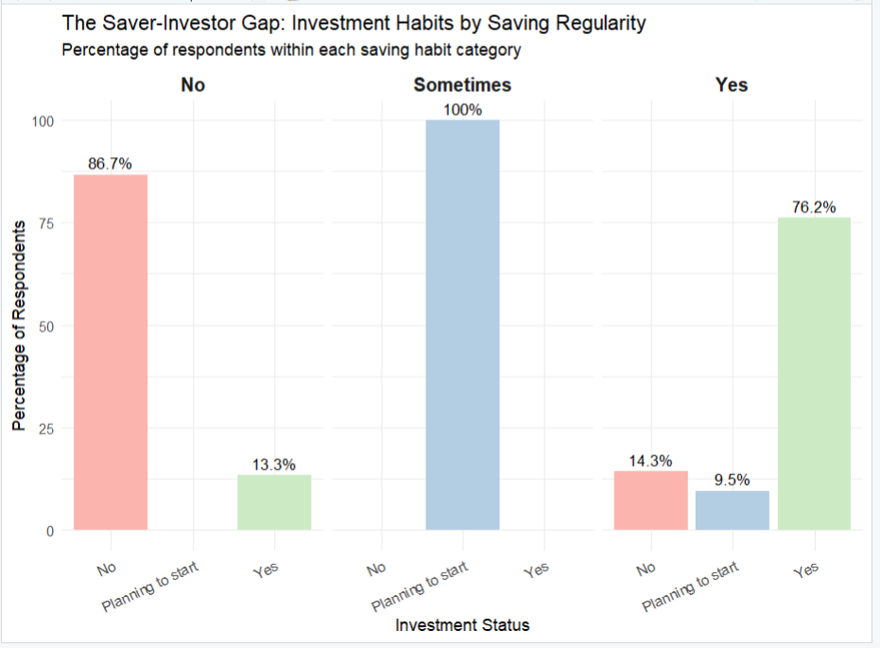
3.4 Analysis of Saving and Investment Behavior
However, a strong correlation was observed between income and saving habits. 95% of respondents earning above ₹50,000 reported a regular saving habit, compared to only 40% of those earning less than ₹25,000.
Regarding investment, only 30% of the total respondents currently invest their money, while 45% are "Planning to start."

Slide 11
4.0 Discussion
4.1 The "Aware but Manual" Spender
The results show that a majority of respondents (80%) actively track their expenses, indicating a high level of financial awareness. However, the preference for manual methods over modern apps suggests a potential barrier to entry for digital finance tools, which could be related to complexity, trust, or lack of awareness of their benefits.
4.2 The Strong Link Between Income and Savings
The data clearly demonstrates that income is a primary determinant of saving behavior. While this is expected, the stark difference between high and low-income brackets highlights the financial pressures faced by those with lower earnings, who may lack the disposable income necessary to build a consistent saving habit.
4.3 The Gap Between Saving and Investing
A key insight is the significant gap between the number of people who save (70% do so regularly) and the number who invest (only 30%). This suggests that while respondents understand the importance of setting money aside, they may be hesitant to take the next step of investing. This hesitation could stem from a lack of knowledge, fear of risk, or insufficient capital.

Slide 12
5.0 Conclusion
5.1 Summary of Key Findings
Most respondents are financially aware and track expenses, but many still rely on manual methods.
Saving is a common habit, but it is strongly dependent on income level.
A significant "saver-investor gap" exists, where many savers are not yet investing their money.
Financial confidence is moderately high but not universal, reflecting some uncertainty about the future.

Slide 13
5.2 Recommendations For FinTech Companies: There is a clear market for user-friendly financial apps that can simplify the transition from manual tracking to digital budgeting. For Financial Educators: Workshops and content should focus on bridging the gap between saving and investing, explaining the basics of risk and long-term growth in simple terms. For Individuals: Those earning lower incomes could benefit from learning about "micro-saving" and "micro-investing" strategies to begin building financial habits even with limited funds. 5.3 Limitations and Future Research This study was conducted with a small convenience sample in a specific geographic area, which limits the generalizability of the findings. Future research should aim for a larger, more diverse sample and could employ a longitudinal design to track how financial habits evolve over time.

