Slide 1
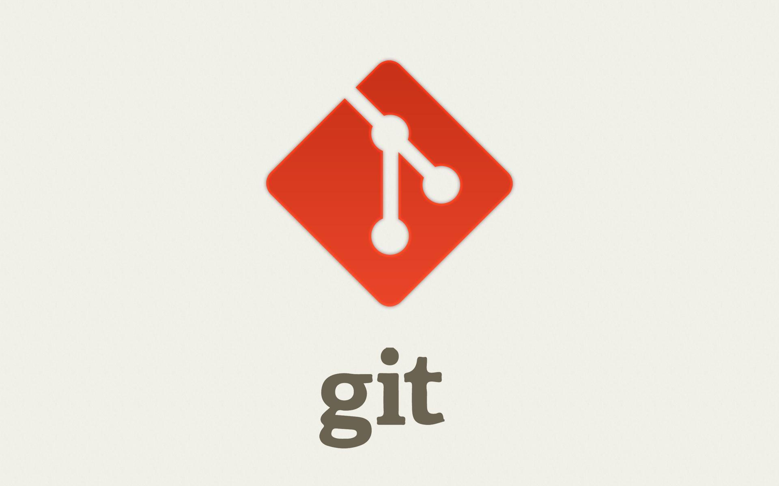

Slide 2
Version Control System
Version control is a system that records changes to a file or set of files
Local Version Control System
(Ex) RCS
Centralized Version Control System
(Ex) CVS, Subversion, Perforce
Distributed Version Control System
(Ex) Git , Mercurial, Bazaar or Darcs

Slide 3
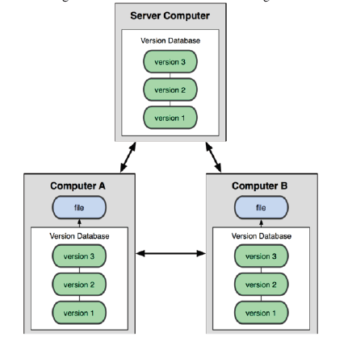
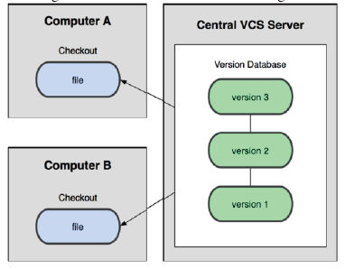
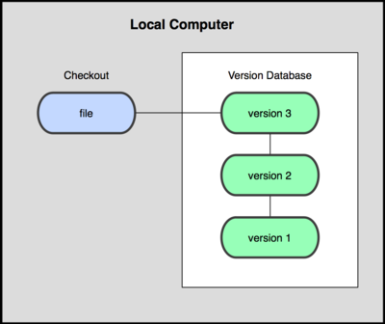
Distributed VCS
Centralized VCS
Local VCS

Slide 4
Git Basics
It was developed by Linus Torvalds
There are two steps to get the project into the git.
Step 1 : Cloning the existing Git repository from the server to your local git repository.
Commands:
git clone git://github.com/schacon/grit.git(URL)
Step 2 : Import the existing project or directory into your local git repository and push into
remote git repository.
Commands:
git init // Create an empty Git repository or reinitialize an existing one
git add *.* // Add file contents to the index
git commit -m ‘ initial version’ // Record changes to the local repository
git push origin master // Push the code into remote repository

Slide 5
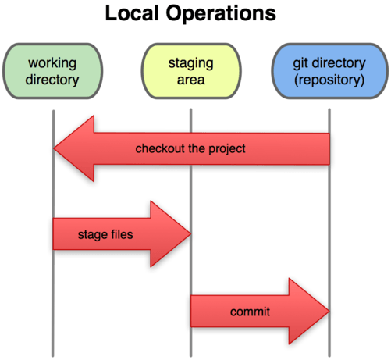
Three states
Three main sections of a Git:
Git directory - Stores the metadata and object database for your project (while cloning
the repository)
Working directory - Single checkout of one version of the project.
These files are pulled out of the compressed database in the Git directory and placed
on disk for you to use or modify
Staging area - It is a simple file, generally contained in your Git directory, that stores
information about what will go into your next commit.

Slide 6
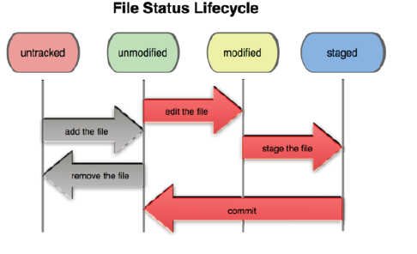
Recording Changes to the Repository
Each file in your working directory can be in one of two states: tracked or untracked
File status in Life Cycle : Untracked , Unmodified, Modified, Staged

Slide 7
Checking the status of Your files
To see the status of your file
Command : git status
1. Untracked Files - any files in your working directory that were not in your last snapshot and are not
in your staging area.
2. Tracked Files - files that were in the last snapshot
The following command is used to make the file as trackable
Command : git add filename
3. Staging Modified Files - a file which is already tracked and it has been modified in the working
directory but not yet staged.
4. Unstaging Modified Files - it make the files to get them out of the staging area.
The following command is used to make the file to unstage
Command : git reset HEAD filename

Slide 8
Viewing Your Staged and Unstaged Changes
To see differences in staged and unstaged files
Command : git diff
To see the differences in staged and last committed file
Command : git diff –cached
Note : git diff does not show the difference of staged and last committed file

Slide 9
Commit Your Changes
The simplest way to commit is to type
Command : git commit
To commit along with comments
Command : git commit –m “Comments”
Skipping the Staging Area
To skip staging area during commits
Command: git commit –a –m “Comments”
Removing Files
To remove the file
Command : git rm filename rm filename
To remove the file from staged area
Command : git rm -- cached filename

Slide 10
Moving Files
No metadata is stored in Git that tells it you whether the file is renamed. To rename a file in Git,
Command : git mv file_from file_to
Viewing the Commit History
To see the commit history
Command : git log
To see the difference introduced in each commit
Command : git log p
It is possible to limit output for last two entries
Command : git log p -2

Slide 11
Changing Your Last Commit
To change the last commit (if we forget to add anyone of the file)
Command : git commit –amend
This will takes to the staging area and use it for commit
Ex
git commit –m ‘comments’ // Record changes to the repository
git add filename // Realize, you forgot to add the file
git commit –amend // Record changes to the repository with newly added file
Unstaging a Staged File
To Make the Staged files to Unstaged file
Command : git reset HEAD filename
Unmodifying a Modified File
To make the Modified files to unmodified file
Command : git checkout filename

Slide 12
Working with remotes
To push our code to the remote server (actual git repository)
Command : git push origin branchname
To pull the code from the remote server (actual git repository)
Command : git pull
To get the newly created branches in our local repository
Command : git fetch

Slide 13
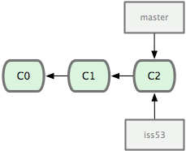
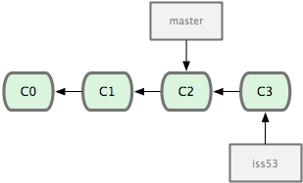
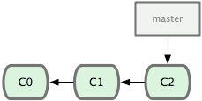
Branching
To create a branch in local repository
Command : git checkout –b branchname
To Delete a branch in local repository
Command : git branch –d branchname

Slide 14
Merging and Rebasing
To merge the branch
Merging brings two lines of development together while preserving the ancestry of each
commit history.
Command : git merge branchname
git checkout devel // Switch to devel branch in local repository
git pull // Pull the latest code of devel from remote repository
git merge hotfix // Merge the hotfix branch into devel branch present in the local repository
git push origin devel // Merged devel branch is pushed to the remote repository
To rebase the branch
Rebasing unifies the lines of development by rewriting changes from the source branch so
that they appear as children of the destination branch
Command : git rebase branchname
git checkout devel // Switch to devel branch in local repository
git pull // Pull the latest code of devel from remote repository
git rebase hotfix // Get the hotfix branch changes to the devel branch present in the local repository
git push origin devel // Rebased devel branch is pushed to the remote repository

Slide 15
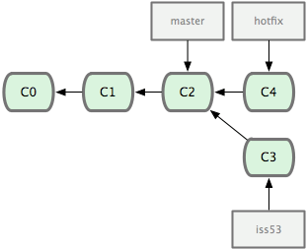
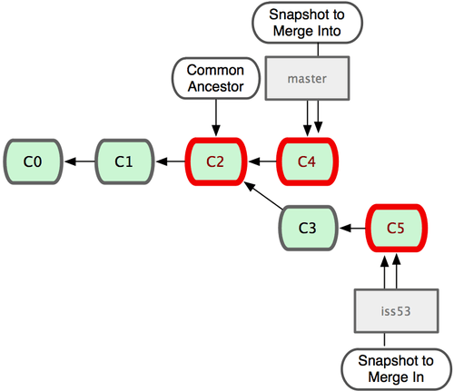
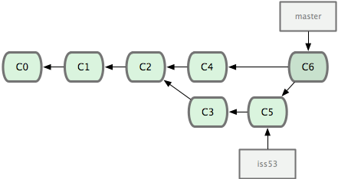
Example for Merging the branch

Slide 16
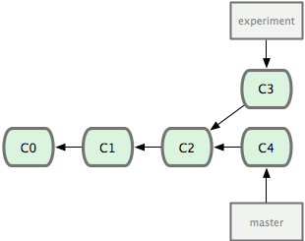
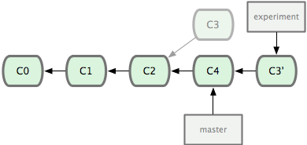
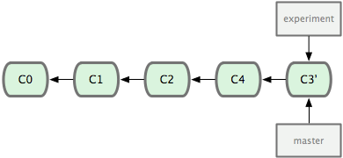
Example for Rebase a branch

Slide 17


