Slide 1
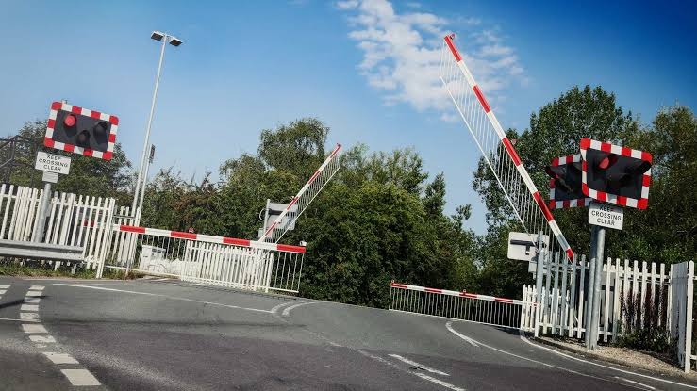
Railway Level Crossing Monitor
A SKY130 RTL-to-GDSII ASIC Design
Fail-safe sequence watchdog for level crossings
B.Tech, Electronics and Communication Engineering
T. Murali · 24EG104C35
Anurag University, School of Engineering · 2026–27

Slide 2
Why level crossings need a watchdog
Lights ON
→
Barrier DOWN
→
Train passes
→
Barrier UP
→
Back to idle
!
What can go wrong
?
Why not firmware?
✓
Our answer
Warning light never turns on
Barrier stuck, never reaches down
Train reported gone before barrier was down
Barrier does not rise after the train
A microcontroller needs firmware, boot sequence, often an OS
Each adds a point of failure and start-up delay
Relay logic and manual checks can miss faults
Dedicated digital hardware watchdog
Reacts within a single clock cycle
No software to crash: deterministic
Latched fail-safe alarm plus error code

Slide 3
Project objectives
1
Define a functional specification: safe sequence, stage timeouts, out-of-order detection, latched fault and a 3-bit error code
2
Implement it as a six-state FSM with a shared 8-bit timeout counter in synthesizable, macro-free Verilog-2005
3
Verify the RTL with a self-checking testbench and the synthesized netlist with gate-level simulation
4
Synthesize to SKY130 high-density cells and close timing in all 16 PVT corners, before and after layout
5
Run OpenLane RTL-to-GDSII in a 100 µm × 100 µm die with zero DRC, LVS, antenna, CVC and routing violations

Slide 4
What the monitor sees and reports
Inputs (7 bits)
Outputs (5 bits)
clk 20 MHz clock
reset synchronous, active high
train_approach train approaching
train_depart train has cleared
light_on_sensor lights are ON
barrier_down_sensor barrier fully DOWN
barrier_up_sensor barrier fully UP
MONITOR
6-state FSM
8-bit shared counter
3-bit error register
fail_safe 1 = violation or timeout; crossing unsafe
sequence_ok 1 = sequence proceeding normally
error_code[2:0] 000 = no error; other values identify the violation
→
→
A parallel safety checker: it watches the crossing but never drives the barriers or lights, and fail_safe and sequence_ok can never be 1 together.

Slide 5
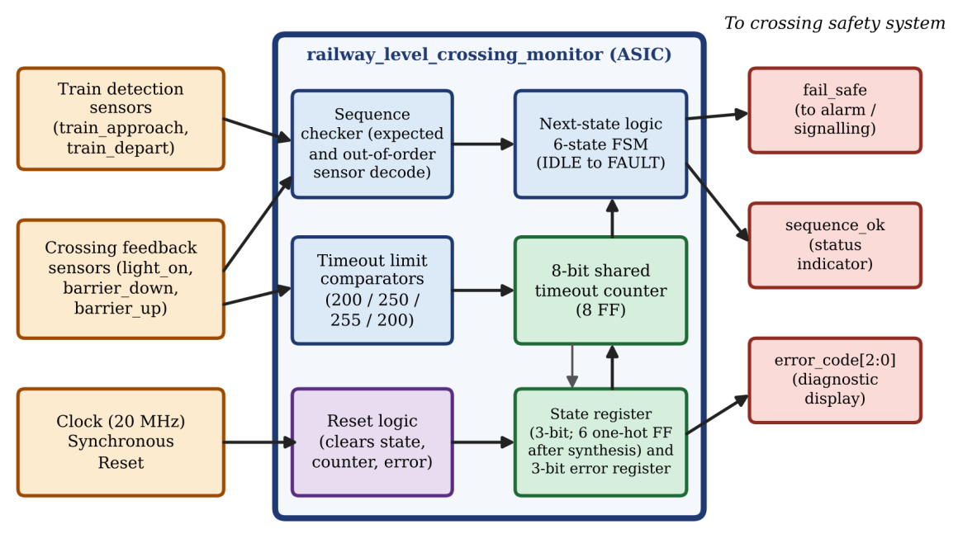
Architecture: block diagram
Sequence checker
expected, out-of-order or no event
Timeout comparators
shared counter vs limit 200 / 250 / 255 / 200
Next-state logic
next state and error code to latch
Registers
3-bit state, 8-bit counter, 3-bit error
Output decoder
driven by registers only, so glitch-free

Slide 6
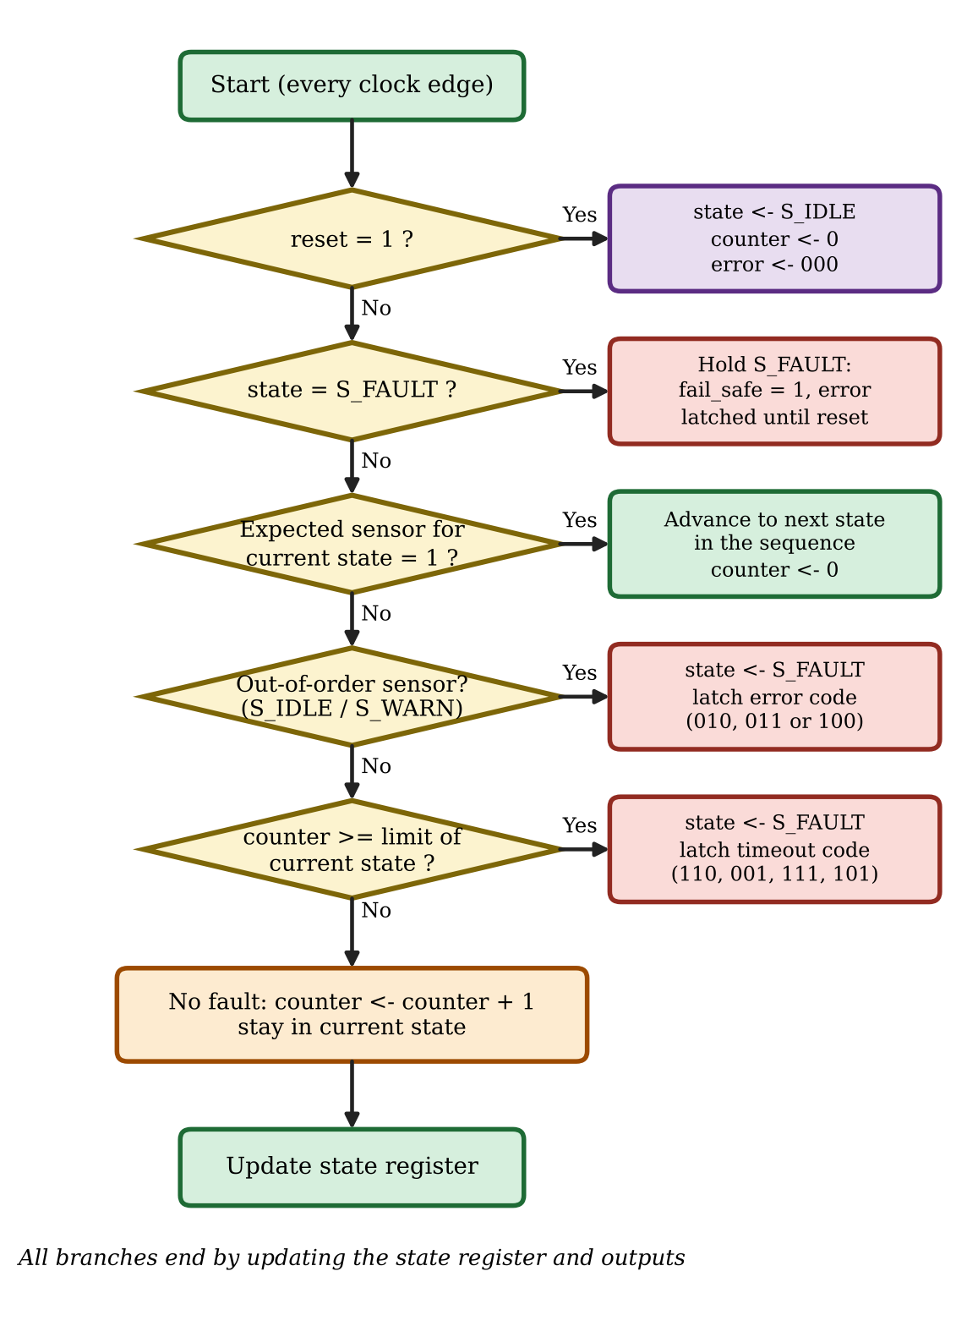
Flowchart: one decision order per clock
1
Reset: load S_IDLE, clear counter and error register
2
Fault latched: S_FAULT holds fail_safe = 1 until reset
3
Expected sensor: advance to next state, clear counter
4
Out-of-order sensor: S_IDLE / S_WARN only: fault code 010, 011 or 100
5
Timeout: counter ≥ limit: fault code 110, 001, 111 or 101
6
Otherwise: counter + 1 and stay in the current state

Slide 7
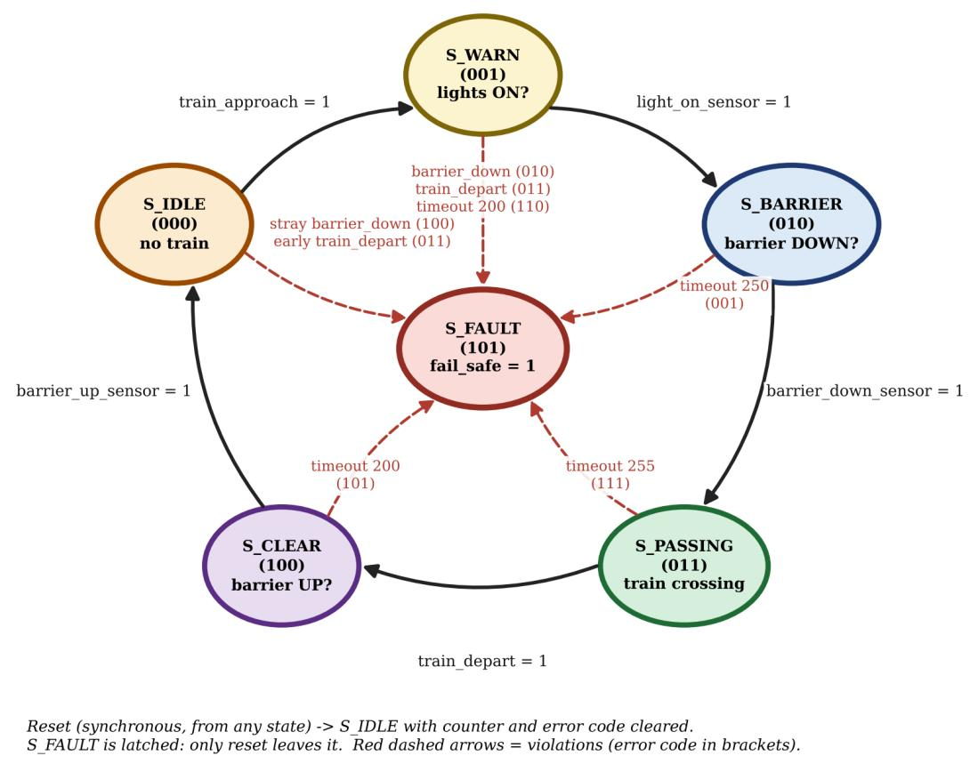
Six-state Moore FSM
State | Code | Waits for
S_IDLE | 000 | no train (reset state)
S_WARN | 001 | lights ON?
S_BARRIER | 010 | barrier DOWN?
S_PASSING | 011 | train crossing
S_CLEAR | 100 | barrier UP?
S_FAULT | 101 | latched until reset
Unused codes 110 and 111 return to S_IDLE
Yosys re-encodes the state as one-hot: 6 state flip-flops

Slide 8
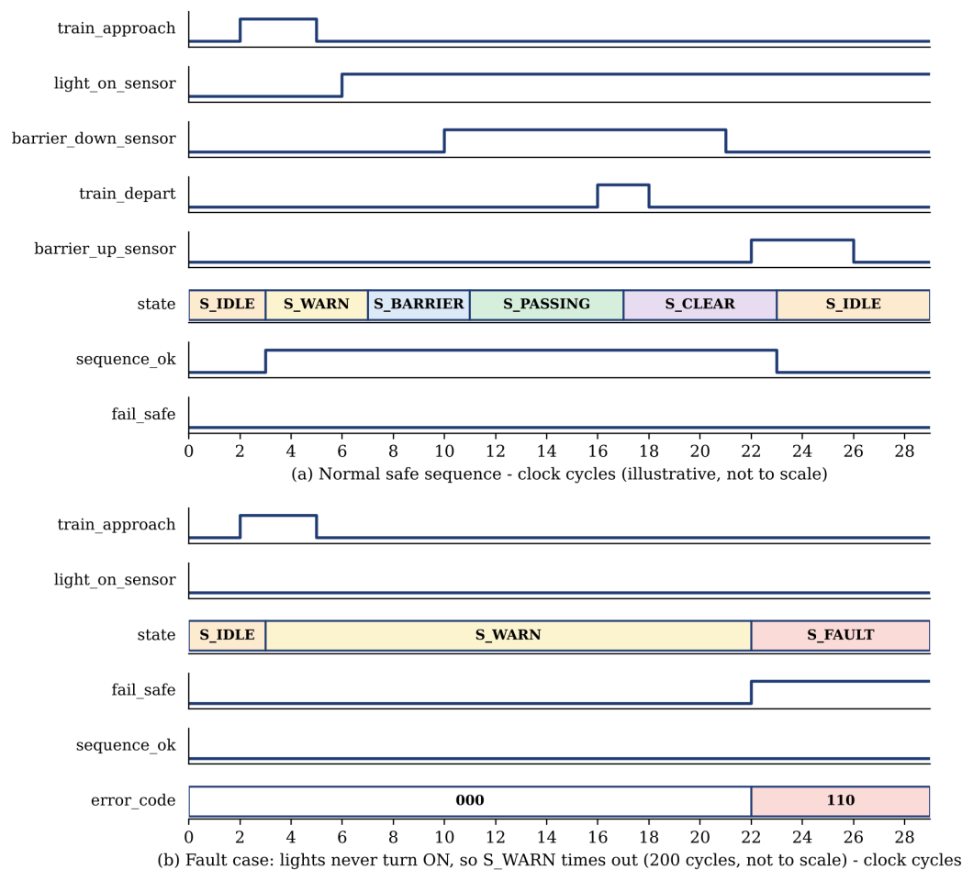
Timing: safe sequence vs. fault case
State | Cycles | At 20 MHz | Rationale
S_WARN | 200 | 10.00 µs | lights respond quickly
S_BARRIER | 250 | 12.50 µs | barrier has mechanical delay
S_PASSING | 255 | 12.75 µs | longest train transit
S_CLEAR | 200 | 10.00 µs | similar to barrier descent
S_IDLE and S_FAULT have no limit: idle waits for a train, fault is latched until reset
One shared counter, cleared on every transition
(b) Lights never turn ON: S_WARN times out after 200 cycles, S_FAULT, error_code 110

Slide 9
Error codes identify the violation
Code | Meaning | Detected in
000 | No error | —
001 | Timeout: barrier did not go down in time | S_BARRIER
010 | barrier_down_sensor asserted before lights were ON | S_WARN
011 | train_depart asserted before barrier was down | S_IDLE or S_WARN
100 | barrier_down_sensor asserted while no train expected | S_IDLE
101 | Timeout: barrier did not go up in time | S_CLEAR
110 | Timeout: lights did not turn ON in time | S_WARN
111 | Timeout: train did not depart within the limit | S_PASSING
Red rows = timeouts · Amber rows = out-of-order sensor events · error_code reads 000 in every state except S_FAULT, where the latched code is held until reset

Slide 10
Design and verification flow
1
2
3
4
RTL design and simulation
Logic synthesis
Pre-layout STA
Gate-level simulation
Verilog-2005 · Icarus Verilog 10.1
Yosys 0.29 → sky130_fd_sc_hd
OpenSTA · 16 PVT corners
SKY130 cell models, functional FF override
100% open source
SKY130A PDK · Yosys · OpenROAD · Magic · KLayout
5
6
7
Physical design
Post-layout STA
Pre vs post comparison
OpenLane v0.21: floorplan, placement, CTS, routing, DRC, LVS, antenna, CVC
SPEF parasitics · same 16 corners
slack change at every corner

Slide 11
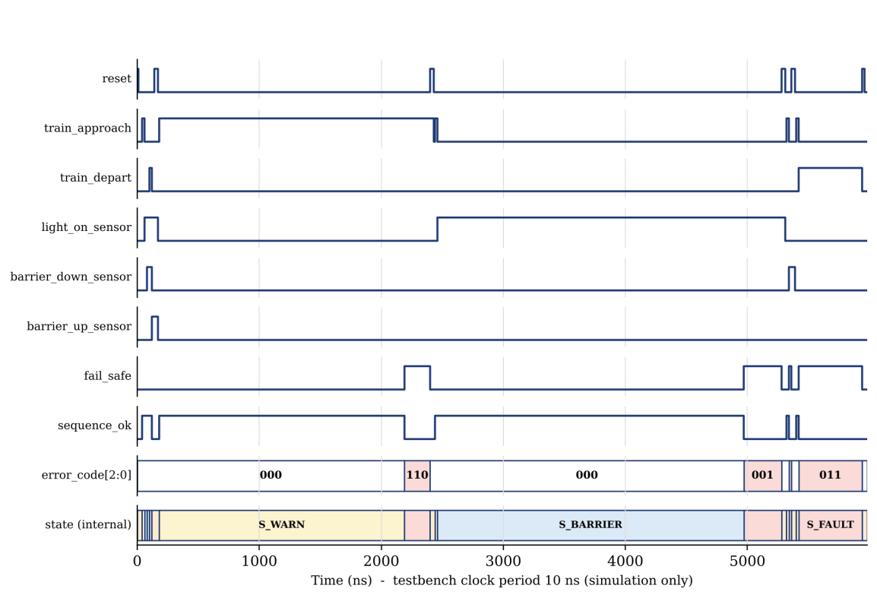
RTL simulation: 13 tests, 14 checks
14 / 14
checks PASS in Icarus Verilog
Full safe sequence, back to S_IDLE
S_WARN timeout → code 110
S_BARRIER timeout → code 001
Barrier early → 010; early depart → 011
Fault held 50 cycles, cleared by reset
Interlock: never both outputs 1
Figure 5.1: waveform of the 13 test cases (10 ns clock, simulation only)

Slide 12
Synthesis and gate-level check
139
1,300 µm²
17
0
standard cells
total cell area
flip-flops (6 state + 8 counter + 3 error)
latches or memories
Gate-level simulation: 14/14 PASS
Same stimulus on the synthesized netlist
Functional FF model (ff_override.v) avoids false X from the UDP hold check
Only primary outputs compared, since the state is one-hot
Netlist is functionally equivalent to the RTL

Slide 13
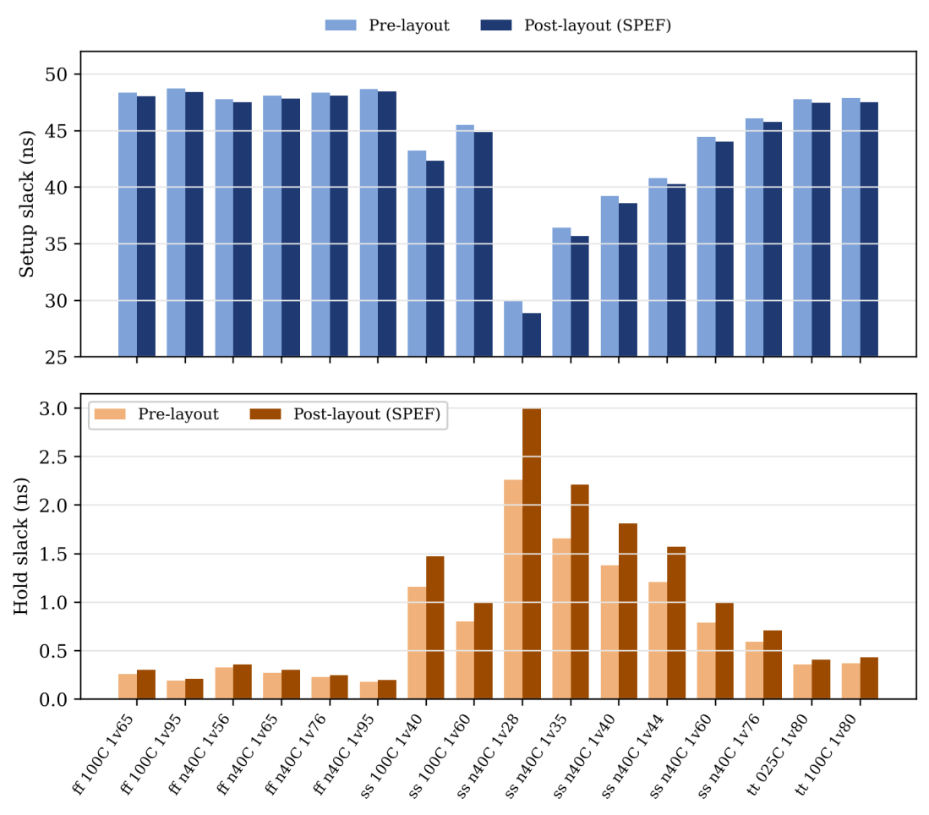
Static timing: 16 of 16 corners pass
+28.85 ns
+0.20 ns
worst setup, post-layout
worst hold, post-layout
Quantity | Pre-layout | Post-layout
Worst setup | +29.93 ns | +28.85 ns
Worst hold | +0.18 ns | +0.20 ns
Corners passing | 16 / 16 | 16 / 16
50 ns clock (20 MHz). Worst setup is the slow corner ss_n40C_1v28: wire parasitics cost about 1 ns, still far inside the period. Hold slack improves slightly after layout.

Slide 14
Slack at every PVT corner (ns)
Corner | Setup pre | Setup post | Δ | Hold pre | Hold post | Δ
ff_100C_1v65 | 48.35 | 48.03 | -0.320 | 0.26 | 0.30 | +0.040
ff_100C_1v95 | 48.72 | 48.43 | -0.290 | 0.19 | 0.21 | +0.020
ff_n40C_1v56 | 47.78 | 47.49 | -0.290 | 0.33 | 0.36 | +0.030
ff_n40C_1v65 | 48.10 | 47.82 | -0.280 | 0.27 | 0.30 | +0.030
ff_n40C_1v76 | 48.38 | 48.11 | -0.270 | 0.23 | 0.25 | +0.020
ff_n40C_1v95 | 48.69 | 48.44 | -0.250 | 0.18 | 0.20 | +0.020
ss_100C_1v40 | 43.23 | 42.35 | -0.880 | 1.16 | 1.47 | +0.310
ss_100C_1v60 | 45.51 | 44.88 | -0.630 | 0.80 | 0.99 | +0.190
Corner | Setup pre | Setup post | Δ | Hold pre | Hold post | Δ
ss_n40C_1v28 | 29.93 | 28.85 | -1.080 | 2.26 | 3.00 | +0.740
ss_n40C_1v35 | 36.43 | 35.69 | -0.740 | 1.66 | 2.21 | +0.550
ss_n40C_1v40 | 39.20 | 38.60 | -0.600 | 1.38 | 1.81 | +0.430
ss_n40C_1v44 | 40.81 | 40.27 | -0.540 | 1.21 | 1.57 | +0.360
ss_n40C_1v60 | 44.43 | 44.04 | -0.390 | 0.79 | 0.99 | +0.200
ss_n40C_1v76 | 46.08 | 45.77 | -0.310 | 0.59 | 0.71 | +0.120
tt_025C_1v80 | 47.77 | 47.48 | -0.290 | 0.36 | 0.41 | +0.050
tt_100C_1v80 | 47.86 | 47.50 | -0.360 | 0.37 | 0.43 | +0.060
Setup slack falls 0.25–1.08 ns from real wire parasitics; hold slack improves 0.02–0.74 ns. Every corner stays positive. Worst case highlighted.

Slide 15
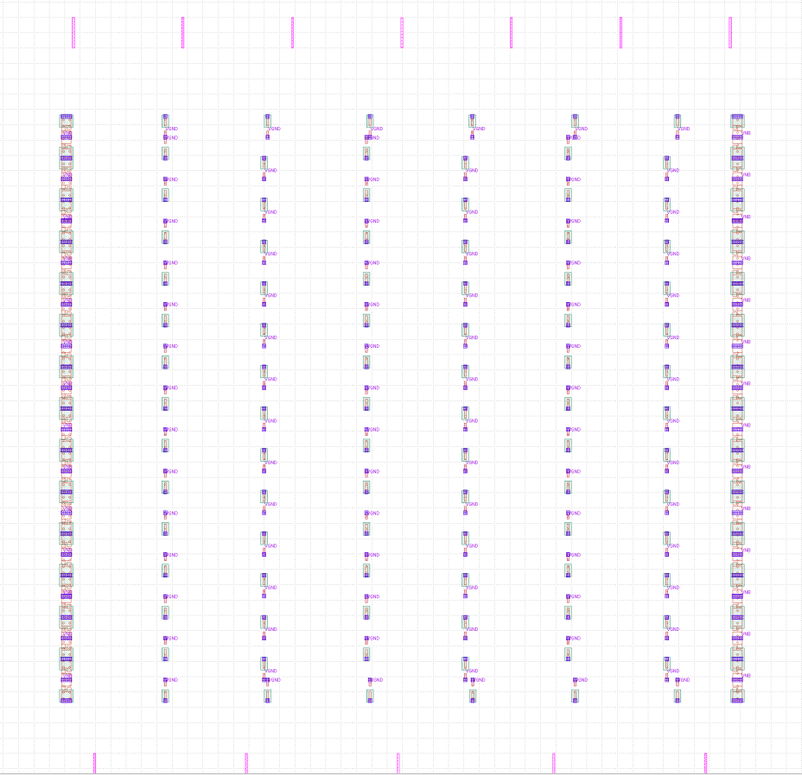
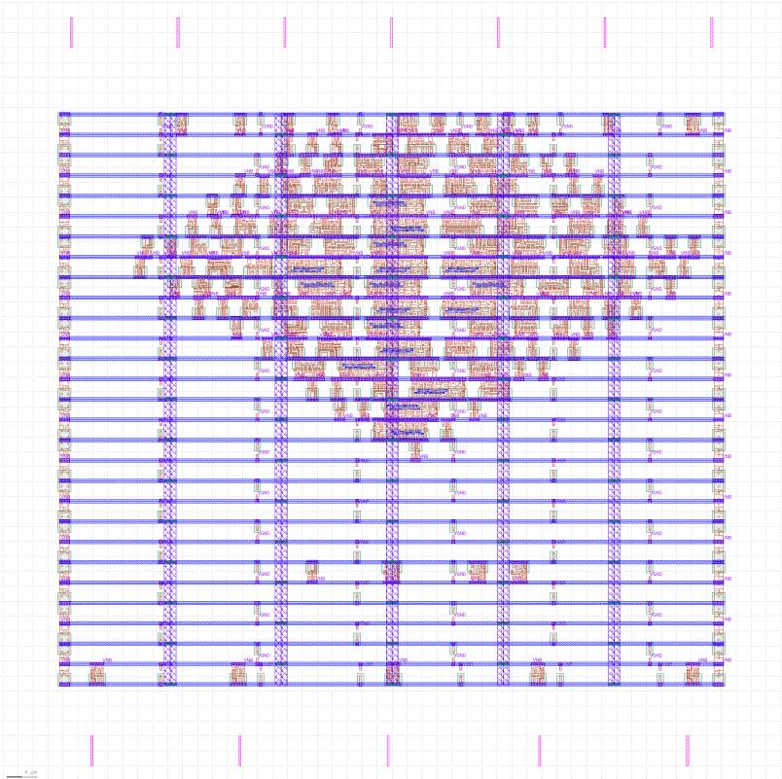
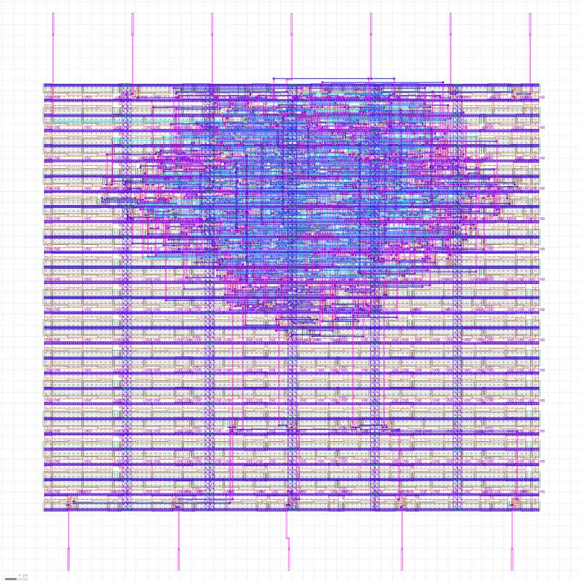
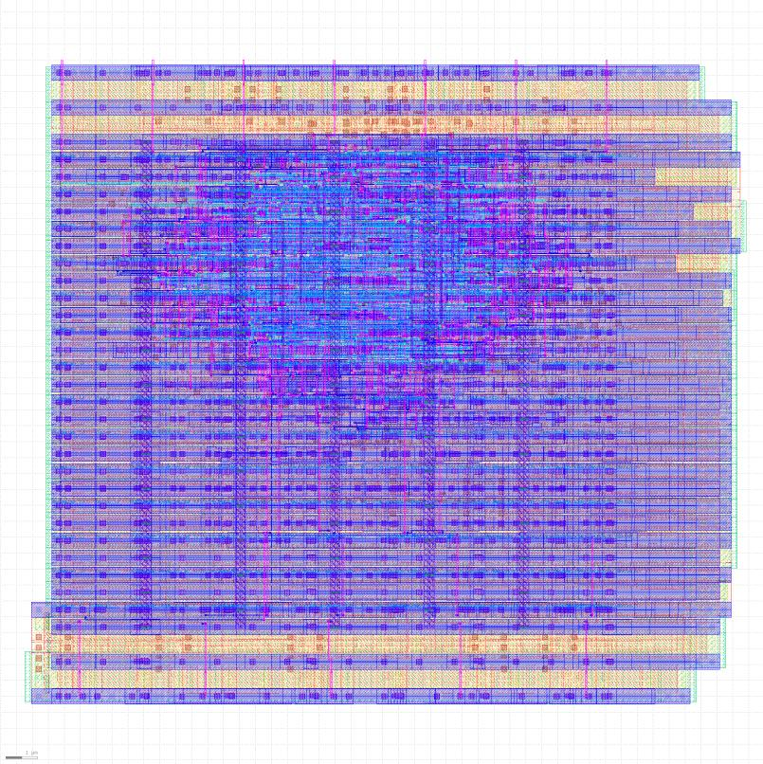
Physical design: floorplan to GDSII
Floorplan
Placement
Routing
Final GDSII
pins and tap cells (Fig. 5.2)
after global placement (Fig. 5.3)
routed layout view (Fig. 5.4)
final layout view (Fig. 5.5)
100 × 100
88.96 × 78.24
139 / 90 / 56
7,135 µm
1,428
3 min 27 s
die, µm (0.01 mm²)
core, µm
logic / tap / end-cap cells
total wire length
vias
OpenLane run time

Slide 16
Sign-off checks: all zero
0
0
0
0
TritonRoute violations
Short violations
Metal spacing violations
Off-grid violations
0
0
0
0
Magic DRC violations
Antenna violations
LVS errors
CVC errors
OpenLane warns the core is too small for the standard power-grid pitch (about 153 µm vs a 100 µm die). It minimises the grid and every check still passes. LVS proves the layout matches the synthesized netlist.

Slide 17
Cost, society and environment
1
Cost
2
Usefulness to society
3
Environmental safety
Free open-source tools and PDK: no licence cost
Only 1,300 µm² of cells in a 0.01 mm² die
No firmware, so no software development or update cost
Fabrication cost depends on shuttle and volume (out of scope)
Real-time sequence check with an immediate alarm
Runs in parallel with the existing controller
Small enough for a control cabinet
Open design files reusable for teaching
Low-complexity CMOS: small dynamic power (power analysis not done)
Never reboots, no software to update: long service life
Latched fault is never silently cleared
No hazardous materials beyond standard fabrication

Slide 18
Problems we hit and how we fixed them
Problem | Fix
Timeout counter not cleared on state change | Counter now cleared on every transition and on reset
Gate-level state mismatch (Yosys one-hot vs 3-bit RTL) | Internal-state compares removed; only primary outputs checked
False X values in gate-level simulation (UDP hold check) | Functional flip-flop override (ff_override.v); timing covered by STA
Syntax errors in PDK model ("wire 1;" at lines 955, 1097) | Two lines patched in the local copy of sky130_fd_sc_hd.v
Placement divergence: "[GPL-0302] Filler area is negative" | PL_TARGET_DENSITY raised from 0.10 to 0.40 in config.tcl / config.json

Slide 19
Limitations and future scope
Limitations
Future scope
Sensors assumed clean and debounced: no synchronizers
Command-and-feedback only: up / down sensors
Limits counted in clock cycles (10–12.75 µs at 20 MHz): needs a prescaler for seconds
Testbench skips S_PASSING and S_CLEAR timeouts and stray cases in S_IDLE
Single channel, not assessed against IEC 61508 / EN 50129
No power estimate; not fabricated
Input synchronizers, debounce and a slow-tick prescaler
Programmable timeout limits via registers
Full testbench coverage plus formal checks of interlock and latch
Dual-channel redundant monitor with output comparison
Fault log or serial interface with error code and time
Power analysis and open-source shuttle fabrication

Slide 20
Conclusion
14 / 14
139 cells
16 / 16
checks pass in RTL and gate-level simulation
1,300 µm², 17 flip-flops, no latches
PVT corners with positive slack, pre and post layout
+28.85 / +0.20 ns
0 violations
3 min 27 s
worst post-layout setup / hold slack
DRC, LVS, antenna, CVC and routing
OpenLane RTL-to-GDSII run, 100 × 100 µm die
A small, deterministic, firmware-free safety monitor, taken from specification to a sign-off-clean layout with a fully open-source toolchain.

Slide 21
Repository and deliverables
github.com/murali2755/Railway-Level-Crossing-Monitor
RTL, testbench, OpenLane configuration, timing reports and layout results
GDSII (KLayout) | results/railway_level_crossing_monitor.gds
GDSII (Magic) | results/railway_level_crossing_monitor.magic.gds
Parasitics (SPEF) | results/railway_level_crossing_monitor.spef
Routed netlist | results/railway_level_crossing_monitor.synthesis_preroute.v
Flow summary | results/final_summary_report.csv
Pre / post-layout STA | timing/prelayout, timing/postlayout, timing/comparison.txt
RTL and testbench | rtl/…monitor.v, tb/…monitor_tb.v
Gate-level simulation | gls/
Thank you

