Slide 1
TBX FINANCE
TBX INSIGHT
A finance assistant built for trustworthy, explainable answers.
Ask in plain language. Query the ledger. Show the evidence.
TBX Finance · BVP Tech Catalyst Hackathon

Slide 2
From finance question to verified answer
The product combines natural-language interaction with database-grounded computation.
1
Ask naturally
THE CORE DESIGN PRINCIPLE
Finance users can ask questions about banks, accounts, balances and transactions without navigating reports.
The model is the translator. The database is the calculator.
2
Compute where the data lives
SQL performs filtering, joins, MoM calculations and anomaly logic; the model explains the returned results.
A deliberately thin language layer sits on top of strong tools and hard guardrails.
3
Verify before you trust
GROUNDED
VERIFIABLE
SAFE
EFFICIENT
Answers can expose evidence and SQL, while missing or ambiguous data is surfaced rather than guessed.
TBX INSIGHT · TBX FINANCE
02

Slide 3
02 · THE OPPORTUNITY
Finance questions are simple. Getting a trusted answer isn't.
The product targets the gap between everyday questions and the systems that hold the answer.
↗
Report hunting
↻
Repeated requests
!
Trust risk
Routine lookups can mean moving between dashboards, static reports and Excel exports.
The same balance, spend and reference questions recur — consuming finance-ops time.
A plausible but incorrect number is worse than no answer when auditability matters.
THE BUSINESS QUESTION
Can anyone ask in plain language and get a clear, accurate answer in seconds — without opening a dashboard?
What TBX Insight is designed to guarantee
✓
Real dataset grounding
✓
SQL-first computation
✓
Human-checkable evidence
✓
Explicit handling of missing data
TBX INSIGHT · TBX FINANCE
03

Slide 4
03 · SOLUTION
One conversation. One source of truth.
The assistant follows a controlled path from user intent to database evidence.
1
2
3
4
5
6
ASK
RESOLVE
PLAN
COMPUTE
VERIFY
EXPLAIN
Natural-language question
Clarify account when needed
Gemini selects approved tools
Read-only SQL on PostgreSQL
Rows + SQL become evidence
Plain-language answer
A
No silent account selection
Σ
No model arithmetic
!
No fabricated data
If several accounts match, the user chooses the exact account instead of the assistant guessing.
Financial calculations are executed in SQL using the underlying data.
Unsupported questions return an explicit insufficient-data outcome.
TBX INSIGHT · TBX FINANCE
04

Slide 5
04 · ARCHITECTURE
How a business question becomes a verified ledger answer
A controlled architecture keeps the AI layer useful without giving it unrestricted access to financial data.
1 · Experience
2 · API
3 · Agent
4 · Ledger
React 19 + Vite Chat · Dashboard · Ledger
FastAPI /chat · /api · /export
Gemini tool loop Guide · SQL tools · session memory
PostgreSQL bank · account · transaction
CONTROLLED TOOL BOUNDARY
read_database_guide · list_tables · find_accounts · analyze_debit_trends · run_sql_query
read_database_guide · list_tables · find_accounts · analyze_debit_trends · run_sql_query
READ-ONLY BY DESIGN
SELECT / WITH only · row limit 200 · 5s timeout · account + UTR masking · never invent rows
TBX INSIGHT · TBX FINANCE
05

Slide 6
05 · TECH STACK
A pragmatic stack built around reliability and speed
Key technologies from the project; versions retained from the source presentation.
FRONTEND
BACKEND & API
DATA & AI
React 19.2.8 React Router DOM 7.18.3 Vite 8.2.2 Recharts 3.10.1 react-markdown 10.1.0 Node 20.19+ / 22.12+
FastAPI 0.115.12 Uvicorn 0.34.2 SQLAlchemy 2.0.40 psycopg2-binary 2.9.10 Pydantic 2.11.3 openpyxl 3.1.5
PostgreSQL 3 tables: bank · account · txn Gemini 3.5 Flash-Lite Gemini 3.5 Flash google-genai ≥ 1.0.0 Temperature 0.1
MAX 5 TOOL ROUNDS
SQL LIMIT 200
5s TIMEOUT
IN-MEMORY SESSION
TBX INSIGHT · TBX FINANCE
06

Slide 7
06 · PRODUCT CAPABILITIES
Designed as a finance workspace — not a search box
The strongest capabilities can be grouped into four business-facing themes.
A
1. Natural-language finance
B
2. Conversational analysis
Ask about balances, spend, transactions and references in the language finance teams already use.
Multi-turn follow-ups preserve context; trend questions can return charts and month-over-month analysis.
C
3. Evidence & actionability
D
4. Trust controls
Expand the underlying rows and SQL, then export evidence to CSV or Excel for follow-up.
Account disambiguation, confidence/status, anomaly callouts and honest insufficient-data responses.
OPTIONAL: PRODUCT OVERVIEW SCREENSHOT
Add a clean application screenshot here later
TBX INSIGHT · TBX FINANCE
07

Slide 8
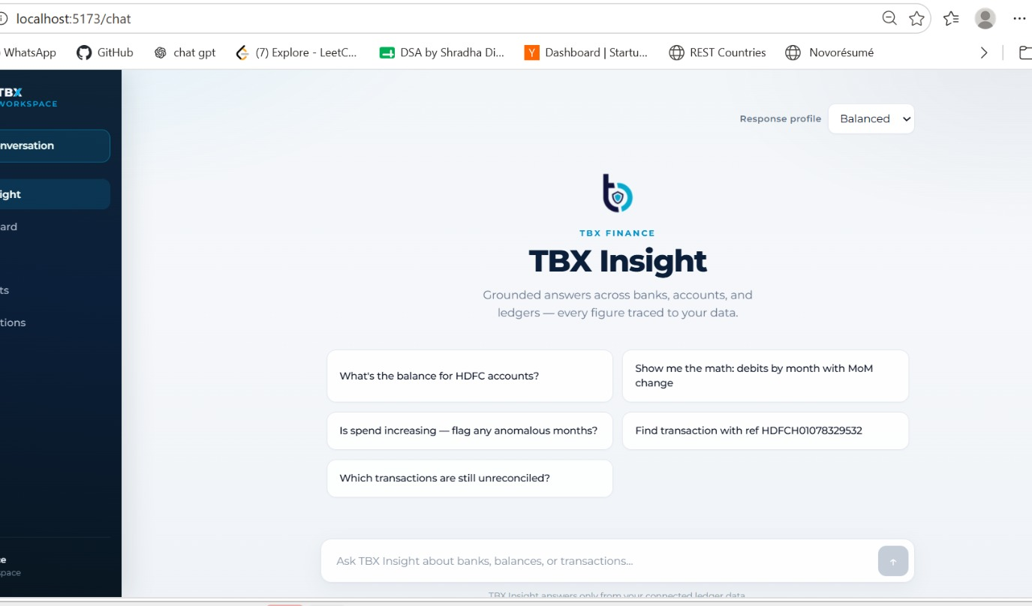
07 · PRODUCT EXPERIENCE
A polished front door for finance conversations
Use this slide to anchor the business story in the actual product UI.
Chat-first workspace
Suggested questions reduce time-to-value.
Response profiles
Efficient / Balanced / Precision makes model choice visible.
Finance navigation
Dashboard, Banks, Accounts and Transactions share the same source of truth.
Traceable outputs
Answers can expose evidence, SQL, confidence and status.
TBX INSIGHT · TBX FINANCE
08

Slide 9
08 · TRUST & SAFETY
The assistant can look up money. It cannot change it.
Guardrails are part of the product experience — not hidden implementation details.
✓
Read-only SQL
SAFE BY DESIGN
Only SELECT / WITH statements are allowed.
Read. Verify. Explain.
✓
Data masking
Account numbers and UTRs are masked in user-facing outputs.
No write operations. No silent account selection. No invented rows.
✓
Explicit uncertainty
Answered / needs clarification / insufficient data.
✓
Evidence trail
Rows and SQL can be inspected behind the answer.
TBX INSIGHT · TBX FINANCE
09

Slide 10
09 · DEMO JOURNEY
A six-minute story from overview to proof
Keep the live walkthrough focused: start with the business view, then demonstrate how trust is earned.
01
Dashboard
02
Ask
03
Inspect
Show live workspace totals, spend by bank and top payees.
Show a real finance question and the grounded response.
Expand evidence and SQL to show how the number was produced.
04
Analyze
05
Challenge
06
Retry
Show trend / MoM logic and anomaly callouts.
Ask something the schema cannot support; show honest handling.
Use feedback or response profile to demonstrate controlled flexibility.
TBX INSIGHT · TBX FINANCE
10

Slide 11
10 · BUSINESS IMPACT
Faster answers. Higher trust. Safer AI.
The prototype is designed to reduce friction around everyday finance questions without compromising auditability.
SPEED
TRUST
CONTROL
EFFICIENCY
Seconds to a useful answer
Every figure is query-backed
AI operates within guardrails
Small model + strong tools
Less time spent hunting dashboards or reports.
Evidence and SQL make the answer inspectable.
Read-only access, masking and explicit uncertainty.
Model choice is optimized for the task, not size.
TBX Insight turns finance data into a conversation — without turning trust into a trade-off.
TBX INSIGHT
TBX INSIGHT · TBX FINANCE
11

Slide 12
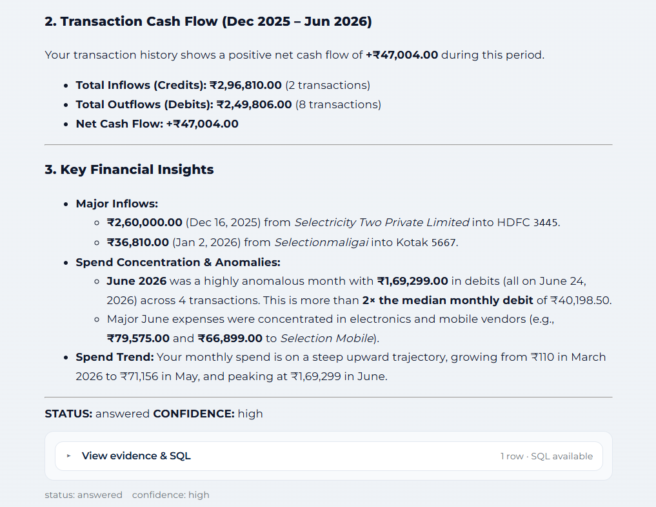
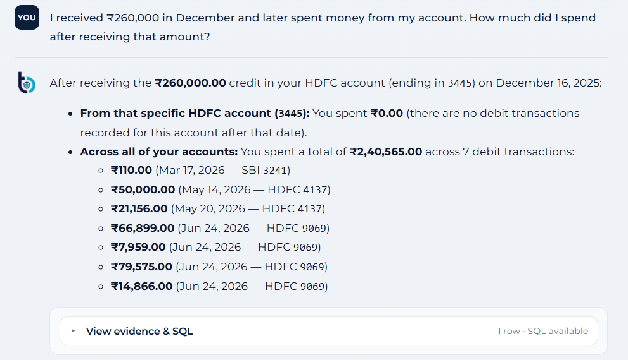
TBX INSIGHT · PRODUCT FEATURES
Ask Your Finances. Get Instant Answers.
Natural-language interaction turns everyday finance questions into fast, data-grounded answers.
1
Ask in plain language
2
Conversational analysis
3
Data-grounded answers
Query balances, transactions, spending and accounts without navigating reports.
Ask follow-ups naturally while keeping the financial context intact.
Responses are tied to the underlying ledger rather than generic assumptions.
Finance summary — account & balance overview
Follow-up analysis — spending after a specific credit
TBX INSIGHT · 12

Slide 13
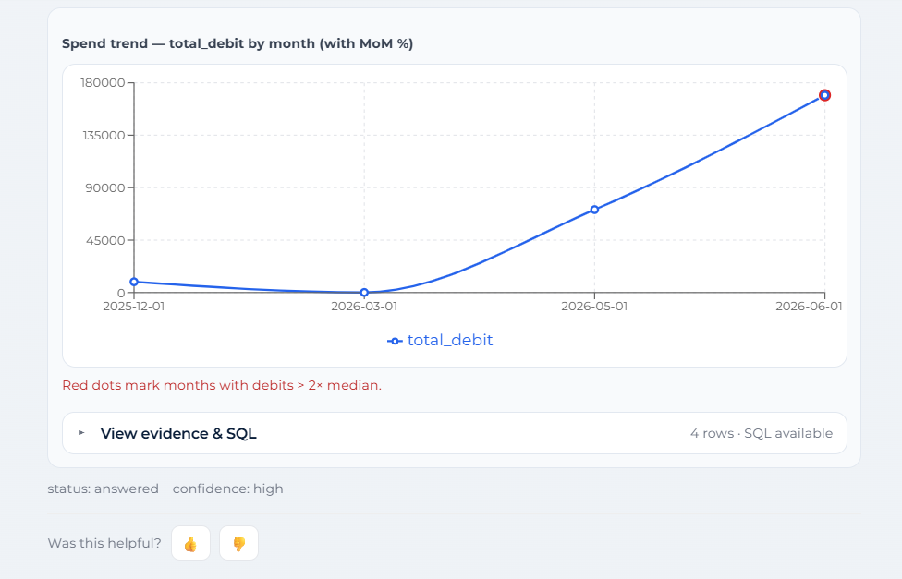
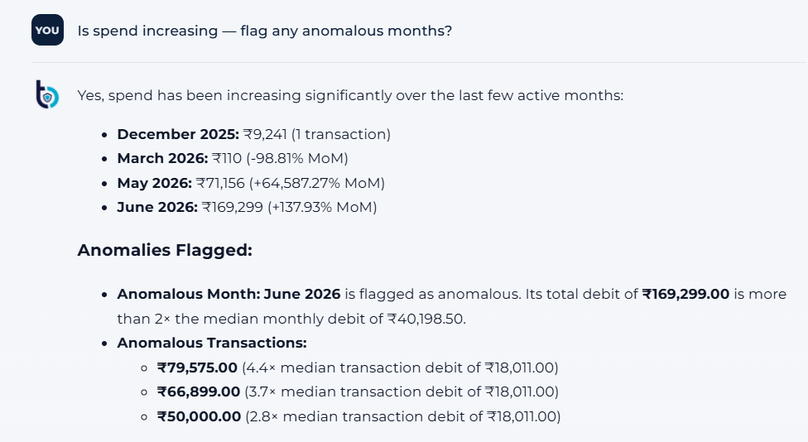
TBX INSIGHT · PRODUCT FEATURES
From Spending Data to Actionable Insights.
The assistant converts transaction history into trends, month-over-month changes and anomaly callouts.
1
Spot spending trends
2
Detect anomalies
3
Explain what changed
See monthly debit movement and MoM changes at a glance.
Flag unusually high months and individual transactions automatically.
Surface the transactions and categories driving a spending spike.
Spend trend — monthly debits with MoM context
Anomaly detection — flagged month & transactions
TBX INSIGHT · 13

Slide 14
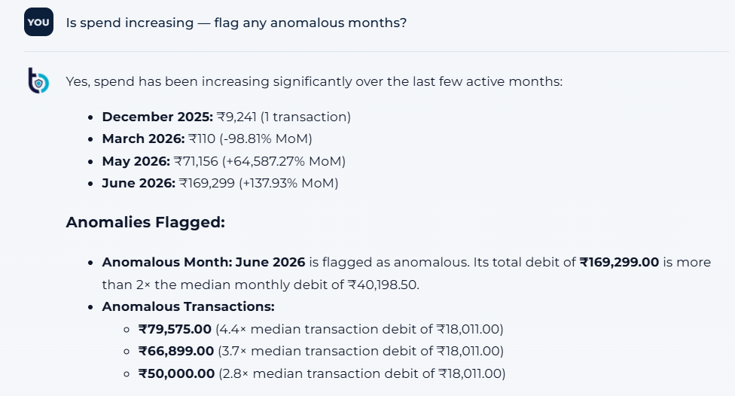
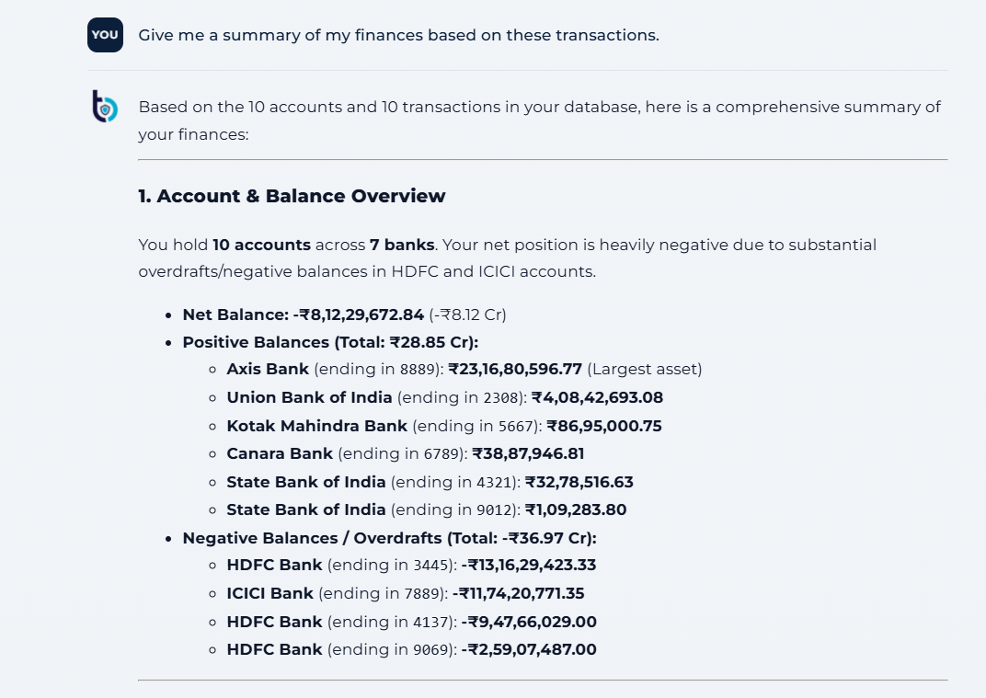
TBX INSIGHT · PRODUCT FEATURES
Every Answer Comes With Proof.
Explainability is built into the experience: users can inspect the evidence and the SQL behind an answer.
1
Inspect the evidence
2
SQL-backed reasoning
3
Traceable outputs
Expand the underlying transaction rows supporting the response.
Financial calculations are executed against the database, not improvised by the model.
Confidence, status, evidence and SQL make results easy to verify.
Evidence trail — trend analysis with SQL access
Evidence trail — financial summary with source data
TBX INSIGHT · 14

Slide 15
THANK YOU
Team Members:
- Nikita Chelani
- Shashank Joshi
- Murali Krishna Reddy
- Ishita Verma

