Slide 1

How to Record in JMeter?
Murali Chandra Arandala
Emp Id: 6145

Slide 2
What is JMeter and why it is used?
Apache JMeter may be used to test performance both on static and dynamic resources, Web dynamic applications. It can be used to simulate a heavy load on a server, group of servers, network or object to test its strength or to analyze overall performance under different load types.

Slide 3
Requirements for JMeter
Apache JMeter
Java Version. JMeter requires a fully compliant JVM 6 or higher.
Mozilla Firefox browser

Slide 4
Steps involved in record scripting
Setting HTTP proxy server
Record Test Activity
Run your Test plan
Save your Test Results

Slide 5
JMeter Script Recording Steps:
1. Launch JMeter by navigating to <JMETER_HOME>/bin (Example: C:\apache-jmeter-5.3\bin)
2. Click jmeter.bat (Windows) or Enter command ‘JMeter’ (Linux/Unix). Read the article to know more on different Launching modes of JMeter

Slide 6
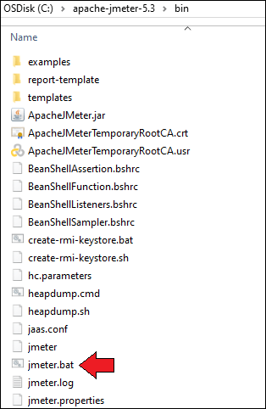
Installation of Apache JMeter

Slide 7
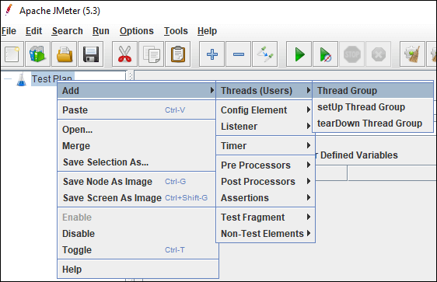
3. Select ‘Test Plan’ on the tree
4. Right-click on the ‘Test Plan’ and add a ‘Thread Group’

Slide 8
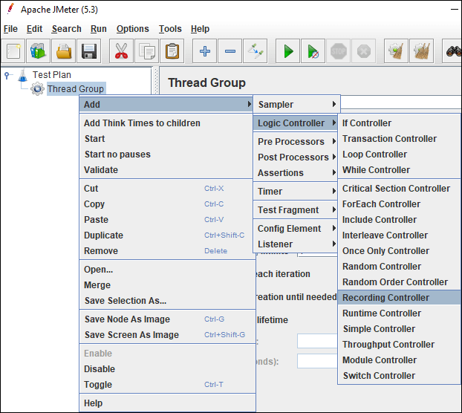
5. Select ‘Thread Group’ and right-click to add ‘Recording Controller’.

Slide 9
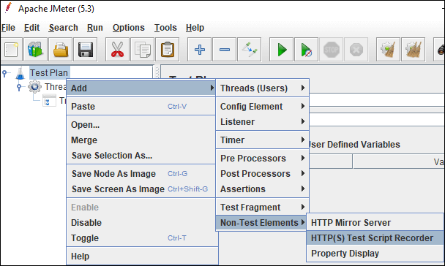
6. Right-click on the ‘Test Plan’ and add ‘HTTP(S) Test Script Recorder’ which is a ‘Non-test Element’.

Slide 10
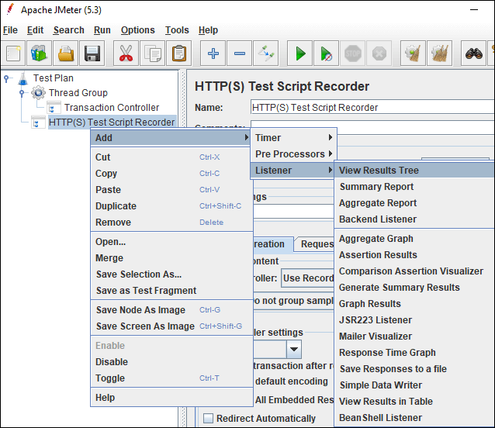
7. Under ‘HTTP(S) Test Script Recorder’, add ‘View Results Tree’ listener by right-clicking on ‘HTTP(S) Test Script Recorder’ element and provide a .jtl file path in the Filename. This .jtl file is required to save the recording logs.

Slide 11
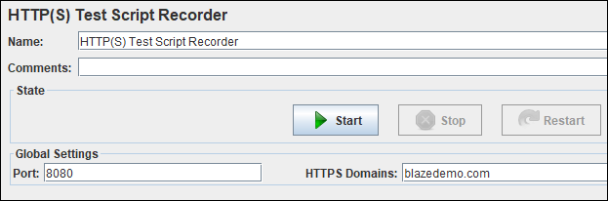
8. In ‘HTTP(S) Test Script Recorder’, under ‘Global Settings’ section, provide the port number as ‘8080’ and application URL in ‘HTTPS Domain’ text field. While providing application URL do not use http, https, : and /.
9. In ‘HTTP(S) Test Script Recorder’, under ‘Test Plan Creation’ tab, the default value of the ‘Target Controller’ is ‘Use Recording Controller’ In case you use ‘Transaction Controller’ as shown in step 5 then select the particular transaction controller as target controller.

Slide 12
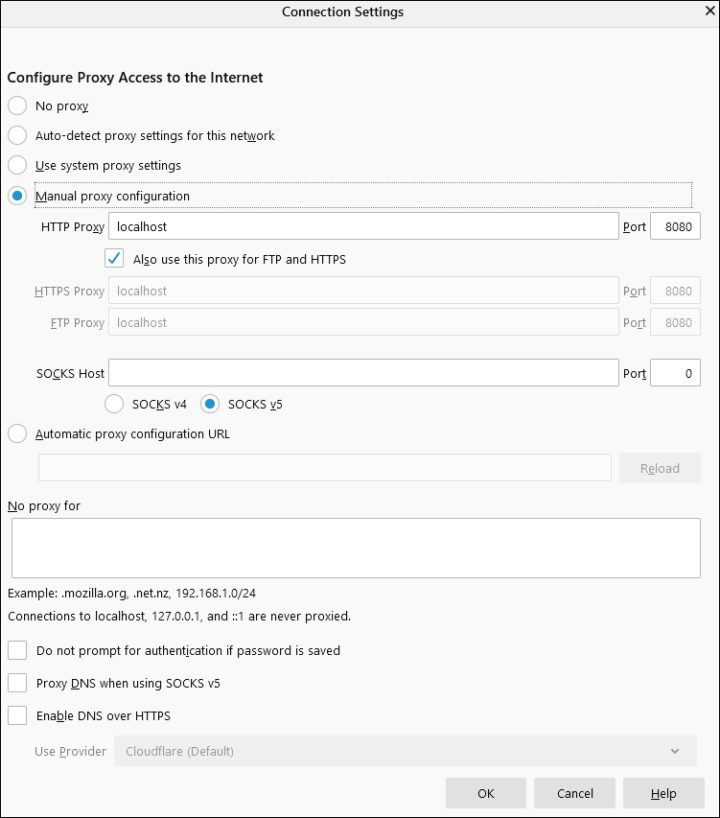

10. Now, Launch Browser (Chrome/Firefox/Edge) and set Manual Proxy.
Address: localhost or IP address of your system Port: 8080

Slide 13
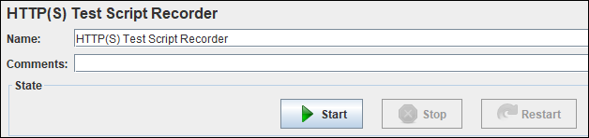
11. In case the application is secured (https) then you need to add ‘JMeter Root CA certificate’ to the browser. More details are given in ‘How to record JMeter script for a secured (https) application?‘.
12. Go back to JMeter, in ‘HTTP(S) Test Script Recorder’ and click the ‘Start’ button.

Slide 14
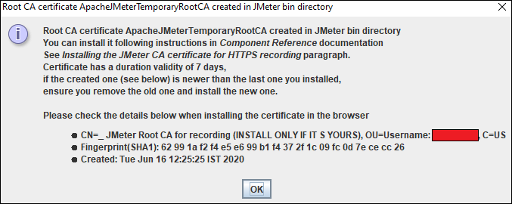
13.A ‘Root CA Certificate’ pop-up will open. Click ‘OK’.
14.Go to your browser and type the application URL and follow the transaction flow. You can see a floating ‘Recording Bar’ while recording the flow.

Slide 15

15.Once navigation is completed, click the ‘Stop’ button on Recording Bar or in ‘HTTP(S) Test Script Recorder’.

Slide 16
Thank you

