Slide 1
Shape of Computer – Type
OS, CPU- Processor, Mother Board, RAM-Memory, Hard Disk – Size 1TB
Networking: Router, LAN, LAN Cables, Firewall
Backup: CD, External HDD, Pen Drive, OneDrive, Gdrive
Database: Excel, MS Access, Oracle, MSSQLServer, Mongodb, RDS, MYSQL
Security: Fire Wall
Running Notes in class

Slide 2
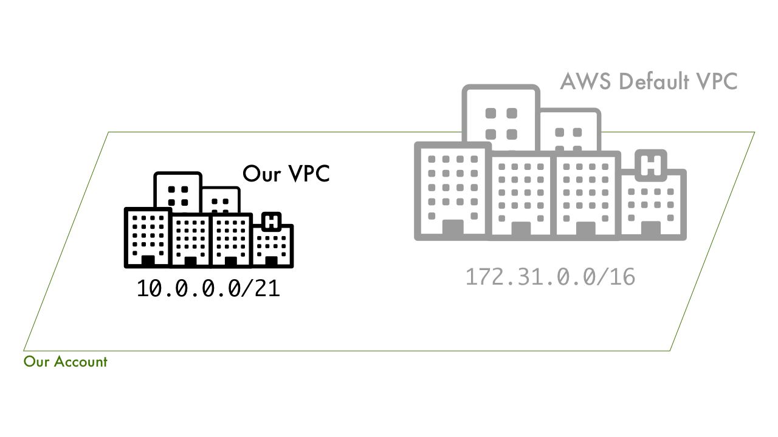
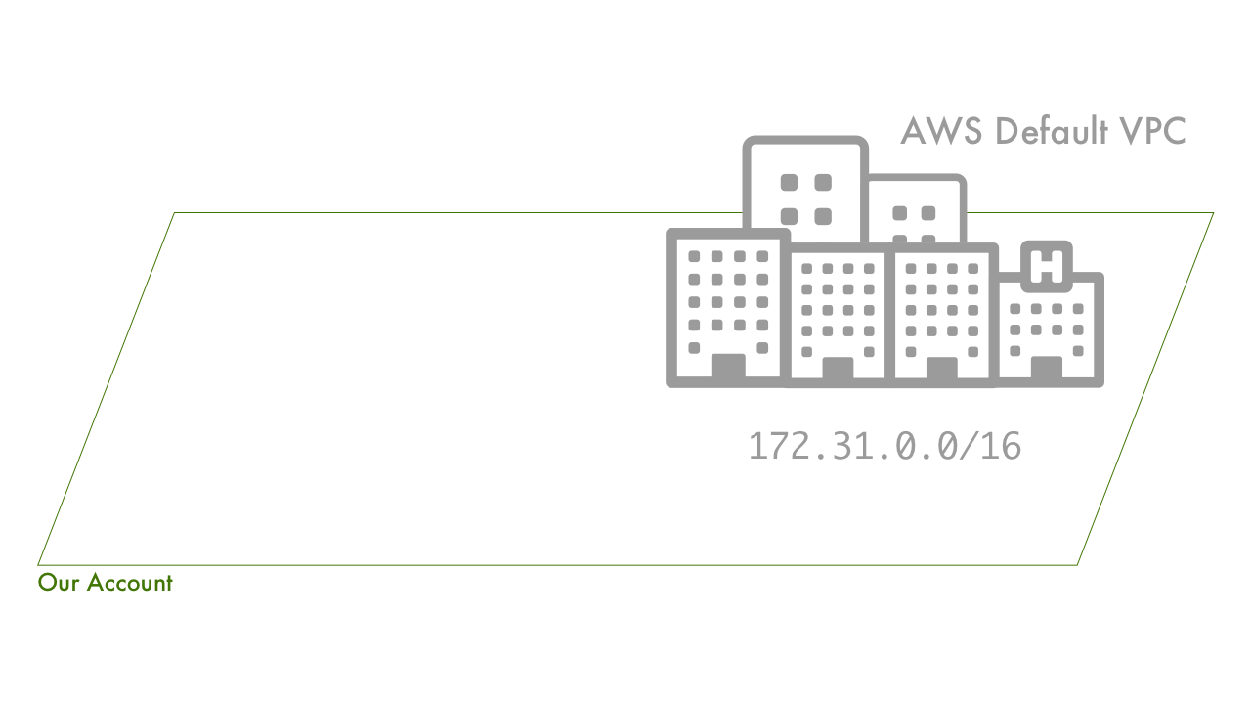
VPC
What is a VPC?
Amazon VPC enables you to define a virtual network in your own logically isolated area within the AWS cloud, known as a virtual private cloud (VPC)
Your VPC closely resembles a You can launch your AWS resources, such as instances, into your VPC
traditional network that you might operate in your own data centre, with the benefits of using AWS scalable infrastructure

Slide 3
Regions:
AWS provides customers with the flexibility to place instances and store data within multiple geographic regions called Region
Each region is an independent collection of AWS resources in a defined geography
Availability Zones:
Each Region consists of multiple, isolated locations known as Availability Zones and each Availability Zone runs on its own physically distinct, independent infrastructure and is engineered to be highly reliable
Each Region has multiple, isolated Availability Zones (ranging from. 2-6)
Each AZ has independent power, cooling, and physical security and is connected via redundant, ultra-low-latency networks
Each AZ is physically isolated from each other so that an uncommon disaster such as fire, earthquake would only affect a single AZ
AZs are geographically separated from each other, within the same region, and acts as an independent failure zone
Multi-AZ feature, distribution of resources across multiple AZs, can be used to distribute instances across multiple AZ to provide High Availability

Slide 4
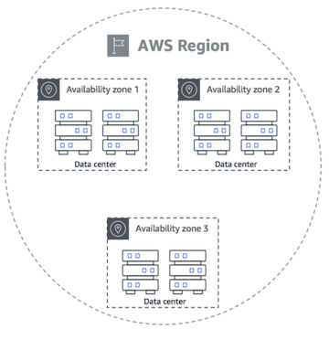
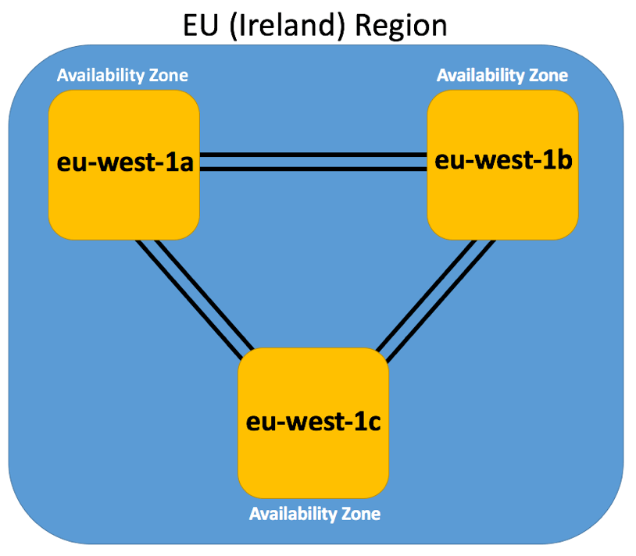
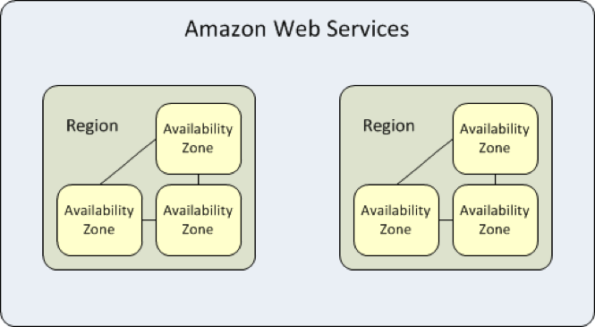

Slide 5
Subnet:
A subnet, or subnetwork, is a segmented piece of a larger network
You can launch AWS resources, such as EC2 instances, into a specific subnet
Each subnet must reside entirely within one Availability Zone and cannot span zones
By launching instances in separate Availability Zones, you can protect your applications from the failure of a single zone
Public subnet:
A public subnet will be used for instances that need a public IP to be accessible from the internet
Example Webservers
Private subnet
A private subnet is used for instances that do not need to be directly reachable from the internet
For the best security, it's important to keep backend instances and databases private subnet

Slide 6
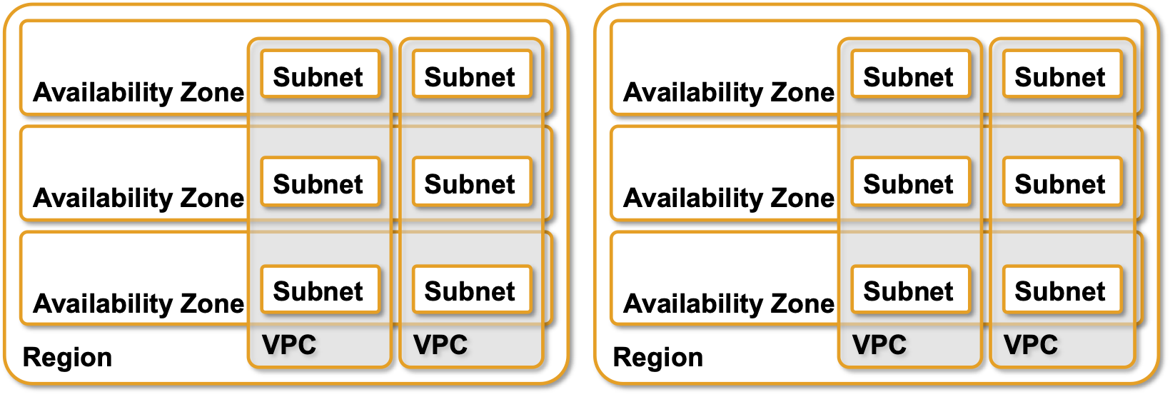
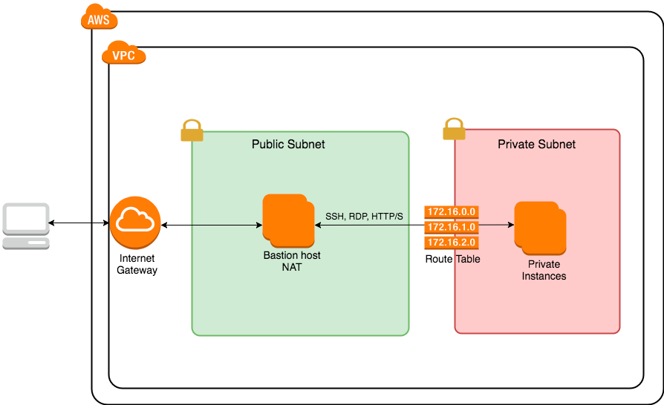

Slide 7
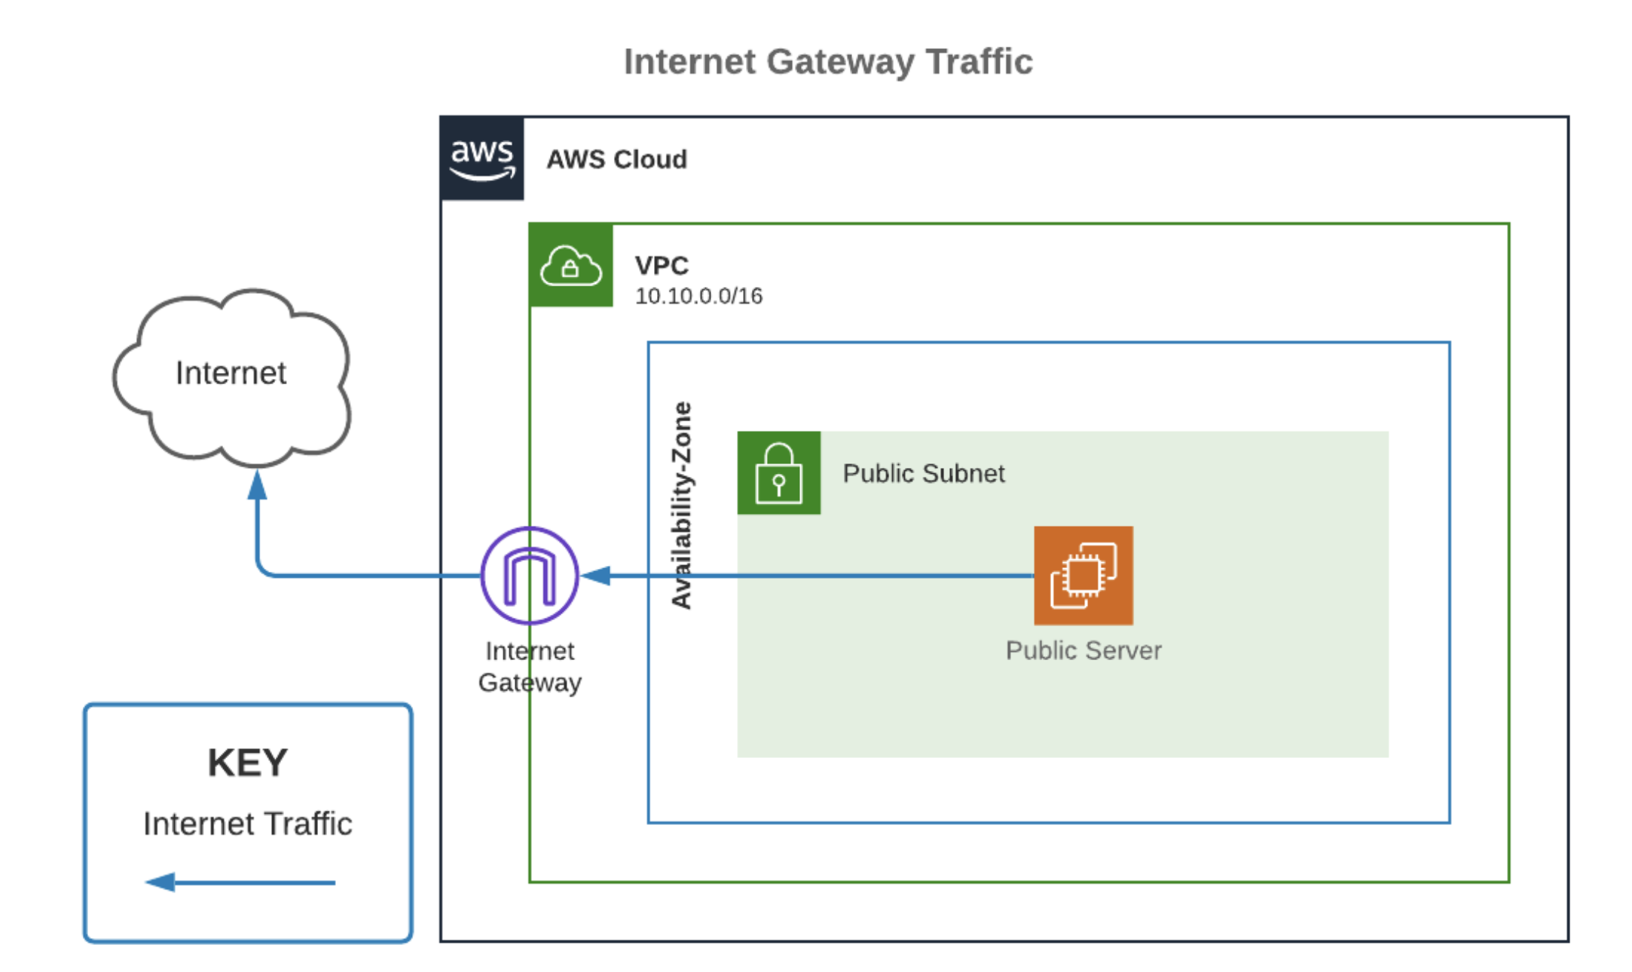
Internet Gateway

Slide 8
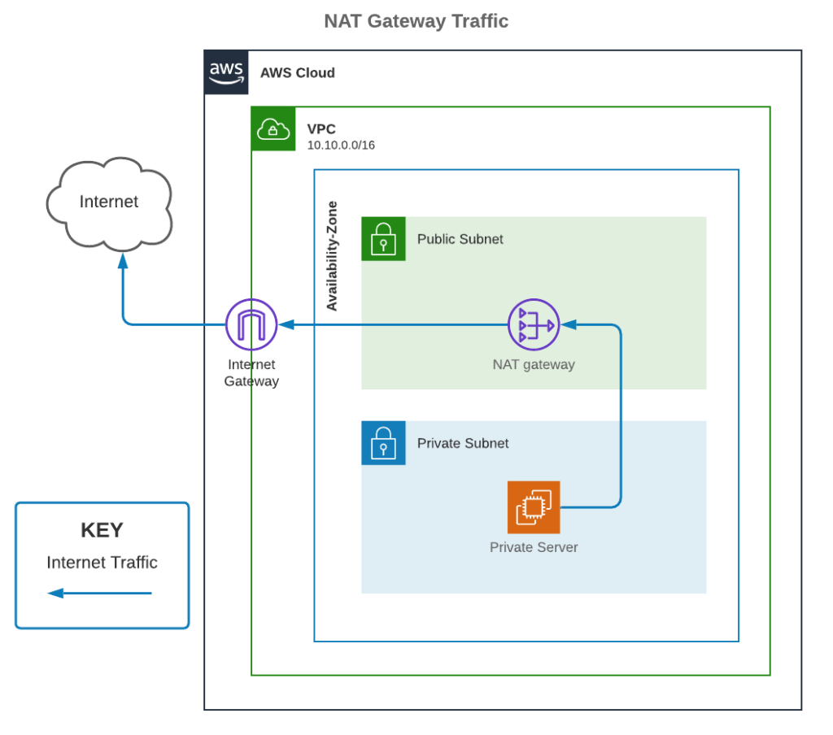
NAT Gateway

Slide 9
NAT Instance
Unlike NAT Gateway and Internet Gateway, a NAT Instance is not a special service offered by AWS
It is just a term for when using an EC2 instance to perform NAT Gateway-like functionality
Because it is a self-managed instance, configuring routing, updating the software and operating system, and right-sizing instances is the responsibility of the owner
Similar to a NAT Gateway, a NAT Instance will need to be in a public subnet, and a private subnet will need a route to the NAT Instance to have internet access
It is generally not recommended unless there is a specific use-case that needs to support this customization

Slide 10
Putting it together
For a public subnet to have Internet access, inbound and outbound, an account needs:
Internet Gateway attached to a VPC
Route to the Internet Gateway in the attached route table
Instances have public IP addresses (auto-assigned or attached Elastic IP address)
Appropriate security group and NACL allowances
For a private subnet to have Internet access, the following will provide outbound Internet access but not inbound:
Internet Gateway attached to a VPC
NAT Gateway or Instance in a public subnet in the same VPC
Route to the NAT Gateway or Instance in the private subnet’s attached route table
Appropriate security group and NACL allowances

Slide 11
Disaster
Recovery
Hyderabad
Region
Mumbai - Region
MerkhanPet – Flipkart
AZ-1
Chandravelli – Flipkart
AZ-2
Andheri AZ-1
Malad AZ-2
Running Notes in class

Slide 12
Virtual Networking – Cloud – Private
Subnet - Piece/Part of Whole Network
Public Subnet: Web Server
Private Subnet: Application, Data Base
Region
AZ
Subnet
Hyderabad Region
Customer
Customer
Public Subnet
Public Subnet
Web Server
Web Server
SG
SG
Private Subnet
Application
Private Subnet
Application
SG
SG
DB
DB
AZ1 - KPHB
AZ2 - UPPAL
Running Notes in class

