Slide 1
Comp Photography
(Spring 2015)
Final Project
Murali Bhupatiraju
themurali@gatech.edu
Computational Photography @ GT
http://compphotography.wordpress.com/

Slide 2
Tone Mapping
Extending HDR Assignment to include Tone Mapping for addressing the strong contrast reduction and the loss of detail observed seen with straight normalization of HDR output.
Computational Photography @ GT

Slide 3
The Goal of Your Project
In Assignment 10 we created a HDR image. However we did not finish the final step of making the HDR image viewable. We just normalized the radiance map to output an image. The result was washed out(contrast loss) image that did not look good. So I took on the challenge expressed in the note in the assignment:
Note(2): We do not perform tone mapping which is an additional step of HDR images due to filters which are not readily available in the libraries we use. There are great resources for how to do this but the output image will give you a decent idea of how tone mapping can be performed. This is why the output will not have as many bright tones as some HDR algorithms output.
Computational Photography @ GT

Slide 4
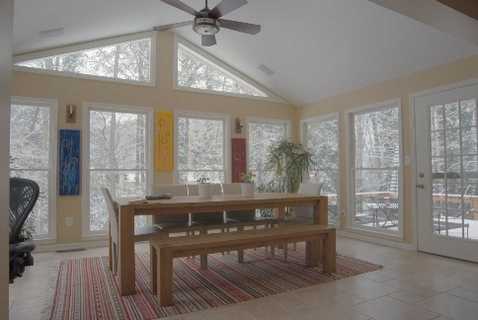
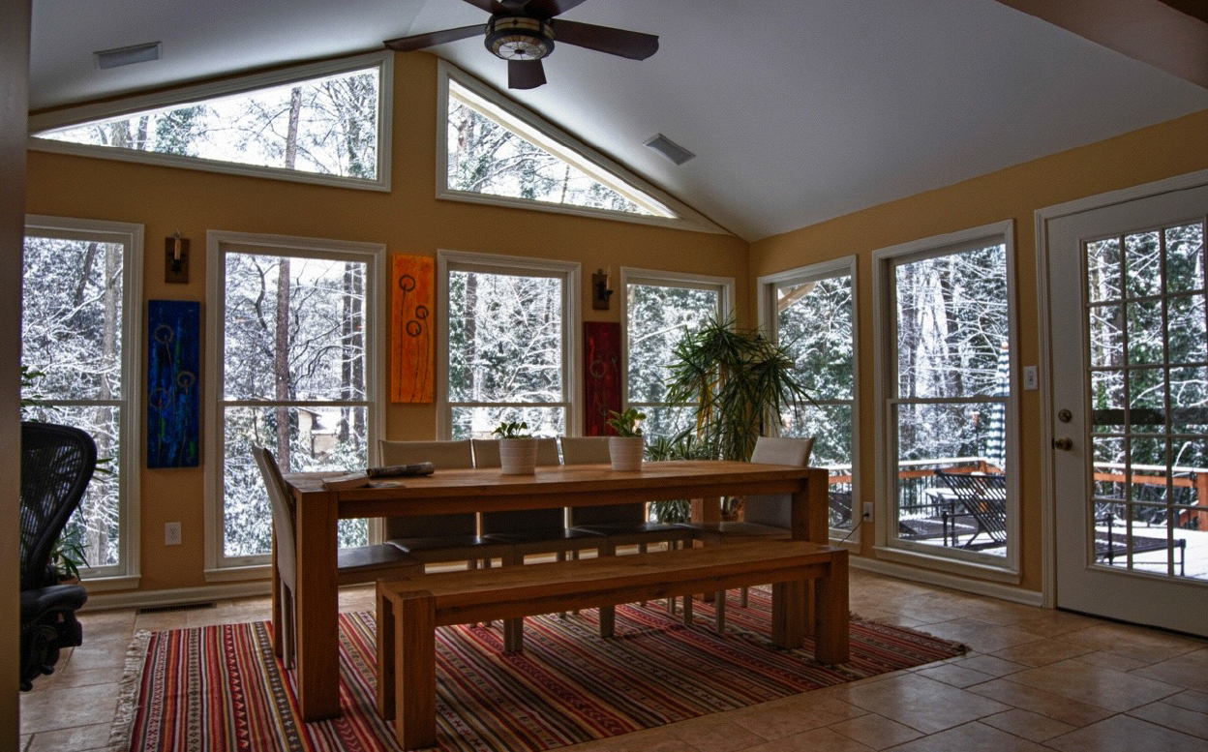
Assignment 10 Output: HDR
Goal: Output From Prof. Essa
From CP-05-04 Slides
Computational Photography @ GT

Slide 5
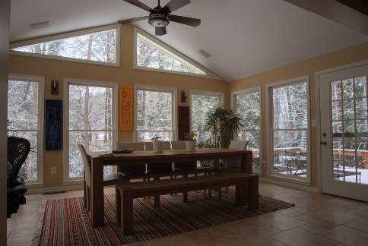
Assignment 10 Output: HDR
This Project Result LDR: Tonemapped
Computational Photography @ GT

Slide 6
Project Pipeline
Modify Python Code in Assignment 10 to allow Tone Mapping
Explore Literature on Tone
Mapping
Identify Algorithms for Tone
Mapping
Study One Algorithm and Implement It
Test Tone Mapping on Images From Assignment 10
Computational Photography @ GT

Slide 7
Tone Mapping Pipeline
Scale
Luminance Map
HDR Algorithm Output
Radiance Map
RGB Combined Luminance Map
LDROutput
Reapply Colors
Apply Reinhard Operator to Scale Luminance Map
Calculate Reinhard Operator
Computational Photography @ GT

Slide 8
Python Code Pipeline
readImages()
computeResponseCurve()
computeRadianceMap()
computeLDR()
computeImage()
Computational Photography @ GT

Slide 9
Project Links
This Report
https://github.com/muraligit/6475Project/blob/master/6475/Final_Report.pptx
Python Code:
https://github.com/muraligit/6475Project/blob/master/6475/final.py
Input Images:
https://github.com/muraligit/6475Project/tree/master/6475/input
Output Images:
https://github.com/muraligit/6475Project/tree/master/6475/output
Computational Photography @ GT

Slide 10
What worked
Before
Improved Color Reproduction
(Example See the wall, carpet, and wall painting colors)
Improved Detail
(For Example: Lawn Chairs outside, Paintings on the wall, leaves)
Improved Contrast
(Washed-Out before to Good-Contrast after, For Example see the carpet and cieling)
After
Computational Photography @ GT

Slide 11
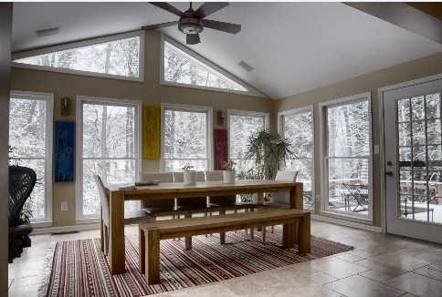

What did not work?
Prof. Essa Output
Result was not as good as the output
Prof. Essa showed in class (Color reproduction and contrast was not as good, more shadows were also retained)
So I used matlab build in Image processing
toollbox to generate another tone mapped image
My result appears to be in between the two results
Matlab hdr/tonemap Output
My Output
Computational Photography @ GT

Slide 12
Needed Improvements
I tweaked the parametrs of Reinhard operator only a little but optimizing these parameters further would improve the result (saturation, key factor, and proprtion of RGB to Luminance Map)
I implemented the simple Reinhard Operator; The improved Reinhard Operator seems to address the issues raised in the previous slide.
Used Operator: Ld(x, y) = L(x, y) / (1 + L(x, y))
Improved Operator: Ld(x, y) = L(x, y) / (1 + V (x, y, s) )
V(x, y, s) = L(x, y) ⊗ Ri(x, y, s) is the local average luminance, Ri is a Gaussian
Computational Photography @ GT

Slide 13
Needed Improvements
Try Bi-Lateral Filter ( Study of the results published shows that this is a good alternative to try, I started implementing and wanted to present additional results from this also but ran out of time due to the finals)
Durand and Dorsey, Fast Bilateral Filtering for the Display of High-Dynamic-Range Images (http://people.csail.mit.edu/fredo/PUBLI/Siggraph2002/)
Computational Photography @ GT

Slide 14
References
Tone Mapping Algorithm: E. Reinhard et al. - Photographic Tone Reproduction for Digital Images
Durand and Dorsey, Fast Bilateral Filtering for the Display of High-Dynamic-Range Images (http://people.csail.mit.edu/fredo/PUBLI/Siggraph2002/)
CS Notes
Computational Photography @ GT

Slide 15
Credits/Thanks
Prof. Erfan Essa for the motivation and images
6475 TA(s) for help with starter HDR code and implementation
E. Reinhard et al. for the algorithm
Computational Photography @ GT

