Slide 1
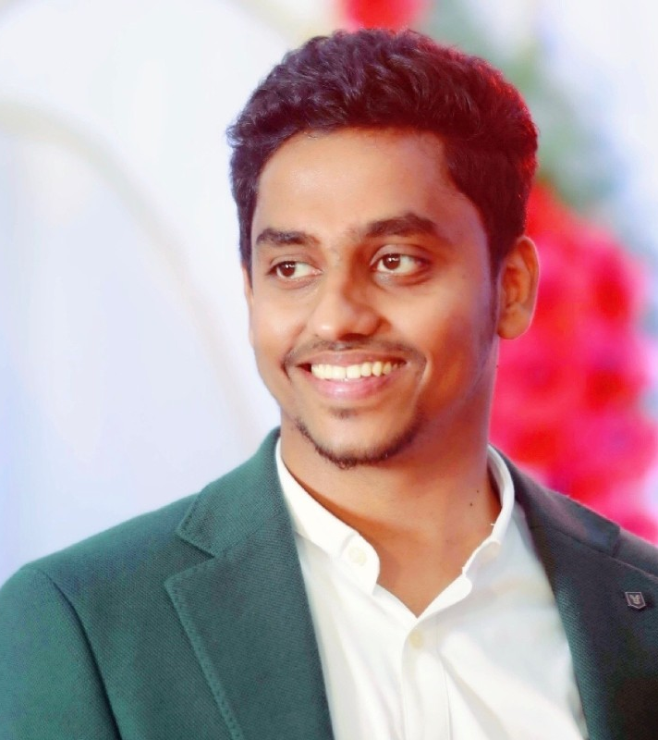
Prabhu Thangavel aka Vijay
Experienced IT professional with over 10+ years of industry expertise.
I began my career as a Linux Engineer, where I honed my skills in managing and optimizing Linux-based systems. As my career progressed, I ventured into various roles, including
Datacenter Engineer
Automation Engineer
DevOps Engineer, and Site Reliability Engineer.
These diverse roles allowed me to develop a comprehensive understanding of IT operations and software development.
Currently, I hold the position of Lead Architect at a prominent FinTech startup based in Dubai.
Throughout my career, I have had the privilege of working with renowned product-based companies such as Cisco, Amadeus, Tesco, and Chef.
These experiences have enriched my knowledge and provided me with valuable insights into industry best practices and cutting-edge technologies.
I'm here because I'm passionate about sharing my knowledge and empowering others in the world of technology.
I believe with over 10 years of industry experience, I have cultivated a deep understanding of IT operations and software which can be helpful for others.

