Slide 1
MelodyLeak
Foundation-Model Music as a Covert Speech Channel
Murali Krishna Ediga
CS 5542 — Big Data Analytics & AI · Spring 2026
University of Missouri — Kansas City · Quiz Challenge 2

Slide 2
Problem & motivation
Generative audio foundation models are now production-grade in BOTH directions:
• Generate music + speech: MusicGen, SpeechT5, AudioLDM2, Bark
• Transcribe speech: Whisper, wav2vec2
Question
Can a single pipeline use both ends to smuggle a hidden message inside generated music?
Why it matters: as generative-AI audio proliferates online, content provenance and covert-channel detection become open security problems. Demonstrating channels of this kind is a prerequisite to building defences.

Slide 3
Models used — HuggingFace, inference only, no fine-tuning
Role | HuggingFace model | Params | License
TTS (Vector A encoder) | microsoft/speecht5_tts + speecht5_hifigan | 144 M | MIT
Carrier (both vectors) | facebook/musicgen-small | 300 M | CC-BY-NC-4.0
Decoder (Vector A) | openai/whisper-base | 74 M | MIT
Decoder + perceptual (Vector B) | laion/clap-htsat-unfused | 153 M | CC0
Footprint: ~3.4 GB VRAM total on float32. Single RTX 5080 runs everything live.
All training was done by the model authors. No data of mine touches model weights.

Slide 4
Two-vector design
Same secret routed through two complementary channels that share a MusicGen carrier.
Vector A — semantic
Vector B — categorical
secret text
↓
SpeechT5 → vocals (16 kHz)
MusicGen → carrier (32 kHz, resampled)
↓ mix at gain α
↓
Whisper-base → recovered text
secret bits (2 bits per clip)
↓
MusicGen with prompt from a 4-class codebook
(mood × tempo)
↓
CLAP cosine to anchor prompts → argmax
→ recovered bits
high bandwidth (~5–10 bps) · fragile to gain attenuation · audible to humans
low bandwidth (~0.33 bps) · robust to MP3 / time-stretch · carrier looks like normal music

Slide 5
Prompt / input engineering
Vector A — two mix variants compared
• flat: full-band TTS vocals + music (baseline)
• bandpass: TTS vocals filtered to 300–3400 Hz before mixing (improved hypothesis)
Hypothesis: telephone-band vocals match Whisper's training distribution → lower WER at same loudness.
Vector B — 4-prompt codebook over mood × tempo
bits | prompt
00 | happy upbeat acoustic guitar pop, 140 bpm, major
01 | happy warm soft acoustic guitar, 60 bpm, major
10 | sad melancholic piano, 140 bpm, minor
11 | sad melancholic piano, 60 bpm, minor

Slide 6
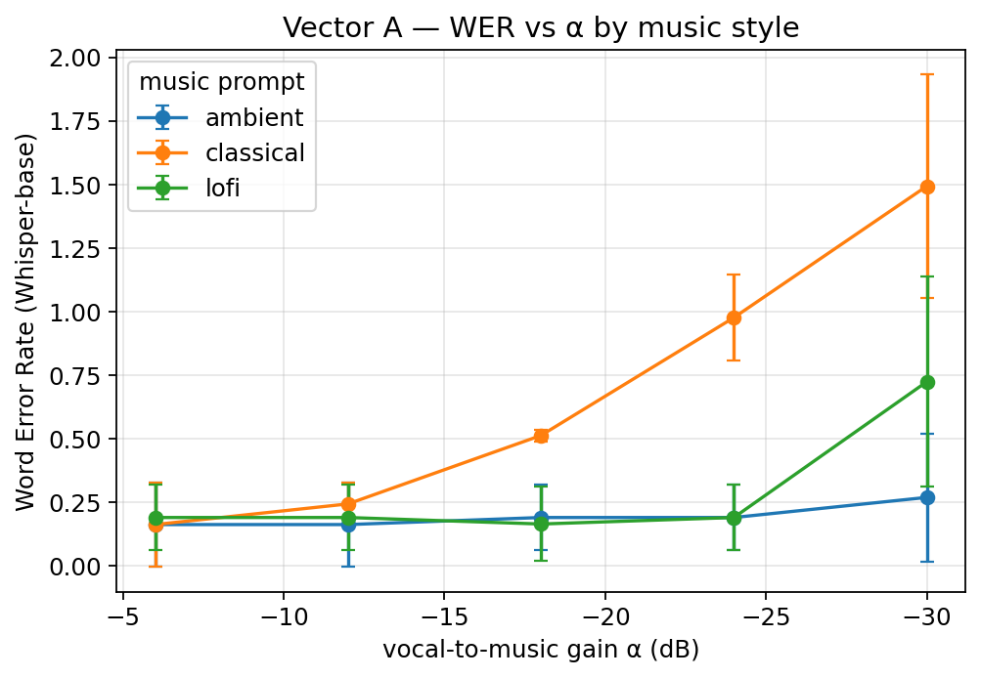
Vector A results — WER vs α
Findings
• Ambient is the most permissive carrier — WER ≈ 0.18 across the entire α range (-6 to -30 dB).
• Classical is the worst — WER explodes past α=-18 dB; string formants compete with vocals in-band.
• Lo-fi sits between — usable until α=-30 dB.
Insight
Carrier choice matters as much as gain level.
n=45 runs (3 prompts × 5 α × 3 secrets)

Slide 7
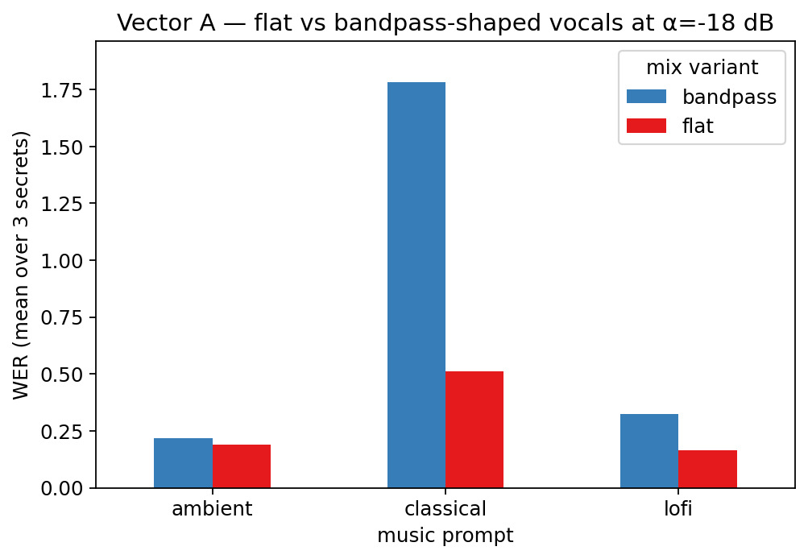
Vector A — bandpass surprise (counter-hypothesis result)
Hypothesis
Bandpass-shaping vocals (300–3400 Hz, telephone band) should reduce WER at the same loudness.
Result
Bandpass HURTS — classical (0.51 → 1.78), lo-fi (0.16 → 0.32). Only ambient is roughly neutral.
Interpretation
Whisper relies on out-of-band fricatives (sibilants /s/, /sh/ above 3.4 kHz) that the filter strips.
The 'improvement' backfires.

Slide 8
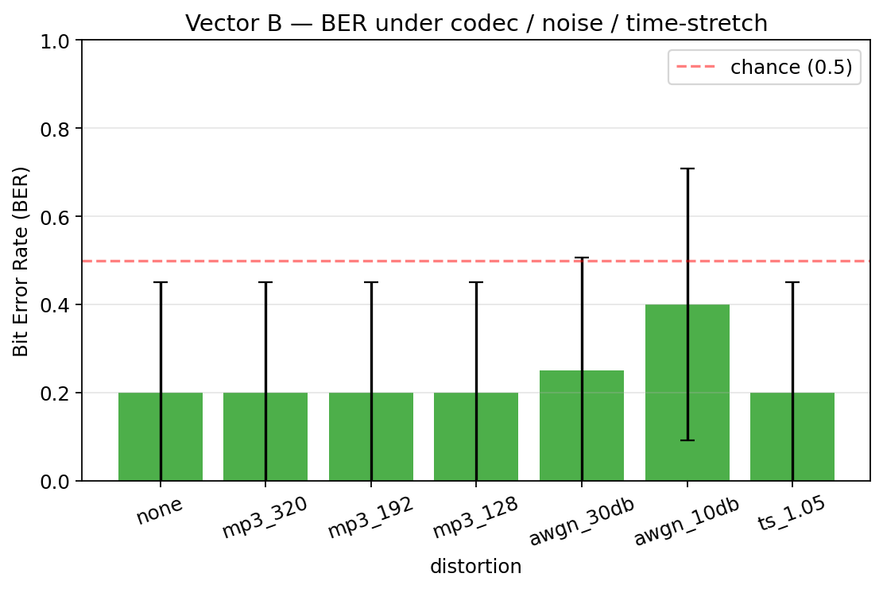
Vector B — BER under codec / noise / time-stretch
Headline
BER flat at 0.20 through MP3 (320/192/128 kbps), time-stretch ±5%, AWGN 30dB. Only AWGN 10dB pushes BER higher.
Why 0.20?
Confusion matrix (clean): CLAP perfectly discriminates mood (happy vs sad, 0% conf) but is tempo-blind — all slow prompts get classified as fast.
Implication
A 1-bit mood-only codebook would give BER = 0 — capacity halves, robustness jumps.
n=140 decodes (20 clips × 7 distortions)

Slide 9
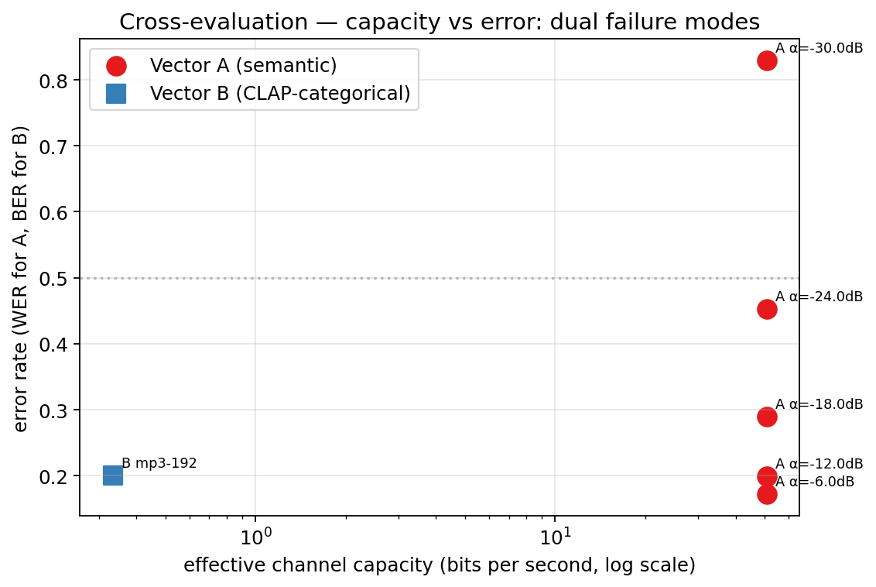
Cross-evaluation — dual failure modes
Vector A (red)
~50 bps speech, WER from 0.17 (α=-6) to 0.83 (α=-30). Fragile to gain attenuation.
Vector B (blue)
~0.33 bps, BER 0.20 across all codec/time-stretch conditions. Fragile to noise but not codec.
Insight
The two vectors fail in opposite directions. A defence that catches one does NOT catch the other. Defending generative-AI audio covert channels requires more than one detector.

Slide 10
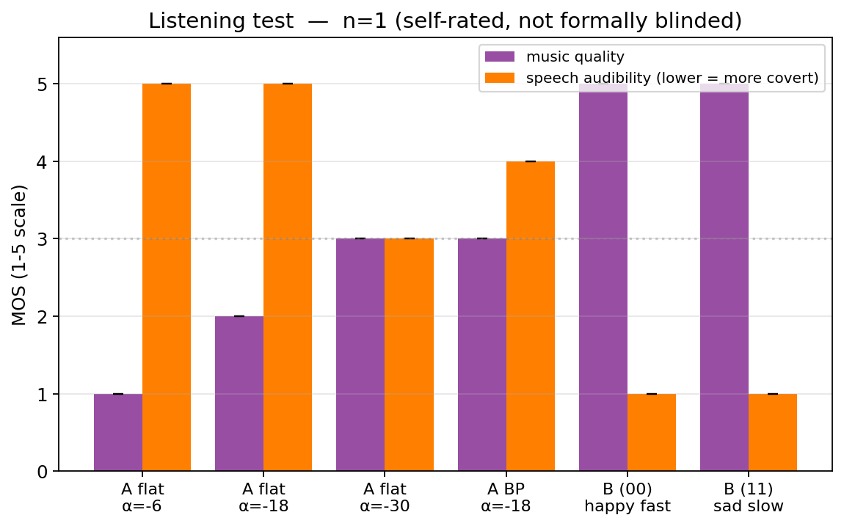
Listening test — Vector A is not perceptually covert
Setup
n=1 self-rated, not formally blinded. Listener had not memorized the secret texts before listening.
Headline result
Listener recovered 'the quick brown fox jumps over the lazy dog' VERBATIM from clips at α=-6, -18, -30 dB and the bandpass variant — without prior memorisation.
Vector A is not covert at any tested setting.
Music vs speech
Music quality drops 5 → 1 with vocals at α=-6; recovers to 3 at α=-30 (loud vocals destroy the cover).
Vector B sanity check
Clean carriers rated 5/5 music, 1/5 speech — confirms B has no leaked speech.

Slide 11
Limitations · Ethics · Future work · AI disclosure
Limitations
Future work
• Listening test n=1 self-rated, not formally blinded
• English-only secrets, single TTS speaker (CMU Arctic xvector idx 7306)
• Single carrier model (MusicGen-small)
• No active steganalysis tested
• 3 secrets × 3 prompts × 5 α — small N
1. Adversarial perturbation of MusicGen output to fool Whisper while preserving human listening.
2. Mood-only 1-bit Vector B + redundancy coding for near-zero BER.
3. Detection: train a classifier on (clean MusicGen) vs (vocal-mixed MusicGen).
Ethics
AI tools disclosure
• Demonstration of a covert channel as a prerequisite for DEFENSIVE research.
• Vector A is detectable by attentive listeners — NOT perceptually-secure stego.
• Vector B leaks via prompt-distribution biases over a session.
• Framed as measurement of attack surface, not deployment guide.
• Anthropic Claude (Opus 4.7) — adversarial design review, code scaffolding, slide outline. Specific decisions logged in AI_DISCLOSURE.md.
• HuggingFace pretrained models — inference only.
• No model trained or fine-tuned by me.
Repo: github.com/muralikrish9/CS5542 — QuizChallenge2/ · Code, eval CSVs, plots, audio samples

