Slide 1
WEB TECHNOLOGY
Sikhinam Nagamani
Assistant Professor
Computer Science & Engineering
RGUKT- Ongole-AP

Slide 2
Unit 1- Syllabus
Unit - I
Introduction to Web World: Recap on HTML, inserting Frames and frame sets, inserting hyperlinks, lists, tables and images,
JavaScript :Client side scripting with JavaScript, variables, functions, conditions, loops and repetition, Pop up boxes, objects, HTML DOM and web, Browser environments, form validation, Events and Event Listeners

Slide 3
INTRODUCTION
HTML stands for HyperText Markup Language. It is used to design web pages using a markup language. HTML is the combination of Hypertext and Markup language. Hypertext defines the link between the web pages.
HTML is a markup language used by the browser to manipulate text, images, and other content, in order to display it in the required format. HTML was created by Tim Berners-Lee in 1991.

Slide 4
INTRODUCTION
Elements and Tags: HTML uses predefined tags and elements which tell the browser how to properly display the content.
<b>Web Technology</b>

Slide 5
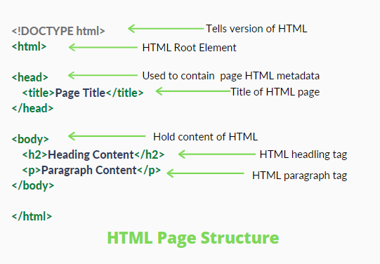
INTRODUCTION
HTML page structure: The basic structure of an HTML page contains the essential building-block elements (i.e. doctype declaration, HTML, head, title, and body elements)

Slide 6
INTRODUCTION
<DOCTYPE! html>: This is the document type declaration (not technically a tag). It declares a document as being an HTML document. The doctype declaration is not case-sensitive.
<html>: This is called the HTML root element. All other elements are contained within it.
<head>: The head tag contains the “behind the scenes” elements for a webpage. Elements within the head aren’t visible on the front-end of a webpage. HTML elements used inside the <head> element include:
<style> <title> <base> <noscript> <script> <meta> <link>
<body>: The body tag is used to enclose all the visible content of a webpage. In other words, the body content is what the browser will show on the front-end.
An HTML document can be created using any text editor. Save the text file using .html or .htm. Once saved as an HTML document, the file can be opened as a webpage in the browser.

Slide 7
INTRODUCTION
<!DOCTYPE html>
<html>
<head>
<title>Demo Web Page</title>
</head>
<body>
<h1>Web Technology</h1>
<p>A computer science portal </p>
</body>
</html>

Slide 8
INTRODUCTION
Features of HTML:
It is easy to learn and easy to use.
Images, videos, and audio can be added to a web page.
Hypertext can be added to the text.
It is a markup language.
Why learn HTML?
It is a simple markup language. Its implementation is easy.
It is used to create a website.
Helps in developing fundamentals about web programming.

Slide 9
INTRODUCTION
Advantages:
HTML is used to build websites.
It is supported by all browsers.
It can be integrated with other languages like CSS, JavaScript, etc.
Disadvantages:
HTML can only create static web pages. For dynamic web pages, other languages have to be used.
A large amount of code has to be written to create a simple web page.
The security feature is not good.

Slide 10
INTRODUCTION
HTML text editors
HTML text editors are used to create and modify web pages. HTML codes can be written in any text editors including the notepad. One just needs to write HTML in any text editor and save the file with an extension “.html”. Some of the popular HTML text editors are given below:
Notepad
Notepad++
Atom

Slide 11
HTML COMMENTS
HTML Comments
The comment tag (<!– Comment –>) is used to insert comments in the HTML code. It is a good practice of coding so that coder and the reader can get help to understand the code. It is helpful to understand the complex code. The comment tag is useful during the debugging of codes.
It helps the coder and reader to understand the piece of code used for especially in complex source code.
Types of HTML Comments: There are three types of comments in HTML which are:
Single-line comment
Multi-lines comment
Using <comment> tag

Slide 12
HTML COMMENTS
<!DOCTYPE html>
<html>
<body>
<!--This is single line comment -->
<h2>This is single line comment</h2>
<!– This is
Multi Line
Commen-->
<comment>This is the Heading Tag<comment>
</body>
</html>

Slide 13
HTML BASICS
Basic HTML Document: Below mentioned are the basic HTML tags that divide the whole document into various parts like head, body, etc.
Every HTML document begins with a HTML document tag. Although this is not mandatory, it is a good convention to start the document with this below-mentioned tag.
<html> :
HTML Paragraph:
<head>:
HTML Horizontal Lines
<title>:
HTML Images:
<body>:
HTML Headings:

Slide 14
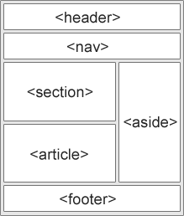
HTML Layout
<header> - Defines a header for a document or a section
<nav> - Defines a set of navigation links
<section> - Defines a section in a document
<article> - Defines an independent, self-contained content
<aside> - Defines content aside from the content (like a sidebar)
<footer> - Defines a footer for a document or a section

Slide 15
HTML Elements
An HTML element is the collection of start and end tags with the content inserted in between them.
<tagname > Contents... </tagname>
Example 1: In this example <p> is a starting tag, </p> is an ending tag and it contains some content between the tags, which form an element.
<!DOCTYPE html>
<html>
<head>
<title>HTML Elements</title>
</head>
<body>
<h2>Welcome To WT</h2>
<p>Hi Every one!</p>
</body>
</html>

Slide 16
HTML Elements
Nested HTML Elements: The HTML element is use inside the another HTML Element is called nested HTML elements.
Example : This example describes the use of the Nested HTML elements. Here, <html> tag contains the <head> and <body>. The <head> and <body> tag contains another elements so it is called nested element.
Necessary to add end tag: It is necessary to add the end tag of an element. Otherwise, the displayed content may or may not be displayed correctly.

Slide 17
HTML Elements
Empty HTML Elements: HTML Elements without any content i.e, that do not print anything are called Empty elements. Empty HTML elements do not have an ending tag. For instance. <br>, <hr>, <link>, <input> etc are HTML elements.
<!DOCTYPE html>
<html>
<head>
<title>Empty HTML Elements</title>
</head>
<body>
<h2>Welcome To GfG</h2>
<br />
<p>Hello Geeks.</p>
</body>
</html>

Slide 18
HTML Heading
An HTML heading tag is used to define the headings of a page. There are six levels of headings defined by HTML. These 6 heading elements are H1, H2, H3, H4, H5, and H6; with H1 being the highest level and H6 the least.
Syntax: <h1> Hi </h1>
Importance of Heading:
Search Engines use headings for indexing the structure and content of the webpage.
Headings are used for highlighting important topics.

Slide 19
HTML Heading
Changing the size of HTML Headings: The default size of HTML headings can be changed using the style attribute.
<!DOCTYPE html>
<html>
<body>
<!-- Style attribute is used here-->
<h1 style="font-size: 50px">H1 with new size.</h1>
</body>
</html>

Slide 20
Horizontal rule: The <hr> tag is an empty tag, and it does not require an end tag. It is basically used to separate content.
<!DOCTYPE html>
<html>
<body>
<h1>Heading 1</h1>
<p>I like HTML.</p>
<!-- hr Tag is used here-->
<hr />
<h2>Heading 2</h2>
<p>I like CSS.</p>
<!-- hr Tag is used here-->
<hr />
<h2>Heading 3</h2>
<p>I like Javascript.</p>
</body>
</html>

Slide 21
HTML Paragraphs
The <p> tag in HTML defines a paragraph. These have both opening and closing tags. So anything mentioned within <p> and </p> is treated as a paragraph.
As already mentioned, the<p>tag automatically adds space before and after any paragraph, which is basically margins added by the browser.
If a user adds multiple spaces, the browser reduces them to a single space.
If a user adds multiple lines, the browser reduces them to a single line.

Slide 22
HTML Paragraphs
<!DOCTYPE html>
<html>
<body>
<p>
This paragraph has multiple spaces.
But HTML reduces them all to a single
space, omitting the extra spaces and line we have used.
</p>
</body>
</html>

Slide 23
<br> tag: There is a way to let the HTML know where does the browser need to change the lines by the use of the <br> tag. These tags do not have any closing tag. So, just a single opening tag will change the line.
Align attribute: The <p> tag specifically supports the alignment attribute and allows us to align our paragraphs in left, right, or center alignment.
<p align="value">
<p align="center">Welcome </p>

Slide 24
<pre> tag: We have seen how the paragraph tag ignores all the changes of lines and extra spaces within a paragraph, but there is a way to preserve this by the use of <pre> tag. It also contains an opening and a closing tag. It displays a text within a fixed height and width and preserves the extra lines and spaces we use.
<body>
<pre>
This paragraph has multiple
lines. But it is displayed
as it is unlike the paragraph
tag.
</pre>
</body>

Slide 25
HTML Text Formatting
HTML facilitates the ability for formatting text just like we do in MS Word or any text editing software.
<body>
<h2>Welcome To Web Technology</h2>
<!--Text in Strong-->
<strong>Hello Geeks</strong>
<br>
<!--Text in small-->
<small>Hello Geeks</small>
<br>
<!--Text in Highlight-->
<mark>Hello Geeks</mark>
</body>

Slide 26
HTML Text Formatting
Making text Bold or Strong:
Making text Italic or emphasize:
<!--Text in Italics-->
<p>
<i>WelCome</i>
</p>
<!--Text in Emphasize-->
<p>
<em> WelCome </em>
</p>
<!--Text in Bold-->
<p>
<b> WelCome </b>
</p>
<!--Text in Strong-->
<p>
<strong> WelCome </strong>
</p>
<!--Text in Highlight-->
<p>
<mark> WelCome </mark>
</p>

Slide 27
HTML Text Formatting
<!--Text in small--
<p><small>Hello Web Technology</small>
</p>
Making a text Subscript or Superscript:
Making text smaller:
<!--Text in Superscript-->
<p>Hello <sup> WelCome </sup>
</p>
<!--Text in Subscript-->
<p>Hello <sub> WelCome </sub>
</p>
Striking through the text:
<!--Text in Delete-->
<p> <del>Hello Web Technology</del> </p>

Slide 28
HTML | Quotations
<q> element: The <q> element is used to set a set of text inside the quotation marks. It has both opening and closing tags.
<!--Inside quotes-->
<p><q>The quick brown fox jumps over the lazy dog</q></p>

Slide 29
HTML Links
It is a connection from one web resource to another. A link has two ends, An anchor and direction. The link starts at the “source” anchor and points to the “destination” anchor, which may be any Web resource such as an image, a video clip, a sound bite, a program, an HTML document.
<!DOCTYPE html>
<html>
<h3>Example Of Adding a link</h3>
<body>
<p>Click on the following link</p>
<a href = "https://www.anylink.org">Welcome</a>
</body>
</html>

Slide 30
HTML Images
Images can be uploaded by providing the file path relative to the location of the current web page file.
Adding images on a webpage: The <img> tag is used to add or embed the images to a webpage/website. The “img” tag is an empty tag, which means it can contain only a list of attributes and it has no closing tag.
<img src="url" alt="some_text" width="" height="“>
<img src="url" alt="some_text" width="" height="“ border=“”align=“right” >

Slide 31
HTML TABLES
HTML tables allow web developers to arrange data into rows and columns.
<table> <tr> <th>Company</th> <th>Contact</th> <th>Country</th> </tr> <tr> <td>Alfreds Futterkiste</td> <td>Maria Anders</td> <td>Germany</td> </tr> <tr> <td>Centro comercial Moctezuma</td> <td>Francisco Chang</td> <td>Mexico</td> </tr> </table>
Company | Contact | Country
Alfreds Futterkiste | Maria Anders | Germany
Centro comercial Moctezuma | Francisco Chang | Mexico

Slide 32
<table border=“4” align=“center”>

Slide 33
HTML-FORMS
HTML Forms are required, when you want to collect some data from the site visitor. For example, during user registration you would like to collect information such as name, email address, credit card, etc.
The HTML <form> tag is used to create an HTML form and it has following syntax
<form action = "Script URL" method = "GET|POST">
form elements like input, textarea etc.
</form>
Action: Backend script ready to process your passed data.
Method : Method to be used to upload data. The most frequently used are GET and POST methods.
Target : Specify the target window or frame where the result of the script will be displayed. It takes values like _blank, _self, _parent etc.

Slide 34
HTML Form Controls : There are different types of form controls that you can use to collect data using HTML form
Text Input Controls
Checkboxes Controls
Radio Box Controls
Select Box Controls
File Select boxes
Submit and Reset Button

Slide 35
Text Input Controls
Single-line text input controls: This control is used for items that require only one line of user input, such as search boxes or names. They are created using HTML <input> tag.
<body>
<form >
First name: <input type = "text" name = "first_name" />
<br>
Last name: <input type = "text" name = "last_name" />
</form>
</body>

Slide 36
Password input controls : This is also a single-line text input but it masks the character as soon as a user enters it. They are also created using HTML <input>tag but type attribute is set to password.
<body>
<form >
User ID : <input type = "text" name = "user_id" />
<br>
Password: <input type = "password" name = "password" />
</form>
</body>

Slide 37
Multiple-Line Text Input Controls :This is used when the user is required to give details that may be longer than a single sentence. Multi-line input controls are created using HTML <textarea> tag.
<body>
<form>
Description : <br />
<textarea rows = "5" cols = "50" name = "description">
Enter description here...
</textarea>
</form>
</body>

Slide 38
Checkbox Control : Checkboxes are used when more than one option is required to be selected. They are also created using HTML <input> tag but type attribute is set to checkbox.
<body>
<form>
<input type = "checkbox" name = "maths" value = "on"> Maths
<input type = "checkbox" name = "physics" value = "on"> Physics
</form>
</body>

Slide 39
Radio Button Control : Radio buttons are used when out of many options, just one option is required to be selected. They are also created using HTML <input> tag but type attribute is set to radio.
<body>
<form>
<input type = "radio" name = "subject" value = "maths"> Maths
<input type = "radio" name = "subject" value = "physics"> Physics
</form>
</body>

Slide 40
Select Box Control : A select box, also called drop down box which provides option to list down various options in the form of drop down list, from where a user can select one or more options.
<body>
<form>
<select name = "dropdown">
<option value = "Maths" selected>Maths</option>
<option value = "Physics">Physics</option>
</select>
</form>
</body>

Slide 41
File Upload Box : If you want to allow a user to upload a file to your web site, you will need to use a file upload box, also known as a file select box. This is also created using the <input> element but type attribute is set to file.
<body>
<form>
<input type = "file" name = "fileupload" accept = "image/*" />
</form>
</body>

Slide 42
Button Controls : There are various ways in HTML to create clickable buttons. You can also create a clickable button using <input>tag by setting its type attribute to button.
<body>
<form>
<input type = "submit" name = "submit" value = "Submit" />
<input type = "reset" name = "reset" value = "Reset" />
<input type = "button" name = "ok" value = "OK" />
</form>
</body>

Slide 43
HTML-FRAMES
HTML frames are used to divide your browser window into multiple sections where each section can load a separate HTML document. A collection of frames in the browser window is known as a frameset.
DISWANTAGES
Some smaller devices cannot cope with frames often because their screen is not big enough to be divided up.
Sometimes your page will be displayed differently on different computers due to different screen resolution.
The browser's back button might not work as the user hopes.There are still few browsers that do not support frame technology.

Slide 44
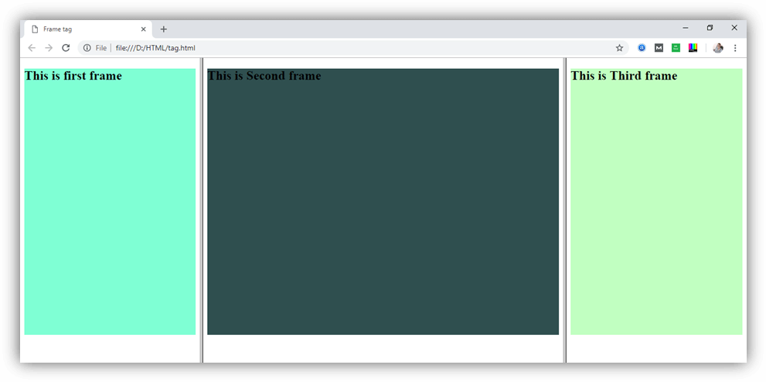
Create Vertical frames:
<html>
<head>
<title>Frame tag</title>
</head>
<frameset cols="25%,50%,25%">
<frame src="frame1.html" >
<frame src="frame2.html">
<frame src="frame3.html">
</frameset>
</html>

Slide 45
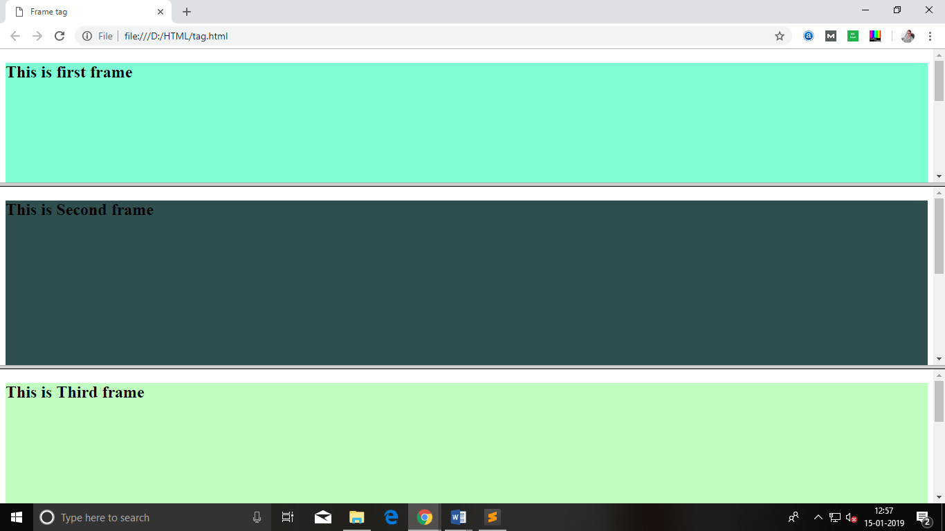
Create Horizontal frames:
<html>
<head>
<title>Frame tag</title>
</head>
<frameset rows="30%, 40%, 30%">
<frame name="top" src="frame1.html" >
<frame name="main" src="frame2.html">
<frame name="bottom" src="frame3.html">
</frameset>
</html>

Slide 46
CSS
CSS is the language we use to style an HTML document.
CSS describes how HTML elements should be displayed.
CSS stands for Cascading Style Sheets
CSS describes how HTML elements are to be displayed on screen, paper, or in other media
CSS saves a lot of work. It can control the layout of multiple web pages all at once
External stylesheets are stored in CSS files

Slide 47
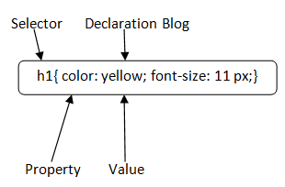
CSS Syntax
Selector: Selector indicates the HTML element you want to style. It could be any tag like <h1>, <title> etc.
Declaration Block: The declaration block can contain one or more declarations separated by a semicolon. For the above example, there are two declarations:
color: yellow;
font-size: 11 px;
Each declaration contains a property name and value, separated by a colon.

Slide 48
CSS Selector
CSS selectors are used to select the content you want to style. Selectors are the part of CSS rule set. CSS selectors select HTML elements according to its id, class, type, attribute etc.There are several different types of selectors in CSS.
CSS Element Selector
CSS Id Selector
CSS Class Selector
CSS Universal Selector
CSS Group Selector

Slide 49
1) CSS Element Selector
The element selector selects the HTML element by name.
<!DOCTYPE html>
<html>
<head>
<style>
p{
text-align: center;
color: blue;
}
</style>
</head>
<body>
<p>This style will be applied on every paragraph.</p>
<p id="para1">Me too!</p>
<p>And me!</p>
</body>
</html>

Slide 50
2) CSS Id Selector
The id selector selects the id attribute of an HTML element to select a specific element. An id is always unique within the page so it is chosen to select a single, unique element.
It is written with the hash character (#), followed by the id of the element.
<!DOCTYPE html>
<html>
<head>
<style>
#para1 {
text-align: center;
color: blue;
}
</style>
</head>
<body>
<p id="para1">Hello Javatpoint.com</p>
<p>This paragraph will not be affected.</p>
</body>
</html>

Slide 51
3) CSS Class Selector
The class selector selects HTML elements with a specific class attribute. It is used with a period character . (full stop symbol) followed by the class name.
<!DOCTYPE html>
<html>
<head>
<style>
.center {
text-align: center;
color: blue;
}
</style>
</head>
<body>
<h1 class="center">This heading is blue and center-aligned.</h1>
<p class="center">This paragraph is blue and center-aligned.</p>
</body>
</html>

Slide 52
CSS Class Selector for specific element
If you want to specify that only one specific HTML element should be affected then you should use the element name with class selector.
<!DOCTYPE html>
<html>
<head>
<style>
p.center {
text-align: center;
color: blue;
}
</style>
</head>
<body>
<h1 class="center">This heading is not affected</h1>
<p class="center">This paragraph is blue and center-aligned.</p>
</body>
</html>

Slide 53
4) CSS Universal Selector
The universal selector is used as a wildcard character. It selects all the elements on the pages.
<!DOCTYPE html>
<html>
<head>
<style>
* {
color: green;
font-size: 20px;
}
</style>
</head>
<body>
<h2>This is heading</h2>
<p>This style will be applied on every paragraph.</p>
<p id="para1">Me too!</p>
<p>And me!</p>
</body>
</html>

Slide 54
5) CSS Group Selector
The grouping selector is used to select all the elements with the same style definitions.
Grouping selector is used to minimize the code. Commas are used to separate each selector in grouping.
Let's see the CSS code without group selector.
h1 {
text-align: center;
color: blue;
}
h2 {
text-align: center;
color: blue;
}
p {
text-align: center;
color: blue;
}
h1,h2,p {
text-align: center;
color: blue;
}

Slide 55
How to add CSS
CSS is added to HTML pages to format the document according to information in the style sheet. There are three ways to insert CSS in HTML documents.
Inline CSS
Internal CSS
External CSS

Slide 56
Inline CSS
We can apply CSS in a single element by inline CSS technique.
If you want to use inline CSS, you should use the style attribute to the relevant tag.
Syntax: <htmltag style="cssproperty1:value; cssproperty2:value;"> </htmltag>
Example:<h2style="color:red;margin- left:40px;">Inline CSS is applied on this heading.</h2>

Slide 57
2. Internal CSS
The internal style sheet is used to add a unique style for a single document. It is defined in <head> section of the HTML page inside the <style> tag.
<!DOCTYPE html>
<html>
<head>
<style>
body {
background-color: linen;
}
h1 {
color: red;
margin-left: 80px;
}
</style>
</head>
<body>
<h1>The internal style sheet is applied on this heading.</h1>
<p>This paragraph will not be affected.</p>
</body>
</html>

Slide 58
3. External CSS
The external style sheet is generally used when you want to make changes on multiple pages. It is ideal for this condition because it facilitates you to change the look of the entire web site by changing just one file.
It uses the <link> tag on every pages and the <link> tag should be put inside the head section.
<head>
<link rel="stylesheet" type="text/css" href="mystyle.css">
</head>
The external style sheet may be written in any text editor but must be saved with a .css extension. This file should not contain HTML elements.

Slide 59
CSS Comments
CSS comments are generally written to explain your code. It is very helpful for the users who reads your code so that they can easily understand the code. Comments are ignored by browsers.
Comments are single or multiple lines statement and written within /*............*/ .

Slide 60
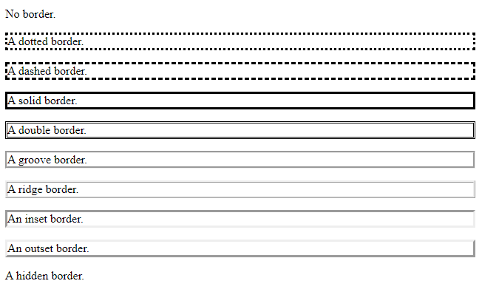
CSS PROPERTIES
<head>
<style>
p.none {border-style: none;}
p.dotted {border-style: dotted;}
p.dashed {border-style: dashed;}
p.solid {border-style: solid;}
p.double {border-style: double;}
p.groove {border-style: groove;}
p.ridge {border-style: ridge;}
p.inset {border-style: inset;}
p.outset {border-style: outset;}
p.hidden {border-style: hidden;}
</style>
</head>
<body>
<p class="none">No border.</p>
<p class="dotted">A dotted border.</p>
<p class="dashed">A dashed border.</p>
<p class="solid">A solid border.</p>
<p class="double">A double border.</p>
<p class="groove">A groove border.</p>
<p class="ridge">A ridge border.</p>
<p class="inset">An inset border.</p>
<p class="outset">An outset border.</p>
<p class="hidden">A hidden border.</p>
</body>

Slide 61
JavaScript

Slide 62
JavaScript (js) is a light-weight object-oriented programming language which is used by several websites for scripting the webpages.
It is an uninterpreted, full-fledged programming language that enables dynamic interactivity on websites when applied to an HTML document.
With JavaScript, users can build modern web applications to interact directly without reloading the page every time.

Slide 63
Features of JavaScript
All popular web browsers support JavaScript as they provide built-in execution environments.
JavaScript follows the syntax and structure of the C programming language. Thus, it is a structured programming language.
It is a case-sensitive language.
JavaScript is supportable in several operating systems including, Windows, macOS, etc.
It provides good control to the users over the web browsers.

Slide 64
JavaScript provides 3 places to put the JavaScript code:
Between the body tag of html
Between the head tag of html
In .js file (external javaScript)
<script type="text/javascript">
document.write("JavaScript is a simple language for java learners");
</script>
The script tag specifies that we are using JavaScript.
The text/javascript is the content type that provides information to the browser about the data.

Slide 65
1) JavaScript Example : code between the body tag
Below code displays the simple example of JavaScript that displays alert dialog box.
<script type="text/javascript">
alert("Hello Javatpoint");
</script>

Slide 66
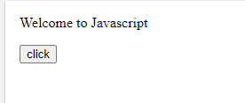
2) JavaScript Example : code between the head tag
In this example, we are creating a function msg(). To create function in JavaScript, you need to write function with function_name as given below.
To call function, you need to work on event. Here we are using onclick event to call msg() function.
<html>
<head>
<script type="text/javascript">
function msg(){
alert("Hello Java");
}
</script>
</head>
<body>
<p>Welcome to Javascript</p>
<form>
<input type="button" value="click" onclick="msg()"/>
</form>
</body>
</html>

Slide 67
External JavaScript file
We can create external JavaScript file and embed it in many html page.
It provides code re usability because single JavaScript file can be used in several html pages.
An external JavaScript file must be saved by .js extension. It is recommended to embed all JavaScript files into a single file. It increases the speed of the webpage.
index.html
<html>
<head>
<script type="text/javascript" src="message.js"></script>
</head>
<body>
<p>Welcome to JavaScript</p>
<form>
<input type="button" value="click" onclick="msg()"/>
</form>
</body>
</html>
Example:
message.js
function msg(){
alert("Hello Javatpoint");
}

Slide 68
Advantages of External JavaScript
There will be following benefits if a user creates an external javascript:
It helps in the reusability of code in more than one HTML file.
It allows easy code readability.
It is time-efficient as web browsers cache the external js files, which further reduces the page loading time.
It enables both web designers and coders to work with html and js files parallelly and separately, i.e., without facing any code conflictions.
The length of the code reduces as only we need to specify the location of the js file.

Slide 69
Comment
The JavaScript comment is ignored by the JavaScript engine i.e. embedded in the browser.
To make code easy to understand It can be used to elaborate the code so that end user can easily understand the code.
To avoid the unnecessary code It can also be used to avoid the code being executed. Sometimes, we add the code to perform some action. But after sometime, there may be need to disable the code. In such case, it is better to use comments.
There are two types of comments in JavaScript.
Single-line Comment
Multi-line Comment

Slide 70
Single Line Comments
<script>
// It is single line comment
document.write("hello javascript");
</script>
Multi Line Comments
<script>
/* It is multi line comment.
It will not be displayed */
document.write("example of javascript multiline comment");
</script>

Slide 71
JavaScript Variables
In a programming language, variables are used to store data values.
JavaScript uses the keywords var, let and const to declare variables.
An equal sign is used to assign values to variables.
In this example, x is defined as a variable. Then, x is assigned (given) the value 6:
let x; x = 6;

Slide 72
Data Types | Description | Example
String | represents textual data | 'hello', "hello world!" etc
Number | an integer or a floating-point number | 3, 3.234, 3e-2 etc.
BigInt | an integer with arbitrary precision | 900719925124740999n , 1n etc.
Boolean | Any of two values: true or false | true and false
undefined | a data type whose variable is not initialized | let a;
null | denotes a null value | let a = null;
Symbol | data type whose instances are unique and immutable | let value = Symbol('hello');
Object | key-value pairs of collection of data | let student = { };

Slide 73
JavaScript Variable
A JavaScript variable is simply a name of storage location. There are two types of variables in JavaScript :
local variable
global variable.
There are some rules while declaring a JavaScript variable (also known as identifiers).
Name must start with a letter (a to z or A to Z), underscore( _ ), or dollar( $ ) sign.
After first letter we can use digits (0 to 9), for example value1.
JavaScript variables are case sensitive, for example x and X are different variables.

Slide 74
JavaScript local variable
A JavaScript local variable is declared inside block or function. It is accessible within the function or block only. For example:
<script>
function abc(){
var x=10;//local variable
}
</script>

Slide 75
JavaScript global variable
A JavaScript global variable is accessible from any function. A variable i.e. declared outside the function or declared with window object is known as global variable. For example:
<script>
var data=200;//gloabal variable
function a(){
document.writeln(data);
}
function b(){
document.writeln(data);
}
a();//calling JavaScript function
b();
</script>

Slide 76
JavaScript Functions
JavaScript functions are used to perform operations. We can call JavaScript function many times to reuse the code.
Advantage of JavaScript function
There are mainly two advantages of JavaScript functions.
Code reusability: We can call a function several times so it save coding.
Less coding: It makes our program compact. We don’t need to write many lines of code each time to perform a common task.

Slide 77
JavaScript Function Syntax
function functionName([arg1, arg2, ...argN]){
//code to be executed
}
Simple example of function in JavaScript that does not has arguments.
<script>
function msg(){
alert("hello! this is message");
}
</script>
<input type="button" onclick="msg()" value="call function"/>

Slide 78
JavaScript Function Arguments
call function by passing arguments. Let’s see the example of function that has one argument.
<script>
function getcube(number){
alert(number*number*number);
}
</script>
<form>
<input type="button" value="click" onclick="getcube(4)"/>
</form>
64

Slide 79
Function with Return Value
We can call function that returns a value and use it in our program. Let’s see the example of function that returns value.
<script>
function getInfo(){
return "hello java! How r u?";
}
</script>
<script>
document.write(getInfo());
</script>

Slide 80
JavaScript Loops
The JavaScript loops are used to iterate the piece of code using for, while, do while. It makes the code compact. It is mostly used in array.
There are three types of loops in JavaScript.
for loop
while loop
do-while loop

Slide 81
1) JavaScript For loop
The JavaScript for loop iterates the elements for the fixed number of times. It should be used if number of iteration is known. The syntax of for loop is given below.
for (initialization; condition; increment)
{
code to be executed
}

Slide 82
2) JavaScript while loop
The JavaScript while loop iterates the elements for the infinite number of times. It should be used if number of iteration is not known. The syntax of while loop is given below.
while (condition)
{
code to be executed
}

Slide 83
3) JavaScript do while loop
The JavaScript do while loop iterates the elements for the infinite number of times like while loop. But, code is executed at least once whether condition is true or false. The syntax of do while loop is given below.
do{
code to be executed
}while (condition);

Slide 84
JavaScript Conditions
The JavaScript if-else statement is used to execute the code whether condition is true or false. There are three forms of if statement in JavaScript.
If Statement
If else statement

Slide 85
JavaScript If statement
It evaluates the content only if expression is true. The signature of JavaScript if statement is given below.
if(expression){
//content to be evaluated
}
JavaScript If...else Statement
It evaluates the content whether condition is true of false. The syntax of JavaScript if-else statement is given below.
if(expression){
//content to be evaluated if condition is true
}
else{
//content to be evaluated if condition is false
}

Slide 86
The JavaScript switch statement is used to execute one code from multiple expressions. It is just like else if statement. But it is convenient than if..else..if because it can be used with numbers, characters etc.
The signature of JavaScript switch statement is given below.
switch(expression){
case value1:
code to be executed;
break;
case value2:
code to be executed;
break;
......
default:
code to be executed if above values are not matched;
}

Slide 87
Application of JavaScript
JavaScript is used to create interactive websites. It is mainly used for:
Client-side validation,
Dynamic drop-down menus,
Displaying date and time,
Displaying pop-up windows and dialog boxes (like an alert dialog box, confirm dialog box and prompt dialog box),
Displaying clocks etc.
It can change HTML Content
It can change HTML attributes
It can change style of HTML element
Java script can validate HTML Content

Slide 88
JavaScript Can Change HTML Content
<!DOCTYPE html>
<html>
<body>
<h2>What Can JavaScript Do?</h2>
<p id="demo">JavaScript can change HTML content.</p>
<button type="button" onclick='document.getElementById("demo").innerHTML = "Hello JavaScript!"'>Click Me!</button>
</body>
</html>

Slide 89
JavaScript Can Change HTML Styles (CSS)
Changing the style of an HTML element, is a variant of changing an HTML attribute:

Slide 90
<!DOCTYPE html>
<html>
<body>
<h2>What Can JavaScript Do?</h2>
<p id="demo">JavaScript can change the style of an HTML element.</p>
<button type="button" onclick="document.getElementById('demo').style.fontSize='35px'">Click Me!</button>
</body>
</html>

Slide 91
Java Script OUT puts
JavaScript Display Possibilities
JavaScript can "display" data in different ways:
Writing into an HTML element, using innerHTML.
Writing into the HTML output using document.write().
Writing into an alert box, using window.alert().
Writing into the browser console, using console.log().

Slide 92
Using innerHTML
To access an HTML element, JavaScript can use the document.getElementById(id) method.
The id attribute defines the HTML element. The innerHTML property defines the HTML content:
<!DOCTYPE html> <html> <body> <h1>My First Web Page</h1> <p>My First Paragraph</p> <p id="demo"></p> <script> document.getElementById("demo").innerHTML = 5 + 6; </script> </body> </html>

Slide 93
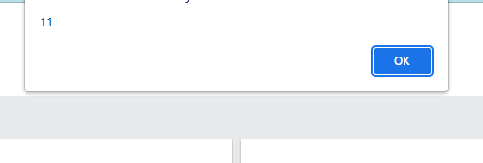
window.alert().
<!DOCTYPE html>
<html>
<body>
<h1>My First Web Page</h1>
<p>My first paragraph.</p>
<script>
window.alert(5 + 6);
</script>
</body>
</html>

Slide 94
Using document.write()
For testing purposes, it is convenient to use document.write():
<!DOCTYPE html> <html> <body> <h1>My First Web Page</h1> <p>My first paragraph.</p> <script> document.write(5 + 6); </script> </body> </html>

Slide 95
Functions
Variables
Operators
Statements
Arrays
Objects
Strings

Slide 96
Browser object model in javaScript(BOM)
Method | Description
alert() | displays the alert box containing message with ok button.
confirm() | displays the confirm dialog box containing message with ok and cancel button.
prompt() | displays a dialog box to get input from the user.
open() | opens the new window.
close() | closes the current window.

Slide 97
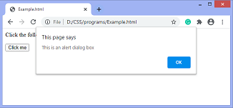
<html>
<head>
<script type = "text/javascript">
function fun() {
alert ("This is an alert dialog box");
}
</script>
</head>
<body>
<p> Click the following button to see the effect </p>
<form>
<input type = "button" value = "Click me" onclick = "fun();" />
</form>
</body>
</html>
Window.alert(“Hello”)
Window.confirm(“Hello”)
Window.prompt(“Hello”)
Open(“www.google.com”)
Close() = toclose the window

Slide 98
prompt() in javascript
open() in javascript
<script type="text/javascript">
function msg(){
var v= prompt("Who are you?");
alert("I am "+v);
}
</script>
<input type="button" value="click" onclick="msg()"/>
<script type="text/javascript">
function msg(){
open("http://www.javascript.com");
}
</script>
<input type="button" value="javatpoint" onclick="msg()"/>

Slide 99
The HTML DOM (Document Object Model)
Write()
GetelementByID
Getelementby name
Changing content
Changing Value
Changing Style

Slide 100
Form validation in javascript
If a form field (fname) is empty, this function alerts a message, and returns false, to prevent the form from being submitted:
Data validation is the process of ensuring that user input is clean, correct, and useful.
Typical validation tasks are:
has the user filled in all required fields?
has the user entered a valid date?
has the user entered text in a numeric field?
Most often, the purpose of data validation is to ensure correct user input.
Validation can be defined by many different methods, and deployed in many different ways.
Server side validation is performed by a web server, after input has been sent to the server.
Client side validation is performed by a web browser, before input is sent to a web server.

Slide 101
<!DOCTYPE html>
<html>
<head>
<script>
function validateForm() {
let x = document.forms["myForm"]["fname"].value;
if (x == "") {
alert("Name must be filled out");
return false;
}
}
</script>
</head>
</html>
<body>
<h2>JavaScript Validation</h2>
<form name="myForm" action="/action_page.php" onsubmit="return validateForm()" method="post">
Name: <input type="text" name="fname">
<input type="submit" value="Submit">
</form>
</body>

