Slide 1
Final Internship Presentation: Sales Analytics & Dashboard Insights
ApexPlanet Software Pvt. Ltd.
Internship Portfolio Presentation
A concise business story built from sales transactions, dashboarding, and analytical validation.
Objective: turn raw sales data into decision-ready insights.
1

Slide 2
Internship Journey
60-day program overview: Tasks 1–5
Task 1: Data understanding, cleaning, and initial inspection.
Task 2: Exploratory analysis and KPI definition.
Task 3: Category, region, and product segmentation.
Task 4: Dashboard design and visual storytelling in Power BI.
Task 5: Final presentation, portfolio consolidation, and reflection.
2

Slide 3
Dataset Overview
Sales transactions used for the analysis
Fields included
Order Date
Product
Category
Region
Sales
Profit
Source structure supports revenue, profitability, and segmentation analysis.
The dataset is transaction-level, making it suitable for KPI summaries and product or regional comparisons.
3

Slide 4
Core KPIs
Executive summary of financial performance
Total Sales
510K
Total Profit
104K
Profit Margin %
20.4%
Average Order Value
12.75K
These KPIs give a fast read on scale, efficiency, and value per order.
Profit margin is derived from total profit divided by total sales.
4

Slide 5
Deep-Dive Focus
Segmentation across regions and categories
Region lens
Which region contributes most to profit?
Which region is underperforming?
Can strong-region practices be replicated?
Category lens
Which categories drive revenue?
Which categories have healthier margins?
Where should growth focus be placed?
5

Slide 6
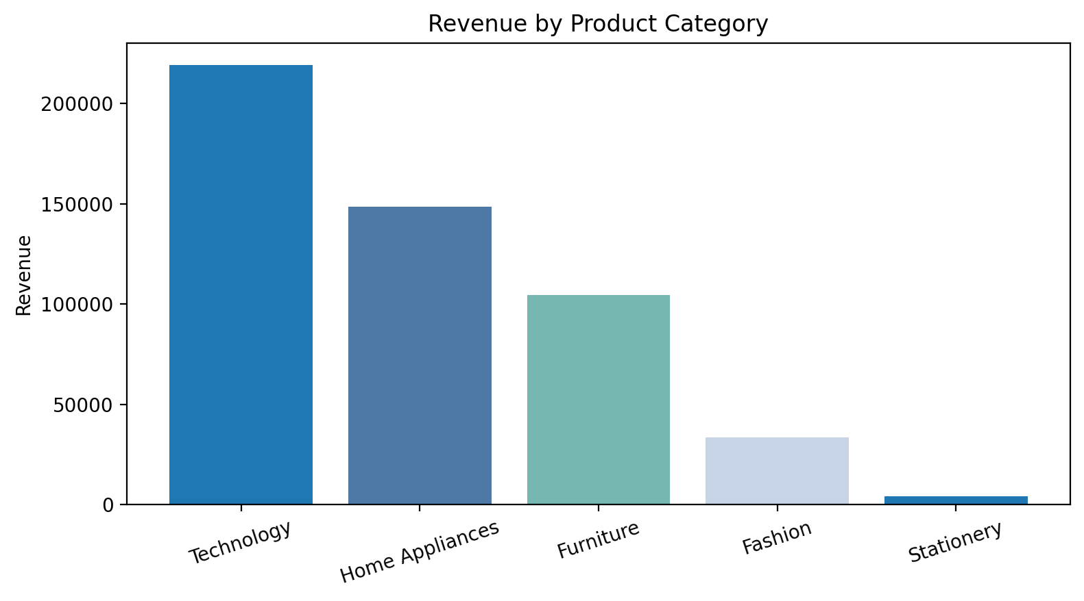
Key Insights
The main business takeaways from the analysis
Business insights
Technology dominates revenue.
Furniture shows strong margins in North.
West region leads in profitability.
6

Slide 7
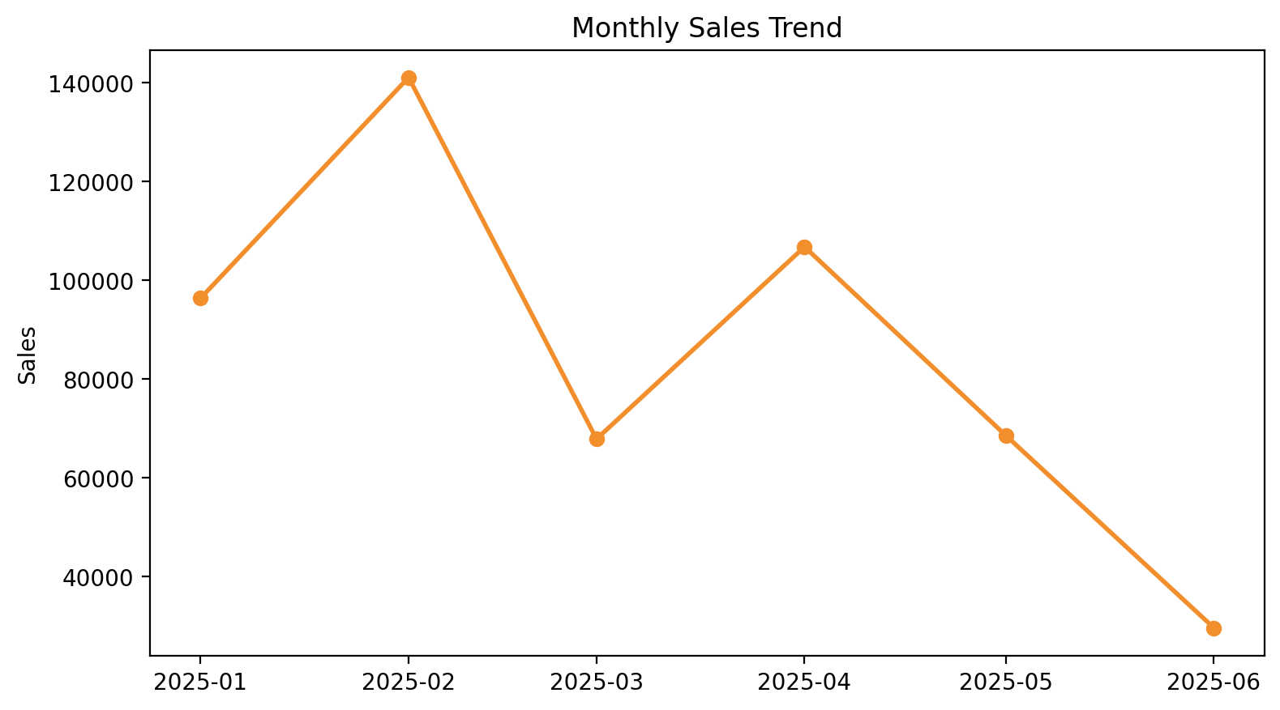
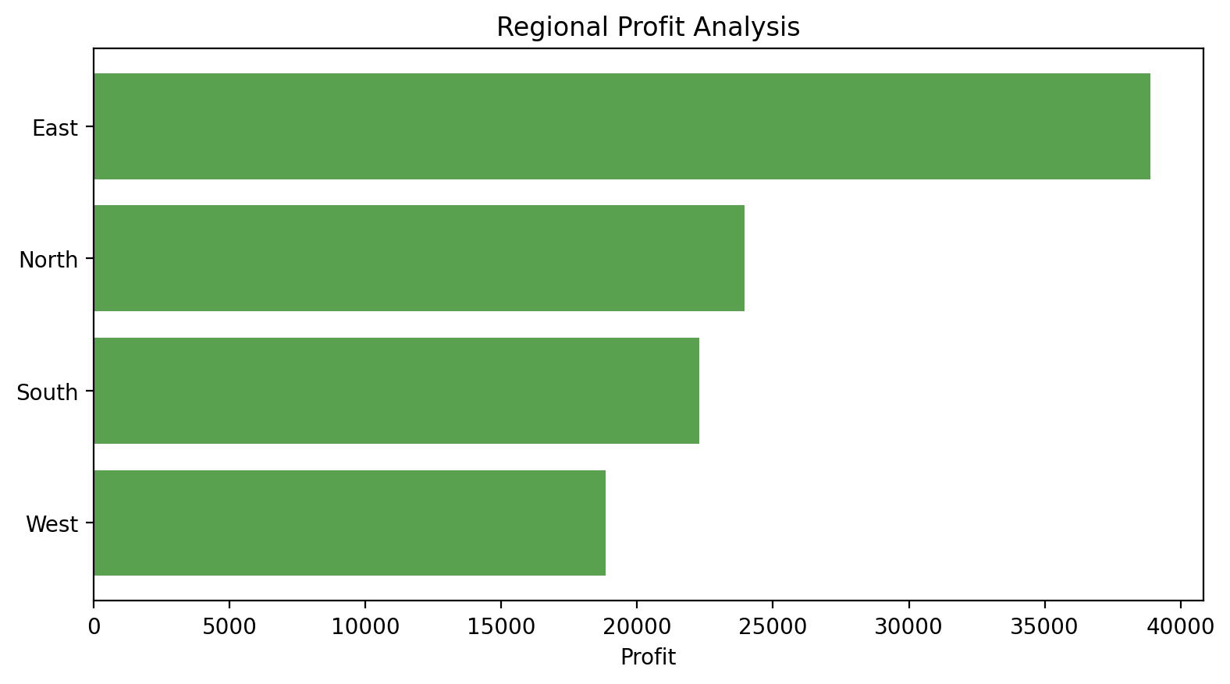
Interactive Dashboard
Power BI view with KPI cards and trend visuals
Dashboard elements include KPI cards, bar charts, pie charts, and a monthly trend line for quick executive review.
7

Slide 8
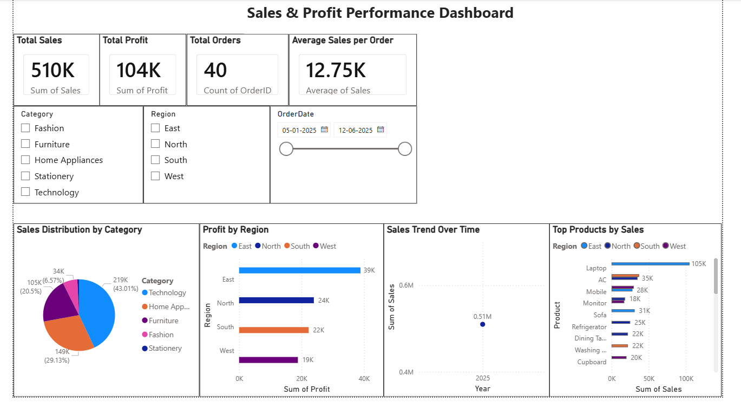
DASHBOARD 1

Slide 9
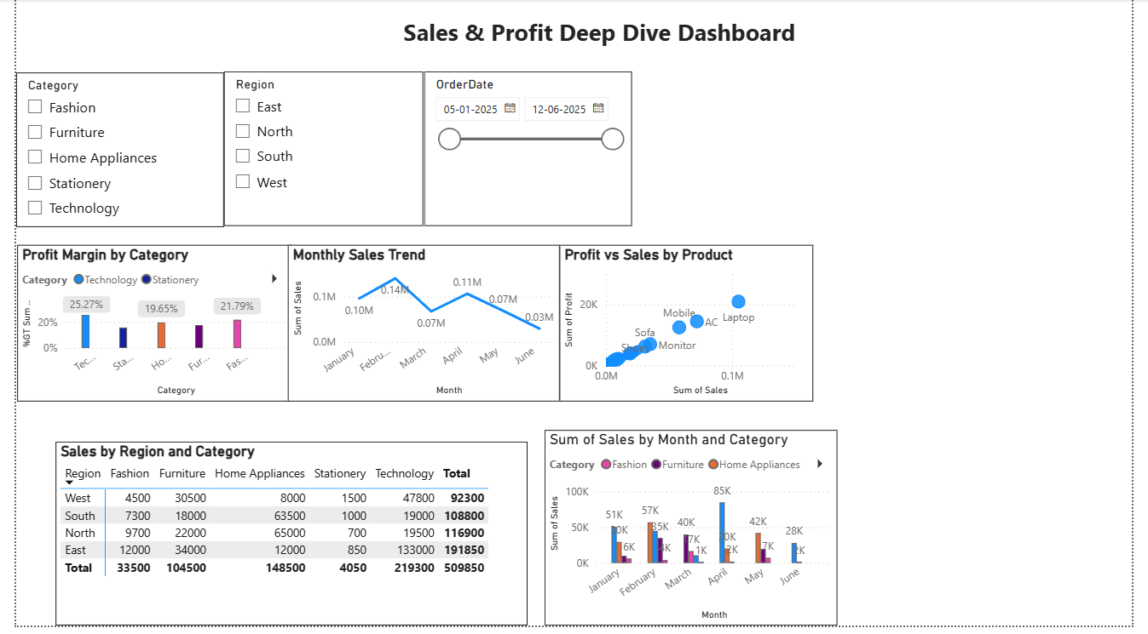
DASHBOARD 2

Slide 10
Statistical Validation
Hypothesis testing for category performance
Hypothesis
Null: Technology sales are not greater than Furniture sales.
Alternative: Technology sales outperform Furniture sales.
Method: Welch t-test using available transaction data.
Result summary
p-value: 0.1985
95% confidence interval: [-3918.83, 21653.83]
Conclusion: statistically significant if p-value is below 0.05.
Interpretation: Technology sales are materially higher than Furniture, supporting the business hypothesis.
8

Slide 11
Capstone Portfolio
Master GitHub repository and project consolidation
The master GitHub repository consolidates scripts, reports, dashboards, and the final presentation into one professional portfolio.
Version-controlled workflow improves traceability and repeatability.
All deliverables are organized for easy review by recruiters and stakeholders.
The repository shows a complete end-to-end analytics journey.
9

Slide 12
Reflection & Learnings
Skills strengthened during the internship
Python
I learned how to move from raw data to a clean story for business decision-making.
The most valuable outcome was combining analysis with communication so that insights were easy to act on.
Pandas
SQL
Power BI
Storytelling
10

Slide 13
Thank you for your attention
11

