Slide 1



Dual-Readout Calorimetry Signal Analysis with Neural Networks
Murali Saravanan

Slide 2
Overview
Dual-Readout Calorimetry Recap
Current Results
Part I: Monte Carlo Simulations
Part II: Real Data
Part III: hls4ml
Future Steps

Slide 3
The LHC and Calorimetry
Calorimeters are responsible for energy measurement in ATLAS, CMS, and various particle detectors
Hadronic and Electromagnetic Calorimetry
protons, pions, and fragmenting quarks and gluons
Notes:
Need to understand where the energy is going, otherwise we can’t reconstruct what particles are coming out of batch collisions in the LJC

Slide 4
Hadronic Calorimetry
Measure em and non-em components
Huge fluctuations in em component (up to 40%) on event-by-event basis
Different calorimeter materials respond to em and non-em differently. Use response curves but this works on average
Notes:
EM component comes from decaying pi and eta mesons that decay into photons and electrons. This em shower energy resolution is somewhat limited in current designs.
fluctuations in the em shower fraction dominate the hadronic energy resolution, making it difficult to reconstruct energy. Hard to tell what is the em and what is not the em component. (“invisible energy”)

Slide 5
Dual Readout Calorimetry Recap
Measure both Cerenkov and Scintillation radiation to achieve em energy resolution on event-by-event basis
Amount of Cerenkov/Scint light can be tweaked by materials and geometry of physical calorimeter
Huge improvement for hadronic energy resolution, would be useful in future colliders (FCC, ILC, CLIC)

Slide 6
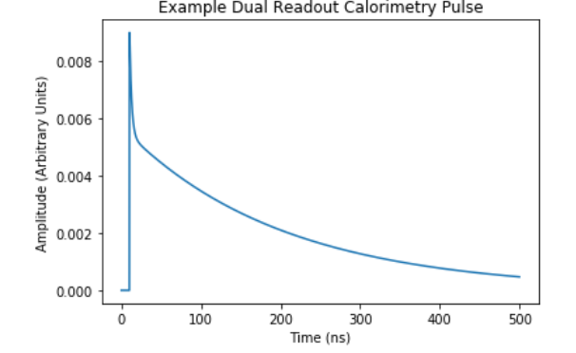
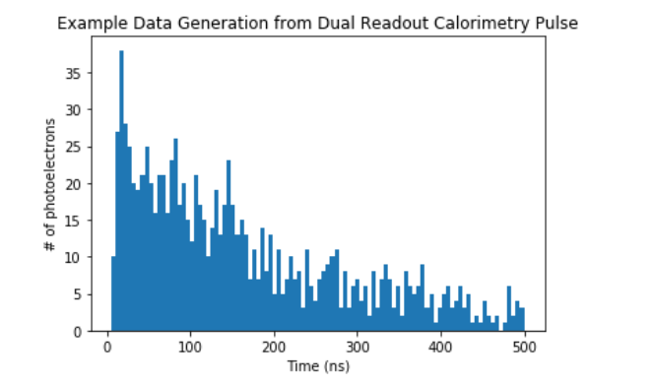
Single Channel Readout?
Single Channel saves overhead
Four parameters vary
Ratio of Cerenkov/Scintillation Radiation (Area)
Scintillation Decay Rate
Photoelectron Count
Digitizer Freq/Bin Number
Material Properties

Slide 7
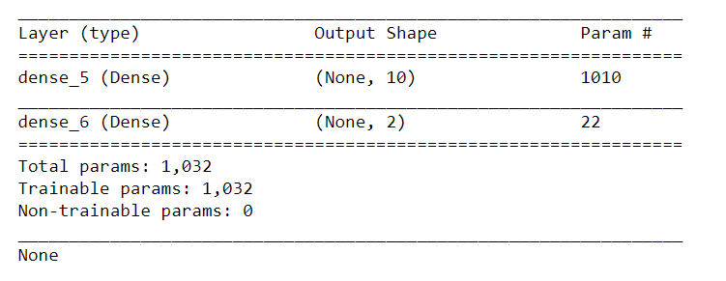
Using NN
NN is constant time
Predict two parameters
Cerenkov pulse area
Scintillation pulse area

Slide 8
Part 1: Monte Carlo Simulated Data
8

Slide 9
Monte-Carlo Generation of Data
Modify:
Ratio
10-> 10x more area of Cerenkov than Scintillation
-10-> 10x more area of Scintillation than Cerenkov
Scintillation Decay
Photoelectron Count
Binning
Generate a library of histograms, varying the above parameters to create different experiments
Create many events per experiment to create needed random fluctuations
9

Slide 10
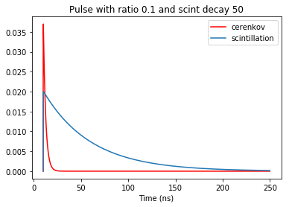
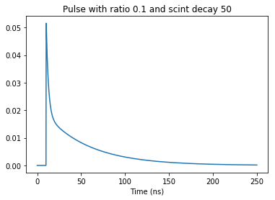
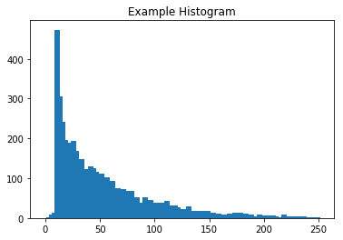
Example Pulse
Vary Ratio between -25 and 25
Vary Scint Decay from 15ns to 50ns
1k-5k photoelectrons
30, 100, 300 bins
10

Slide 11
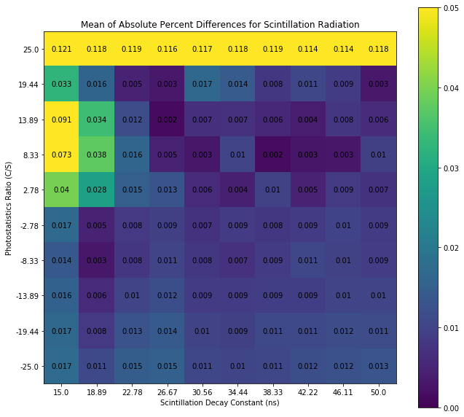
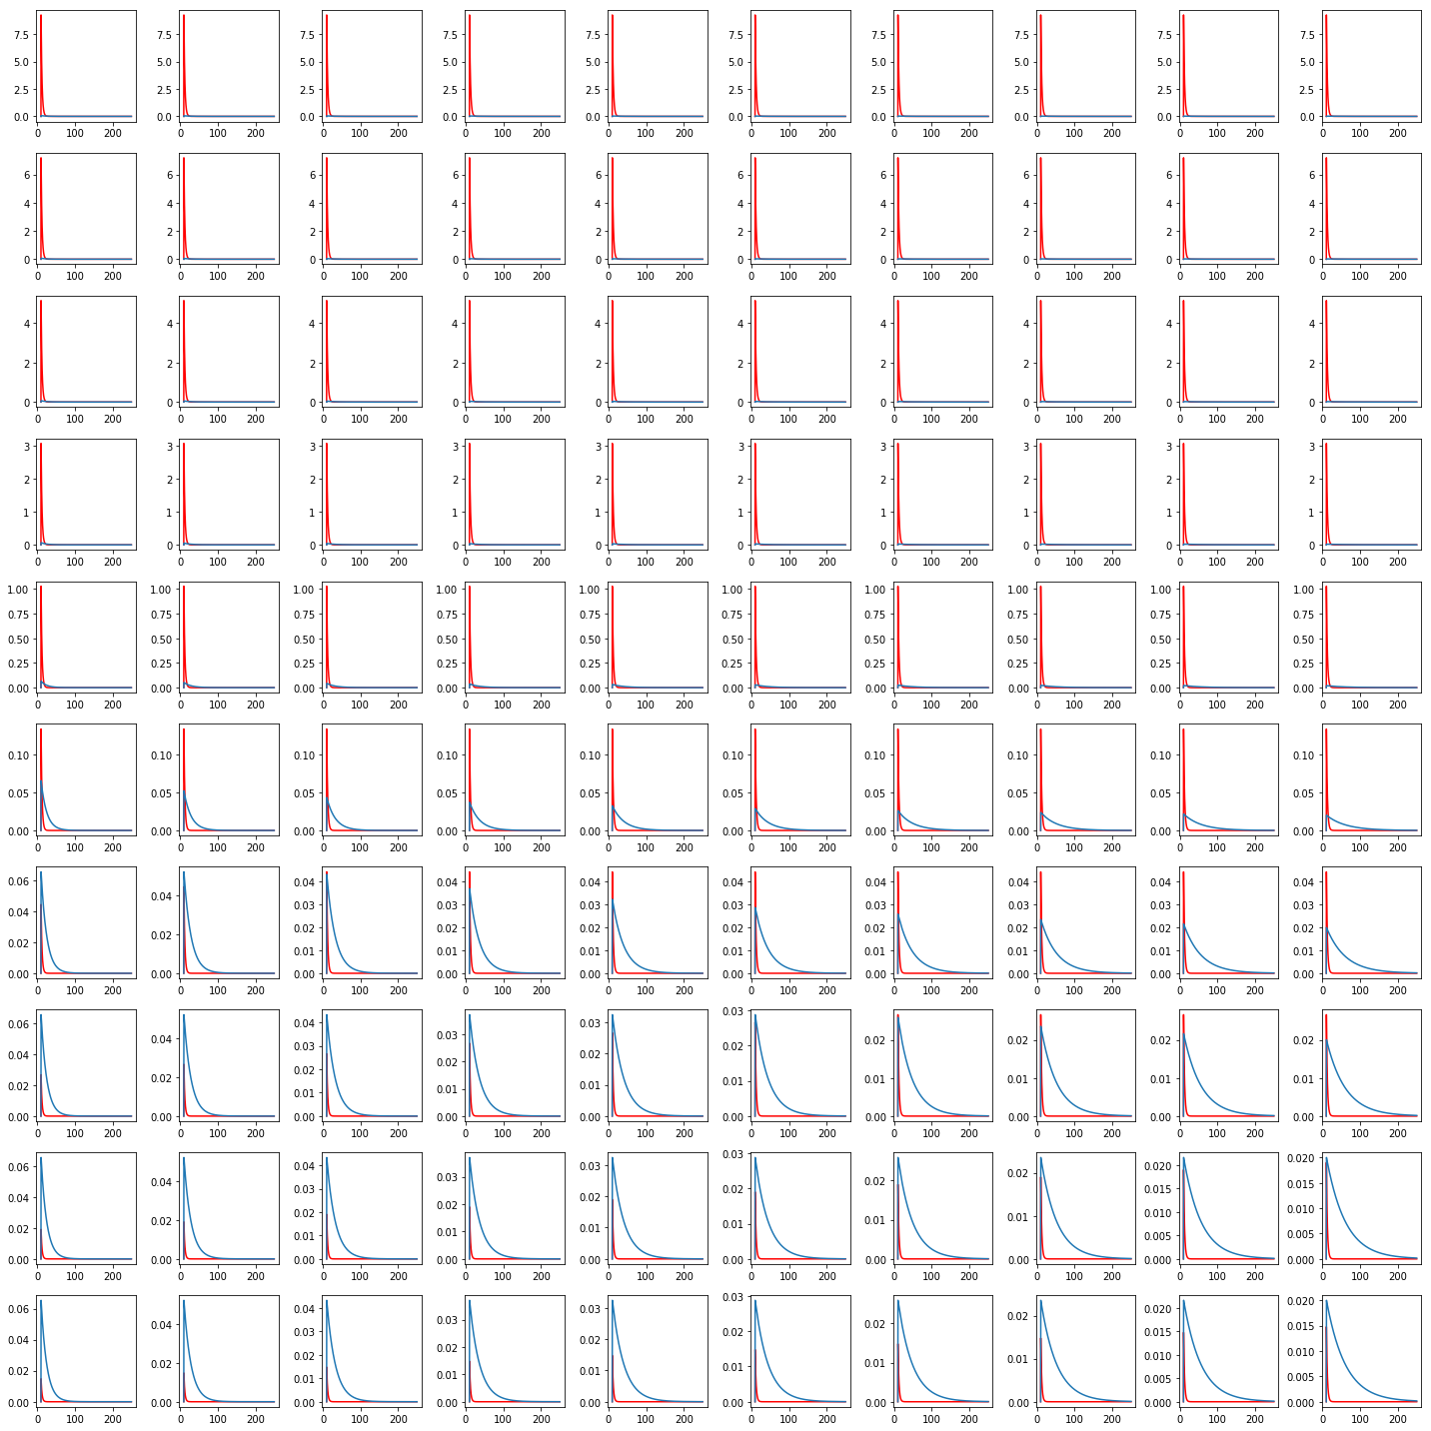
11

Slide 12
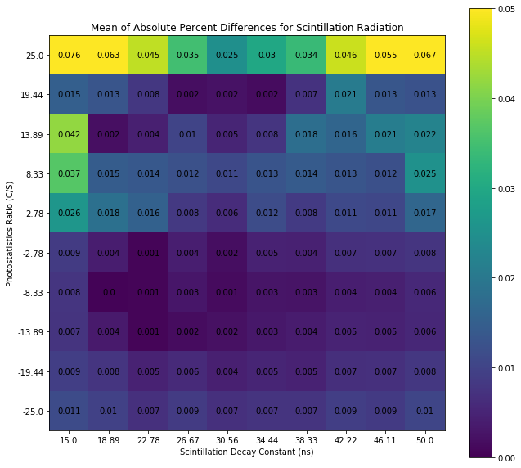
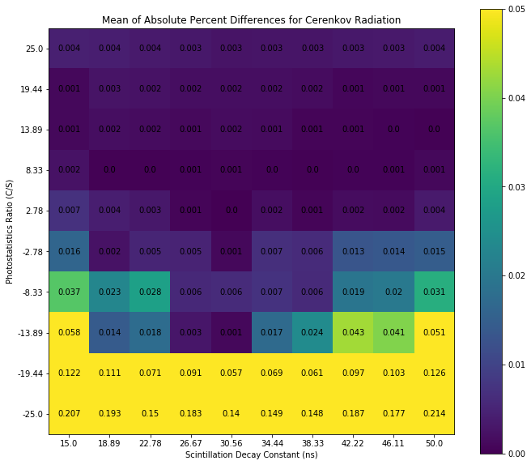
Vary digitizer freq and photostatistics
30 bins, 5k
12

Slide 13
Part I Conclusions
Major dependence is on ratio and not scintillation decay time
Higher photoelectron count gives better results
Gradual change over 1k-5k photoelectrons range (no tipping point)
Higher digitizer freq ≠ better prediction
Low freq hides the effects of fluctuations
Scintillation prediction is much more stable than Cerenkov prediction
13

Slide 14
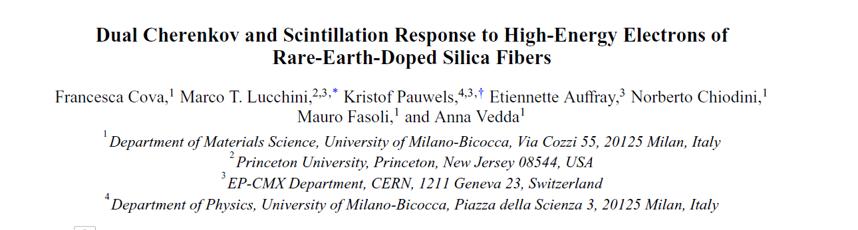
Part 2: Real Data
14

Slide 15
Real Data
response of Ce-doped silica fibers exposed to electrons in the 20–200-GeV
What does a realistic pulse look like? What is the actual ratio of C/S? Expected photoelectron count?
15

Slide 16
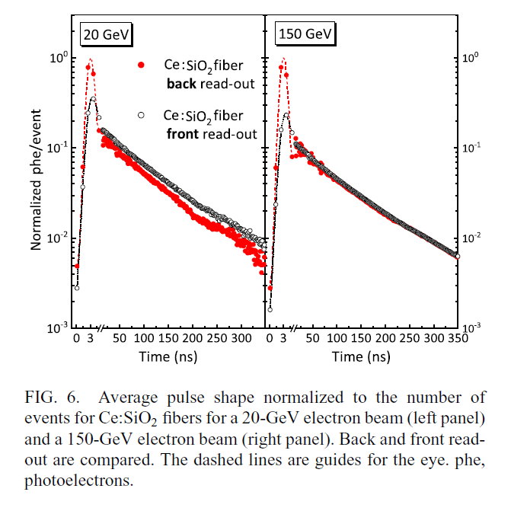
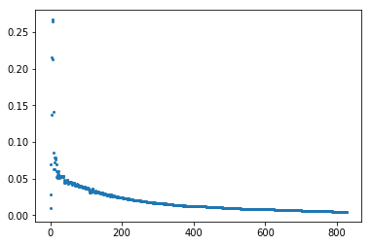
Average Pulse
200 GeV Pulse
PMT Voltage (arbitrary Units)
Sample number
[1] Cova, Francesca, et al. Physical Review Applied 11.2 (2019): 024036.
16

Slide 17
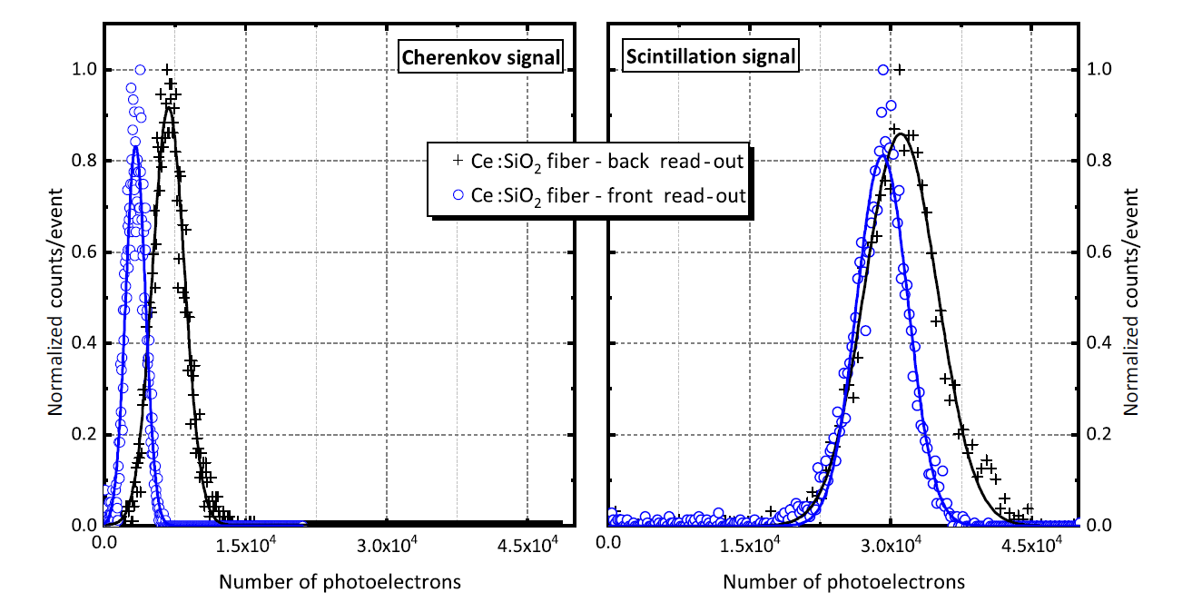
Photoelectron Count
7.5k for Cerenkov, 30k for Scintillation (ratio=-4)
[1] Cova, Francesca, et al. Physical Review Applied 11.2 (2019): 024036.
17

Slide 18
18

Slide 19
Monte Carlo results in this area
With 5,000 photoelectrons and 100 bins, possibility of less than 1% error
19

Slide 20
Real Data NN
In progress!
Need to consistently clean data
20

Slide 21
Part 3: Implementation on FPGAs
21

Slide 22
Intro to FPGAs
Multiplier Units
Does arithmetic
Flip Flops
Short term memory registers
Wire algorithms into board
High Level Synthesis (HLS) is the language that Xilinx FPGAs use
22

Slide 23
hls4ml
Takes NN and creates HLS implantation that provides resource usage estimates
Up to 6,000 parallel operations=# of multiplication units=max # of nodes and weights in NN if we aim for one clock cycle per analysis
Can trade latency for lower resource usage
[2] J.M. Duarte et al., arXiv:1804.06913, April 2018.
23

Slide 24
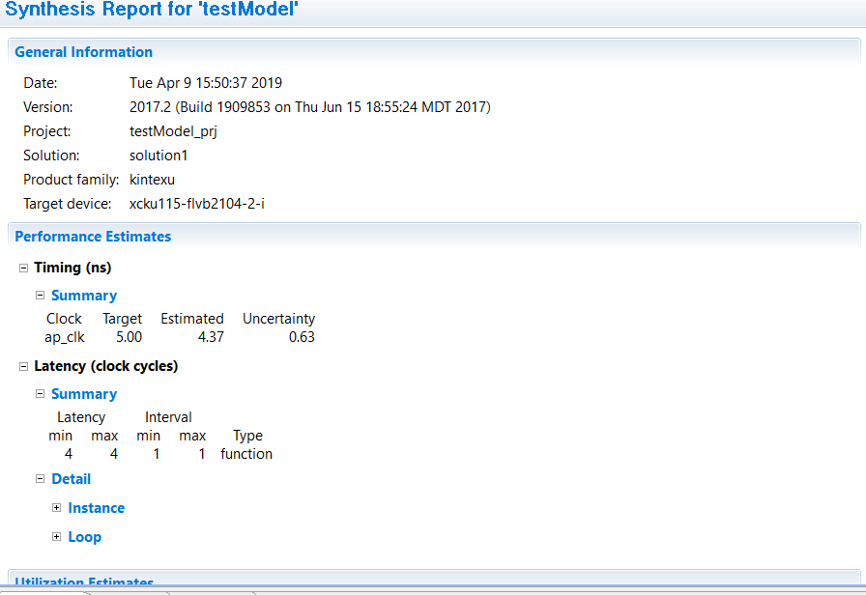
Preliminary Results
100 bin Model with 5ns goal
24

Slide 25
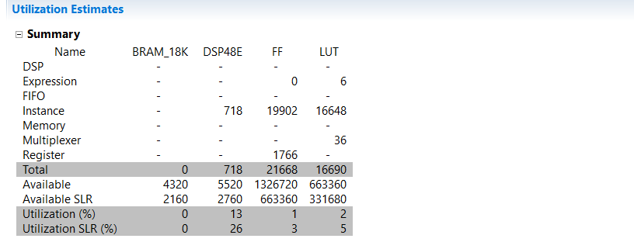
Preliminary Results
hls4ml in general provides an overestimate of resource usage
Can prune unnecessary nodes from intermediate layer to decrease resource usage
25

Slide 26
Project Conclusions
Dual Readout Calorimetry is promising for improving resolution of em-portion of hadronic energy on an event-by-event basis
Neural Networks can be implemented into FPGAs for low latency inference in single channel dual readout calo
Small networks are adequate
Simulated performance of NNs can be used to inform the geometry/construction of the calorimeters and the associated hardware
26

Slide 27
Project Conclusions
Single Channel Dual Readout Calorimetry can work thanks to Neural Networks
27

Slide 28
Future Steps
Produce NN results on real data
Look at implementation on real FPGA
28

Slide 29
Questions?

