Slide 1
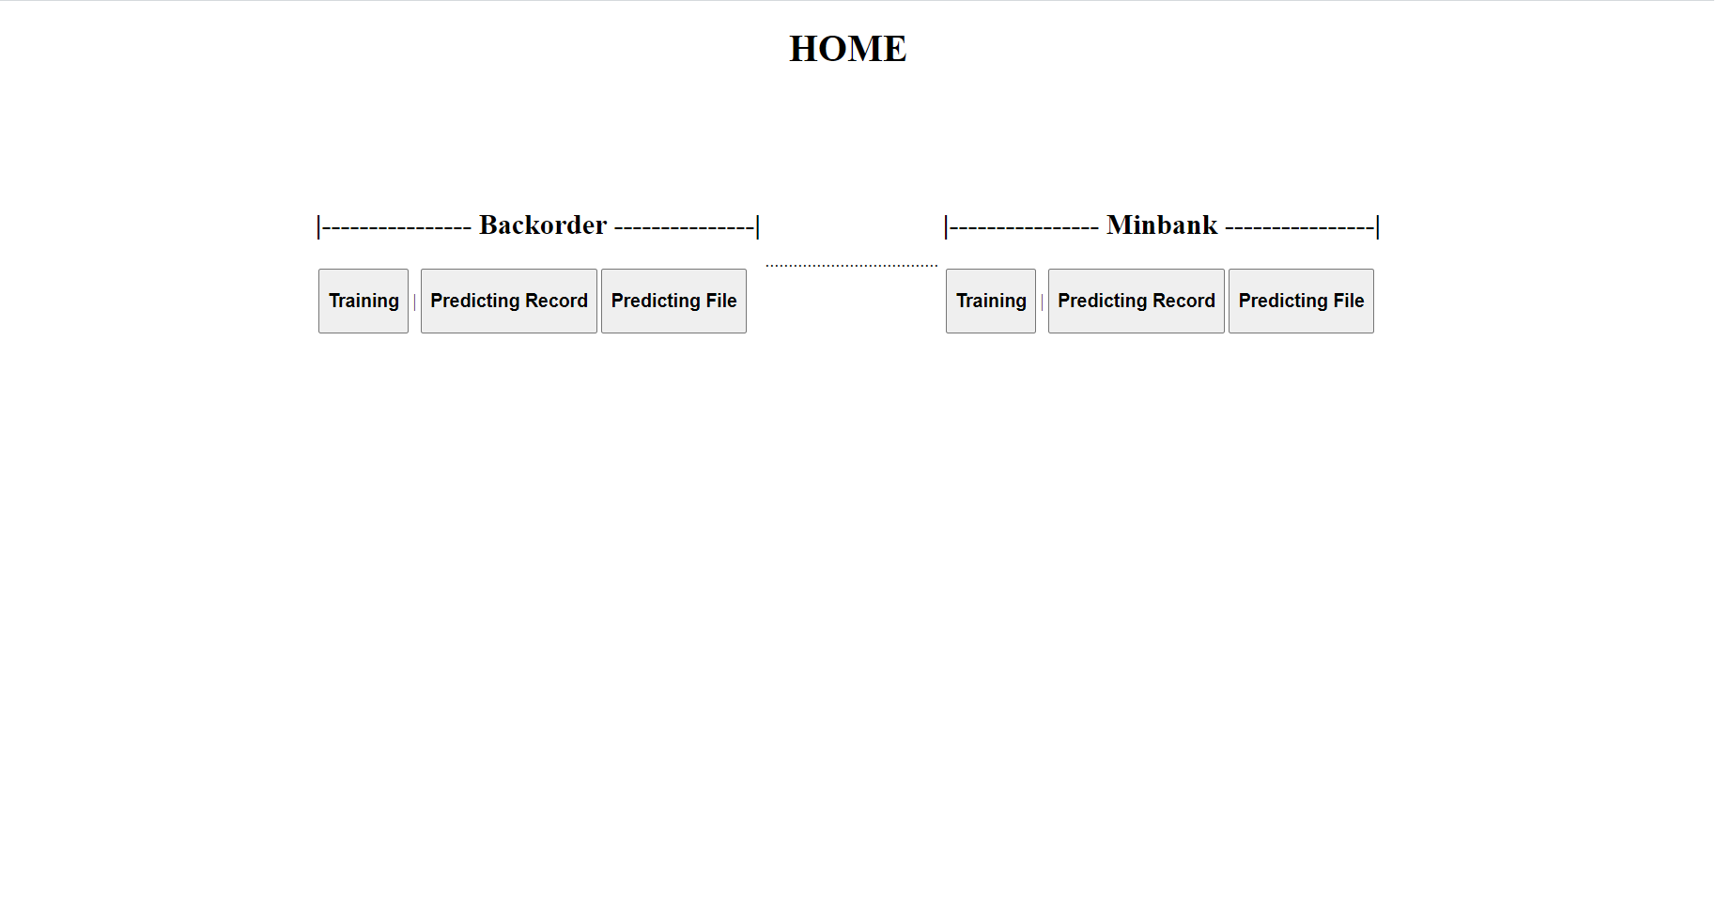
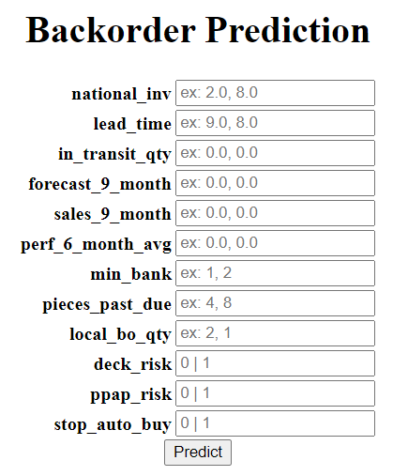
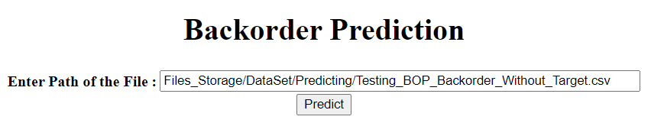
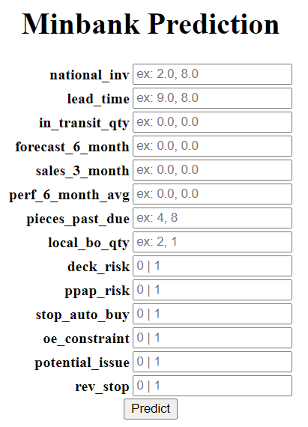
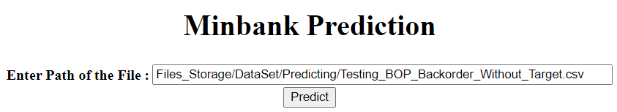

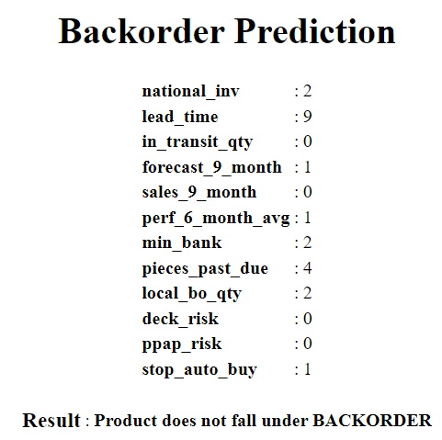
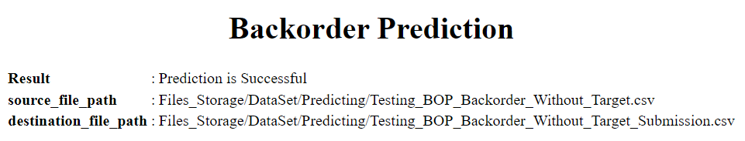
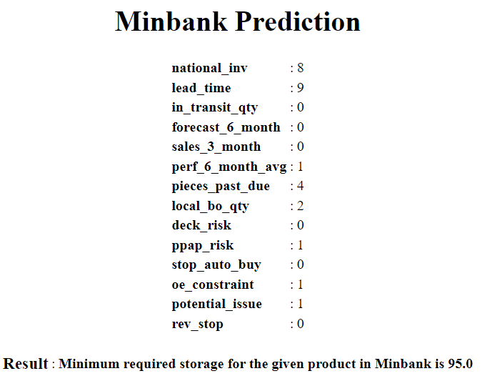
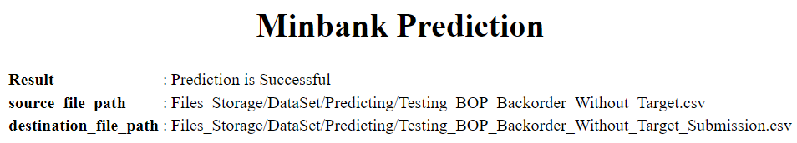
Method: home_Backorder_Record ()
Method: home_Backorder_File ()
Method: home_Minbank_Record ()
Method: home_Minbank_File ()
Display the HTML page to enter the record values.
Display the HTML page to enter the path of the file.
Display the HTML page to enter the record values.
Display the HTML page to enter the path of the file.
home_Backorder_Record.html
home_Backorder_File.html
home_Minbank_Record.html
home_Minbank_File.html
Method: backorderTraining()
Method: predict_Backorder_Record()
Method: predict_Backorder_File()
Method: minbankTraining ()
Method: predict_Minbank_Record()
Method: predict_Minbank_File()
Extract the record values
Create Data frame
Send to Predicting model
Display the output in HTML
Load CSV into Data Frame
Send to Predicting model
Method: thyroidPredicting (data)
Store the predicted result in csv file
Display the output in HTML
Extract the record values
Create Data frame
Send to Predicting model
Display the output in HTML
Load CSV into Data Frame
Send to Predicting model
Method: thyroidPredicting (data)
Store the predicted result in csv file
Display the output in HTML
results_Backorder_Record.html
results_Backorder_File.html
results_Minbank_Record.html
results_Minbank_File.html

