Slide 1
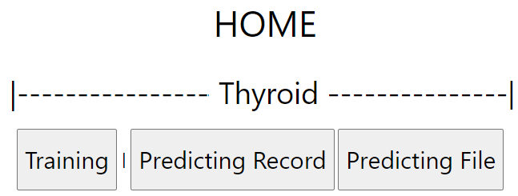
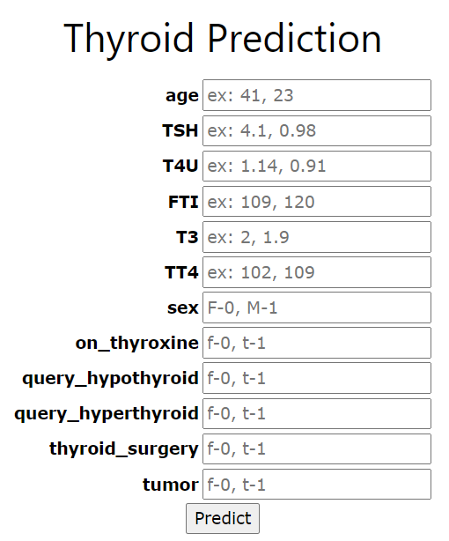
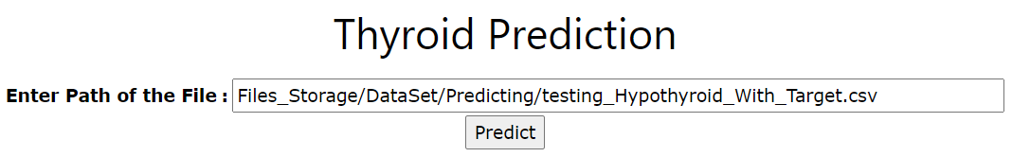

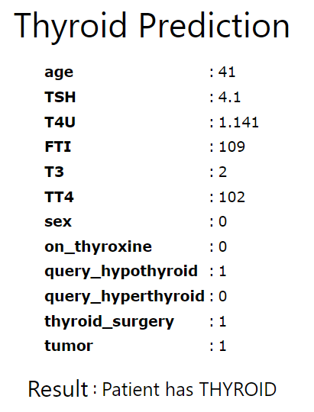
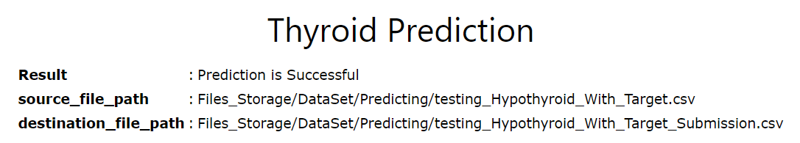
Method: home_Thyroid_Record ()
Method: home_Thyroid_File ()
Display the HTML page to enter the record values.
Display the HTML page to enter the path of the file.
home_Thyroid_Record.html
home_Thyroid_File.html
Method: thyroidTraining()
Method: predict_Thyroid_Record()
Method: predict_Thyroid_File()
Extract the record values
Create Data frame
Send to Predicting model
Display the output in HTML
Load CSV into Data Frame
Send to Predicting model
Method: thyroidPredicting (data)
Store the predicted result in csv file
Display the output in HTML
results_Thyroid_Record.html
results_Thyroid_File.html

