Slide 1
WEB FRAMEWORKS PROJECT

Slide 2
TITLE
CHAT ROOM

Slide 3
WEBSITE DESCRIPTION:
THE PRIMARY USE OF CHAT ROOM WEBSITE IS TO SHARE INFORMATION VIA TEXT WITH A GROUP OF OTHER USERS
IN THIS WEBSITE,THE USER CAN ADD THE CONTACT ,UPDATE THE CONTACT,DELETE THE CONTACT.
Assume that a team is working on a project……. How irritating would it be to work on the laptop and if needed to communicate open WhatsApp and text them.
Would it not be easy to just have a tab open where u could send messages to ur team members instantly
This is what we seek do do by this project using django and we called it Team chat

Slide 4
CONTINUED……
THIS WEBSITE IS TYPICALLY DESIGNED FOR ONE-TO-ONE COMMUNICATION .
IF A USER HAVE TO SEND A MESSAGE TO THE OTHER PERSON,HE SHOULD ALSO HAVE AN ACCOUNT IN THE WEBSITE.

Slide 5
LINK TO WHERE THE WEBSITE IS HOSTED
http://vishnusmurali.pythonanywhere.com/webpage/

Slide 6
INDIVIDUAL CONTRIBUTION
TOTAL WORK:
1)DJANGO PART
2)HTML PART
3)HOSTING
4)GITHUB
5)REPORT

Slide 7
CONTINUED….
Monish : views.py and some html part and report
Vishnu : urls.py and some html part and github link
Chandan: models.py and some html part.
And all other parts of the work is done by all equally.

Slide 8
SCREEN SHOTS

Slide 9
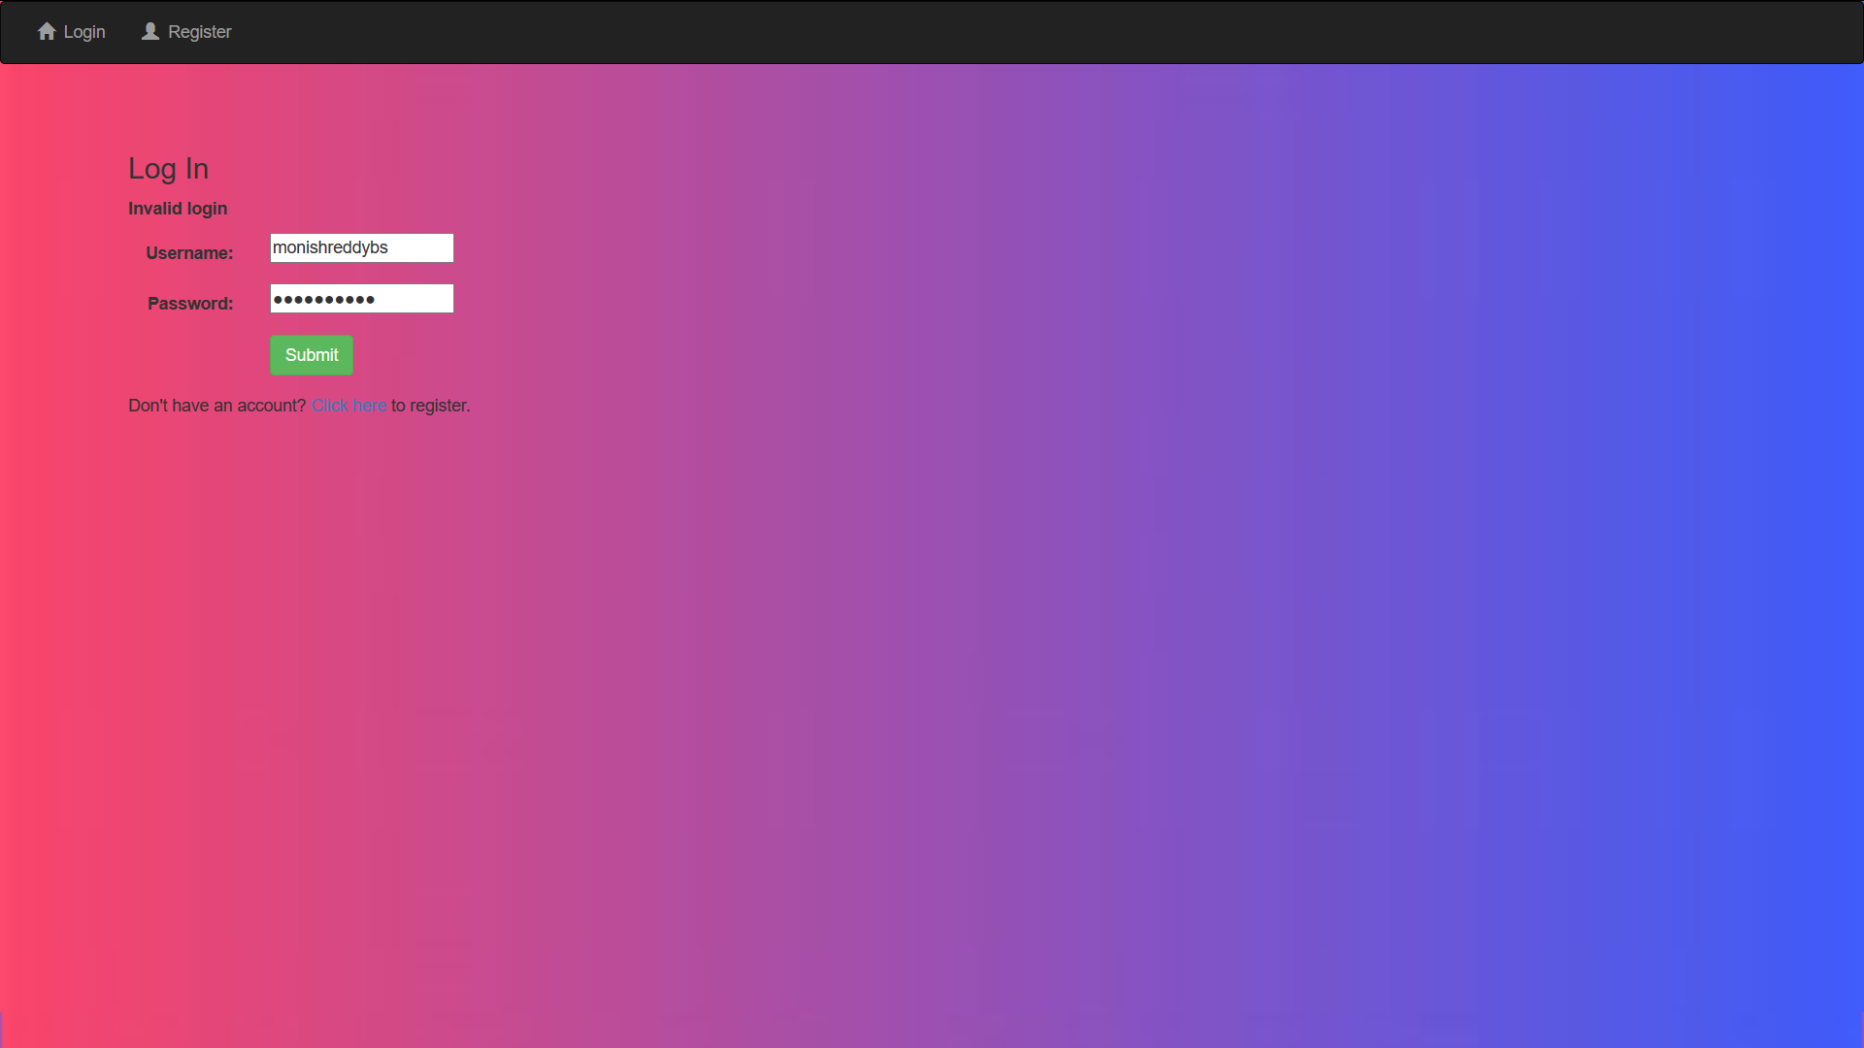
LOGIN PAGE

Slide 10
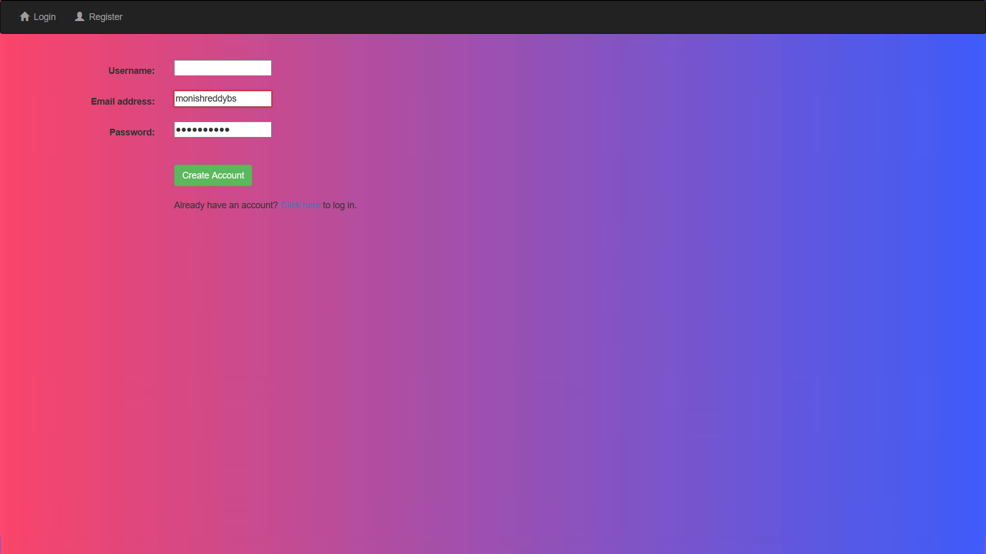
REGISTER PAGE

Slide 11
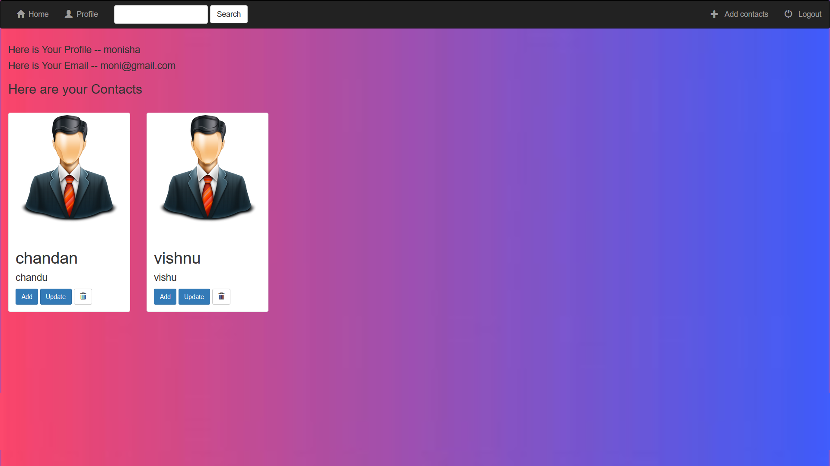
PROFILE PAGE

Slide 12
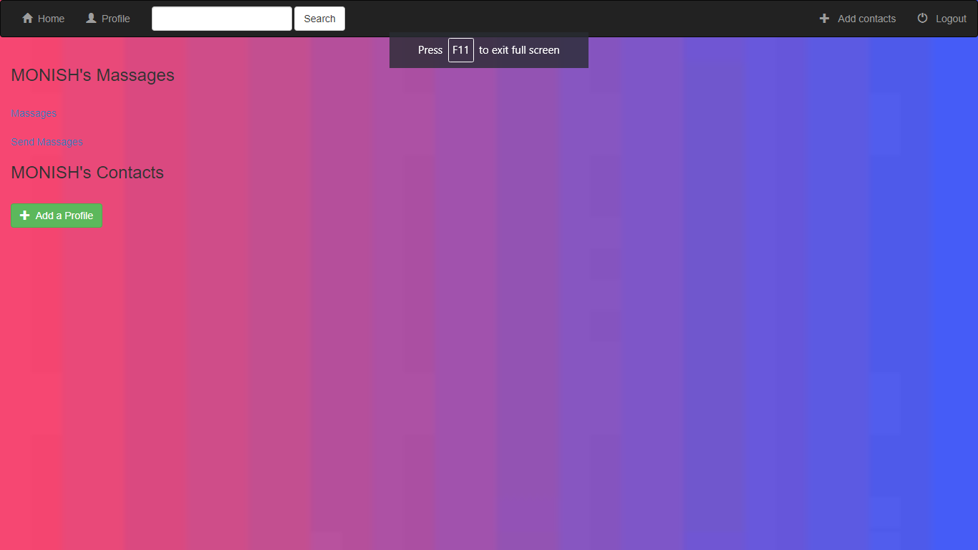
HOME PAGE

Slide 13
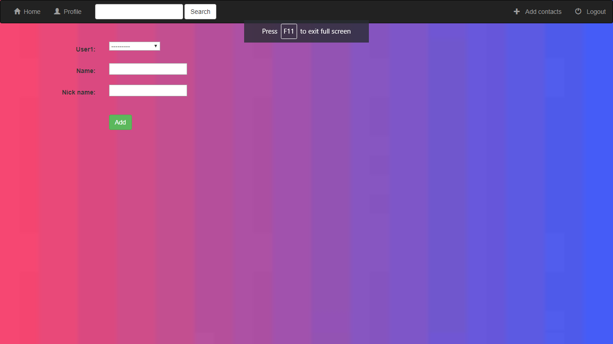
ADD CONTANT

Slide 14
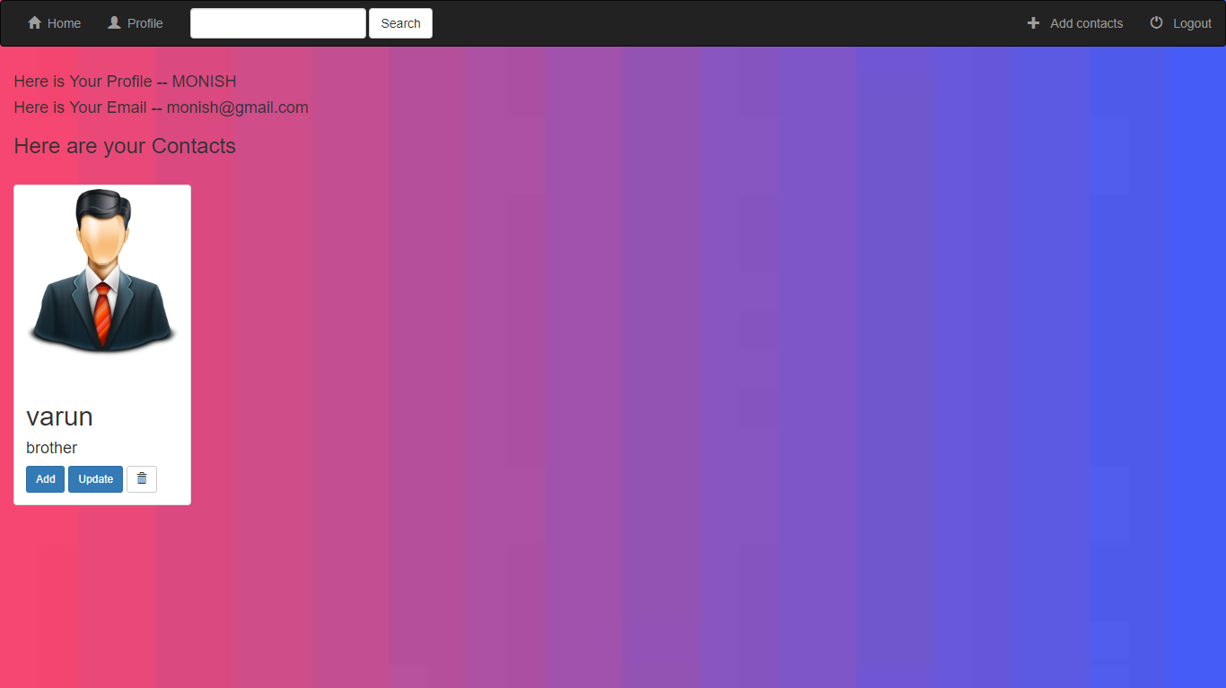
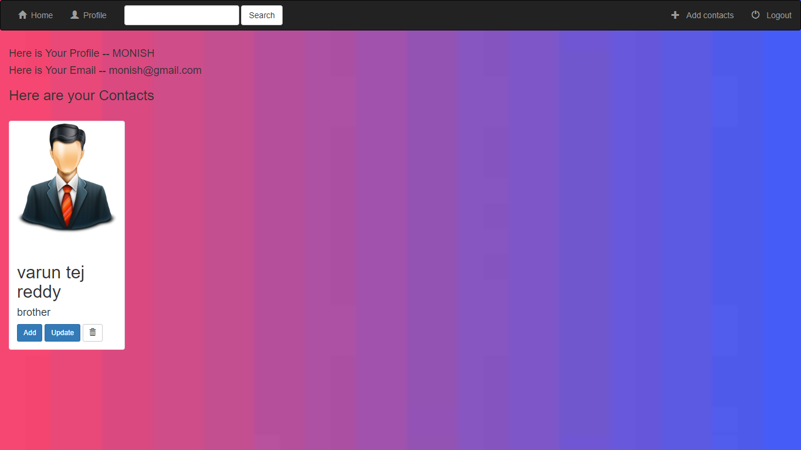
Updating contacts
Before update
After update

Slide 15
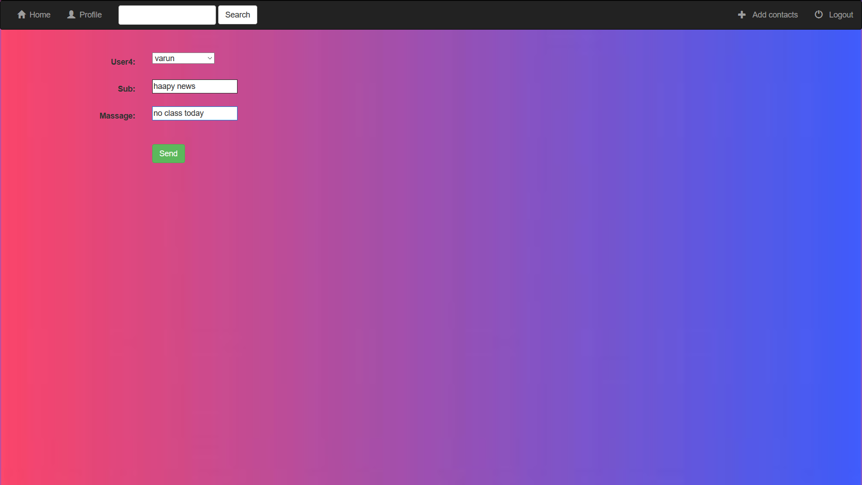
Sending messages

Slide 16
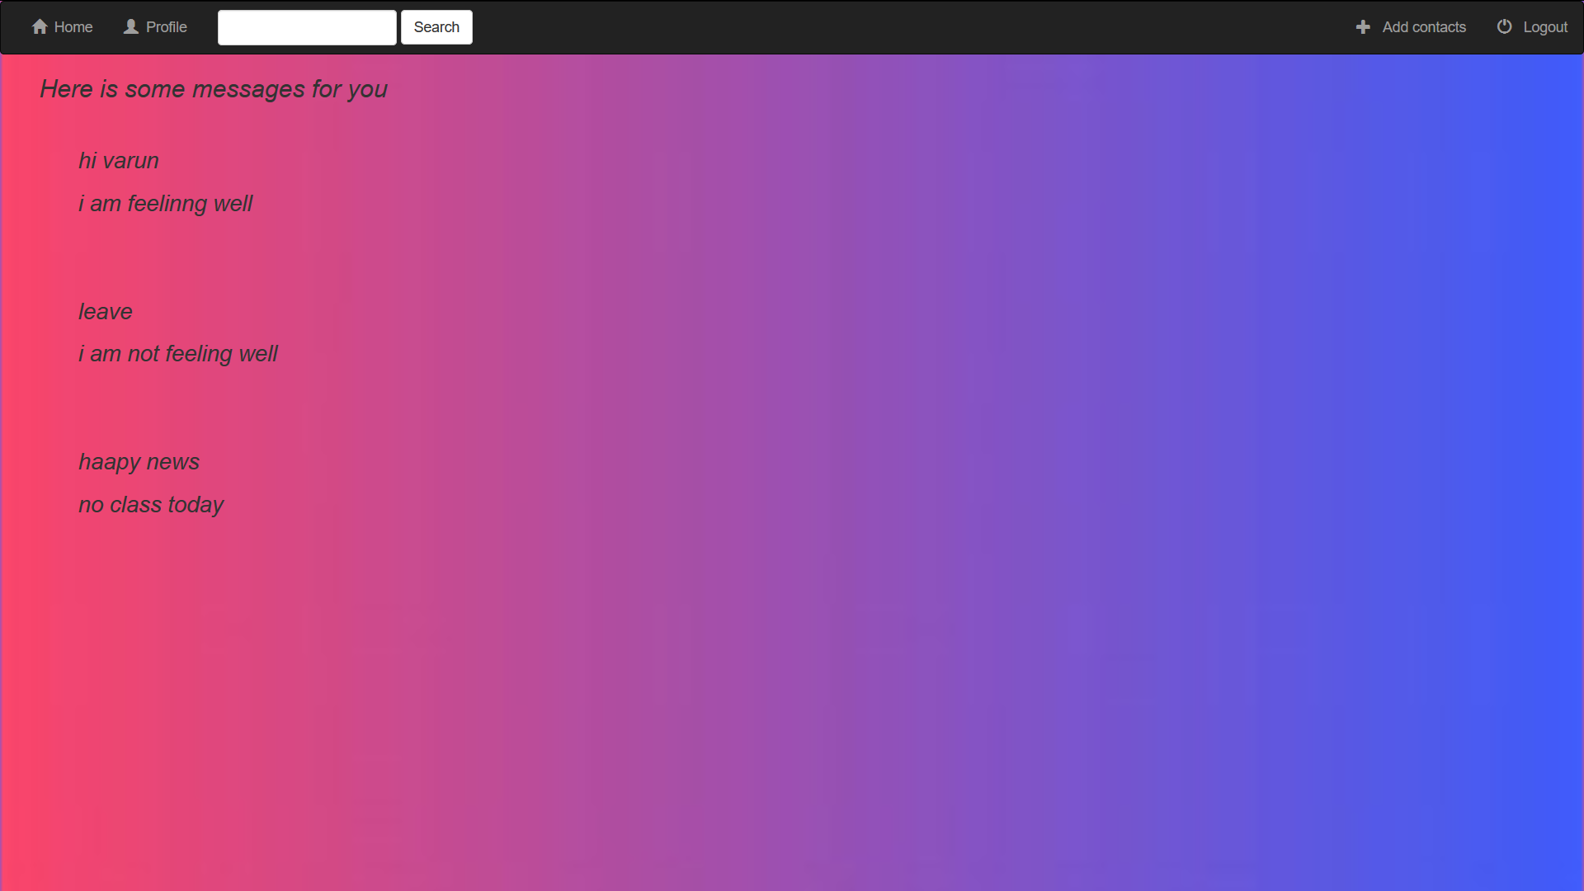
RECEIVED MESSAGES

Slide 17
TAKE AWAYS AND CHALLENGES
WE LEARNT HOW TO WRITE A REGULAR EXPRESSION IN THE URLS.PY
WE WERE HAVING SOME DOUBTS RELATED TO DJANGO,WHICH WERE WELL UNDERSTOOD WHILE DOING THE PROJECT.
WE WEREN’T AWARE OF HOW TO UPDATE,DELETE THE CONTACTS WHICH WE TOOK THE HELP OF BROWSER AND LEARNT HOW TO UPDATE,DELETE A CONTACT
DJANGO GIRLS TUTORIALS WAS VERY HELPFUL IN OUR PROJECT.

Slide 18
CONTACT INFO
NAME:MONISH REDDY BS
SRN :PES1201701666
EMAIL-ID: monishreddy542@gmail.com
NAME:CHANDAN N BHAT
SRN :PES1201701593
EMAIL-ID:chandanbhat9799@gmail.com
NAME:VISHNU S MURALI
SRN :PES1201701624
EMAIL-ID : muralisvishnu@gmail.com

