Slide 1
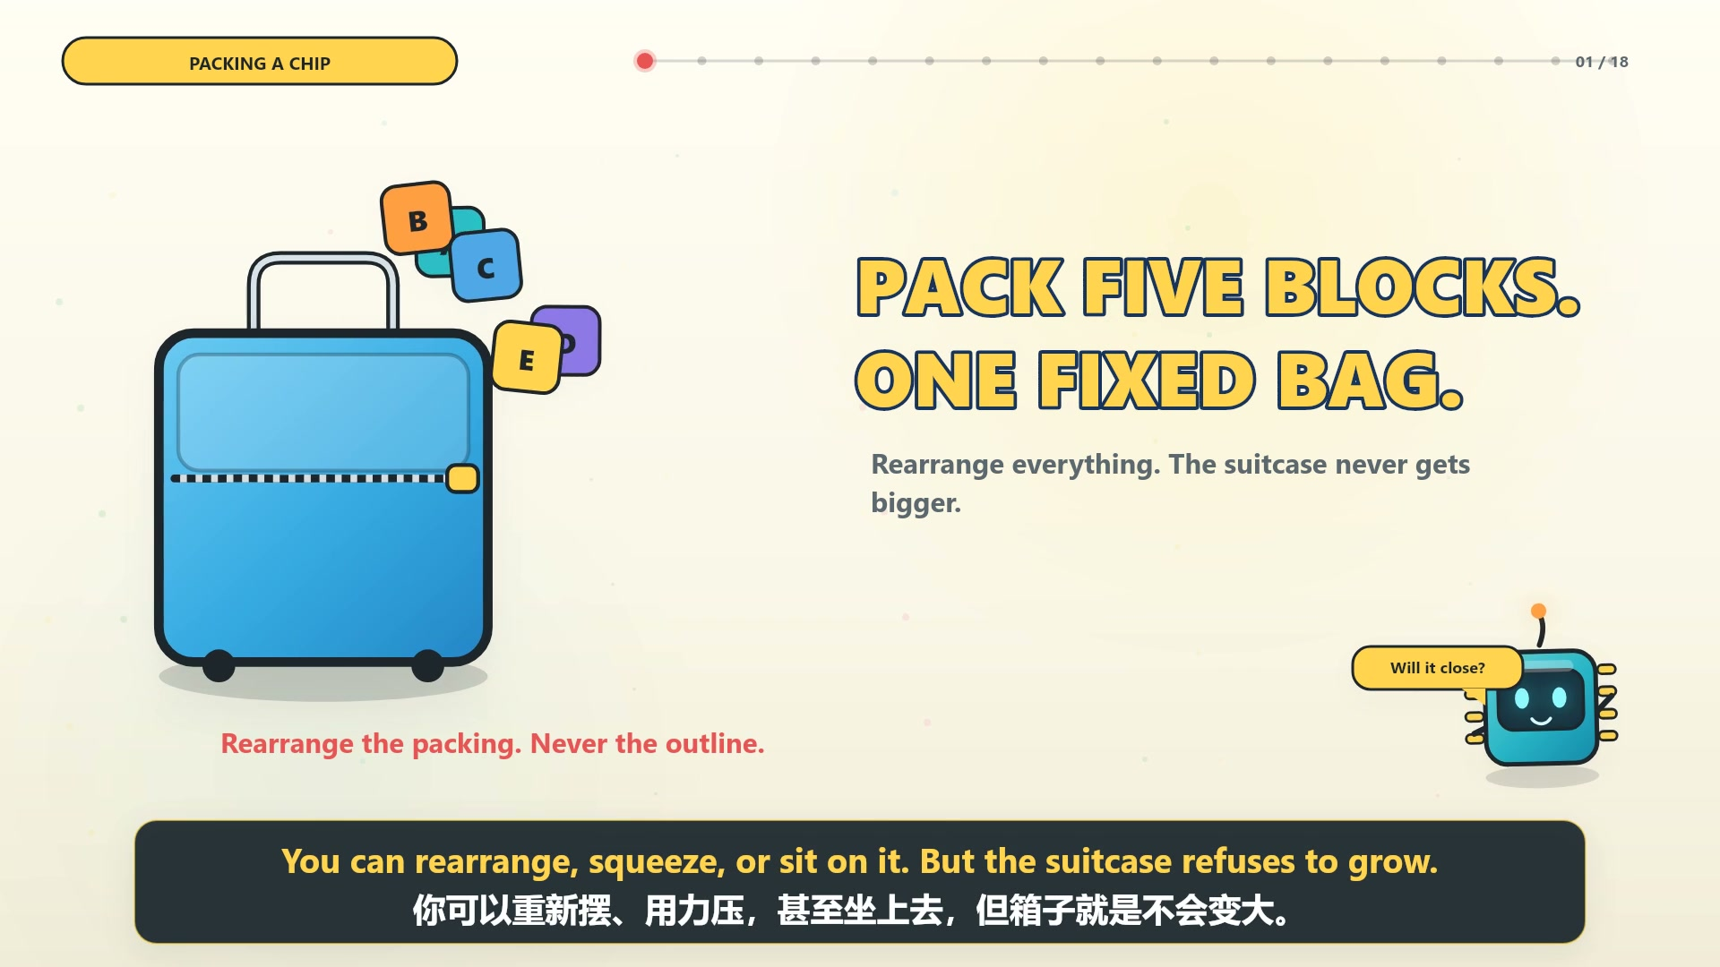
EDA LEARNING / FLOORPLANNING
TOPIC 02
FIXED-OUTLINE
CONSTRAINTS
固定轮廓合法性
两项检查，一道合法性门槛。
Two checks. One gate.
LEGALITY FIRST / 先合法
Bilingual lesson deck / 双语教学资料
01 / 08
Notes:
This deck summarizes the fixed-outline legality lesson. The opening image is taken from the lesson animation. The accompanying page includes English and Chinese videos plus practice questions.
Source: https://yongfu-li.github.io/eda-learning/courses/learn_floorplanning/index.html
Visual reference: Floorplanning Topic 02 bilingual web lesson and animated video.

Slide 2
02 / THE PACKING MODEL
THE SUITCASE BECOMES THE CHIP
登机箱变成了芯片
Same packing rules.
Much less space.
Floorplanning chooses
where each module goes.
规则一样，空间更小。
布局规划决定每个模块的具体位置。
FIXED BAG
固定箱子
CHIP OUTLINE
芯片轮廓
ITEMS
行李
CIRCUIT MODULES
电路模块
THE CONSTRAINT
The outline does not grow.
PACKING
装箱
FLOORPLAN
布局规划
轮廓不会为了容纳模块而变大。
02 / 08
Notes:
Connect the life example to the chip representation. The fixed suitcase is the outline, items become modules, and packing becomes floorplanning.
Source: https://yongfu-li.github.io/eda-learning/courses/learn_floorplanning/index.html
Visual reference: Floorplanning Topic 02 bilingual web lesson and animated video.

Slide 3
03 / LEGALITY
TWO CHECKS DEFINE LEGALITY
两项检查定义合法性
1
CONTAINMENT
2
NO POSITIVE-AREA OVERLAP
包含性
无正面积内部重叠
A
E
C
E
outside / 轮廓外
overlap / 重叠
All modules inside / 全部模块在内
Zero shared interior area / 内部共享面积为零
BOTH MUST PASS. ONE FAILURE REJECTS THE LAYOUT.
两项都通过；任一项失败，布局即被拒绝。
03 / 08
Notes:
Legality requires both containment and zero positive-area interior overlap. The order of the checks does not change the result.
Source: https://yongfu-li.github.io/eda-learning/courses/learn_floorplanning/index.html
Visual reference: Floorplanning Topic 02 bilingual web lesson and animated video.

Slide 4
04 / CHECK 01
CONTAINMENT ARITHMETIC
包含性算术
9 + 2 = 11
OUTLINE ENDS
11 > 10
FAIL / 失败
E
E starts at x = 9 and is 2 units wide.
The fixed outline ends at x = 10.
E
E 从 x = 9 开始，宽为 2。
固定轮廓右边界到 x = 10。
10
One unit outside / 向外多出一格
04 / 08
Notes:
Use x + width to test the right edge. A module at x = 9 with width 2 reaches x = 11, so it fails containment in a width-10 outline.
Source: https://yongfu-li.github.io/eda-learning/courses/learn_floorplanning/index.html
Visual reference: Floorplanning Topic 02 bilingual web lesson and animated video.

Slide 5
05 / GEOMETRY
EDGE CONTACT IS NOT OVERLAP
边缘接触不等于重叠
LEGAL / 合法
ILLEGAL / 非法
Zero-area contact
Positive-area overlap
C
E
C
E
C.right = E.left
接触面积为 0
接触面积 = 0，内部重叠面积 > 0
Touching at a boundary is legal. Sharing interior area is not.
05 / 08
Notes:
Contact along an edge has zero area and can be legal. Overlap requires positive shared interior area and is illegal.
Source: https://yongfu-li.github.io/eda-learning/courses/learn_floorplanning/index.html
Visual reference: Floorplanning Topic 02 bilingual web lesson and animated video.

Slide 6
06 / VALID EXAMPLE
GOLDEN PACKING
标准合法布局
01
All modules inside
所有模块都在轮廓内
02
No interiors overlap
内部区域互不重叠
D
03
Legality = TRUE
B
合法性成立
A
C
E
Both rules must hold.
10 × 8 OUTLINE
两项规则同时成立，布局才合法。
06 / 08
Notes:
This arrangement keeps A at the origin, D above A, and B, C, and E along the bottom. Every module is inside the 10 by 8 outline with no interior overlap.
Source: https://yongfu-li.github.io/eda-learning/courses/learn_floorplanning/index.html
Visual reference: Floorplanning Topic 02 bilingual web lesson and animated video.

Slide 7
07 / ALGORITHM
CHECKER PROCEDURE
检查流程与常见陷阱
CHECKER
COMMON TRAPS
Check containment
A
Off-by-one boundaries
1
检查每个模块是否在轮廓内
边界差一会把合法情况判错
Check every module pair
B
Centre vs lower-left
2
检查每一对模块的内部重叠
中心坐标不等于左下角定义
Reject on any failure
C
Touching vs overlap
3
任一项失败就拒绝布局
接触没有面积，重叠有正面积
Check the geometry, not the picture.
07 / 08
Notes:
The checker order does not matter. One failed containment or overlap check rejects the pack. Off-by-one boundaries, centre coordinates, and contact are common sources of mistakes.
Source: https://yongfu-li.github.io/eda-learning/courses/learn_floorplanning/index.html
Visual reference: Floorplanning Topic 02 bilingual web lesson and animated video.

Slide 8
08 / METRICS
LEGALITY BEFORE METRICS
先合法，后指标
An illegal layout can produce a density number. The number means nothing.
GATE
Legality checks
合法性检查
非法布局也能算出密度和空白率，
但这些结果没有意义。
METRICS
Area · Density · Deadspace
面积 · 密度 · 空白率
KEEP IT INSIDE. KEEP IT APART.
保持在内。保持分离。
08 / 08
Notes:
Legality is a gate. Only legal layouts should proceed to area, density, and deadspace calculations. The next lesson uses the same packed suitcase example.
Source: https://yongfu-li.github.io/eda-learning/courses/learn_floorplanning/index.html
Visual reference: Floorplanning Topic 02 bilingual web lesson and animated video.

