Slide 1

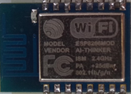



server
ESP DB
Actuator
TCP
server
INTERNET
client
HTTP
HTTP
TCP
Actuator
Manager
client
client
client
TCP
TCP
DB
server
server
Sensor
Sensor

