Slide 1
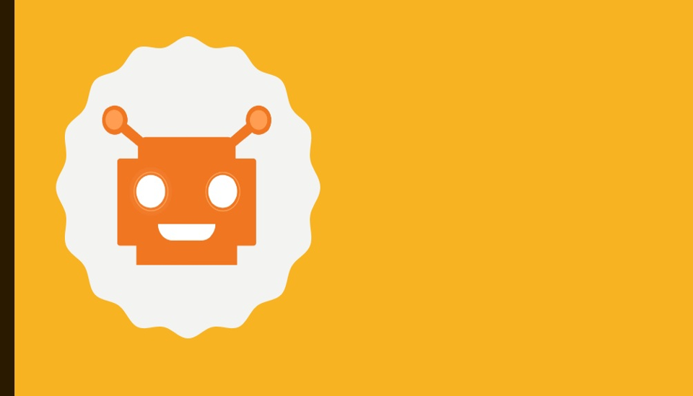
CHATBOT

Slide 2
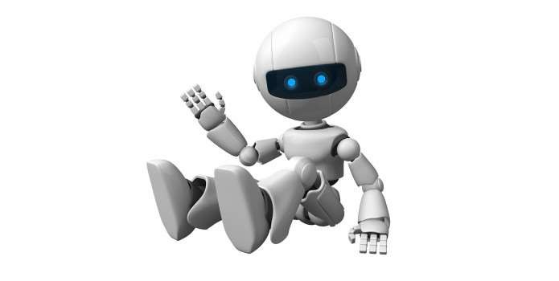
What Is A Chatbot ?
chat robot, a computer program that simulates human conversation, or chat, through artificial intelligence. Typically, a chat bot will communicate with a real person.

Slide 3
Why Chatbot ?
Bots are a lot easier to install than mobile apps.
Bots are easily distributed.
Quality mobile apps are expensive to build, maintain and deploy.
Moving complexity to the cloud reduces a user’s cognitive load.

Slide 4
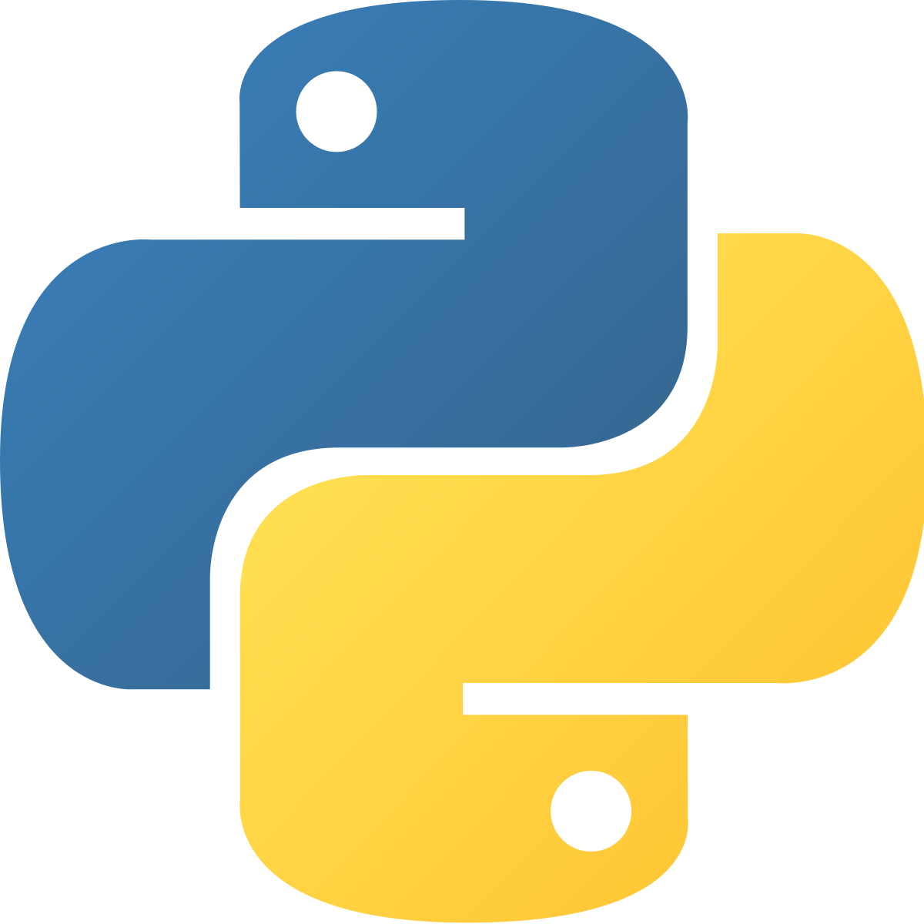

What we have used :
Python 3.5
Flask for Backend
HTML, CSS for Frontend

Slide 5
PACKAGES USED :
NLP (NATURAL PROCESSING LANGUAGE)
CHATTERBOT
CHATTERBOT CORPUS

Slide 6
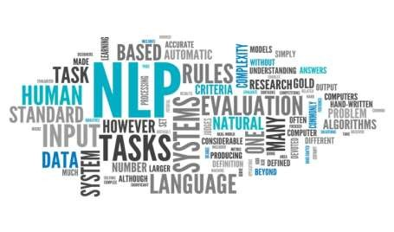
Natural Language Processing
Natural language processing (NLP) is the ability of a computer program to understand human speech as it is spoken. NLP is a component of artificial intelligence .
It makes computer to perform useful tasks with the natural languages humans use.
Current approaches to NLP are based on machine learning
The input and output of an NLP system can be −
Speech
Written Text

Slide 7
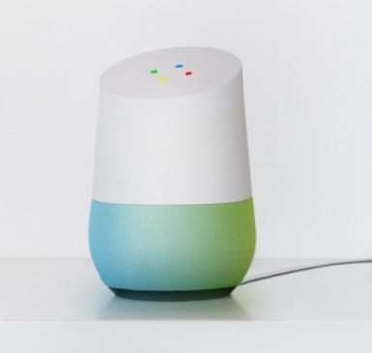
Google Home
Google Home is a voice-activated home product that allows you and your family to get answers from Google, stream music, and manage everyday tasks.

