Slide 1
Introduction To Databases
Designing Instagram

Slide 2
Contents
Database Models and Rankings
Databases Models
Designing Instagram Using Relational Database Model
Retrieving Information from Table
Homework: Money Transfer Application

Slide 3
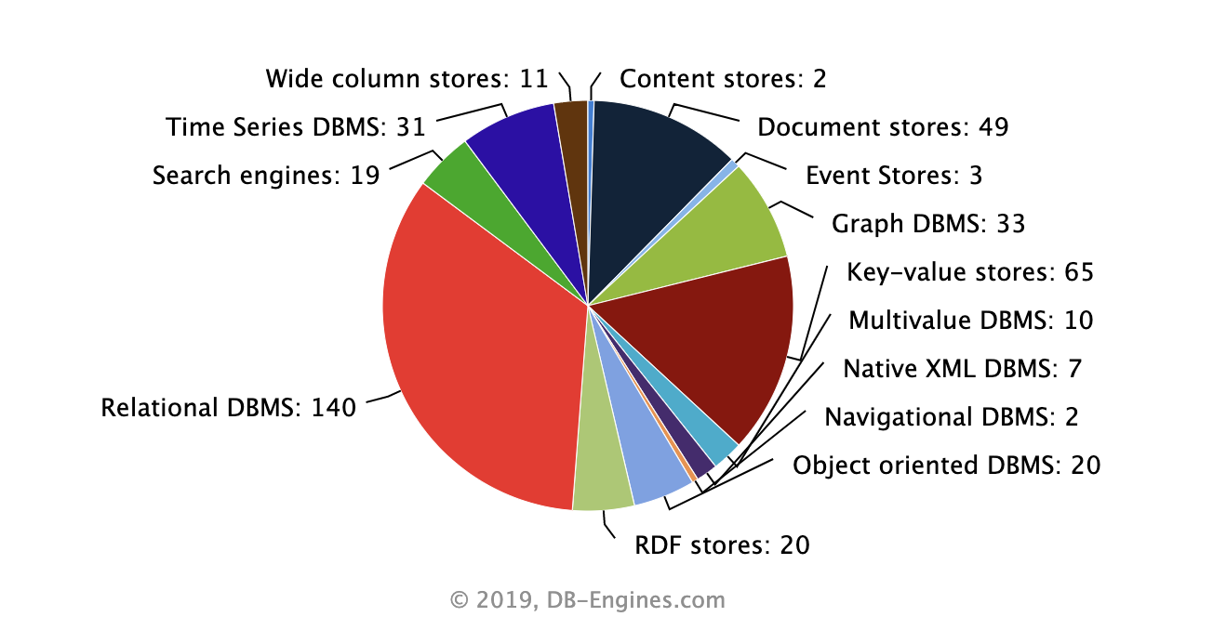
DB Systems By Model
Total: 352
Number of systems per category, September 2019

Slide 4
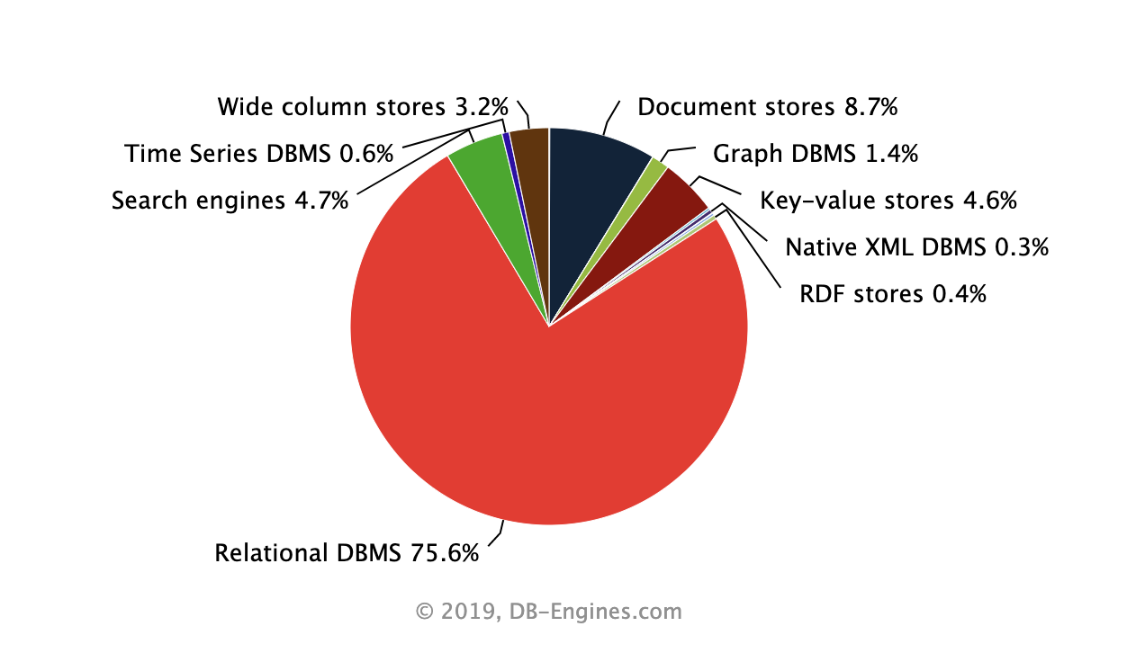
DB Popularity By Category
Popularity per category, September 2019

Slide 5
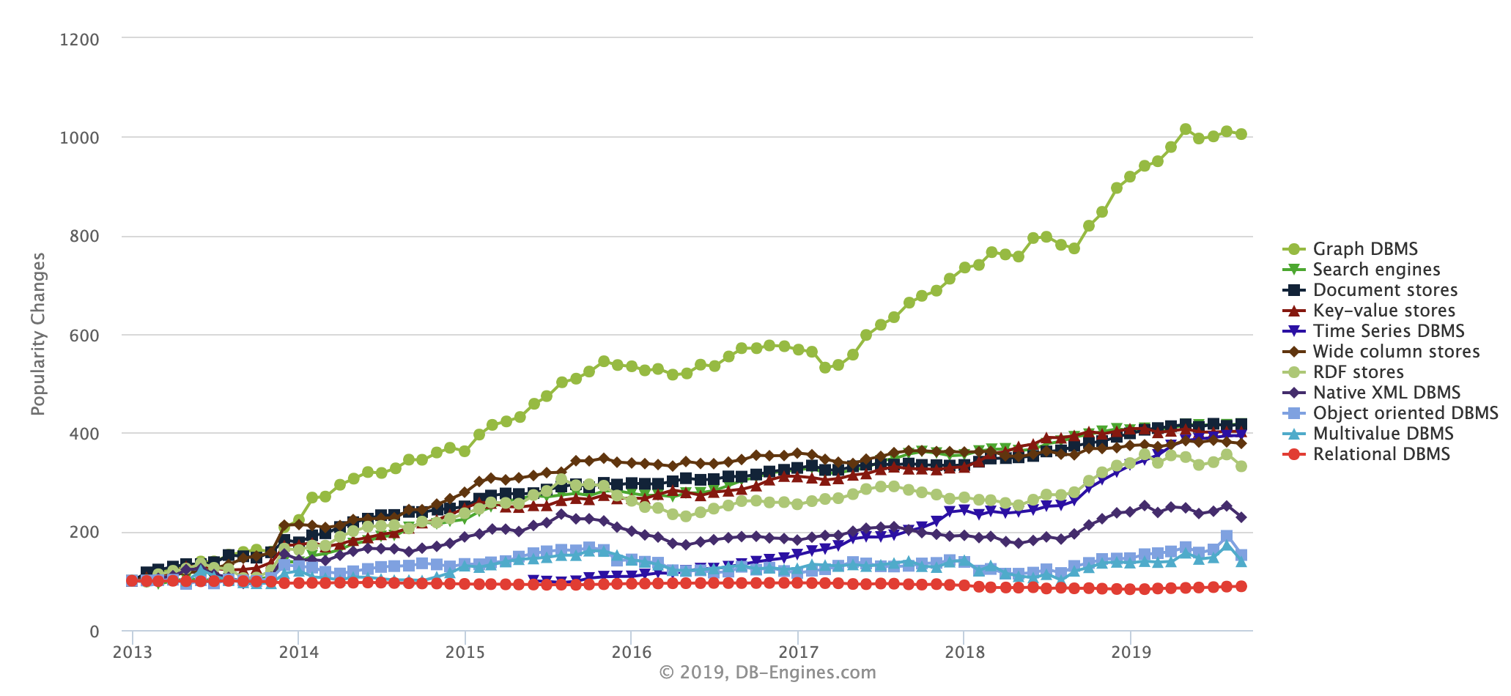
DB Trends
Complete trend, starting with January 2013

Slide 6
Relational Graph
Document
Key-Value
Database Models

Slide 7
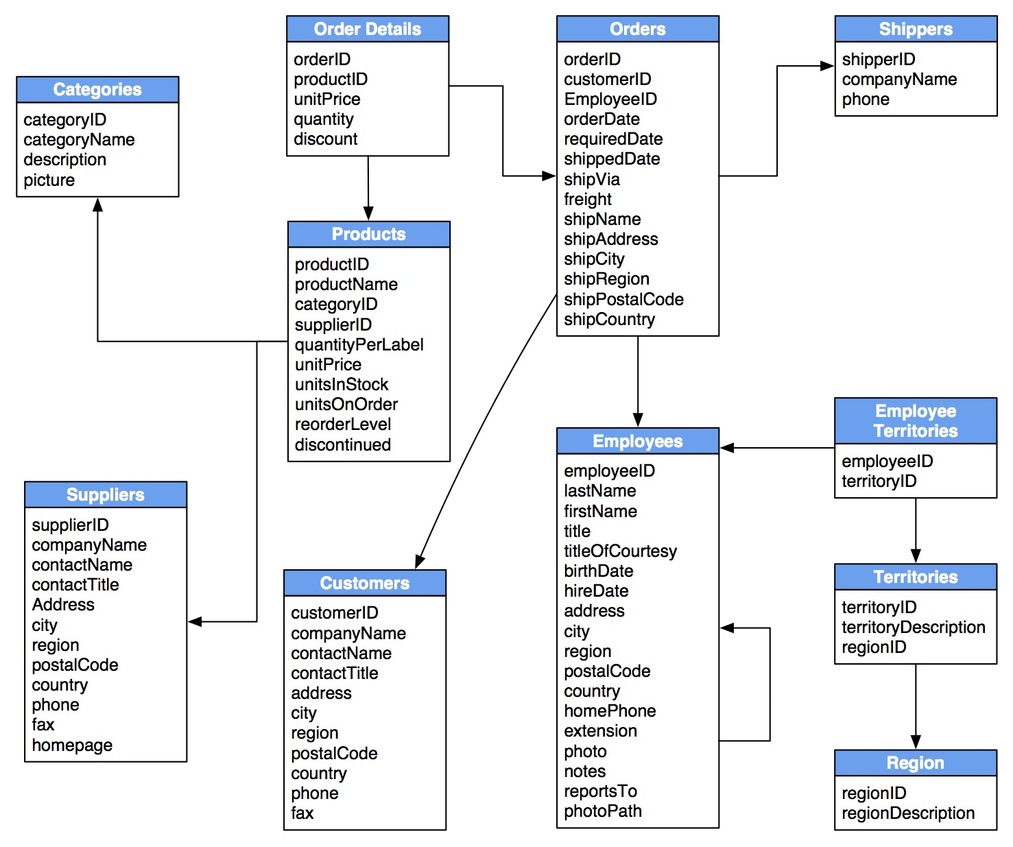
Relational Databases

Slide 8
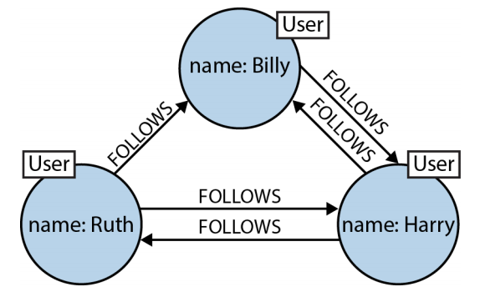
Graph Databases

Slide 9
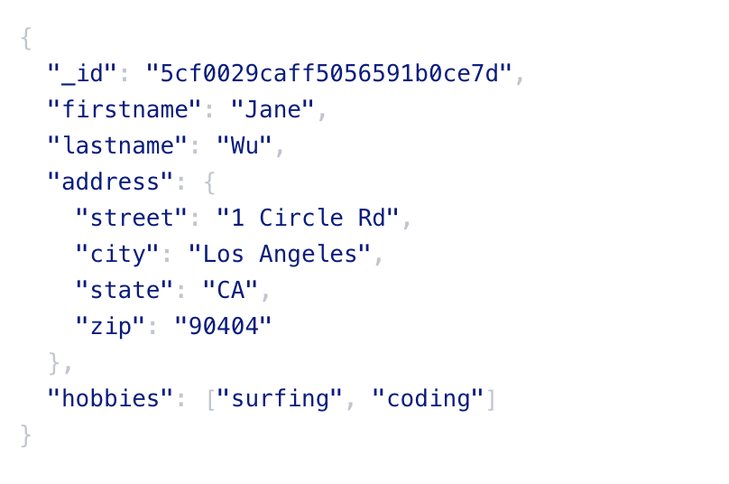
Document Database

Slide 10
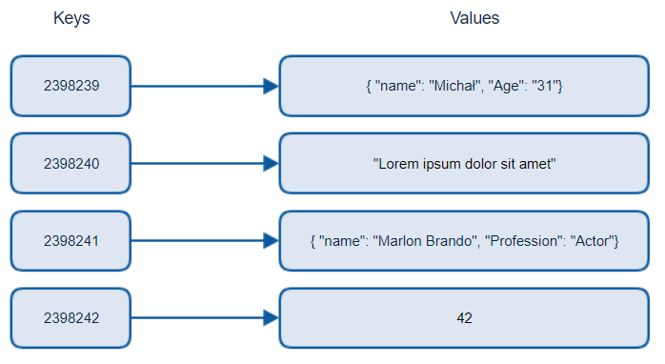
Key-Value

Slide 11
Designing Instagram Using Relational Database Model

Slide 12
Retrieving Information
From Table

Slide 13
Money Transfer Application
Relational Database Design
Homework

Slide 14
References
https://db-engines.com
https://www.mongodb.com/
https://redis.io/
https://graphql.org
http://www.mysqltutorial.org/basic-mysql-tutorial.aspx
http://www.luciopanasci.it/Ebooks/MySQL%20Cookbook,%203rd%20Edition.pdf

