Slide 1
Money Transfer Application Normalization
Indexing
Information Retrieval

Slide 2
Database Normalization
Eliminating redundant(useless) data.
Ensuring data dependencies make sense i.e data is logically stored.
Database Normalization is a technique of organizing the data in the database. Normalization is a systematic approach of decomposing tables to eliminate data redundancy(repetition) and undesirable characteristics like Insertion, Update and Deletion Anomalies. It is a multi-step process that puts data into tabular form, removing duplicated data from the relation tables.

Slide 3
Normalization Rule
First Normal Form
Second Normal Form
Third Normal Form
BCNF
Fourth Normal Form

Slide 4
First Normal Form (1NF)
Rule 1: Single Valued Attributes
Each column of your table should be single valued which means they should not contain multiple values. We will explain this with help of an example later, let's see the other rules for now.
Rule 2: Attribute Domain should not change
This is more of a "Common Sense" rule. In each column the values stored must be of the same kind or type.
For example: If you have a column dob to save date of births of a set of people, then you cannot or you must not save 'names' of some of them in that column along with 'date of birth' of others in that column. It should hold only 'date of birth' for all the records/rows.
Rule 3: Unique name for Attributes/Columns
This rule expects that each column in a table should have a unique name. This is to avoid confusion at the time of retrieving data or performing any other operation on the stored data.If one or more columns have same name, then the DBMS system will be left confused.
Rule 4: Order doesn't matters
This rule says that the order in which you store the data in your table doesn't matter.

Slide 5
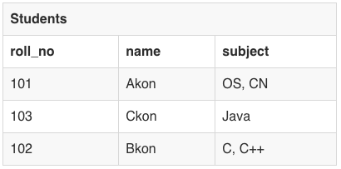
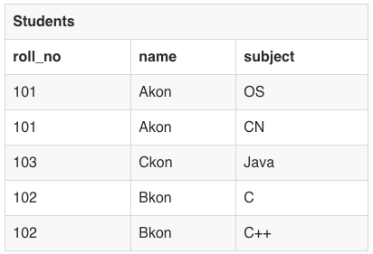
First Normal Form (1NF)

Slide 6
Second Normal Form (2NF)
Rule 1: Table should be in the First Normal Form
Rule 2: There should be no Partial Dependency
Partial Dependency exists, when for a composite primary key, any attribute in the table depends only on a part of the primary key and not on the complete primary key.
To remove Partial dependency, we can divide the table, remove the attribute which is causing partial dependency, and move it to some other table where it fits in well.

Slide 7
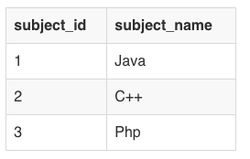
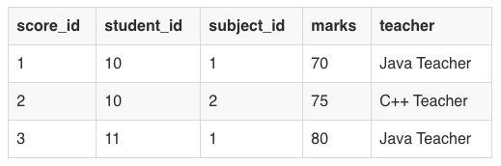
Second Normal Form (2NF) Partial Dependency
Subjects Table
Scores
Teacher is partially dependent

Slide 8
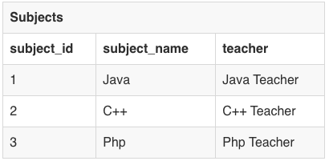
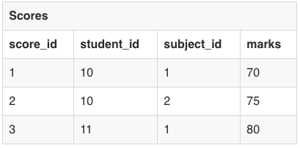
Second Normal Form (2NF) Removing Partial Dependency

Slide 9
Third Normal Form (3NF)
Rule 1: It should be in the Second Normal form
Rule 2: And it should not have Transitive Dependency
Advantage of removing Transitive Dependency
Amount of data duplication is reduced
Data integrity achieved

Slide 10
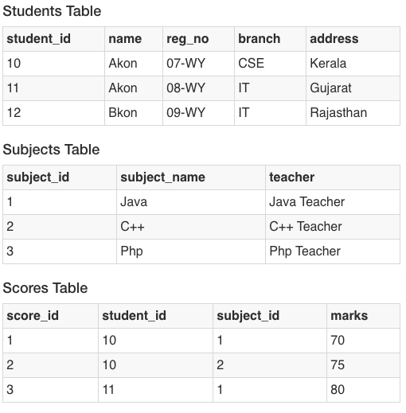
Third Normal Form (3NF)

Slide 11
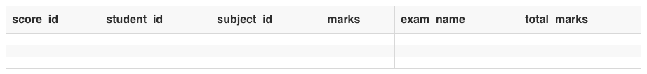
Third Normal Form (3NF)
With exam_name and total_marks added to our Score table, it saves more data now. Primary key for our Score table is a composite key, which means it's made up of two attributes or columns → student_id + subject_id.
Our new column exam_name depends on both student and subject. For example, a mechanical engineering student will have Workshop exam but a computer science student won't. And for some subjects you have Practical exams and for some you don't. So we can say that exam_name is dependent on both student_id and subject_id.
And what about our second new column total_marks? Does it depend on our Score table's primary key?
Well, the column total_marks depends on exam_name as with exam type the total score changes. For example, practicals are of less marks while theory exams are of more marks.
But, exam_name is just another column in the score table. It is not a primary key or even a part of the primary key, and total_marks depends on it.
This is Transitive Dependency. When a non-prime attribute depends on other non-prime attributes rather than depending upon the prime attributes or primary key.

Slide 12
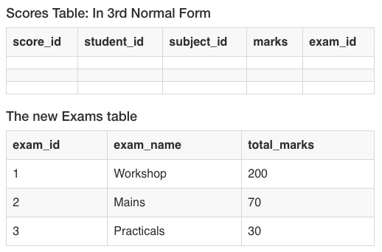
Third Normal Form (3NF) Resolution

Slide 13
Boyce-Codd Normal Form Fourth Normal Form
Homework
https://www.studytonight.com/dbms/database-normalization.php

Slide 14
Indexing
Every time your web application runs a database query containing a WHERE statement, the database server's job is to look through all the rows in your table to find those that match your request. As the table grows, an increasing number of rows need to be inspected each time.
Indexes solve this problem in exactly the same was as the index in a reference book, by taking data from a column in your table and storing it alphabetically in a separate location called an index. The same process can be applied to all data types, for example numeric data will be stored in numeric order and dates in date order.
By doing this, the database does not need to look through every row in your table, instead it can find the data you are searching for alphabetically, then skip immediately to look at the row(s) where the data is located.

Slide 15
Indexing
Every time your web application runs a database query containing a WHERE statement, the database server's job is to look through all the rows in your table to find those that match your request. As the table grows, an increasing number of rows need to be inspected each time.
Indexes solve this problem in exactly the same was as the index in a reference book, by taking data from a column in your table and storing it alphabetically in a separate location called an index. The same process can be applied to all data types, for example numeric data will be stored in numeric order and dates in date order.
By doing this, the database does not need to look through every row in your table, instead it can find the data you are searching for alphabetically, then skip immediately to look at the row(s) where the data is located.

Slide 16
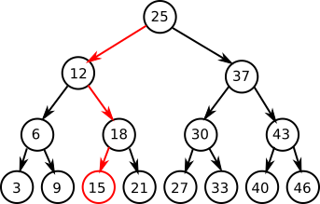
B Tree Indexing

Slide 17
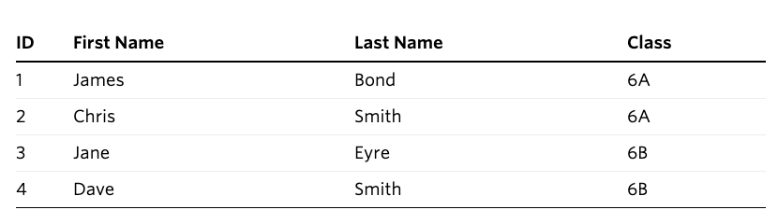
Indexing Example
Students Table
CREATE TABLE `students` (
`id` int(11) NOT NULL AUTO_INCREMENT,
`first_name` varchar(255) DEFAULT NULL,
`last_name` varchar(255) DEFAULT NULL,
`class` varchar(255) DEFAULT NULL,
PRIMARY KEY (`id`)
) ENGINE=InnoDB

Slide 18
Frequently Used Queries
SELECT * FROM students WHERE id = 1
SELECT * FROM students WHERE last_name = 'Smith'
SELECT * FROM students WHERE class = '6A' AND last_name = 'Smith'
Primary key already has a key
CREATE INDEX by_last_name ON students (`last_name`);
CREATE INDEX by_class_and_last_name ON students (class, last_name);

Slide 19
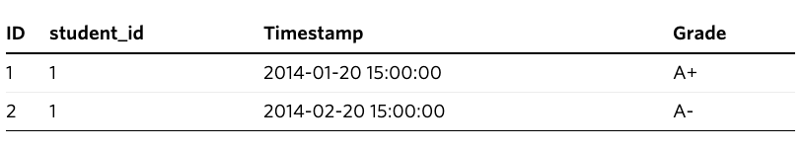
Indexing on Joins
Grades Table
SELECT * FROM grades WHERE student_id = 1
CREATE INDEX by_student_id ON grades (student_id);

Slide 20
Information Retrieval
Selecting All Data
Selecting Particular Rows
Selecting Particular Columns
Sorting Rows
Date Calculations
Working with NULL Values
Pattern Matching
Counting Rows
Using More Than one Table

Slide 21
References
http://sql-ex.ru/
https://dev.mysql.com/doc/refman/8.0/en/mysql-indexes.html
https://www.studytonight.com/dbms/database-normalization.php
https://dev.mysql.com/doc/refman/8.0/en/retrieving-data.html

