Slide 1
Documentation
OpenAPI and Swagger

Slide 2
Exercises
Remove all optionals from user and transaction endpoints
Remove all try catches from users and transactions controllers

Slide 3
What Is OpenAPI?
OpenAPI Specification (formerly Swagger Specification) is an API description format for REST APIs. An OpenAPI file allows you to describe your entire API, including:
Available endpoints (/users) and operations on each endpoint (GET /users, POST /users)
Operation parameters Input and output for each operation
Authentication methods
Contact information, license, terms of use and other information.
API specifications can be written in YAML or JSON.
http://editor.swagger.io/

Slide 4
What Is Swagger?
Swagger is a set of open-source tools built around the OpenAPI Specification that can help you design, build, document and consume REST APIs. The major Swagger tools include:
Swagger Editor – browser-based editor where you can write OpenAPI specs.
Swagger UI – renders OpenAPI specs as interactive API documentation.
Swagger Codegen – generates server stubs and client libraries from an OpenAPI spec.

Slide 5
Maven Springfox Swagger
<dependency>
<groupId>io.springfox</groupId>
<artifactId>springfox-swagger2</artifactId>
<version>2.9.2</version>
</dependency>

Slide 6
Enable springfox swagger with default configuration
@SpringBootApplication
@EnableSwagger2
public class MoneyTransferAppApplication {
public static void main(String[] args) {SpringApplication.run(MoneyTransferAppApplication.class, args);}
@Bean
public Docket api() {
return new Docket(DocumentationType.SWAGGER_2)
.select()
.apis(RequestHandlerSelectors.any())
.paths(PathSelectors.any())
.build();
}
}
Notes:
Swagger 2 is enabled through the @EnableSwagger2 annotation.
After the Docket bean is defined, its select() method returns an instance of ApiSelectorBuilder, which provides a way to control the endpoints exposed by Swagger.
Predicates for selection of RequestHandlers can be configured with the help of RequestHandlerSelectors and PathSelectors. Using any() for both will make documentation for your entire API available through Swagger.
This configuration is enough to integrate Swagger 2 into an existing Spring Boot project. For other Spring projects, some additional tuning is required.

Slide 7
Verification
http://localhost:8080/v2/api-docs
Notes:
To verify that Springfox is working, you can visit the following URL in your browser:
http://localhost:8080/api/v2/api-docs
The result is a JSON response with a large number of key-value pairs, which is not very human-readable. Fortunately, Swagger provides Swagger UI for this purpose.

Slide 8
Swagger UI
Swagger UI is a built-in solution which makes user interaction with the Swagger-generated API documentation much easier.

Slide 9
Enabling Springfox's Swagger UI
<dependency>
<groupId>io.springfox</groupId>
<artifactId>springfox-swagger-ui</artifactId>
<version>2.9.2</version>
</dependency>

Slide 10
Verification
http://localhost:8080/swagger-ui.html
Notes:
Now you can test it in your browser by visiting http://localhost:8080/your-app-root/swagger-ui.html
In our case, by the way, the exact URL will be: http://localhost:8080/spring-security-rest/api/swagger-ui.html
The result should look something like this:

Slide 11
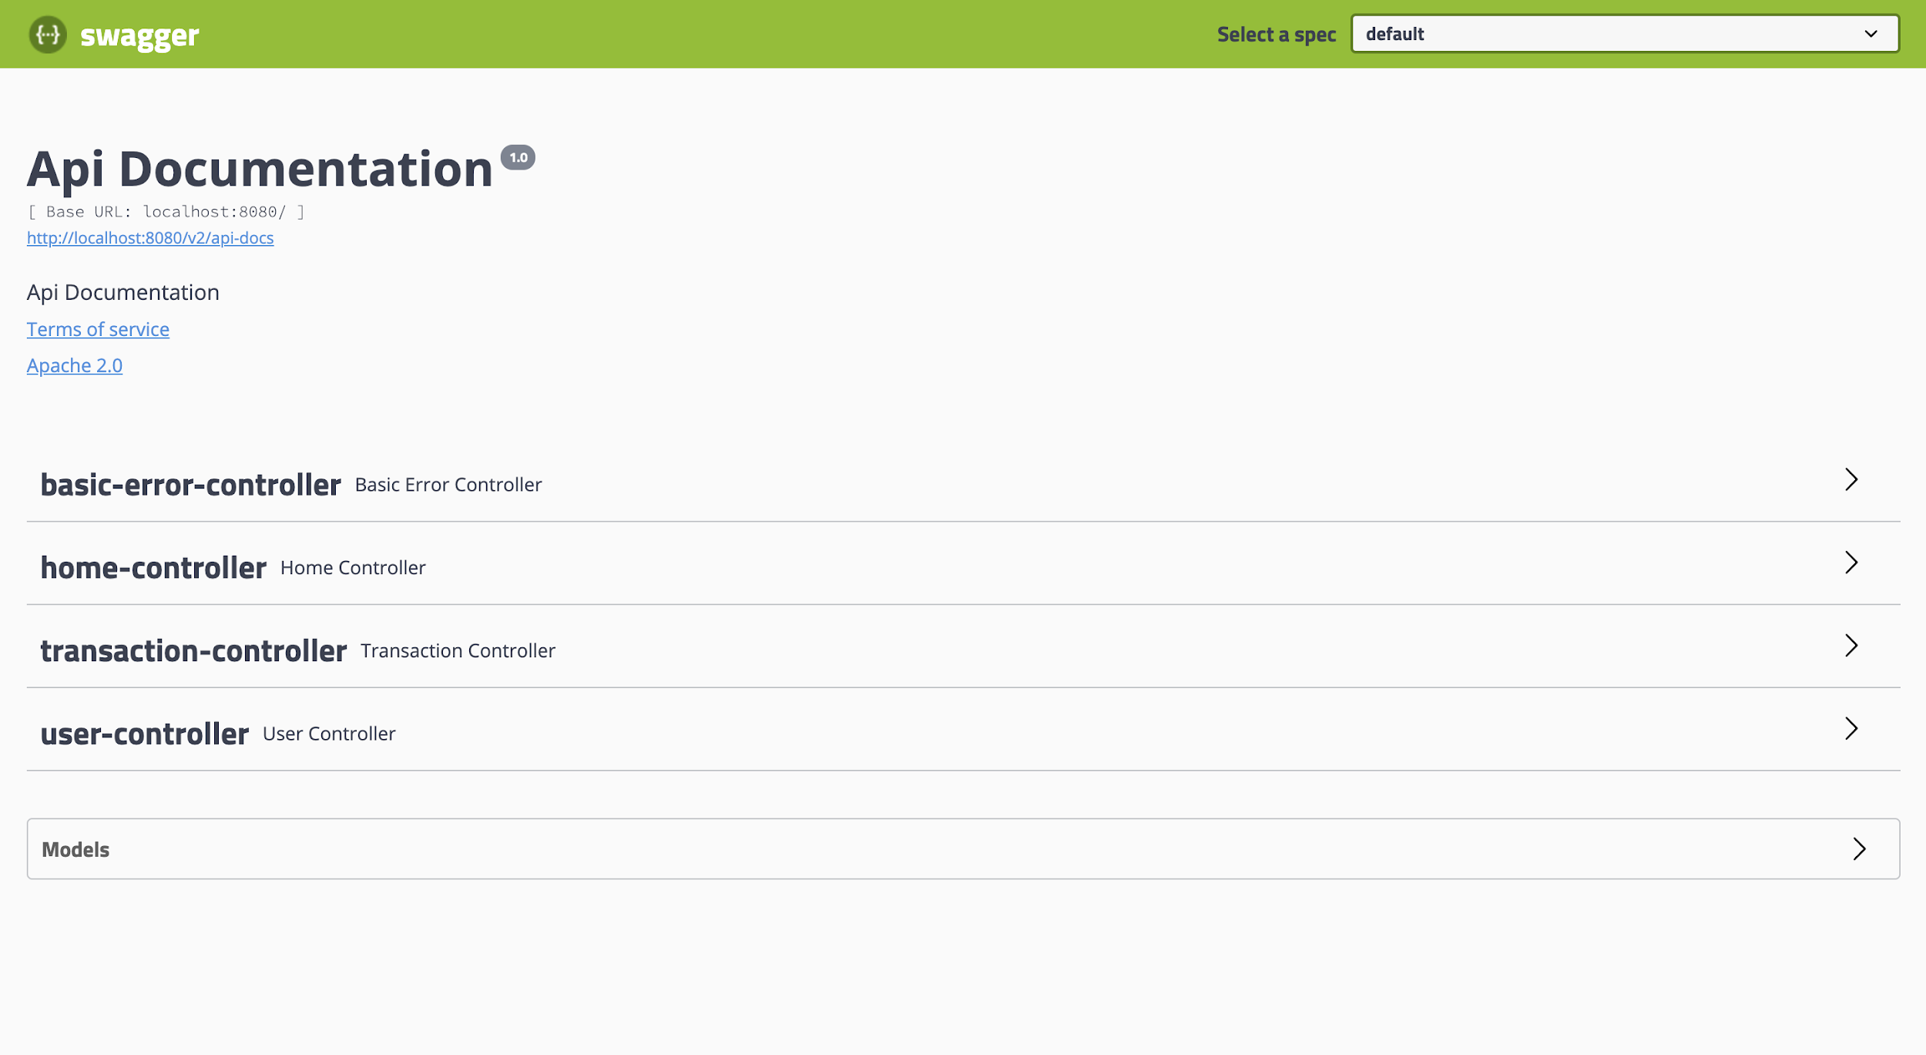
Swagger UI View

Slide 12
Exploring Swagger Documentation
@RestController
public class CustomController {
@RequestMapping(value = "/custom", method = RequestMethod.POST)
public String custom() {
return "custom";
}
}
Notes:
Within Swagger’s response is a list of all controllers defined in your application. Clicking on any of them will list the valid HTTP methods (DELETE, GET, HEAD, OPTIONS, PATCH, POST, PUT).
Expanding each method provides additional useful data, such as response status, content-type, and a list of parameters. It is also possible to try each method using the UI.
Swagger’s ability to be synchronized with your code base is crucial. To demonstrate this, you can add a new controller to your application.
Now, if you refresh the Swagger documentation, you will see custom-controller in the list of controllers. As you know, there is only one method (POST) shown in Swagger’s response.

Slide 13
Advanced Configuration
The Docket bean of the application can be configured to give more control over the API documentation generation process.

Slide 14
Advanced Config: RequestHandlerSelectors
RequestHandlerSelectors allows using the any or none predicates, but can also be used to filter the API according to the base package, class annotation, and method annotations.

Slide 15
Advanced Config: RequestHandlerSelectors
@Bean
public Docket api() {
return new Docket(DocumentationType.SWAGGER_2)
.select()
.apis(RequestHandlerSelectors.withClassAnnotation(Api.class))
.paths(PathSelectors.any())
.build();
}
----------------------------------------------------------------------------------------------------
@Api
public class UserController {
Notes:
The @Api annotation should be used on top of the controller class and have a value of high-level mapping, if there is one (it’s best practice to have one).

Slide 16
Advanced Config: @ApiOperation
@ApiOperation(value = "find user by id")
@GetMapping("/{id}")
public ResponseEntity<User> findOne(@PathVariable Long id) {
User user = userRepository.findById(id).get();
return new ResponseEntity<>(user, HttpStatus.OK);
}

Slide 17
Advanced Config: RequestHandlerSelectors.basePackage
@Bean
public Docket api() {
return new Docket(DocumentationType.SWAGGER_2)
.select()
.apis(RequestHandlerSelectors. basePackage("com.nursultanturdaliev.moneytransferapp.controller"))
.paths(PathSelectors.any())
.build();
}

Slide 18
Advanced Config: RequestHandlerSelectors.withMethodAnnotation
@Bean
public Docket api() {
return new Docket(DocumentationType.SWAGGER_2)
.select()
.apis(RequestHandlerSelectors.withMethodAnnotation(ApiOperation.class))
.paths(PathSelectors.any())
.build();
}

Slide 19
PathSelectors
PathSelectors provides additional filtering with predicates which scan the request paths of your application. You can use any(), none(), regex(), or ant().

Slide 20
Custom Information ApiInfo
private ApiInfo apiInfo() {
return new ApiInfo(
"MONEY TRANSFER APP REST API",
"This is the main rest api documentation.",
"API V1.0.0",
"Terms of service",
new Contact("Nursultan Turdaliev", "www.kapusta.com", "contact@kapusta.com"),
"GPL 3.0", "https://www.gnu.org/licenses/gpl-3.0.en.html", Collections.emptyList());
}

Slide 21
Custom Methods Response Messages
Swagger allows globally overriding response messages of HTTP methods through Docket’s globalResponseMessage() method.
Notes:
Swagger allows globally overriding response messages of HTTP methods through Docket’s globalResponseMessage() method. First, you must instruct Swagger not to use default response messages.
Suppose you wish to override 500 and 403 response messages for all GET methods. To achieve this, some code must be added to the Docket’s initialization block (original code is excluded for clarity):

Slide 22
Custom Methods Response Messages
Swagger allows globally overriding response messages of HTTP methods through Docket’s globalResponseMessage() method.
Notes:
Swagger allows globally overriding response messages of HTTP methods through Docket’s globalResponseMessage() method. First, you must instruct Swagger not to use default response messages.
Suppose you wish to override 500 and 403 response messages for all GET methods. To achieve this, some code must be added to the Docket’s initialization block (original code is excluded for clarity):

Slide 23
Globally Overriding Response Messages of HTTP Methods
@Bean
public Docket api() {
return new Docket(DocumentationType.SWAGGER_2)
.globalResponseMessage(RequestMethod.GET,
newArrayList(new ResponseMessageBuilder()
.code(200)
.message("successful request")
.build(),
new ResponseMessageBuilder()
.code(404)
.message("resource not found")
.build()))

Slide 24
Exercises
Using PathSelector enable API documentation for all endpoints starting with /api/
Change response messages of all POST, DELETE messages

Slide 25
References
https://spring.io/guides/gs/testing-restdocs/
https://swagger.io/
https://www.baeldung.com/swagger-2-documentation-for-spring-rest-api
https://www.vojtechruzicka.com/documenting-spring-boot-rest-api-swagger-springfox/
https://dzone.com/articles/how-to-automatically-document-api-endpoints-via-sw
https://swagger.io

