Slide 1
Cybersecurity Breach Analysis
2015-2024 Global Trends and Patterns

Slide 2
Research Question
What are the most significant factors affecting financial losses and resolution times in cybersecurity breaches across different industries and regions?

Slide 3
Methodology
• Dataset: Global Cybersecurity Threats 2015-2024
• Analysis of financial impacts across industries
• Evaluation of resolution times by attack type
• Examination of security vulnerability effectiveness
• Analysis of attack source patterns
• Supplementary questionnaire for qualitative insights

Slide 4
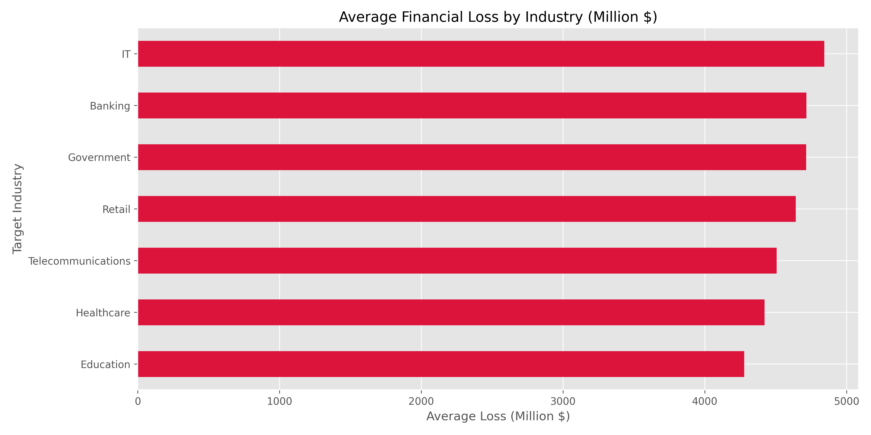
Key Finding 1: Financial Impact by Industry

Slide 5
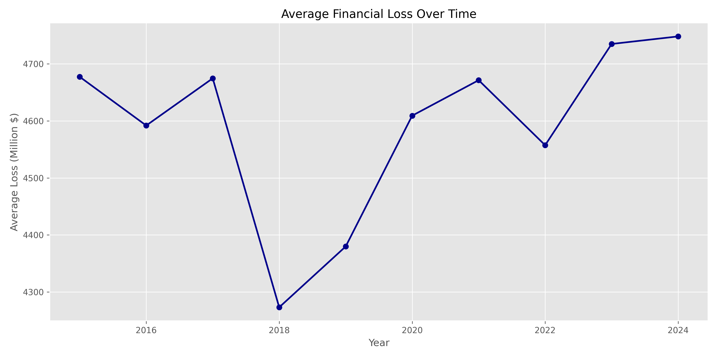
Key Finding 2: Financial Loss Trends Over Time

Slide 6
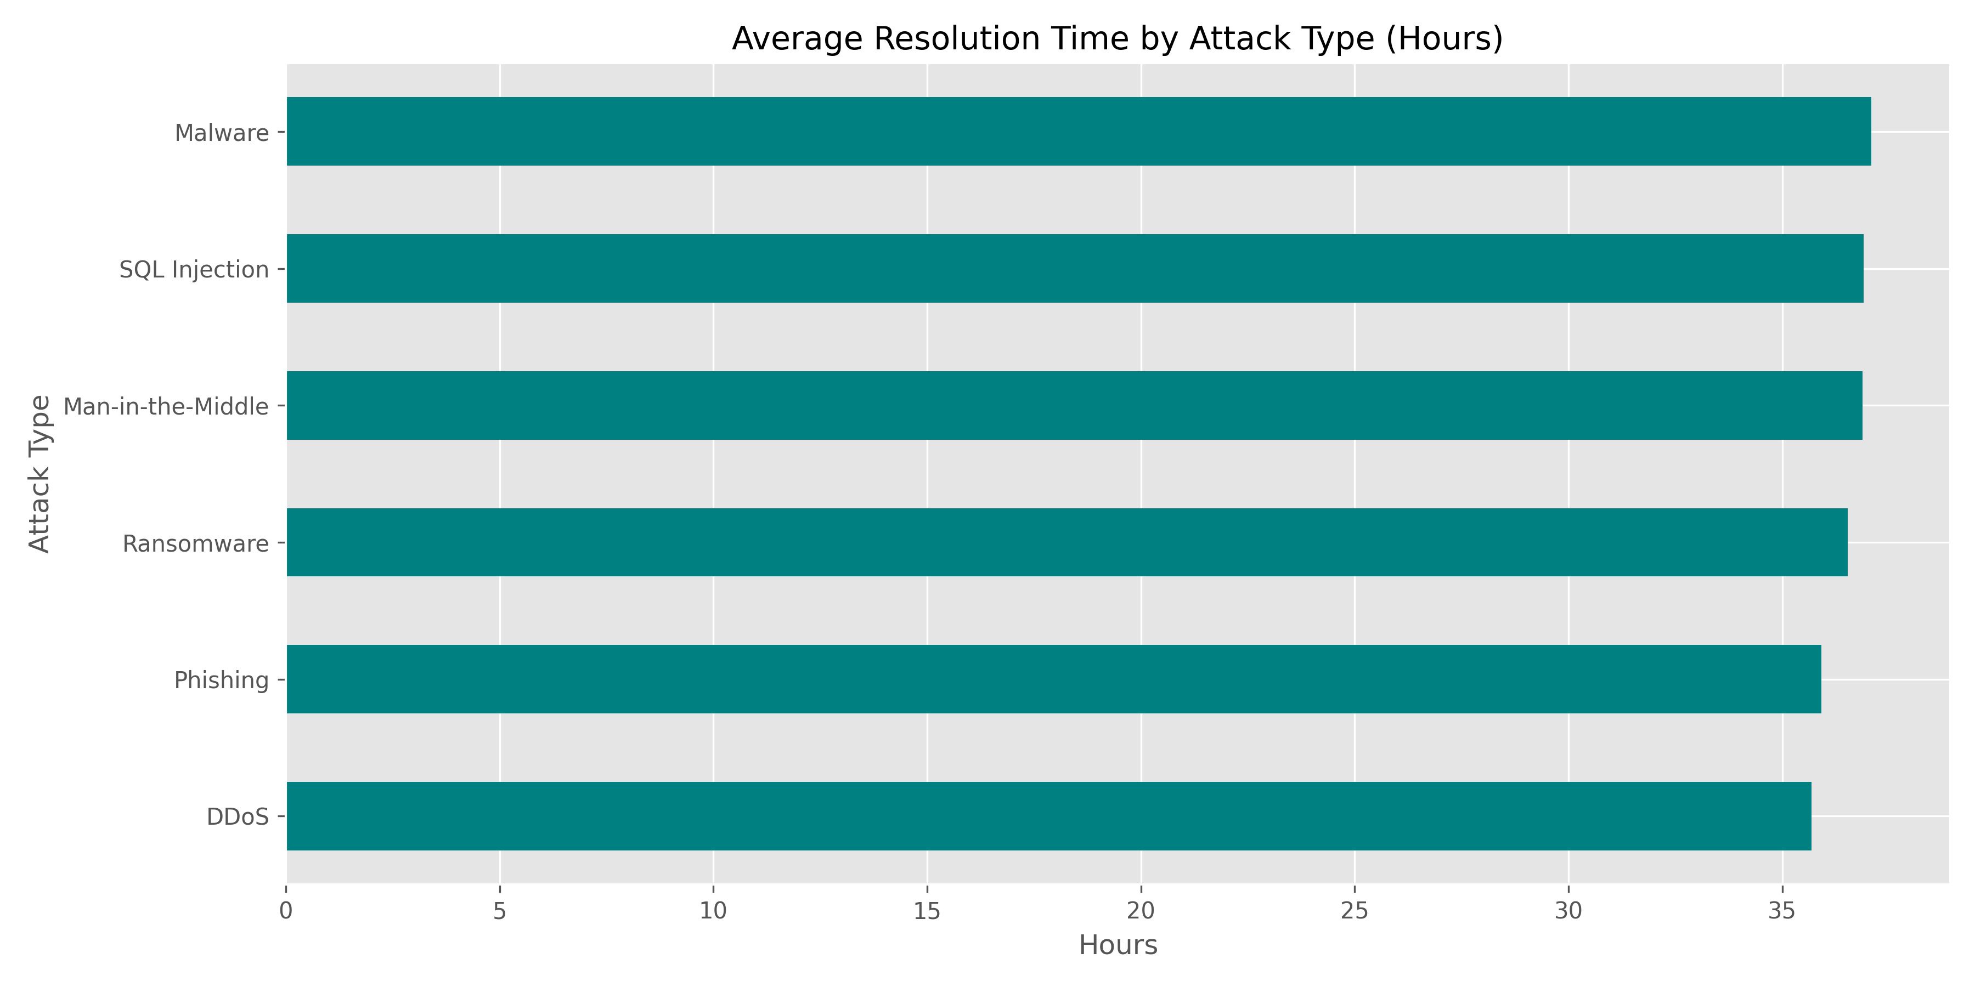
Key Finding 3: Attack Resolution Times

Slide 7
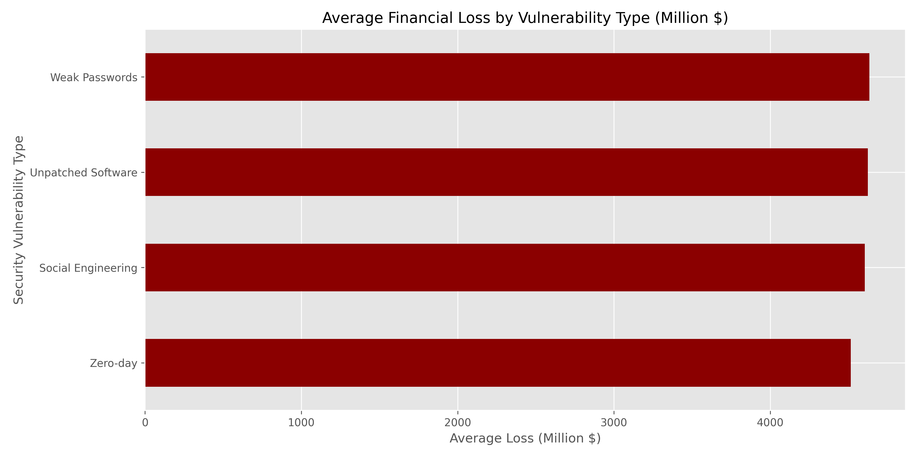
Key Finding 4: Security Vulnerabilities and Financial Impact

Slide 8
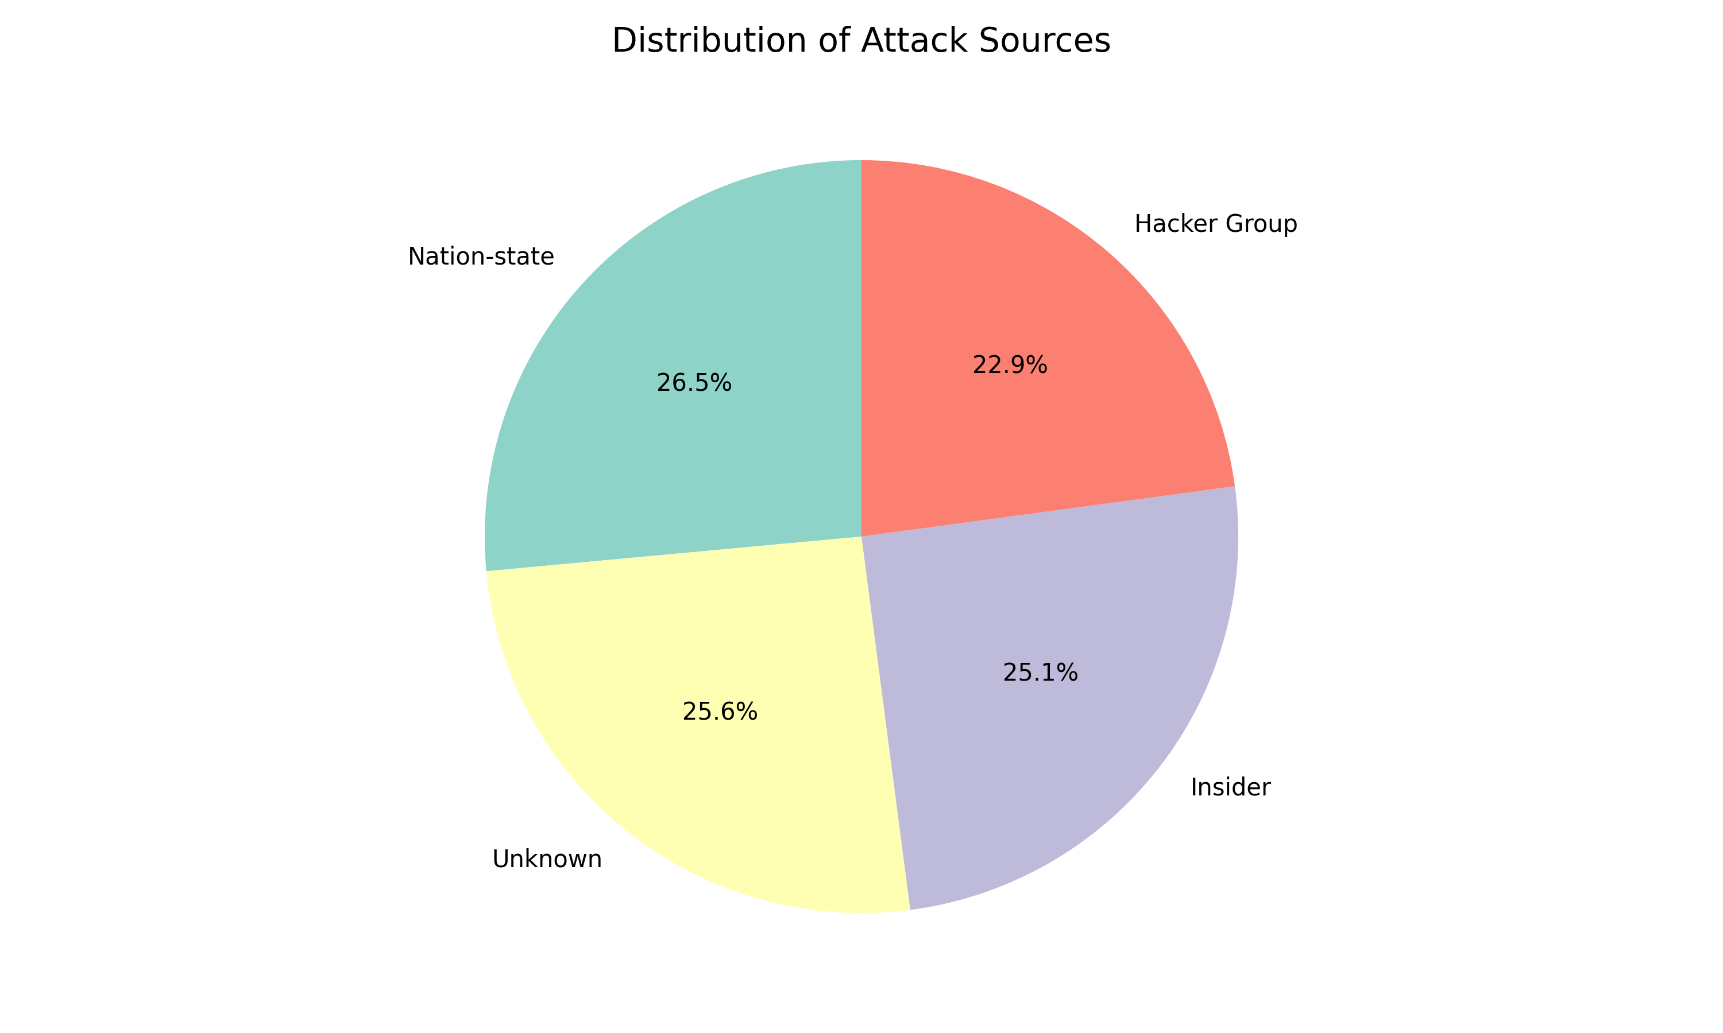
Key Finding 5: Attack Source Distribution

Slide 9
Recommendations
1. Implement layered security with emphasis on AI-based detection
2. Prioritize rapid incident response capabilities
3. Deploy industry-specific security strategies
4. Enhance security awareness training to address social engineering
5. Maintain rigorous software patching practices

Slide 10
Conclusion
• Significant variations in financial impact across industries
• Strong correlation between resolution time and financial damage
• Social engineering and unpatched software remain top vulnerabilities
• AI-based detection systems demonstrate superior effectiveness
• Industry-specific security approaches are essential

Slide 11
Questions & Discussion

